Slide 1
ONLINE PROGRAM
Design Thinking & Innovation
Management Students
Conducted by
Rohit Swarup
Chairman, Innovation & Research Foundation
Founder Director Explorra Design School | Futurz Xplored
© All rights reserved. 2019. Innovation & Research Foundation (IRF)

Slide 2
Introduction
“Design is too important to be left to designers.”
Raymond Loewy
© All rights reserved. 2019. Innovation & Research Foundation (IRF)

Slide 3
Explorra has numerous campuses across India China & Canada. Having trained and placed over 100000+ students & professionals in Digital Media Design over last two decades.
Design Thinking and Innovation Journey Pedigree
Establishing Institutions of National repute & significance. Developing Programmes & Curriculum . Trained 15000+ faculty and 55000+ students, professionals on Design & Innovation Subject. Consulting assignments in India, Australia, China, Dubai.
FX : 2000+ schools in India, USA, Canada running New Age Education Curriculum. Over 1 lac students benefiting from it annually.

Slide 4
Design Thinking 1 Minor Project & 1 Major Project
Day 2
Minor Project - Problem Articulation, Ideation, Prototyping &
Plan Major Project
Day 4
Display, Pitch, Debrief
Day 3
Presentation, Mentoring, Plan work ahead
Day 1
Design Thinking & Innovation
Minor Project - Observation & Empathy

Slide 5
Time
Day 1
Day 2
Design Thinking for solving an Organizations Problem/Possibility
Day 3
Day 4
Session 1
08:30 - 09:45
Why, How What of DT (T), Team formation & One Case study (P), DT Drill (P)
Problem Articulation (T & P)
Presentation & Evaluation
Implementation, Testing, Feedback & Business Plan week
Display
Session 2
09:45 - 11:00
Quick Presentation & Ideation (T & P)
Presentation & Evaluation + Design Clinic
Presentation Pitch
Session 3
11:15 - 12:30
Minor Project Intro & Observation (T)
Ideation (T & P)
Presenation Pitch
Lunch
12:30 - 01:30
Observation (P) during lunch
Session 4
01:30 - 02:45
Empathy (T), Creating Q (P)
One Case Study
Prototyping
Pitch !!!
DT Nuances (T & P)
Session 5
02:45 - 04:00
Field Work
*We can meet 06:30 pm for 5 mins/team*
Presentation, Defining the Major Project &
Business Plan Expectations
Refining & definig the goals for the week
Live cases for Idea to Market
DT in Organisation (T & P)
Session 6
04:15 - 05:30
Debrief

Slide 6
Major Project
Two days
Organized Sector/Public Sector Business from Surrounding locality
How to Select: Kind of Organization where you may want to work
At the end of Day 2
6 minutes pitch per team
One Written Caselet on the Project (Submit)
One Audio Visual Caselet (3 min.) on the Project (Show)
Pitch by the Team (Show): Prototype

Slide 7
Learning Outcome
1. Learn design thinking as an approach for human-centred innovation.
Practice interviewing and observation skills to develop an empathetic worldview.
Framing actionable problem statements.
Ideate & create a storyboard.
Understanding of prototyping as a strategy to develop & test ideas.
Develop problem solving approach.

Slide 8
Assessment
Specific Assessment method Class participation during Project | Weight 10%
Minor Project after day 2 (10% Prototype & Pitch 10%) | 20%
Major Project: Prototype & Pitch + Quiz & Reflective Note | 30%
Final Project Presentation (Prototype & Pitch) | 40%
*Creation of Audio Visual material for different screens will be greatly appreciated

Slide 9
Day One

Slide 10
01
Explore
© All rights reserved. 2019. Innovation & Research Foundation (IRF)

Slide 12
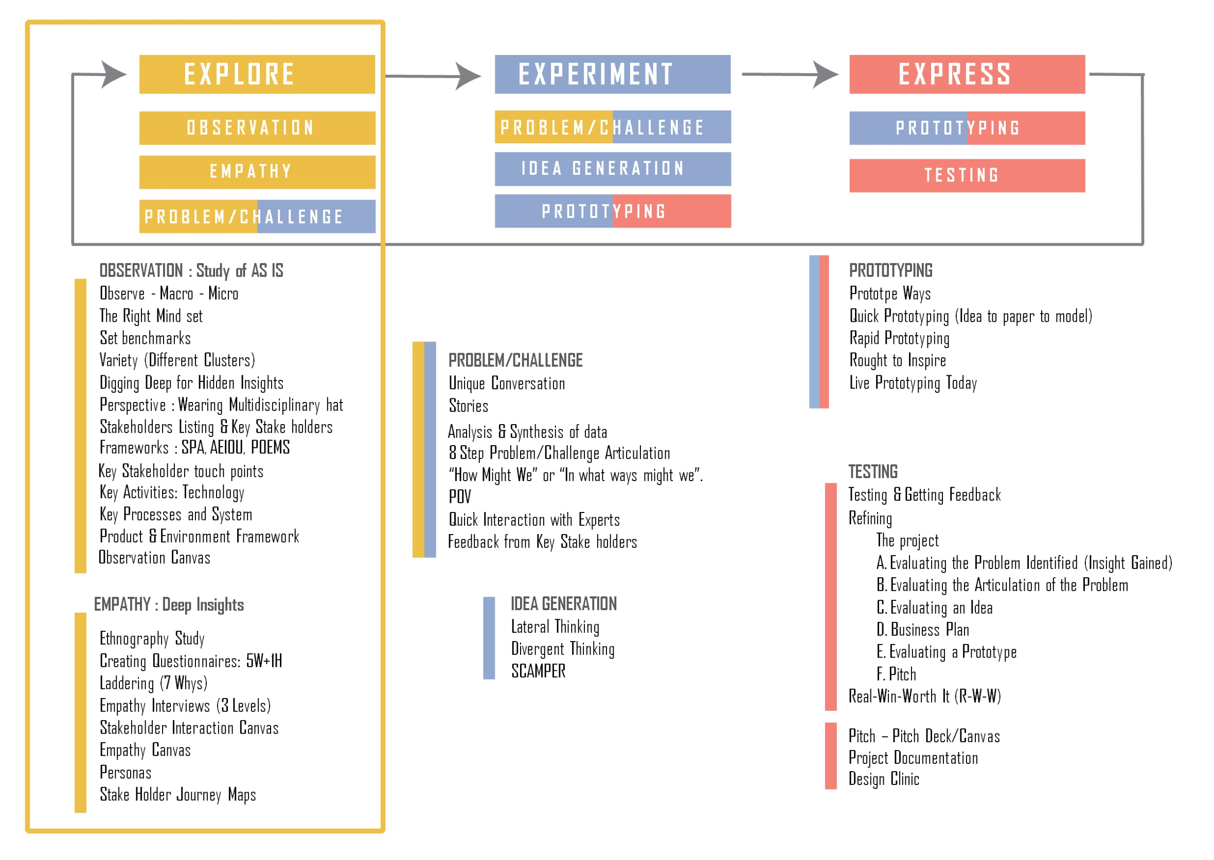

Slide 13
for Managers
Session: Need for Design Thinking and Innovation
So we need... Transformation Lets see...
Each one make quick inferences on post its

Slide 14
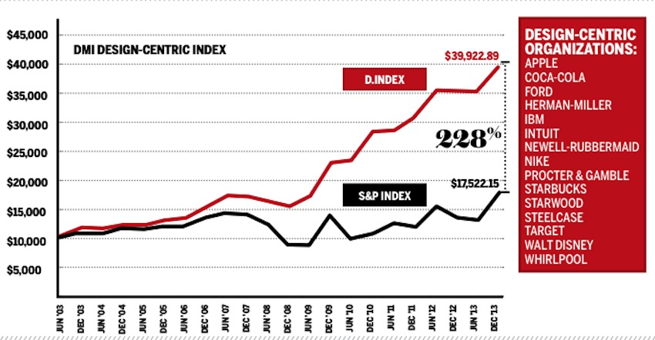
DESIGN-DRIVEN COMPANIES OUTPERFORM S & P BY 228% OVER TEN YEARS - THE ‘DMI DESIGN VALUE INDEX’

Slide 15
81%
of companies say they would be open to a design thinking mindset in the context of corporate strategy
71%
of suitably trained employees perceive that design thinking has improved the working culture
Source: Roland Berger (2016) Schmiedgen, Rhinow, Koppen, Meinel (2015), Rae (2015)

Slide 16
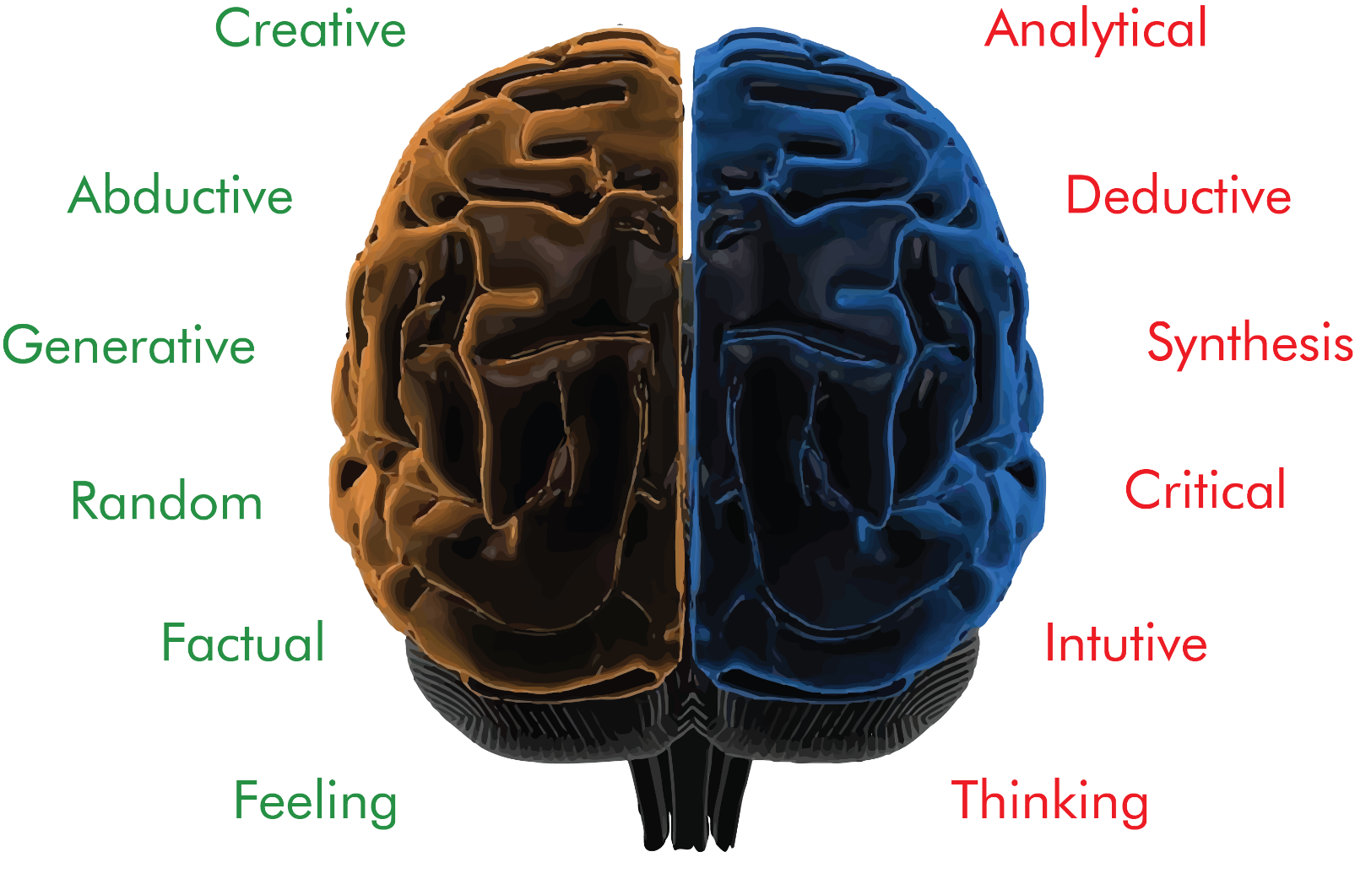
Manager A Bilateral Thinker

Slide 18
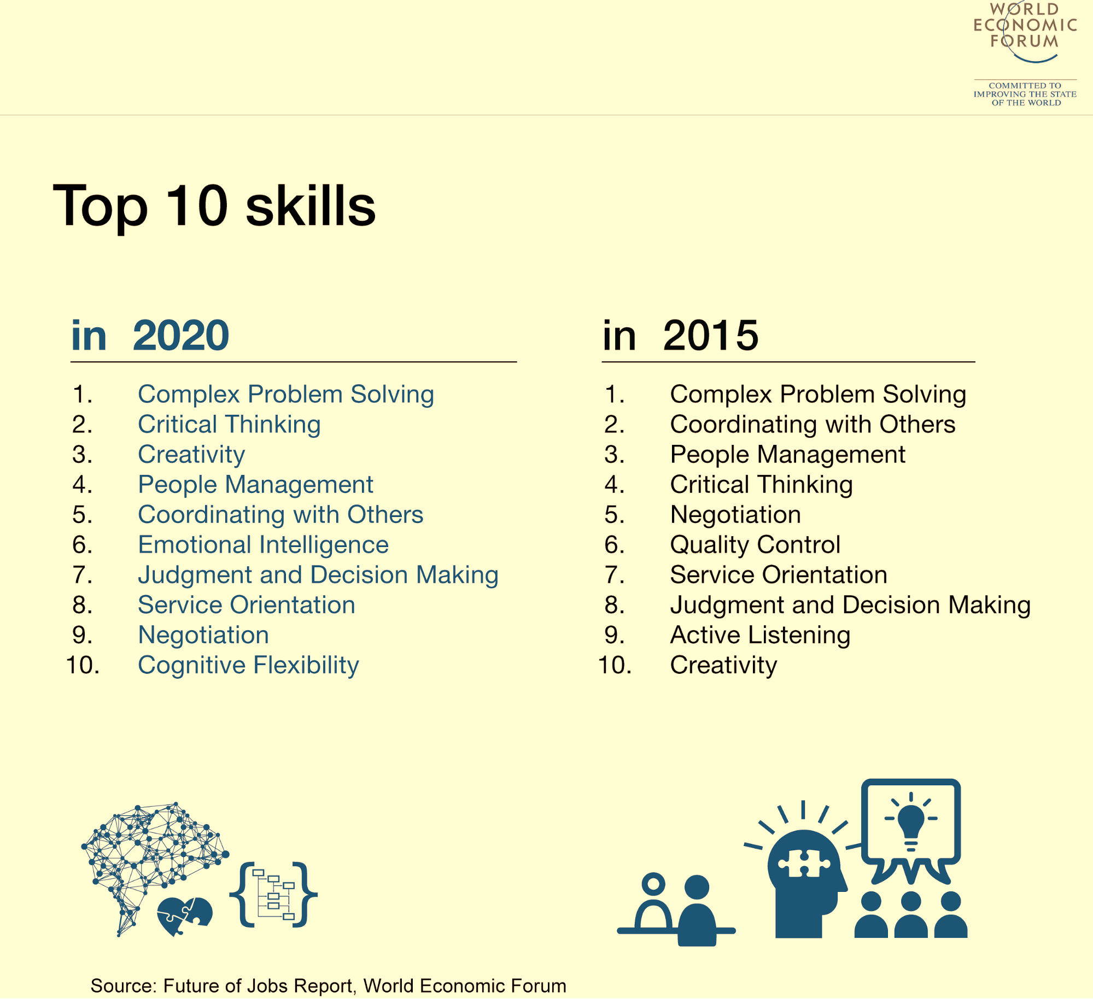
EVERY INDIVIDUAL NEEDS TO HAVE THESE

Slide 19
EXPECTATIONS FROM MANAGERS IN 21ST CENTURY
Integrating global best practices within local cultural centric creativity
Great Ideas
Innovator
Original Thinking,
Great Execution
Entrepreneurial
Great Sensitivity
Leader
Knowing Self, Others & Environment
Scenario Management
Decision Making,
Problem Solving,
Use of material, medium & technology
Connecting &
Communicating,

Slide 20
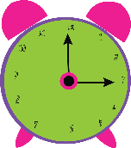
Lets do the
“Wallet Assignement”
1. Each of you need to design a wallet for your neighbor
2. Think of the process that you will use to design the footwear,
Let the fun begin.. What could these steps be?
3. Use the following steps to design the wallet
Five minutes for each step:
Observation and Empathy
Defining problems/possibilities
Ideation
Prototyping and Testing
Presentation
topic 1: insight
topic 2: show solution in prototype
25 mins

Slide 21
Manager
Designer
Iterative, holistic problem solving method
Linear Problem Solving method
Define a problem from given set of data
Identify various solutions
Analyze each
Choose One – the right one
Observe, Empathize, Understand
Problem Articulation
Ideation : Analysis & Synthesis
4. Prototyping
5. Testing

Slide 22
“( ... ) Design thinking is a discipline that uses the designer’s sensibilitiy and
methods to match people’s needs
With what is technologically feasible and what a
viable business strategy can conver into customer value and market opportunity.”
Brown, T. (2008). Design Thinking. Harvard Business review, p.

Slide 23
MINDSET
Design is
Multidisciplinary
Collaborative
Inclusive
Creative
HOLISTIC
Experiencing
doing
expressive
contextual
Playful & challenging
Constructive

Slide 26
THE TOYOTA WAY | The Toyota Way – Tools to “see”
Did you know that many of the core design thinking principles were being used by the Japanese in the 1970s” Visualization, time management, Grenchi-Gembutsu and iterative prototyping. From Toyota we will learn not only about the respect for the individual but thinking tools that make you smarter.
Brief history of Toyota
The documentary Toyota the Global Story is presented by Alec Murdoch – who was a speaker for Toyota USA. The full outline version is here. The point of the video is the stellar moment where:
“A son decides to invent an automatic loom to free her mum from tedious weaving work.”
The scene synthesizes the Toyota ethos: Why it exists and its purpose. Replacing a boring job with automation (aka autonomation) was just one step. However they did not stop there. In their drive to improve they stumbled upon some awesomely productive principles and tools that later because what is known as the Toyota Production System (TPS).
When did Totyota become famous? The 1973 oil-shock
What the video omits is that no one was paying attention to Toyota until the second oil shock came.
“the first time that TPS gets public awareness is during the fall of 1973right after the first oil shock, form that time are the mythical pictures of Japanese homemaker’s scrambling in supermarkets for a WC paper roll. Due to the shock, WC-paper became scarce in Japan. The scenes are depicted in some films of the era. That year many companies logged red numbers in their Profit/Loss statements but not Toyota. In fact, that year Toyota boasts yet again record profits. It is then that many companies realize that there might be something to be learned about Toyota’s TPS. Many consider the possibility of copying Toyota. The first TPS consultants are born. Management consultants at Chubbu Seisanrenmeni create TPS kenkyukai (study group) where even Taiichi Ohno himself would give some talks. It is in the second half of the 70s when the perception that the idea that Toyota’s production technique multi-product mini-batch is efficient diffuses through the Japanese industrialist tissue.” (p. 27, Berengueres, 2007)

Slide 27
Toxic environments “for innovation – Toyota Today
However, the reader should not be fooled into thinking that nowadays Toyota is a great place for inventive people. It is not. Today’s Toyota is as a toxic environment for creativity as GM or Samsung.
Waste
Seven kinds of waste found in the workplace:
Overproduction
This is the number one source of waste. It is the waste that stems from believing that producing in big batches is more efficient than producing in small batches. Huge costs are incurred in unsold items.
Waste due to superfluous
Waste due to the existence of unnecessary things such as personal machines and inadequate machines. Little savings add up over time.
No flow
It is waste due to the lack of flow. Stop and go in production and/or suboptimal line layout, lack of synchronization, changeover times.
Operational
Waste of doing unnecessary work. Due to ignorance, lack of training, lack of technological expertise, lack of planning and/or automation
Waste of movement

Slide 28
These comprise all the movements done during a work shift that do not add value: Ex a bolt picked up from an unnecessary low recipient transportation. Compared to a straight-line production layout, a u-cell layout reduces the time spent by workers on walking anywhere from 2xL to 1xL, this can add up to 4 to 6 km per day in a typical factory. This kitchen kaizen video by Gemba Academy illustrates how to measure improvements in movement economy.
Defect production
It is the waste due to production of defects caused by: lack of training, not enough poka-yoke, quality controls and poor and inadequate maintenance of machinery. In the 2010 Toyota recalled more cars than it had produced. The cost of the recalls is not disclosed.
Overstock
It is the waste related to the cost of maintaining oversized warehouses that act as a buffer between poorly communicated processes. Additionally one pernicious effect of overstock is that it hides problems.
Added value versus non-value-added activity
A typical breakdown of how time is spent to make a product. Time can be spent doing things that add value or doing things that do not add value: when optimizing operations most of the time managers focus on the green part. For example buying a faster machine. However the big savings opportunity is reducing resources spent in the non-value-added activity because it is simply put: larger.

Slide 29
The Nissan turnaround case
When Beirut-born Carlos Ghosn arrived at Nissan circa 1999, Nissan was losing money. What had been one of the flagships of Japanese car making new now to make cars but could not manage to make a profit anymore. It did not take long for the triple digit IQ CEO to figure out was wrong. For one he was appalled that a plant manager proudly reported that he had raised the productivity to a new record, while he did not know what the costs his efforts to the company as a whole were (cost of storage, cost of raw materials, labor.) this was a sign of clear dysfunction: engineers, purchase managers, designers and sales people were not working with the same goal. Carlos had to cut costs and cut them fast. To solve this he forced various types of employees to work together in cross-functional teams. For example in a meeting when designing a new door for a car, there would be various employees from different parts of the organization so all costs could be represented/optimized. This means not only purchasing costs, but also assembly costs, warranty costs, customer points of view etc. he also forced the Japanese managers to use English to communicate. This is what happened: while a manager in speaking Japanese would talk very politely and say his opinion very diplomatically in long sentences, when forced to use English he could be ruthless, direct and clear (time saving). Five years later, from near bankruptcy, Nissan improved its operating profit (EBIT or earnings before interest and taxes) from negative 60 9% (Magee, 2003)
Cross-functional teams? Or course! Isn’t that common sense?

Slide 30
The five whys
Itsutsu no Naze means in Japanese The Five Why’s. It is an expression born in Toyota that has been popularized recently by popular magazines such as R25. It is a technique based on searching relentlessly for the root cause of problems (it requires stepping ot of the comfort zone.) it also means that if we want to solve a problem properly in a permanent manner it is necessary to focus on the root cause not in its sprawling branches. Example problem:
Boy, I have a headache…
Why does it ache? Because I have a cold
Solution: take an aspirin. Wrong!
Meanwhile at Toyota’s…
I have a headache…
Why? Because I have a cold
Why did you catch a cold? Because yesterday I spent time in the cold
Why? Because I didn’t take my coat
Why? Because I didn’t think that it would be so cold outside.
Why? Because in the morning I don’t check the weather forecast.
Solution:
Install a thermometer in the balcony and watch it before going out. The intake of an aspirin is just a superficial countermeasure. The thermometer, on the other hand would solve the problem permanently. However it requires two things: the creation of a rule (watch the thermometer before going out) and discipline. As in real factories success depends on how motivated and disciplined the workplace is. Why five and not another number? It is curious but at Toyota they wonder the same. It turns out if one asks repeatedly five seems to be the magic number of steps. Itsutsu no naze is a powerful tool that can help to solve problems for a long term.

Slide 31
A3/PDCA
P.D.C.A stands for Plan-Do-Check-Act. It is also known as the Deming circle. The virtue of P.D.C.A is not in the planning, doing, checking or acting but in the separation of planning from doing, doing from checking and checking from acting. It is a methodology that ensures what a change to a process such as one improvement is isolated from the following change. If you change the process very often, as in kaizen/continuous improvement, the hygiene of your process might suffer. If changes area plied randomly or ot managed properly it can be hard to track which of them improve the process and which didn’t.
PDCA solves this by:
Plan = Think of one potential improvement
Do=Try it.
Check=Measure the “Effects”
Act=adjust, evaluate, fully implement the proposed change OR discard change
Go to step 1 and repeat cycle.

Slide 32
The A3 restriction
Tracking a PDCA initiative can be done by using the A3 method. A3 method is very simple: you need to be able to display all the information regarding your project in one single eA3 size paper. This space restriction will help you focus on the essential information only. The A3 method can be seen as a reporting method. The idea is to access all the essential information regarding a project with a single look. A3 reporting is common place in Toyota and at many other Japanese corporations. Note: since the Japanese language is twice as dense as English you might need to use smaller 8-point size typeface to be on an equal density footing. Summarizing: A3/PDCA is about quantifying the effects of change and the time-evolution of the change process itself. The ultimate goal is to have total control over the change process so it leads to steady and reliable improvements. This cannot be insured if one change is not separated from the other changes. The following figure is an example of a famous PDCA example by Staffan Nottaberg.

Slide 33
How-to A3 report with value streaming mapping
A3 Report is a way to implement deming’s PDCA. Toyota uses it in meetings for problem solving and to restrict information overload. Here goes the example:
Briefing: we have a family that gets stressed during the morning, there are three daughters.
Here is how a Toyota man would solve and organize the information using A3/PDCA:
In theme section write: stress free morning procedures.
In background whatever info you collected, for example: School starts at 8.20. The children need to sleep for as long as possible. They must leave home at 7.45 to catch the school bus.
In current condition: Lack of time almost every morning. Stress creates bad atmosphere in family.
The so-called Value stream map of the morning activities might help your visualize the problems. It indicates that value adding processes only are 17 out of 45 minutes, the rest seems wasted time.
Goal: Ready to leave for the bus within 45 minutes without stress.
Let’s assume that the father investigates why T2, for instance, is so long and finds out…

Slide 34
Root cause analysis (using five why’s)
Why stress? Because a considerable amount of time is spent on T2.
Why so so much time spent on T2?
Because Samantha (one of the daughters) has to wait for the hairbrush.
Why does she have to wait?
Because her sisters use the hair brush.
Countermeasures
(Try to define who is responsible for what action)
Mother buys two more hairbrushes. Due Friday.
Father reserves space for new hairbrushes, when they are not used. Due Saturday.
Father will measure it T2 decreases after (1) and (2) is done.
Effect confirmation
(try to be visual, charts): Try to measure the effect of the countermeasures… does the stress decrease over a week or not? Find and use a key performances indicator. For example: dBA noise levels, how many minutes late they are, or survey of the daughter’s happiness.
Follow-up Actions: did the countermeasures work? If yes, adopt it. Mother will buy another two hairbrushes. It’s a backup in case of one ordinary is lost. Due Tuesday. As always for every talk define clear responsibility of who when what.

Slide 35
5S
Historical origins of 5S
5S is a “slogan” used in kaizen initiatives of the workplace in service and indsutrt sectors to increase efficiency.
5S is named after
Seiri
Throw away superfluous things (put down seldom used ones…)
Seiton
Every tool must have its designed place and be returned to that place after use.
Seisou
Clean, clean and clean.
Seiketsu
If you make any change in the workplace, make sure it is easy to follow by making a standard or rule.
Shitsuke
Build a culture of rule obedience.

Slide 36
5S in the class
Now you are ready to do 5S. a class is a perfect place.
Seiri: Let the students clear the desks of superfluous objects, purses, wallets…
Seiton: Are the mobiles, papers and pens on the desk aligned or placed at random orientation? Let the students align all the objects in the desk. Do they look smarter?
Seiso: can we clean any dirt in the room?
Seiketsu: If the previous three initiatives are liked by the students why not make them a rule?
Shitsuke: Let’s think about how to enforce the rule so it is effective.
We can also do 5S by organizing a 5S-Kaizen drive:

Slide 37
Organize a kaizen drive
There are three golden rules on how to successfully carry out a kaizen-5S drive:
When there is a 5S activity (such as a meeting) all the employees from the boss to the newest employees are engaged and on an equal footing.
Things are decided by consensus. Consensus rules.
The directives of kaizen committees’ actions must be followed up by controls and inspections.

Slide 38
5S in more detail
Seiri. Seiri should be the first S. if you cannot do Seiri you won’t succeed with any of the other S’s. Seiri is related to the concept of muda. Definition – Seiri is about discriminating the superfluous things from the strictly necessary things needed to perform a task, job or project. In this way the work environment is simplified, things are found faster, it is harder to make mistakes and productivity increases. Seiri = using the trash bin.
Seiton. Seiton is the second S. it means to align things. Definition – seiton means to have the work environment ordered and tidy (everything labeled…) so that anybody that needs something (for example, a tool) does not waste time looking for it. seiton means providing a place for things to be stored. In the previous photo a small pot for pencils is added to keep pencils in place.
Seiso. Seiso (to clean). It comprises those measures to prevent and avoid dirtying. The aim of seiso is to kill the generation of dirt at source. Avoid dirtying. Example: someone left Doritos on the table. A brilliant seiso measures is to attach a vacuum cleaner to an electric saw or grinding machine so that waste is collected instantly. Killing the source of dirt.
Seiketsu. It means Standardize. It is the fourth S. it means to try to make the improvements of the preceding S’s permanent and sustainable. Establishing rules is a great way to encourage good habits. Works better if the employees are involved as stakeholders. A poster can serve as a reminder that no Doritos are allowed that the pen should be returned to a pot and that a clip should bound loose cards.
Shitsuke. The rules that the own employees have decided should be respected and obeyed without expectations. Shitsuke is about the battle for the minds and hearts of the employees. Displaying a poster with the new rules is a great way to encourage good habits every day.

Slide 39
Toyota versus IDEO
Core principles: Toyota/IDEO
Started: 1918 with Pokayoke/1977 (with the Apple mouse)
Less is more (time): Instill “sense of urgency” to battle complacency/skillful use of deadlines.
Human centered: Ergonomy, respect/Empathy for user
Empowerment: Any worker can stop the line/Hire people good at building on other’s ideas.
Visualization solves most problems.
Kanban, A3 tackt time displays, visual management, Andon/Post-its everywhere, the whiteboard as a communication medium.
Standardize: Standardization of tasks, 5S, Kanban, rule obedience/The “standard’ Toolkit
Practice makes perfect. Kaizen, PDCA, humility in prototyping/iterative prototyping.

Slide 40
Design Thinking
Is being used extensively by IBM, Apple, Google, Samsung, Starbucks, SAP, GE…in short all the fortune 500 companies have started using design thinking.
Design thinking comes to India,
‘Infosys trains its 1,00,000 employees on Design Thinking’
Wipro, Godrej, Mahendra follow suit.

Slide 41
BASIC PRINCIPLES OF DESIGN THINKING WORKFLOWS

Slide 42
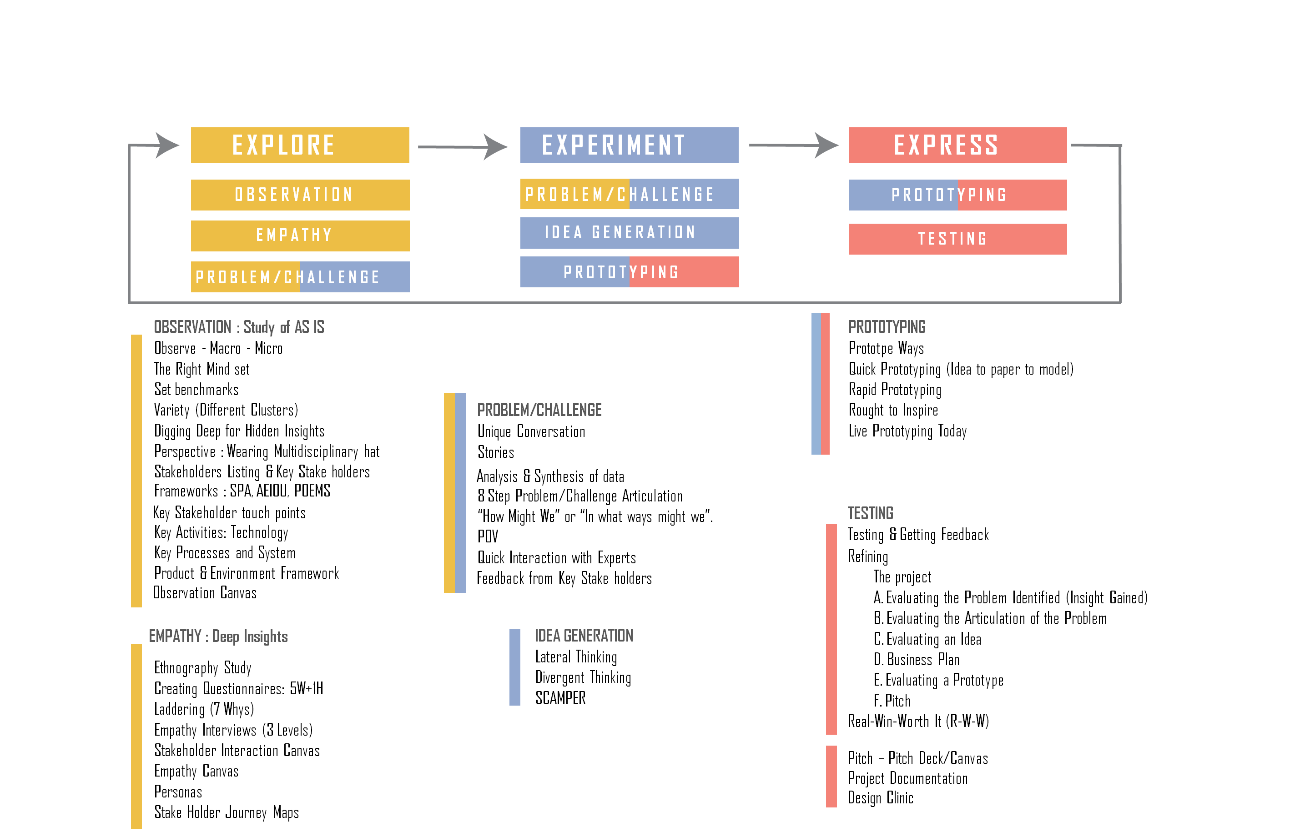

Slide 43
CHALLENGING THE PROCESS WITH THE MARSHMALLOW CHALLENGE
Purpose
Challenge the Process. This is an easy activity that requires minimal space and very few supplies to perform.
Group Size
No more than 5 people per team. If the total group size is just 5 or 6 people, divide the group into teams of 3, if at all possible. Team size is more important than total number of participants involved in the activity.
Time Required
45 minutes or less
5 minute introduction;
18 minute activity;
5 minute video.
Additional time for discussion.
The 18 minute exercise is fixed. Other times can be adjusted as needed.
Materials
Each team needs 1 yard of tape, 1 yard of string, 20 pieces of spaghetti and one marshmallow. One or two small scissors for all teams in the group to access during the activity.

Slide 44
Process
Divide attendees into teams of 3-5 members.
Give each team the tape, string, spaghetti, and marshmallow. Provide each team access to scissors).
Read the following instructions to all teams at the same time.
Each team has 18 minutes to build the tallest, free-standing structure using the materials supplied to each group.
The marshmallow must be attached to the top of the structure you build.
After 18 minutes, measure the height of each structure that remains standing with the marshmallow on top.
The winner is the team whose free-standing structure is the tallest.
Answer any questions the teams may have and give the groups a 30 second warning.
After 30 seconds, start the activity and stand back.
Keep watch on the teams to ensure they are following the rules of the game.
Remind them that the marshmallow must be on the top of the structure, and that the structure itself must be free-standing when the activity concludes.
Let them know how much time has passed until 18 minutes is up.
At the end of 18 minutes, measure those structures created within the rules and that are still standing.
After declaring the winner (assuming there is a structure that remains standing after the marshmallow has been attached)

Slide 45
Follow-up questions to ask of the group to facilitate discussion and further learning:
Was there a leader on your team? Who was it and who decided who the leader would be?
If you had no leader, do you think having designated someone a leader would have helped?
If you had a leader, how did he/she do? Of the leadership practices we have learned so far, which did your leader use?
How helpful was everyone on your team in challenging the process of building the tallest structure? Did anyone appear to be an expert?
Did any team members tune out of the activity — out of frustration with other members or for some other reason? What could you have done to keep all members of the group fully engaged?
Did you feel everyone's ideas were well received during the activity?
How did you feel as the time limit was approaching? Did pressure increase? If yes, was that helpful or not?
In retrospect, what could you have done better to enhance your ability to Challenge the Process?
Did you practice outsight? Where might new ideas have come from given your time constraint?
Did you celebrate small wins? If yes, how did you do this?
Encourage the Heart of all participants by giving everyone the marshmallows remaining in the bag. Everyone loves marshmallows!

Slide 46
The why boring classes workshop
Workshop time. Now it is time to do your own workshop. Pick a topic that motivates students such as … Why are classes so boring? Why people do not recycle? Assign expert roles to each student on relevant topics such as:
How do they do it in other countries
Interview end users on the topic
Interview policy makers on the topic.
Then give students one week to go on a first hand fact finding and data gathering mission. One week later: divide students in groups of 9 students maximum; assign one student as a facilitator to each group. Make sure to follow exactly the ideo shopping cart table layout. The teacher will act as backup man and advices the facilitator if they naturally drift off course. The background music of the gift workshop is great to help shy students talk. At the end demand a one ppt solution proposal to the problem and tell your students that it will be sent to the provost! We did this workshop and after 90 minutes some groups had reached the flow state of intellectual exhilaration. After time was up, some didn’t want to leave the room and continue discussing. That is a good sign.

Slide 47
Comments from the back-up man
There are 4 ways to express an idea:
Speech
Writing
Sketching (2D Prototyping)
A 3D Prototype
Each one has its advantage and activates different brain areas that can help you “see” things that other mediums of expression cannot convey. As Tim Brown says in his book Chane by Design there are storie you can only explain by drawing. So let us use it more! (Brown, 2012)
Note: Majors from Engineering have a harder time exercising empathy
Note to self: Send to the students a copy of Guy Kawasaki’s 10-20-30 rule video on how to do great PowerPoint

Slide 48
Design Thinking Project
Team Formation
- Form a group of 6, having two sub groups of 3 members
- At least 2 members with work experience in a group & equal gender distribution
- 1 team member in each sub group documents (Written, Video, Photo)
Now lets select a domain & area of interest : Organized Sector /Public Sector Business From Surrounding : Name the Domain
Who is the Point of Contact ?
Both Sub Teams do the same project AND Merge frequently BUT Still retain their identity

Slide 49
Each team will behave like a Company
- Though no problem is a trivial one YET Lets solve a problem worth befitting an MBA
- Product/Service or System : it could be anything
The strength will be in excellence at each stage-step AND exhibiting it by exquisite documentation (photos, videos, plan)
Take as much help of experts i.e. faculty & professionals (After Problem Articulation, Problem Solution & Prototyping)
Written, Photo, Video, Canvas Record
Observation, Empathy, Problem
Solution & Prototype

Slide 50
Design Thinking for Non-Designers
Design thinking provides a tremendously powerful set of tools for designers ad non-designers alike.
IBM has opened a 50,000-swuare foot “Home of IBM Design Thinking” in Austin, Texas, that they describe as part of a new approach to reimaging how we design our products and solutions and Infosys has plans to train 30,000 of its employees in design thinking.
The theory can be learned easily the actual practice of design thinking comes with many practical challenges for implementation. To counter this problem there are three important strategies to get trained
Encourage “dual-mode debate” of not only ides but also processes
Manage design thinking transitions of key minds-sets.
Adapt tools under changing team membership.

Slide 51
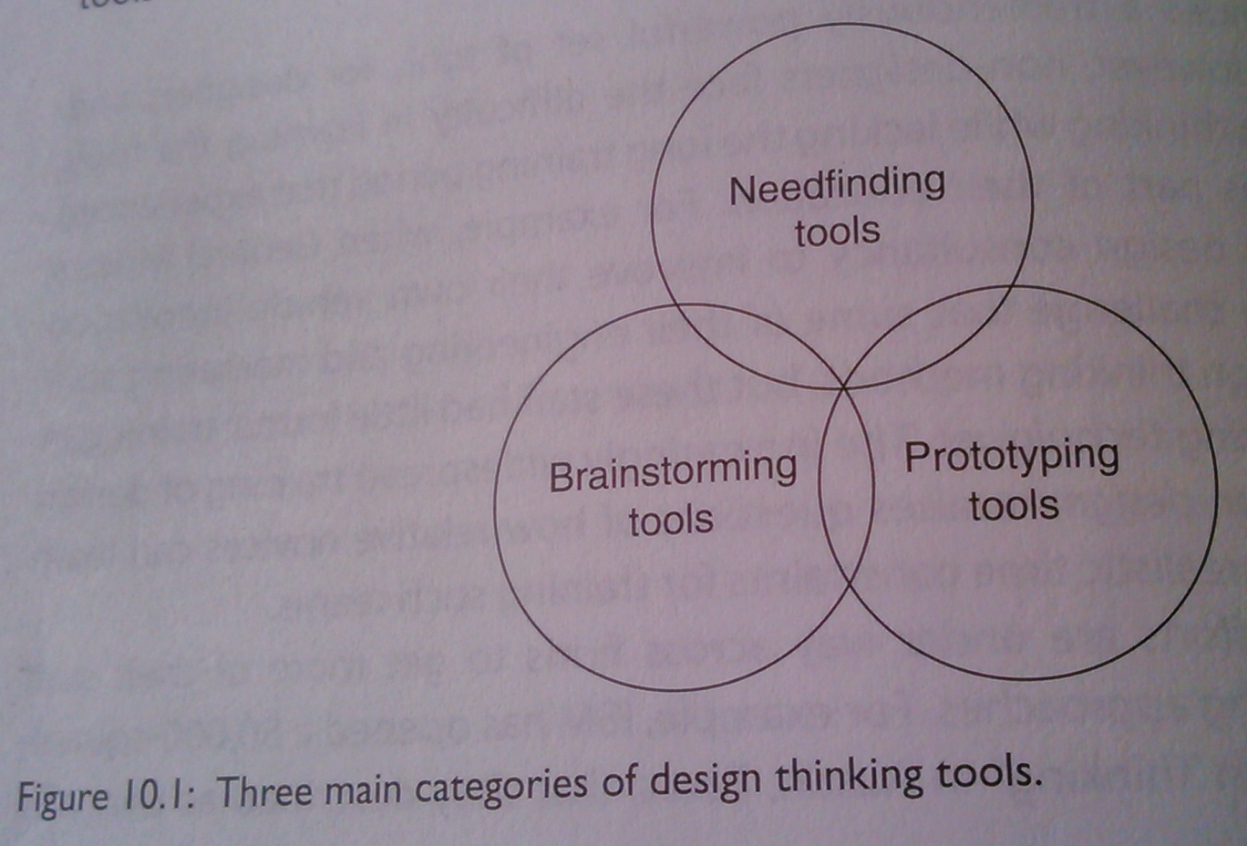
What do Non- Designer need to learn?
Need to learn tools

Slide 52
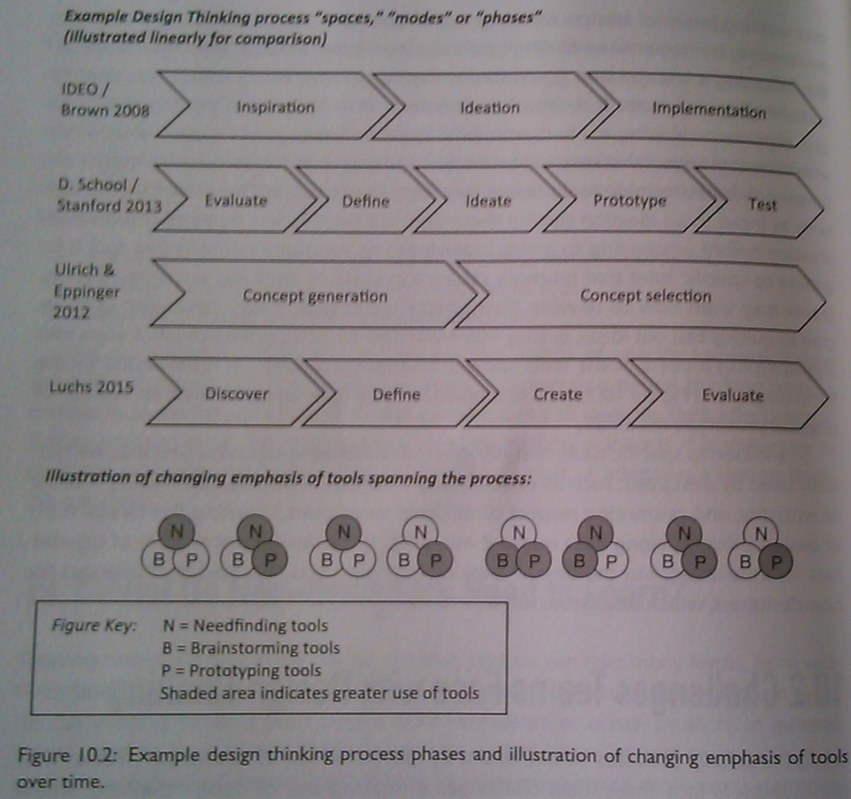

Slide 53
Challenges team faces
That the use of design thinking tools is dynamic and requires adaptation overtime. But there is no “one-size-fits-all”
Is in knowing how and when to encourage different design thinking mid-sets. Avoid too much debate
Is that the team membership may change over the course of a project. There is no moving form one project to another in the middle of design thinking process.

Slide 54
Three team strategies for success

Slide 55
Add metrics for idea and process debate
Teams need to know how well they are engaging in active debate.
Ask following two questions on a scale of 1 to 5 with representing “to a little extent” and 5 representing “to a great extent”
I feel that we debate ideas within our team
I feel that we debate the process to follow within our team
These metrics should be collected in at least two points.
First the survey should be run in the heart of concept generation such as after a team has completed at least one brainstorming session and is developing a range of potential product concepts.
Second the same survey should be conducted a after concept selection, when a team has narrowed down to one main concept and is further refining the concept. How much debate is idea?
The circumstances of the industry and teams may change how individuals rate a level of debate and so the ideal level of idea and process debate can vary by context.
The scores of new teams can be compared with successful teams in the past, allowing managers to determine if team needs to be reminded of how to encourage debate in the early stages of the process.
Also if scores among individuals within a team vary greatly that can be a signal that intervention is needed to see why team members have such disparate perspectives on the level of debate.

Slide 56
Enforce discussion of process phase check-ins
Ask
Where in the development process does the team view itself and so all members agree?
Is the team currently needing to seek out diverse ideas and information. Or does the team need to select among ideas currently at hand?
Would an iteration of a specific design thinking tool be helpful at this point?

Slide 57
Specify a “Contract” of ideas no longer open to debate
Ask
Name the contract such as “The Box,” “The Vault,” or “The design contract,” and make sure all design team members are aware of this contract at the start.
At each major milestone be sure relevant team members can nominate ideas or features to be included in the contract.
Specify the voting process by which ideas or features can be added to the list.
Mak the contract readily accessible and visible to team members.

Slide 58
a. Observation (Study of AS IS)
Observation is useful for generating in-depth descriptions of organizations or events, for obtaining information that is otherwise inaccessible, and for conducting research when other methods are inadequate.

Slide 59
“The jobs that customers are trying to get done cannot be deciphered from purchased database in the comfort of marketers’ offices.
It requires watching, participating, writing and thinking. It entails knwoing where ti look, what to look for, how to look for it and how to interpret what you find.”
- Clayton Christensen, Harvard Business School

Slide 60
Story of Darwin Introducing Observation
1. Observation : Saw things when on trip
- Did not make any inferences or conclusions, did not search for a problem or solution, just explored
2. Documentation : kept on documenting the observation
- Common Place book
3. Reflection
- Upon returning looked at the book/journals and tries to make connections, that is when he stumbled upon and proposed theory of evolution

Slide 61
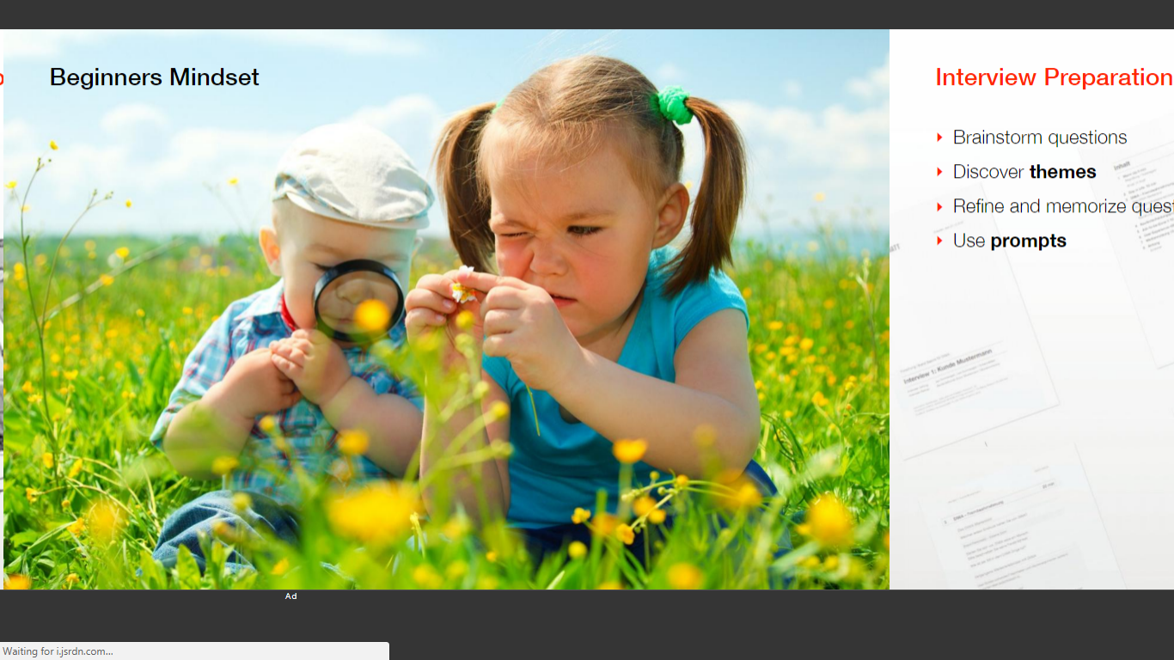
BEGINNERS MINDSET

Slide 62
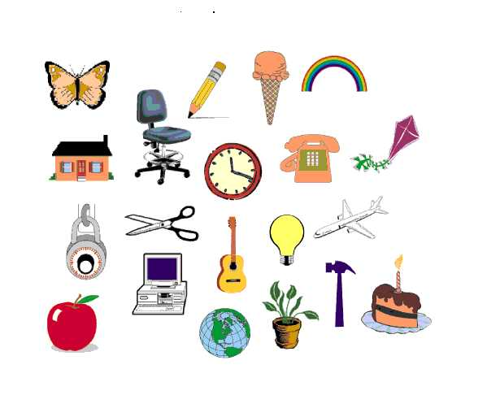
Numbers : Benchmark

Slide 63
Variety

Slide 64
Hidden

Slide 66
Perception/Dececption

Slide 67
LIST THE STAKEHOLDERS
Wide range of citizens
Wide range of Service team
3.
4.
5.
6.
7.
8.
On an A4 sheet

Slide 68
FEW FRAMEWORKS FOR OBSERVATION (use any one)
Sub team 1 use this

Slide 69
Tools and
Techniques for
1. Mind set
2. Set benchmarks : so many numbers
3. Variety (different clusters)
Insights
4. Hidden things
5. Perspective : Wearing multidisciplinary hat
List Stakeholders
Perceive as that Stakeholder
SPA Framework
Product & Environment Framework

Slide 70
CREATE AN OBSERVATION CANVAS (stick post its)
30 mins

Slide 71
FEW FRAMEWORKS FOR OBSERVATION (use any one)

Slide 72
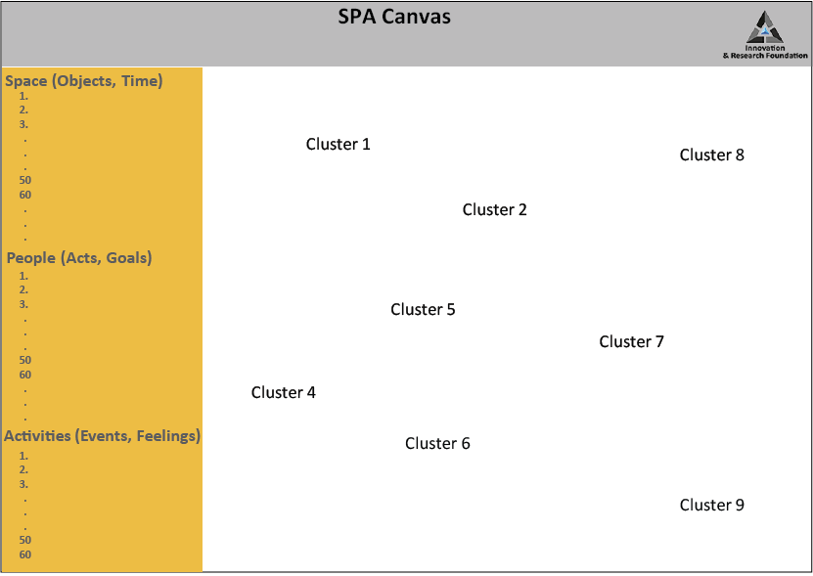
30 mins
Each sub team prepare this and then merge

Slide 74
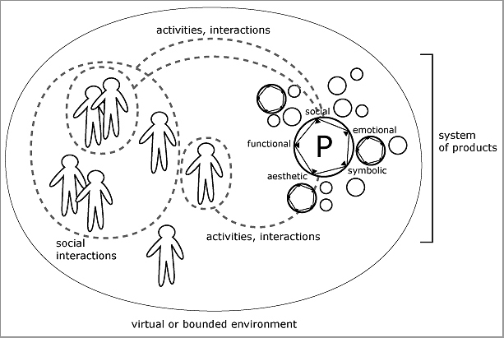

Slide 75
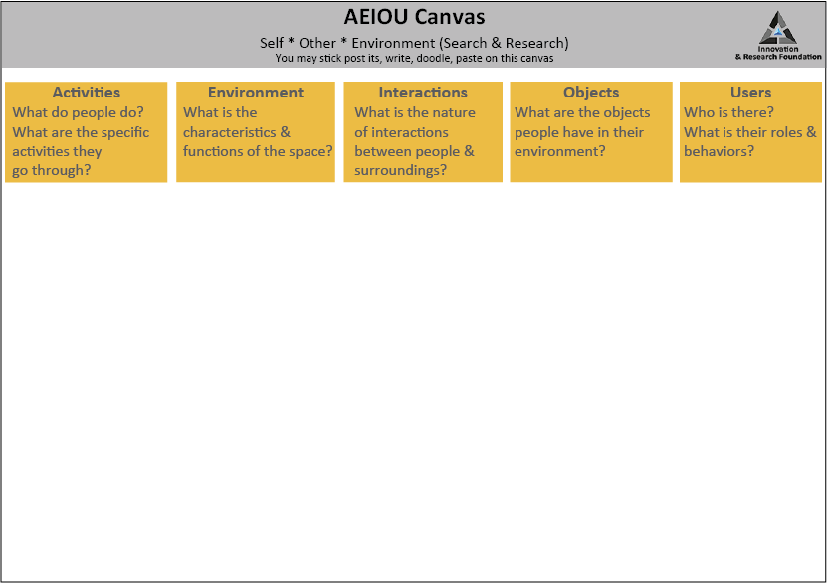
30 mins
Sub team 2 use this

Slide 76
AEIOU
Canvas
INSTRUCTIONS FOR AEIOU CANVAS
1. Go on the field and make your observations
Make observations related to Activities, environment, interaction, objects and user.
Come back and put this information on the post its and stick the post its in their relevant space in terms of Activities, Environment, Interaction, Objects, Users respectively
Click a picture of the AEIOU canvas

Slide 77
MAKE A LIST OF ALL ACTIVITIES :: TECHNOLOGY USED CURRENTLY
1. Customer support activities
:: a tech.
2. HR services and activities
:: b tech.
3. Perfomance Appraisal
4.
5.
6.
7.
8.
On an A4 sheet
© All rights reserved. 2019. Innovation & Research Foundation (IRF)

Slide 78
MAKE A LIST OF ALL PROCESSES AND SYSTEMS
1. Appointment
:: a tech.
2. Meeting
:: b tech.
Attendence
HR 5.
6.
7.
8.
On an A4 sheet
© All rights reserved. 2019. Innovation & Research Foundation (IRF)

Slide 79
OBSERVATION TECHNIQUES
Advanced ways of structuring your field work

Slide 80
POEMS FIELD NOTES

Slide 81
b. Empathy (Deep Insights)
Empathy is how you feel when you stand in the shoes of others or stakeholders, you start behaving, feeling and acting like the stakeholders do and when you transform into being the stakeholders you develop a capacity to capture the insights, insights are the problems, desires, needs, wants of the stakeholders. So here you have to develop empathy such that you can explore the deeper insights of the stakeholders to get a more comprehensive understanding.

Slide 82
EMPATHY
(Ethnographic study, Anthropology, Pattern recognition)

Slide 83
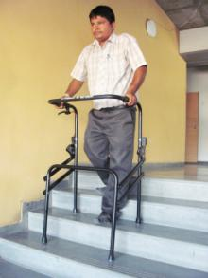
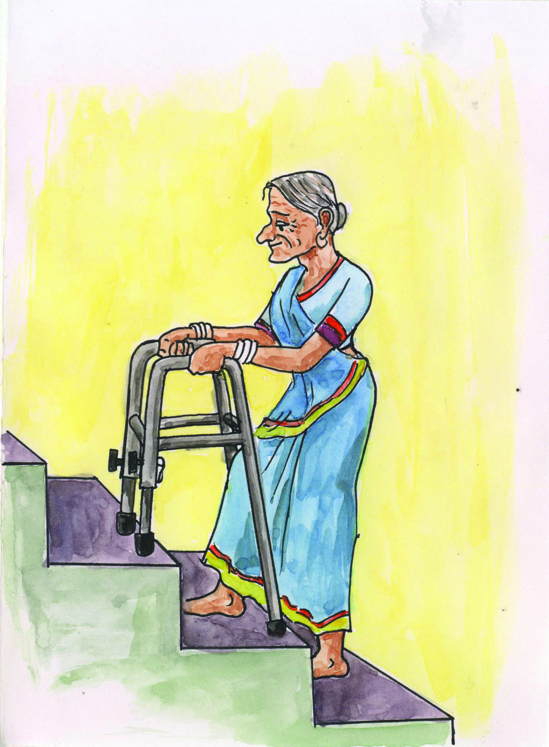
Feel the pain
Good design comes from the heart, not from the brain

Slide 84
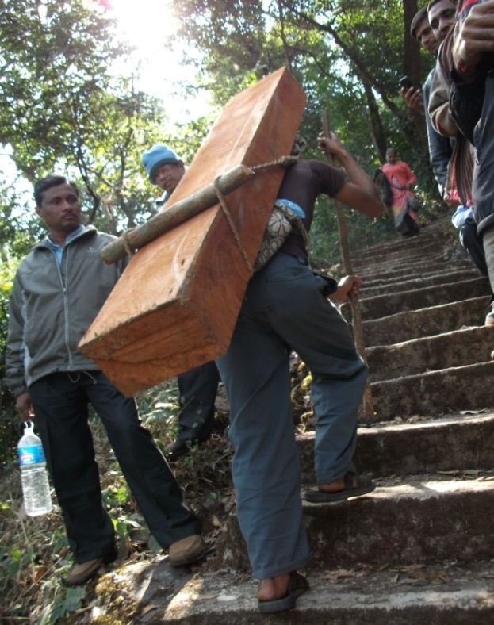
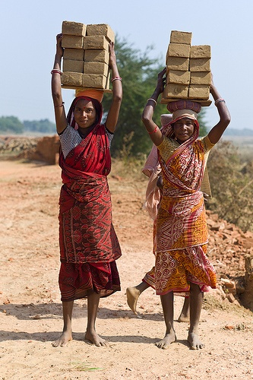
To build Empathy,
Looking is just not enough !!!
– start gazing - start internalizing the pain
– start socializing engineering principles

Slide 85
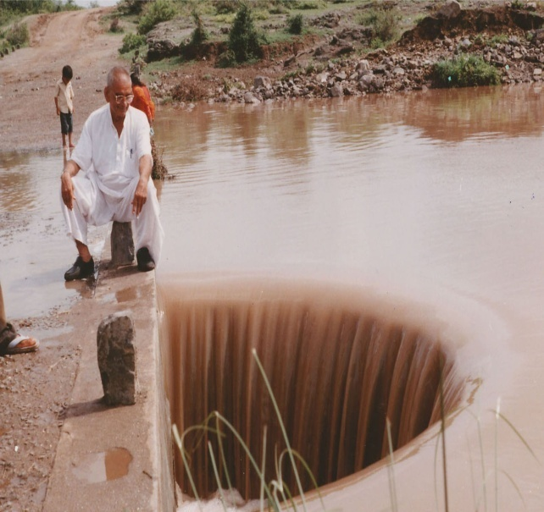
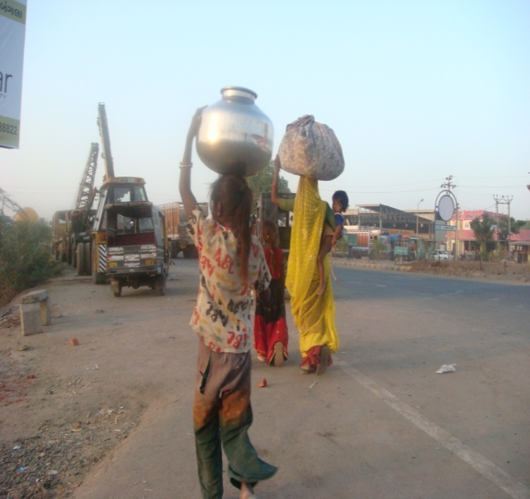
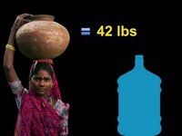
75,000 Civil Engineers produced by India per year… challenge still remains to link affordable drinking water supply to masses in rural areas.
Strengthen the appeal of socializing technologies

Slide 86
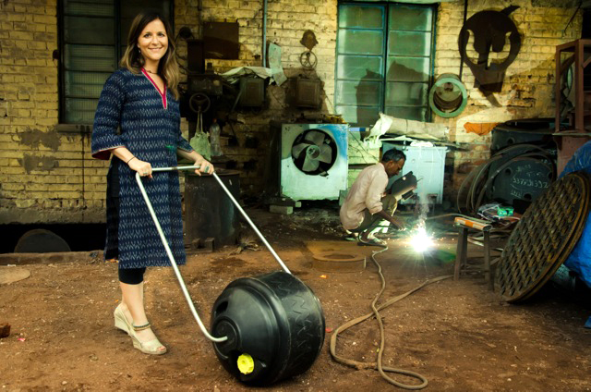
Innovations...
that take away your pain!

Slide 87
How to Develop an Empathatic Approach?

Slide 88
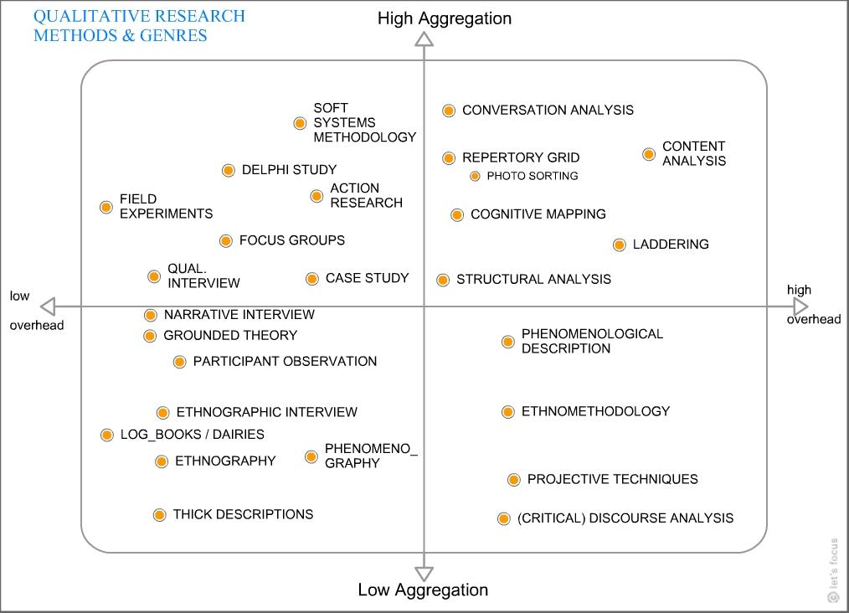
QUALITATIVE RESEARCH METHODS AND GENRES

Slide 89
Ethnographic Research methods
What is fieldwork?
Ethnographic fieldwork entails the extended residence of the researcher in a field setting (e.g., community, village, institution), participating and observing the daily activities and behavior of the people where research is carried out.
What is participant observation?
Who are Key Informants (K.I.)?
In PO the researcher shares as intimately as possible in the field and activities of the setting under study. This entails an extended residence period.
The purpose is to develop an insider’s view of what is happening.
K.I. Are the knowledgeable persons who are considered as authorities pertaining to the history and culture of the community/institution/place. (selection, rapport, marginal people)

Slide 90
Recording Observations
1. Keep field notebook
2. Take notes of your observations as you observe
Write down notes as soon as possible
Notes should include empirical observations and interpretations
Cross files - fill in date and time you made your observation
Analyze and interpret your observations, discerning patters of behavior, finding the underlying meaning in the thing you observed
30 mins

Slide 91
In-Depth Interviewing
1. Introduce your self and your project
2. Share with them your objective and how are they important for you in your project
1. Learn to listen, think and talk almost at the same time
3. Build rapport
4. Ask questions that you feel your stakeholder can answer in depth, and try to pull out stories from the same
2. Probe - how is that? In what way? How do you mean? What would be an example of that?
5. Capture their emotions/feelings
3. Review notes every night
- observe activities/behavior “gaps” that must be further observed.
6. Ask questions
7. Always acknowledge them at the end of the interview
4. Combined with observation, interviews allow the researcher to understand the meanings people hold for their everyday activities
30 mins

Slide 92
Three General Categories of Interviews
1. Informal conversational interview - qualitative in-depth interviews are more like conversations than formal events with predetermined response catefories
2. The general interview guide approach
3. Standard open-ended interview
30 mins

Slide 93
Types/Stages of
Field Notes
1. Substantive field notes focus on the main observations, conversations, experiences and interviews
2. Methodological information documents the subjective impressions of the researcher observed in the data-gathering context.
Analytical field notes contain preliminary stages of analysis. Here data is sorted, coded, and analyzed for the first time - gaps can be addressed and questions can be followed up.
Data Sheet should include date, place, and source of information.

Slide 94
The study of body movements/motion and its accompanying messages is a communication technique known as kinesics. The motion is analyzed systematically in a way that allows the researcher to see and measure significant patterns of communication process.
Birdwhistel labels four channels of the coommunication process: vocal, visual, olfactory, and tactile.
Body language can express unconscious thoughts that may be essential for observers to decide if they are to analyze situations accurately.
Measuring devices are available for researchers to use not only in gaining a further understanding of kinesics but also in learning how to interpret body movements.

Slide 95
Flims, Vidoes and Photographs have a long history in anthropology, called vusual anthropology, or film ethnography. It relies on film and photograohs to capture the daily life of group under study.
Other methods/ stratergies in community studies
Films provide visual records of passing natural events and may be used as permanent resources.
The concept and method of the research film have emerged and are compatible with the variety of research methods and have been used to describe how people navigate in public spaces and the use of space.
Research filming is a powerful tool for inquiry into past events. Film has the ability to capture visible phenomena seemingly yet always from the perspecting of the filmmaker.
Research film methodology requires the documentation of the time, place and subject of the filming as well as the photographer’s intent and interest.

Slide 96
Creating the Questionnaire using...
5W & H :
- List all Stake holders i.e. 6
- Each one create a questionnaire for 1 stake holder
The above stake holders should include User, Extreme User & Expert
Each Sub Group quickly discuss and finalize the most apt questions
Laddering (7 Why) create interview questions
Based on the previous questions NOW create why questions that will take one deeper into gaining insights
FINALIZE THE QUESTIONNAIRES
The Sub Groups exchange the questions and thus the other sub group can gather more meaningful questions.
Remember to collect as many stories from which will emerge the Journey Mapping (Minimum 1 per group i.e. 2 journey maps)
Break the entire experience into specific parts
30 mins

Slide 97
Documenting
Benchmark: 10 per person i.e. 50 per sub group & 100/group
Min. 6 clusters
Empathy : Top 1 videos per sub group
Empathy Interviews
User : Min. 4
Extreme User : Min. 2
Expert : Min. 2
Laddering : Min. 2
2 stories resulting into ONE Journey Map / group
2 Customer Profiles (Most Prominent User/ Stakeholder)

Slide 98
Individual Interview
Telephonic (Short), In-depth Interview
Group Interviews
You can come to a quick understanding of a community’s life, dynamics, and needs by conducting a Group Interview.
Expert Interview
Experts can fill you in quickly on a topic, and give you key insights into relevant history, context, and innovations.

Slide 99
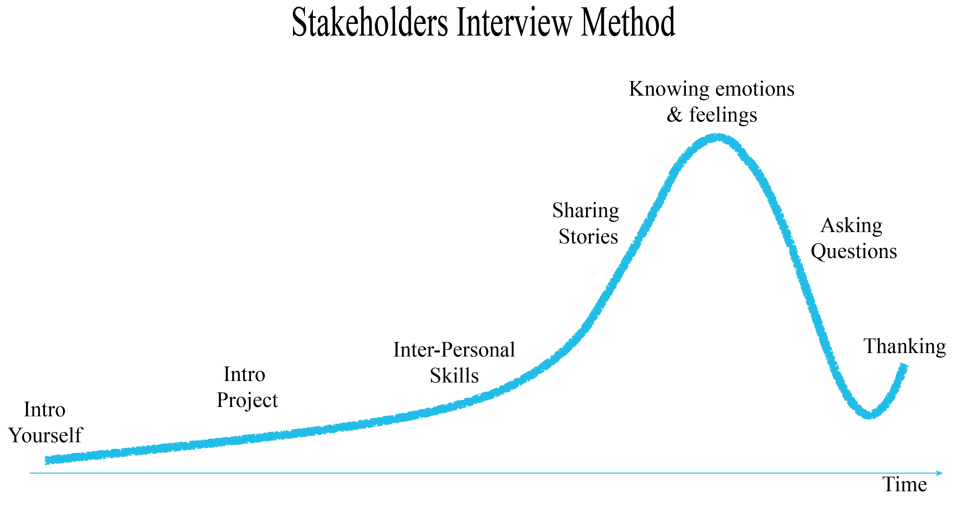
METHOD : INTERVIEW FOR EMPATHY

Slide 100
QUESTIONNAIRE

Slide 101
Personas are created for several stakeholders persona includes what are the stakeholder’s interest, what are the powers (decision making power or other kind of powers) that stakeholder holds, what are the needs of the same, behaviors, values and aspirations. Persona are not general they are related to the kind of business or work you are in.
So pick one person from the list of stakeholders and make his/her persona.
The example next shows the persona of a lady called Linda. They wanted to provide some service to this lady, the information that you besides is the general information. This is a wrong way of profiling, this is more of a survey data, and this does not take you anywhere unless you create the other elements of the persona, once you know this you can train your team accordingly.
Linda
50 years old
Lives in Tallahassee, Florida Widowed with no children
- They did a secondary research, is more of physcology reasons that people hold. E.g. you have a product and your competitor also has the same, how are they different than yours, how are they doing? Why are they doing, so secondary research provides you a physcologial data.

Slide 102
Creating a Persona on an A4sheet

Slide 103
BROWSE INFORMATION OR LEARN MORE ON A GENERAL TOPIC

Slide 104
Future friendly design: designing for and with future consumers
Long term patterns in values change can provide a useful framework understanding emerging consumer needs that in turn provide clues to their purchase preferences.
The long term shift is from left to right in figure below from traditional to modern to postmodern to integral. The percentage estimates below derive form the world values survey data and spiral dynamics. They have not be updated recently and should be judged with caution.

Slide 105
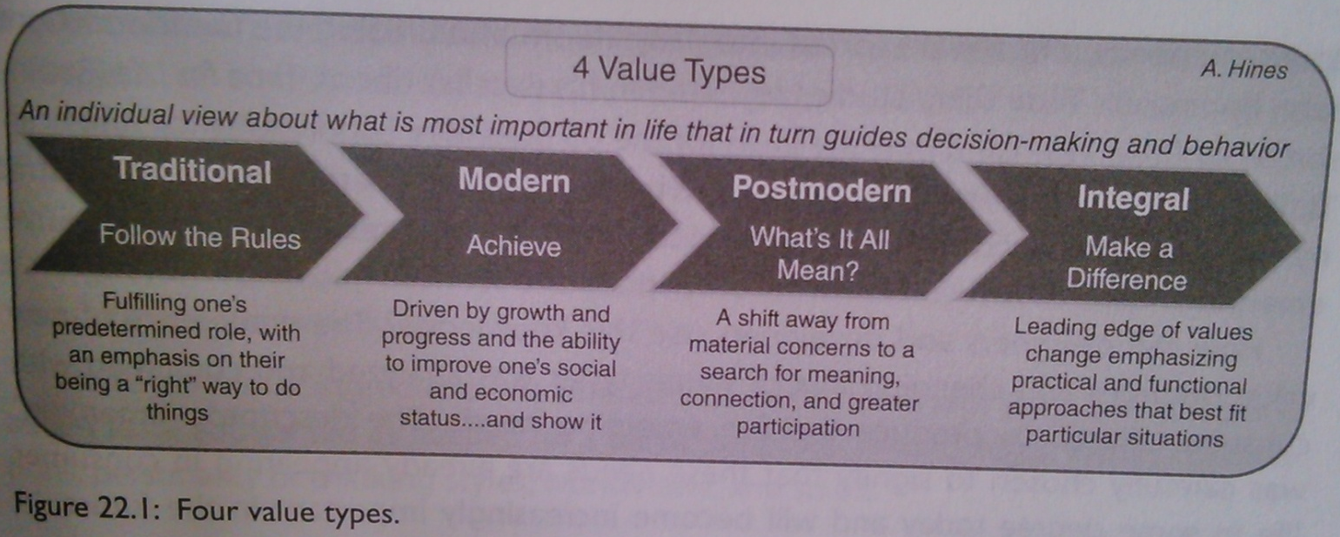
A framework for understanding changing consumer values
In design terms the key task of the designer is to produce a consistent design appropriate to their beliefs, practices, histories, protocols, textbooks and so on.
In design terms the key task of designers is to produce the best design-one that beats the competition is most valuable
They key task here is a participatory design process one in which everyone is heard and has input, honoring the unique perspectives that individuals bring.
They key task here is co-created design that moves beyond input to direct involvement in the design process such as open-source approaches.

Slide 106
Emerging consumer needs
The five emerging consumer needs are:
Keeping it real: Preference for the straight story
The relentless pursuit of happiness: taking responsibility for one’s well-being.
We really are the world: Feeling responsible for the well being of the planet.
Glass houses: Everyone is watching

Slide 107
The future personas emerging
The future personas are covered in a consistent format that include the following:
Summary description: The first few paragraphs characterize the persona in general.
Demographics: A profile of a “Typical” persona who embodies the emerging need, including gender, age, household income, education and life stage
Illustration: A visual to help facilitate the “real-ness” of the persona.
Table: A summary table that includes the supporting need states of the emerging need, the values this persona would likely embrace and the related trends supporting the persona’s emergence.
Committed time activities: How the person would likely approach several aspects of committed time-work, household and family care, shopping and personal/biological necessities.
Free time activities: Description of how the persona would likely approach free time-learning, leisure, affiliation and communication.
Vignette: A brief day-in-the-life snapshot that provides insight into how persona might operate in daily life.

Slide 108
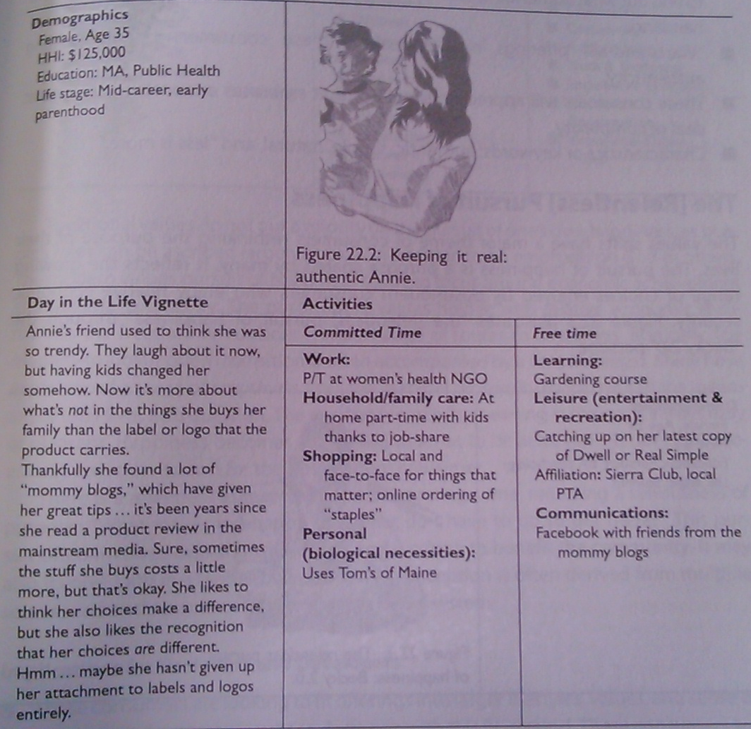
Keeping it real
A key word for postmodern and integral consumers is authenticity. It is the core value driving them to this emerging need. They are asking organizations to give it to them straight and trust them to be able to handle the truth. They will reject any paternalistic “for your own good”. Their view is, “treat me as an adult, as an equal and a someone with a brain. don’t mange me.” the persona besides illustrates “keeping it real” through the “authentic Annie” persona.

Slide 109
They are reacting against an overly manages world. “Delighting the customer” has gone to an extreme. As management of consumer experiences has gotten increasingly sophisticated, it has created a situation where every aspect of the experience is micro managed and these consumers sense that and feel that they are constantly being manipulated and they want it to stop.

Slide 110
Implications for designers and developers
These consumers will appreciate designers and developers who “do the homework” to find out what authentic is, such as being of aware of history, origins, materials and handling.
“warts and all” offerings may appeal to these consumers by representing authenticity.
These consumers will appreciate simplicity that embraces or encompasses a great deal of complexity
Characteristics or keywords: authentic, simple, natural and “less is more”

Slide 111
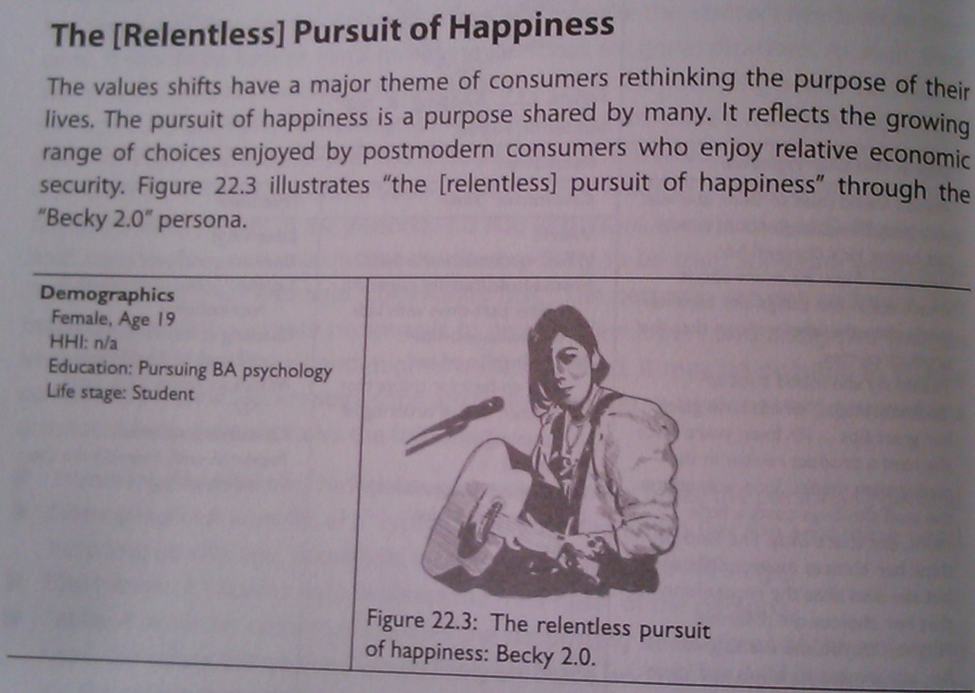

Slide 113
Traditional values do not put a priority on the pursuit of one’s own happiness, as people’s roles can be ascribed largely at birth in addition to an emphasis on God or others. The modern values pursuit of happiness tends to focus around economic achievement and material prosperity. The postmodern values holder with relative economic security has the freedom to consider a wider range of routes to happiness. Ironically the modern to postmodern transition is often accompanied by a sense of angst. Many have experienced a sense of emptiness from the material prosperity route and call the meaning of their lives into question. The resultant search for meaning in life is not always easy or pleasant. Happiness becomes something that has to be achieved-it does not necessarily arrive on its own for the postmodern consumer.
There is a relentless aspect to this pursuit among some, reflecting a seriousness of purpose: “What makes me happy and what do I have to do to get there?” this pursuit often involves assisting with others and working to benefit the community. It may also involve faith in a higher power but this conception is often derived from multiple sources rather than subscribing to a single belief system.

Slide 114
Implications for designers and developers
These consumers are looking to fit offerings into larger lifestyles, values and sense of purpose and evaluate purchase decisions with this fit in mind. These consumers are looking for designers and developers that will “help me help myself.” they may be particularly interested in co-creation, where they may be provided with tools, templates and advice-and handle the rest themselves. For some products and designs, it will be simply about fast, easy and cheap but for others which speak to their identify designs and products will increasingly be evaluated in terms of how they influence one’s sense of “happiness” or well being.
Characteristics and keywords: DIY, happiness, well-being, assistance.

Slide 115
Community first
The emerging values shifts suggest a shift in scale from large to small and in scope from mass to custom. This shows up most strongly in this emerging need. It favors decentralized approaches. It is part of the sense, captured in other need states, that life has gotten too complex, moves too fast and has become impersonal. It is this depersonalization in particular that derives the move to renewed interest in community as people seek to reconnect with their life and with one another. in the ascent up the growth curve in modern society, the frenetic pace is seen as worth the trade off for the economic reward. The postmodern consumer is more aware of the costs, has less need for economic security and thus begins to reject this trade off. The next persona illustrates “community first” through the “good neighbor Bob” persona.

Slide 117
Need states | Values | Trends
Local preferences | Community | Relocalization
Community support | Connectivity | Living within limits
Trust the network | Appropriateness | Sustainable consumption
 | Influential | Empowered individuals
 | Interdependent | Virtual real digital tribes
 | Collaboration | Emerging markets arise
 | Sustainability
 | Questioning
 | Skepticism
 | Tolerance
This desire for connection manifests in both the physical and the virtual worlds. These consumers question why they don’t know their neighbors or even the mayor. They are looking for ways to get involved with what’s going on directly around them, as this helps to provide an anchor or security in what is seen as an increasingly chaotic world. The explosion of Facebook and other social networking sites is evidence of how the virtual world can serve as a mechanism for connection.

Slide 118
Implications for designers and developers
These consumers value locally produced offerings as way to support their community. They will also tend to favor small, local producers in other jurisdiction if they are competing against a big, multinational competitor.
These consumers could be key drivers of a move to require designers and developers provide some kind of local benefit.
These consumers place trust in their physical as well as virtual networks and may rely on them for advice, referrals, or even to co-create via crowsourcing approaches, which will continue to grow stronger.
Characteristics ad keywords: local, community, network, crowdsourcing.

Slide 119
We [Really] Are the world
The title of this emerging need plays on the 1985 song “we are the wrold” which was recorded to support charitable causes in Africa. That effort spurred some short-term attention and while things soon returned to business as usual the song lived on; the thought apparently touched something in these consumers that is now coming back to life thus the “really” in parenthesis. This time, the feeling of global responsibility or planetary consciousness is emerging as a stronger and more genuine force. The persona now shows “we [really] are the world” through “stewart’ship” persona.

Slide 120
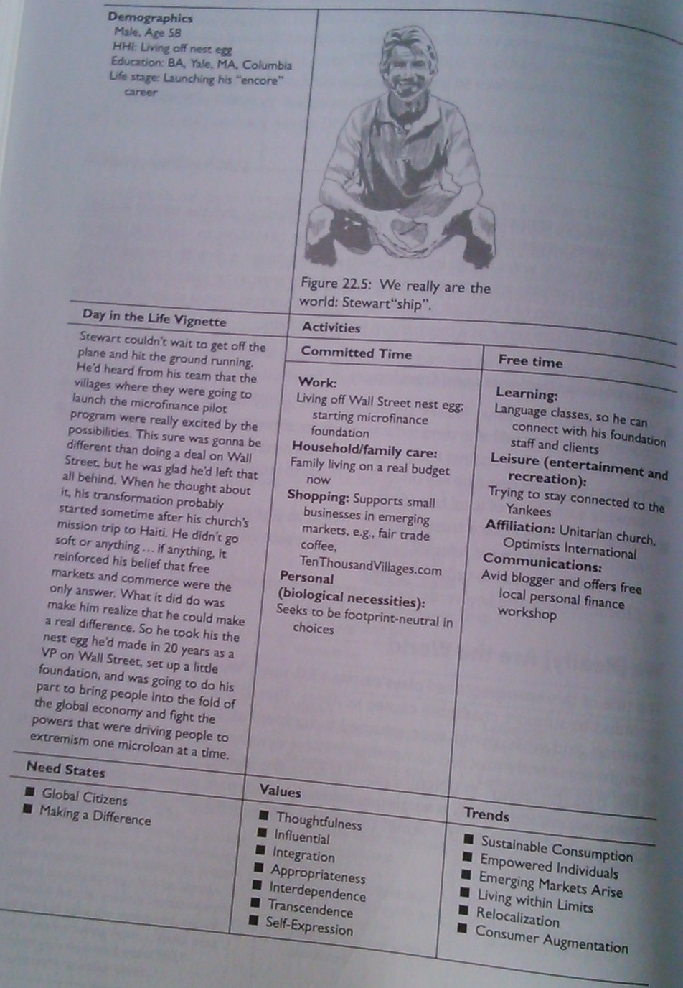
What has changed alongside the strengthening of the supporting values iis the “flattening” of the world that enables easily accessible and real time information about any event or situation almost anywhere in the world. Few geographices are beyond the reach o the global media and communications. The connection to distant problems is more easily maintained and the options for action have increased as well. It has become much easier to act on these values now than it was back in 1985. so while the values supporting this emerging need may well have been present 25 years ago, the supporting infrastructure was not-but it is now and increasingly so in the future.

Slide 121
Implications for designers and developers
These consumers think of themselves as global citizens and will think through the ramification of designs and products that go beyond national borders, with a genuine concern for planetary welfare and a willingness to act on that.
These consumers are for ways to make a tangible difference on the pursuit of idealistic grand schemes that suggest designs and products that blend vision and practicality.
A sense of global social responsibility will be an added criterion for designers and products that appeal to these consumers; they will be inclined to ask what it adds the common welfare?
Characteristics and keywords: global, sustainable, vision, difference.

Slide 123
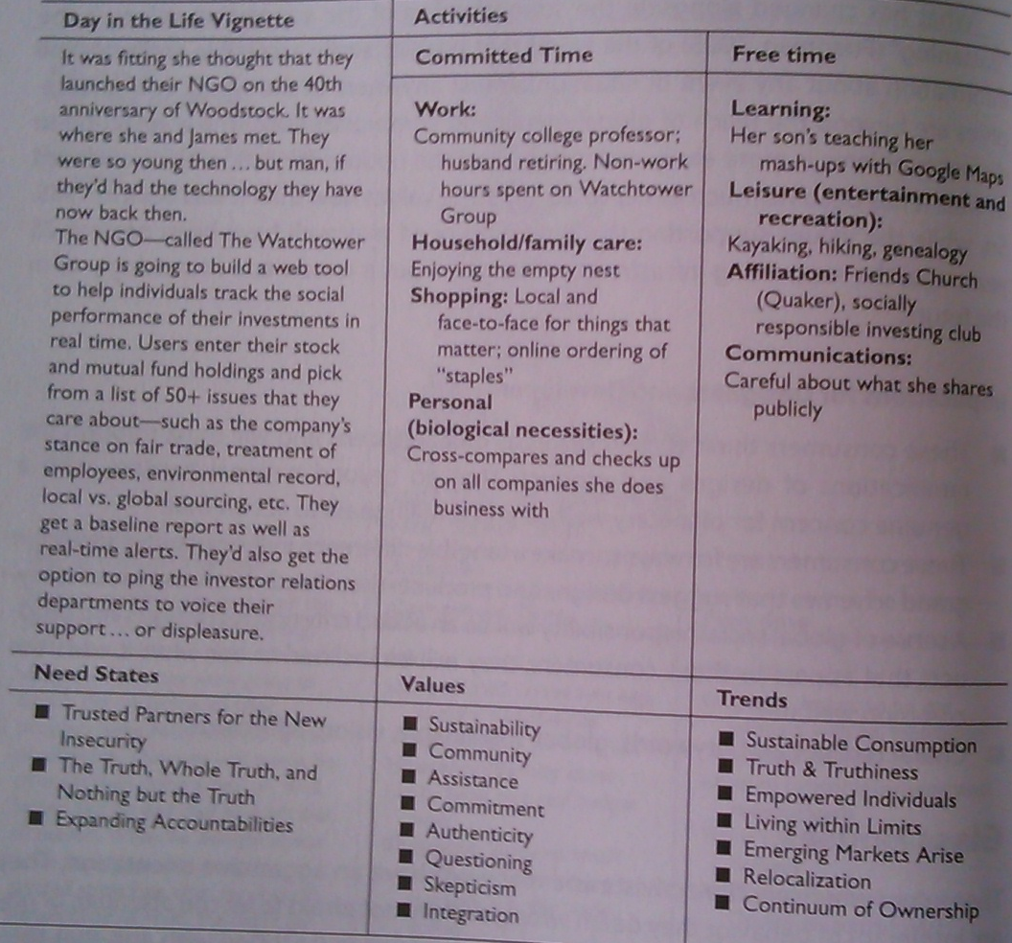

Slide 124
These consumers are watching often all the time. They are often savvy uses of technology and expert in the world of information and they use that to support their cause. Accountability is the buzzword; it wont always be pleasant; and it wont always be fair. The best an organization can do is sty consistent and true-or, closing the circle back to our first emerging need, be authentic. “Spin” and message control and such tools will only get organizations into trouble. Telling the truth will eventually at least earn respect and credibility that will be appreciated and rewarded over the long haul.

Slide 125
Implications for designers and developers
These consumers will be inclined to transparent and open approaches ; they will want to know how a design or product was derived or at least know that they can hav access to that information.
These consumers are looking for trusted partners to help them navigate through what they see as a complicated ad even insure future. They will appreciate partners who are willing to admit faults and mistakes, seeing it as a sign of good faith.
These consumers are likely to embrace a collaboration approach to design and development.
Characteristics and keywords: open, transparent, participation, collaboration.

Slide 126
The tool kit
The four value types provide a “quick-and-dirty” framework.
The values, when combined with consumer trends provide additional understanding
Combining the values into five emerging consumer needs adds another layer of understanding.
Studying the personas that accompany the emerging consumer needs helps bring those needs alive.
Finally the personas can be customized and enhanced to provide a multilayered approach to understanding the consumer targets.

Slide 127
Persona
INSTRUCTIONS FOR CREATING PERSONA
KINESICS
Strengths
It provides a view into unconscious thoughts and provides a means for triangulation of verbal data.
A researcher can be more confident about the accuracy of information privided by a subject if the speaker’s body language is confruent with his words.
Limitations
Body language is not universal. Some gestures signal different meanings in different cultures, example: the up and down head nod signifies “no” and side-to-side movement of head means “yes”.
Body movements must be interpreted in context.
Note the stakeholders following things:
Tasks
Feelings
Pain points & possibilities
Over all goal
Influences
Demographics
Behavior
Goals
Motivations
Strategies
Needs, wants, desires
Any other relevant information

Slide 128
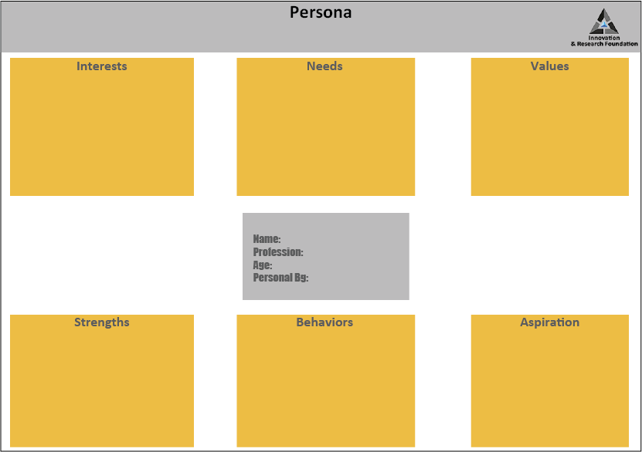
30 mins

Slide 129
Secondary Research:
Linda’s behaviour line, we looked at,
USA.gov Web analytics, including demographics, devices, common paths, popular pages, outbound links, and onsite searches
Web analytics specifically for our Government Benefits, Grants, and Loans content
USA.gov customer satisfaction survey data
Searches on Google that led customers to USA.gov
Contact center content usage
Web analytics for other government websites available through the Digital Analytics Program
General search trends on Google

Slide 130
Once the behaviour line was created, we printed each step on one piece of paper
We taped the steps to the wall, with accompanying images, and the facilitators walked the participants through a series of exercises to explore the journey, which includes:
Employees and systems the customer interacts with personally
Behind-the-scenes employees and systems that support the direct interactions
Customer’s attitudes, emotions, and needs
The highs and lows of the journey

Slide 131
Once you have met a stakeholder you have created a persona, now you have to create a journey map, journey map first has the touch points, then the sequence, and an important thing between a journey map and a flow diagram is that the journey map has emotions plotted too. Flow diagram does not carry emotions, how ever journey map does.
Look into the journey map of Linda and find out how the emotions are attached to the journey map of Linda.

Slide 132
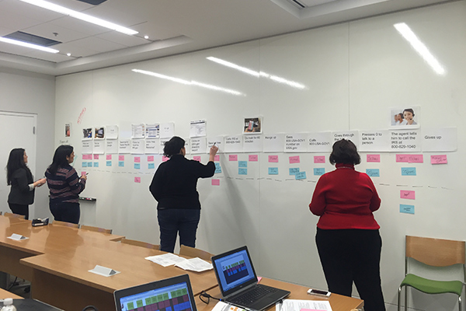
Once you have the data and the persona you put it up on the wall.
This kind of display is done in order to give you a bird eye view, you are connecting
the dots, you can take a walk, look at it, again come back and look at it and find out.
This is how problems are solved now a days, everything is put up on the wall, this called synthesis.
Next you create a journey map.

Slide 133
CASE STUDY | The Good Kitchen
What is?

Slide 134
Outside of the for-profit sector, other organizations were
bringing design thinking to address social issues: In Denmark, The Good Kitchen transformed meal delivery service for the elderly using a comprehensive design thinking process from end to end

Slide 135
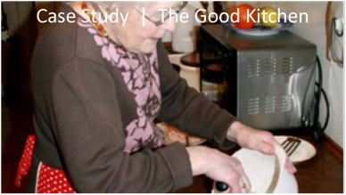
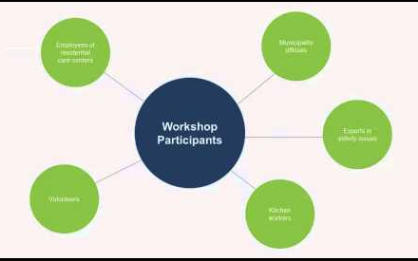

Slide 136
THE SOCIAL PROBLEM
Improving the nutrition of the elderly
THE CONTEXT
A program in Denmark’s Municipality of Holstebro for delivering subsidized meals
DESIGN’S CONTRIBUTION
Using the tools of design thinking to develop deep insights into both customers and employees to reframe the possibilities for improving the nutrition and health of the elderly by creating a more appealing meal service

Slide 137
We focus on a success story from Denmark, a country so well known for its product design prowess that perhaps it should not be surprising that the Danes are also leaders in using design thinking to drive innovation in public-sector-service delivery. In this story the Municipality of Holstebro and the Danish idea and design agency Hatch & Bloom team up to work with stakeholders to use a comprehensive set of design thinking tools-from ethnographic research and mind mapping to analogies, trigger questions and co-creation-with dramatic results.

Slide 138
The Danes like citizens in most developed countries, recognize that the aging of their population presents many challenges. One of these is serving the more than 125,000 senior citizens who rely on government-sponsored meals. Danish municipalities deliver subsidized meals to people who suffer from a reduced ability to function due to illness, age or other conditions. Many of the seniors have nutritional challenges and a poor quality of life because they simply do not eat enough. In fact, it is estimated that 60 percent of Denmark’s seniors in assisted living facilities and residential care units have poor nutrition and 20 percent are actually malnourished. The result is a higher risk of health problems and a low quality of life for the elderly and a greater economic burden on the government. The problem only looks to intensify as the number of senior citizens grows and future generations of seniors expect greater choice and better serivces.

Slide 139
in response to this growing social problem, the Municipality of Holstbro applied for an innovative program, offered through the Danish Enterprise and Construction Authority, that provides funding to municipalities and facilitates partnerships between them and Danish design firms. The firm Hatch & Bloom signed on to be part of the effort to improve meal service for seniors. Innovation director Lotte Lyngsted Jepsen led the six-month project.

Slide 140
A s Lotte recalled it, both Holstebro officials and the leaders of the Hospitable Food Service saw the project as straightforward at its outset: the current menu just needed some updating. In their view they already offered high-quality food and service, so Hatch & Bloom would just need to ask elderly clients about their menu preferences. As the project progressed, however, this view shifted. The result was the design of a wholly new meal service that offered higher quality, more flexibility and increased choice. This dramatic reframing of the opportunity emerged from the user-centered design approach that Hatch & Bloom brought to the process.

Slide 141
Learning to see What is?
The Hatch & Bloom team began by digging deep into seniors behaviors, needs and wishes using a comprehensive ethnographic based research process that focused on identifying their current situation and unarticulated needs. Team members rode with food service employees who delivered the meals to the elderly client, accompanied them to the homes, and watched as clients prepared the food, added ingredients, set the table and ate the meal. In addition to observing current customers, they studied those who had discontinued the service and people close to retirement age who might soon qualify for the subsidized meals.
They also interviewed the supervisor of the food preparation process in her workplace. What they saw in the kitchen surprised them. “The people who worked in the kitchen were a major factor that needed to be addressed,”

Slide 142
Working in a public-service kitchen was a low-status job in Denmark. In addition there had recently been negative press about poor or even old food being served in these kitchens.
It was not going to be enough to focus on the needs of the consumers, team members realized; they would need to address the problems of the employees producing of the employees producing the meals as well. The team decided to broaden the scope of the project beyond just improving menus and helped the government clients understand why this was necessary:
As a result the Hatch & Bloom researchers also conducted interviews with and observed the kitchen workers to understand their needs and work processes. For this dual focus—on the people preparing the meals and on the seniors receiving them—a set of interesting findings began to emerge.

Slide 143
Understanding the kitchen employees
Insight from observation: As team members observed kitchen employees and interviewed then about their jobs, they were surprised to find that one of the workers’ major frustrations was that they were not empowered to do what they loved.
They had chosen to work with the food because they enjoyed creating things out of food, but they were faced to prepare the same meals form the same menu month after month. The decision to use one menu for three months made sense from an operational logistics pov, but it was terribly corrosive to the morale, motivation and commitment of the kitchen employees and the team learned it was not good for customers either.
During the interviews another important thing happened: the kitchen employees realized that someone was listening and trying to help. Catering, officer Birgit Jespersen noted that this generated tremendous goodwill for the project.

Slide 144
Understanding Seniors
Insight form interview: The seniors receiving meals also suffered from feelings of disconnection and stigma, the Hatch & Bloom team learned in interviews with them. The social stigma of even having to receive such assistance weighed heavily: Help for cleaning was considered acceptable in Danish culture, but help for more personal needs was much less so. It also mattered who was providing the help. In Denmark a senior hoped to receive it from a relative or a friend. If that was not possible one would perhaps hire someone. The last resort was government assistance.
Also very painful to seniors was the loss of control over their food choices. The team discovered that the kind f food they put in their mouths was the second most important thing for the elderly after taking care of their own personal hygiene. Furthermore they often disliked eating alone because it reminded them that their families were no longer around. All these factors were linked to the underlying problem: The less you enjoy the situation, the smaller your appetite.

Slide 145
On a more positive note the team also discovered that this generation of seniors was very responsible and capable in the kitchen and had a keen sense of the seasons and positive associations with seasonal food such as apples in the fall and strawberries in summer. They also often tried to customize their meals by adding spices or using their pw potatoes or vegetables.
As Hatch & Bloom began integrating what it had learned from both seniors and kitchen employees, the news was good.
A lot of the findings in the kitchen actually worked very well with the findings from the users. And it lead that it was not chef’s decision and it was not a user’s decision either.

Slide 146
KEY INSIGHTS
Seniors were ambarrassed to accept government assistance
Loss of control over food choices was painful
They were lonely eating alone and missed the seasonal food of their youth
Workers were bored and unmotivated creating the same meals day after day
Insight: The more the team from Hatch & Bloom got to know the kitchen employees, the more it became apparent that this was a skilled workforce. Public perception and reality were quite different. The workers wee making boring, low-cost meals because of perceived economic and logistical constraints not because they faced a skills gap.

Slide 147
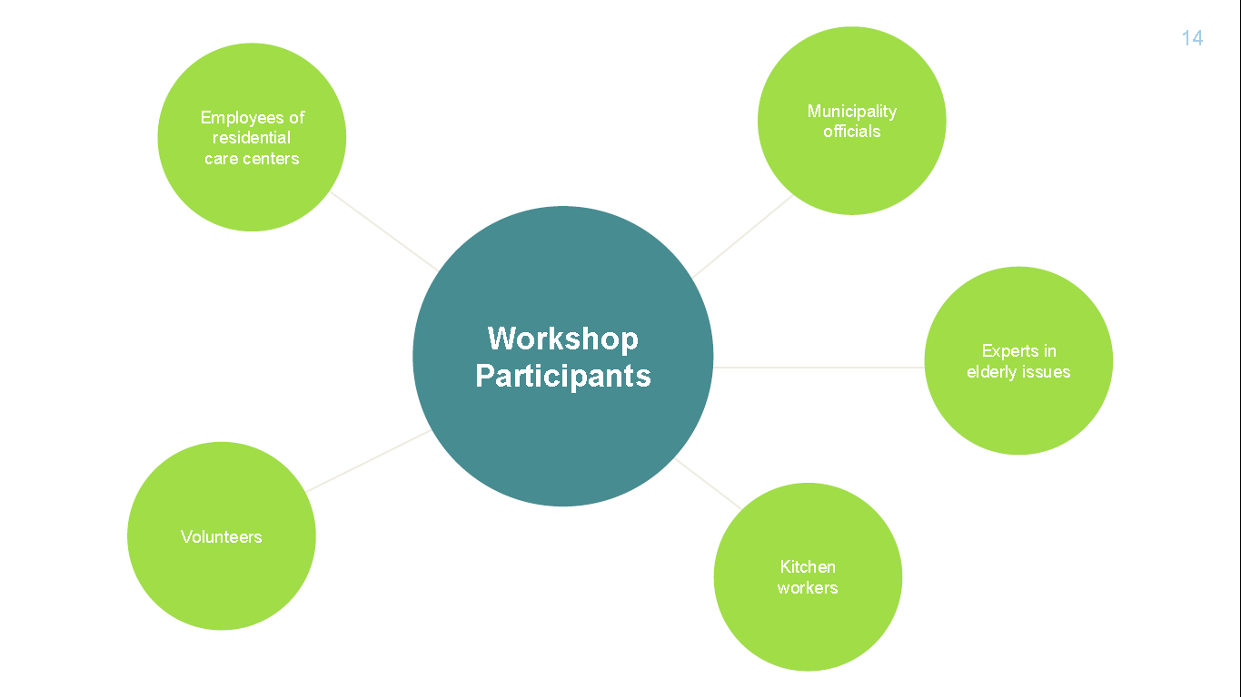
Once team members had finished their ethnographic research, they enlisted a broader group of stakeholders in understanding the nature of the challenges and participating in creating solutions. The goal was to solicit a wide range of ideas for developing a new and better meal service. To accomplish this they held a series of three workshops.

Slide 148
Answer keeping in mind your design thinking process
How will you define problem/challenge statement keeping in mind?
- government-sponsored meals.
- Danish municipalities deliver subsidized meals
- Many of the seniors have nutritional challenges
- both health problems and a low quality of life

Slide 149
- What was the already available solution that Holstebro officials and the leaders of the Hospitable Food Service?
- How did the view shifted as the project progressed?
- How was the wholly new meal service that offered higher quality, more flexibility, and increased choice?
- When does Ethnography in Social Services fail?
- What were the ethnography study the team members took on?
- What were other observations made apart from observing the current customers?
- What was that they observed in the kitchen that surprised them.
- What was the general perception of the people who worked in these public kitchen?
- Why did the team feel “It was not going to be enough to focus on the needs of the consumers, team members realized; they would need to address the problems of the employees producing the meals as well.”

Slide 150
- Give your views upon the following:
Design Challenge: Changing Scope
When we set out to explore an opportunity, we often find that our initial scoping of the issue was flawed. Here a problem that we thought had an obvious solution – whether that be an updated menu or a better search software – actually required the redesign of an entire experience. It’s not easy to reframe an issue or problem. But it can help to think of the initial scope of the project as a hypothesis that you must revisit and refine along the way. Keep in mind – this does not indicate a mistake in our early scoping; it is a sign of important learning

Slide 151
- Why did the decision to use one menu for three months made sense from an operational logistics point of view, but it was terribly corrosive to the morale, motivation, and commitment of the kitchen employees, and, the team learned, it wasn’t good for customers, either?
- What was it that happened during the interviews?
- What were the insights made while the team was understanding the kitchen employees?
- What were the insights that were gained while the team was trying to understand the seniors?
- What did Hatch & Bloom get as they began integrating what they had learned from both seniors and kitchen employees?
- Give an example to explain “A lot of the findings in the kitchen actually worked very well with the findings from the users”

Slide 152
- What was the goal of the first workshop?
- Why were the municipality officials, volunteers, experts in elderly issues, kitchen workers, and employees of residential care centers were taken as the stakeholders?
- Why was food being served from the actual kitchen to the participants?
- What and why was the purpose of the first workshop ‘strategic’?

Slide 153
- How do Trigger Questions work? And what are its advantages?
- How will you use them in your project? Discuss in team

Slide 155
- In the second workshop move from what is to what if?
- How did analogies when taken as trigger questions help?
- What was Lotte’s experience of the effect of introducing the analogy?

Slide 156
Co- Creation Design Tool
Inviting key stakeholders into the design process.

Slide 157
Prototyping with customers
Hatch & Bloom took the results from the workshops and moved into What works?, prototypes with different combinations and ways of presenting food with the customers they had been observing since the beginning of the project. Again they tested the prototypes not only with current customers but also with people who had stopped using the service and with those nearing retirement age.
The learning from this initial set of experiments resulted in a second project with some quick design changes that allowed for meals in which the components were packaged separately.
Idea: instead of having a tray where there's potatoes or rice or past or some meat and some sauce and then some vegetables, the team implemented a solution where you pack these things separately if you prefer to do your own potatoes or If you prefer some kind of specific pasta or if you have some of your won vegetables. So you can order potatoes and vegetables on the side but then you can add what you prefer instead of having someone else decide that for you.

Slide 158
From Public-Sector Food-Service employees to restaurants chefs
In order to change the negative kitchen culture at Hospitable Food Service, the gourmet check Hatch & Bloom had involved earlier came in to work with employees. This generate more than a little nervousness among them.
The chef inspired the kitchen employees to introduce seasonal ingredients and offered ideas for improving presentation. This made the real difference.
Kitchen employees also received new uniforms that were much more “chef like” this was a symbol of their dignity and status, and its signaled a sense of pride and care of their customers as well.

Slide 159
From Hospitable Food Service To The Good Kitchen
The process of ethnographic observations, mind mapping, co-creating with stakeholders and iterative prototyping and experimentation yielded a host of dramatic changes:
A new menu
categories
items explained in greater details E.g. fried liver with gravy, potatoes and vegetables → pan-fried calf's liver with onions and gravy, potatoes tossed with thyme and butter roasted vegetables
a lot of their clients were still very social, so they added a tow-course guest menu.
introduced individual snacks such as pastries and chocolate to enable seniors to adapt their meals to their lifestyles and behaviors.
high quality additions
a weekly surprise
emphasis on traditional dishes
New uniforms
New feedback mechanism
A new name: Hospitable Food Service to The Good Kitchen (this changed the identity)

Slide 160
The Good Kitchen Becomes Part of the Family
Employees in the kitchen had not been accustomed to communicating with the people they served. The drivers who delivered the meals who were all kitchen employees would enter the seniors hoes and leave without reflecting on what they saw. So the team developed simple comment cards that drivers began to carry with them and hand to customers, who wrote reviews of their meals and suggestions for how to prepare them. This immediate feedback enabled the staff to gain insights into the seniors’ thoughts and reactions to their food. The comments were read aloud at staff meetings and pinned up in a central kitchen location. The cards motivated employees and gave seniors the ability to influence their meals. Both groups loved them.
This direct contact was reinforced with indirect contact.
Larger photos from home visits were hung on the walls of the kitchen, bringing employees closer to their customers. The good kitchen also began publishing a newsletter that included posts from kitchen employees, information about and pictures of new hires and other important events such as employee’s birthdays and the birth of a grandchild.

Slide 161
- Why do you think co-creation is a must in social service projects important?
- Why was the chef made to attend the workshop? What are the insights he gained by observation?
- What altered the situation “They just printed these menus out and never gave a thought to how they should look. ”?
- What were the thoughts that went behind the quality of vehicles?

Slide 164
- What was the aim of the third workshop?
- What were the prototypes that got generated?
- Why were even the minutest of the details asked to the participants?

Slide 165
- What might be the information that would go for the following three groups?
Stakeholders want it
We can do it
The economics can sustain it
- What were the WOW factor points that got generated?

Slide 167
Prototyping with customers
What were the learning from the initial set of experiments result to?
Why Instead of having a tray where there’s potatoes or rice or pasta, and then there is some meat and some sauce and then there’s some vegetables, they implemented a solution where they pack these things separately so customer need not order potatoes if they preferred to do on their own or if they preferred some kind of specific pasta or if they had some of their vegetables. So they could order potatoes and vegetables on the side but then they can mix what they preferred themselves instead of someone already deciding that for them.”

Slide 168
- What were the apprehensions the employees had towards gourmet chef who was brought to work with the employees?
Explain “Now we take the time to make an appealing presentation”
- What were the ideas that got generated for “From Public-Sector Food-Service Employees to Restaurant Chefs”?
- What were the dramatic changes that came in with the process of ethnographic observation, mind mapping, co-creating with stakeholders, and iterative prototyping and experimentation?
- How did the new name came by?
- What were the ideas that came in and those that got implemented?
- How did The Good Kitchen Becomes Part of the Family? Which stage of design thinking does this?

Slide 169
Prototyping Design Tool
Make it tangible and concrete. Draw a picture, tell a story, take a photo, make a map..

Slide 170
What were the Results: The Proof Is in the Pudding?

Slide 173
“If you have professional pride, you’ll also cook good food. Good food has to come from the heart!”
Anne Marie Nielsen, Director of The Good Kitchen

Slide 174
Make your inferences keeping in mind each stage of Design Thinking as
Observation: Study of AS IS
Empathy: Deeper Insights
Problem/challenge
Idea generation
Prototyping
Testing

Slide 175
By making a user part of the team, or part of the system or part of process of design thinking it would bring in transparency. Also rapid prototyping that happens with the end customer reduces the project’s risks cost and implementation cost. Design thinking with a context with the end in mind, when you are designing some process in your project, you are keeping problem as an end in mind it is not a never ending thing, it will end there, you learn from it, or you build it and then you move on. So it says that you have achieved with what you had started for. So it reduces the risk of all stakeholders. So bring stakeholders in your team and include them and work for them and build solutions for them, rather than we giving a solution to them let them too be part of solution generation step.

Slide 176
Take aways
Be willing to engage the entire system
It is worth nothing that it is much about system deign as it is about service design. Put the whole system in the room. In business we have gotten much better about the customer part, but we still often neglect employees and communities. Design thinking gives a detailed suggestion about what to-do with the system once all parts of it are in the room: share the findings from the deep ethnographic exploration of the stakeholders we want to serve, build an aligned intent around making their lives better and then invite everyone to derive insights, generate design criteria and co-create solutions.

Slide 177
Be willing to redefine the problem
Even with the problem definition where you start is not where you should expect to end up. And that’s good news. Yu didn’t get it wrong—you learned. So many of our flawed solutions can be traced to having stuck with a limiting question. One of the most significant contributions of design is to help us live longer in the question. It is our willingness to revisit the question we asked at the outset that allows us to reframe the way we see the world and discover new possibilities. It allows us to go places that we never suspected we would visit at the beginning of the process. But doing this requires bravery

Slide 178
Design feedback into the solution so you wont have to fix big problems so often
Why do we spend so much time trying to crate dramatic, wrenching change? Usually because we ignored the signals that would have allowed us to adapt more gradually. If we build those signals into tour design of the offering or service, the odds that we will see them before the crisis go way up. That is what those simple feedback cards do for the good kitchen. They create a seemingly mundane but very valuable ongoing conversation about daily hits and misses that helps employees get to know their stakeholders better along the way and greatly reduces the needs for cataclysmic change later on.

Slide 179
Appreciate the awesome power of ethnography
Without the deep insights produced by ethnography, how many opportunities to do something truly special for an elderly person—something that probably costs little or no additional money—will e fail to see?

Slide 180
Journey Mapping Design Tool
Tracing the journey of a customer as they experience a product or journey.

Slide 181
Creating a Journey Map
A journey map, allows you to visualize a process beginning to end. This simple framework will help you to more easily imagine the entire flow of an experience, whether it’s how a service may work or all the touch points of a customer’s journey with a product. This doesn’t need to be an in-depth, detailed representation, but rather a quick-and- dirty way of thinking out how a process unfolds.
A Customer Journey map could be interpretation of the overall story from an individual’s perspective of their relationship with an organization, service, product or brand, over time and across channels.
Step 1 : Touch Points
Step 2 : Sequence
Step 3 : Emotional Journey over time

Slide 182
LINDA’S JOURNEY MAP Browse information or learn more on a general topic

Slide 183
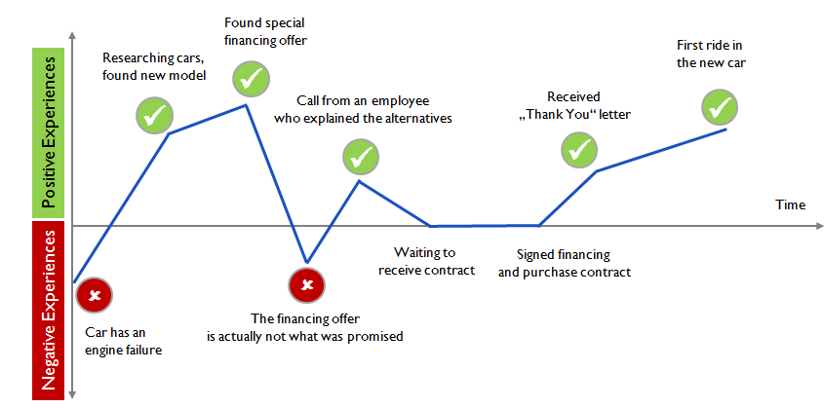
CUSTOMER JOURNEY EXAMPLE : CAR PURCHASE

Slide 184
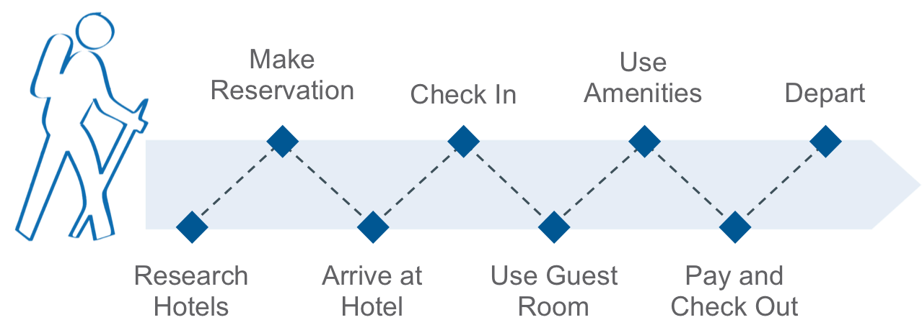
A Customer Journey map is a visual or graphic interpretation of the overall story from an individual’s perspective of their relationship with an organization, service, product or brand, over time and across channels.

Slide 185
CUSTOMER JOURNEY MAP

Slide 186
CUSTOMER JOURNEY MAP WITH EMPATHY

Slide 187
The four journey mapping sessions generated a total of 110 ideas. Of those ideas, 58 were broad, and many were repeated in each session. Clear themes emerged around areas such as:
Content
Partnerships
Marketing
Research
Technology
Contact center operations
The journey mapping process and results helped us clearly see the pain points and gaps in the customer’s experience, including channel, content, and device gaps. It also helped to build empathy and increase understanding with our employees.

Slide 188
INSTRUCTIONS FOR CUSTOMER JOURNEY MAP
Make an axis that shows time
Plot the customers touch points over time axis
Next plot the sequence over the time axis

Slide 189
30 mins

Slide 190
Resource 1: Video
ABC Nightline - IDEO Shopping Cart2
Observe for Design Thinking : Mindset, Culture, Space
Multidisciplinary Teams * Unique Work Culture * Unique Space design

Slide 191
To the Field to find Problems & Possibilities
Keep in mind:
Where to look for, what to look for,
how to look for it and
how to interpret what you find.
listen carefully to understand different viewpoints.
2 hours

Slide 192
01
Cast aside your Biases, Listen and Observe
02
Listen to People’s Personal Stories
03
Contradictions between what People say and do
Let them relate their success and failures.
Stories encompass the implicit rules that governs and organize people’s lives and reveal what they find normal, acceptable and true.
They reveal moral codes, sources of pride, shames, shoulds and should-nots.
Let subjects tell their own story, and listen for the things that elicit emotions, cause them concern or frustration.
“If you want to find out what people really need, you have to forget about your problems and worry about their lives.” (Dale Carnegie)
Opportunities for innovation lie within the disconnect between action and words.

Slide 193
04
Watch for “Work Arounds”
05
Distinguish between Needs and Solutions
06
Look beyond the Obvious
Your research may seem so routine and familiar that you feel there is nothing new to be learned.
Boredom and frustration easily set in.
Stay alert!
The epiphanies and insights emerge from the nuances.
People make do and work around the shortcomings of products and situations.
In everyday life, we all come up with “work arounds”, clumsy or clever, that we usually are totally unaware of. You must take note.
Needs open up possibilities, solutions constrain them.
If you start with a solution then you may overlook the possibility of coming up wth an entirely new and revolutionary product or service.

Slide 194
Proactively document and share past elements of design journey
Design team can occupy project rooms whose walls they can use to layout their data from interviews, ethnographic observations, drawings, storyboards and findings. have movable walls
Movable walls can range from 24” X 36” poster board to 4’ x 8’ foam board
Use project boxes or cubbies

Slide 195
Leading for a corporate culture of design thinking
the critical impact of corporate culture on design thinking
Top executives are likely to be focused on the top and bottom lines, market share, return on investment, share price and employee retention. But empathy? Not in most big companies

Slide 196
By Roger Martin
… is not as simple as hiring ac chief design officer and declaring that design is your top corporate priority. To generate meaningful benefits form design, firms will have to change in fundamental ways to operate more like the design shops whose creative output they covet. To get the full benefits of design firms must embed design into—not append to onto—their business.

Slide 197
Culture as context
The context in which people are working in an organization is primarily the corporate culture
Context can be potent force for change
Corporate culture can drive innovation to significant value
Corporate culture can have one company see an opportunity and another a miss
Corporate culture is a singular determinant of organizational effectiveness
Design thinking sadly, will be successful only if it fits in with the corporate culture as transforming an organization is one of the most difficult initiatives that a company can undertake.

Slide 198
Default culture
In most companies culture is not intentional or purposeful. Typically culture has evolved organically from the company’s founding days, from the personality and likes and dislikes of the founder.
Corporate culture is likely to default to reinforcing what has worked in the past and avoiding what has not worked, especially avoiding significant failures.
At Ford Motor Company, Henry Ford hasped the culture from the firm’s earliest days to avoid a previous traumatic failure and to cause the company’s success. So important was his influence on the firm’s culture that in the early 1980s—moer than three decades after the founder’s death—Ford ghost was said to be walking the halls of the company. Although the auto industry and the methods of manufacturing had changes drastically Ford’s culture had not.

Slide 199
An older participant shared that in his first year at Ford, he was in the lunch room eating the ham sandwich that his wife had made, when Henry Ford sat beside him. The employee said, “Mr Ford was somewhat of a health nut. He had special bread baked every day and when he travelled he had his bread flown to his location. In his instance Mr. Ford said to me, “John, you know that stuff you are eating is bad for your health. You shouldn't be eating it,’ and then he rose and walked away.”
Our colleague asked, “ what happened next?”
Looking a bit surprised at the question the gentleman said, “I've never eaten ham since that day.”
A culture that made Hendry Ford a quotable and inspirational industrialist and gave his company a huge competitive advantage had become a barrier to Ford Motor Company’s success in a much changed marketplace. Fortunately his successors, Donald’s Peterson and Harold “red” Poling, led the cultural transformational to recover Ford’s competitiveness—the first-known intentional transformation of the culture of a large corporation.

Slide 200
Too many organizations, corporate culture is a barrier to design thinking and potent innovation.
Think why?
Answer: Design thinking is human centric—focused on customers, end users, design thinking requires a high degree of empathy for the end user, big doses of risk taking, prototyping and failing.
Hence so, design thinking is likely to be antithetical to the corporate culture of most large companies, where data-driven decisions rigid organizational hierarchies well established rates of return on investment and high cost of failure are often the preferred business-as-usual ways of operating.

Slide 201
The Distinctive elements of corporate culture

Slide 202
What is corporate culture?
Is the particular condition in which people perceive, think, act, interact and work in a particular organization; it acts like a force field or an invisible hand. It shapes, distorts and reinforces the perceptions, thinking and actions of the people within the company, whether realized or note.
Is the unwritten rules for success inside the corporation, creating unseen walls and boundaries.
It is the corporate paradigm
It is whatever reinforced within the organization, analogously it is like a company’s personality.
Organizations must empower and enable their people to continually invent new ways of competing, allow them to try and change the rules within the market place as well as inside the corporation itself. This happens either consciously or by building a spirit
Design thinking promises to do just this. It challenges existing assumptions about what customers want and need. It constantly pushes the organization to reconsider its market place offerings and how work gets done. And it asks people in the organization tow work collaboratively to build something new.

Slide 203
Corporate forces that undermine design thinking
Corporate Gravity: design thinking model can be brought in by an executive who can bridge the gap between top management and the design and innovation teams—someone who can bring their two worlds closer together.
Corporate immune system: Executives and managers need to bring the designer’s tools and methods to their own work. That way not only are employees engaged in the change but also see design thinking in action.
Corporate myopia (design thinking is that it asks those engaged to think in different ways)
A joke
Question: How many designers does it take to change a lightbulb?
The designer’s answer: doe s it have to be a lightbulb?

Slide 204
Pillars of innovation for enabling design thinking
Conduct a cultural assessment
Set up an office of transformation and a transformational leadership team
Set a budget and some deadline
Create a team to win over the team
Create a big commitment, new capabilities and increased capacities and lots of project teams.

Slide 205
When A.G. Lafley, P&G, set out to remake that company around design thinking in 2001, he said, “We will not win on technology alone. Therefore, we need to build design thinking into the DNA of P&G.

Slide 206
Four stages of transforming to a culture of design thinking
Stage 1: Reveal
Stage 2: Unhook
Stage 3: Invent
Stage 4: Implement

Slide 211
Capturing context through service design stories
There is an ongoing trend of gradually increasing the amount of services product manufacturers offer. This is often referred to as serrvitization.
This is a multistage change process. Common to different servitization models is that a supplier starts with offering services supporting its existing products in order to improve accessibility.

Slide 212
Service design: services are always co-produced with the end user
Context Stories and designers as interpreters: the role of contextual understanding is to widen the focus to understand what broader role a product plays in user’s life.
Context through narratives—the CTN method: a largely simplified description of the service design process can be illustrated using a double-diamond process

Slide 213
Case illustration of the CTN Method

Slide 214
CTN method lies within the first diamond and represents the exploring and defining of needs and problems spaces for further innovation work.
Discover largely focuses n extensive user and contextual research but is also aimed at exploring organizational prerequisites and strategies and potentially new or adjacent technologies that are suitable.
It starts out from perceived problems/questions as defined by an organizational; however it attempts to go beyond specifics and explore a larger context.

Slide 215
Company descriptions (Exhibit 1)
indComp is an industrial company aiming for increased service design beyond traditional maintenance service.

Slide 216
Preparation—why? Purpose of collaboration
During the preparation phase, IndComp’s business developer, Walter, met with the two designers from the design firm, Anna and Victor on several occasions to set the scope of the workshop. The meetings involved:
why—set the aim and focus of the project, select the methods to use
What—decide on theme to be discussed, image selection, format of the workshop
Who—
Decide on participants, responsibilities for selection and the invitation of customers
Define and invite the “right people: for the final delivery meeting and the presentation meetings
Where—venue and time frame for the workshop.

Slide 217
Action
The action step captures user’s experiences through stories and images. It is important to have a framework for how to document the stories and for starting to make sense of these together with the users. The workshop participants included seven farmers, two company representatives who had made the presentations and three designers.
After presentation of the participants and the activity the workshop started.

Slide 218
A designer in each group took notes, documented the accounts using keywords and short sentences and added an image to he prepared sheet of paper together with the farmers’ narratives.
Each theme session lasted for 30 minute; in between these the teams gathered and the situations were mapped out in a landscaped style. The aim was to make a collaboratively constructed landscape of the farmers stories and experiences by the end of the day.
The introductory question for each theme was framed along the lines of:
Service is about activities during and surrounding a service
How do you experience that the service of IndComp works?
Describe some situations:
two typical situations where the service encounter works fine
Two typical situations where the service encounter does not work.

Slide 219
This phrasing focuses the discussion on experiences and situation rather than on discussing the extent to which the A

Slide 221
This phrasing focuses the discussion on experiences and situations rather than on discussing the extent to which the AMMs were functioning or not. The designer on each respective team first noted down on post-its both keywords and snippets from the stories while farmers discussed the situation then decided in conversation with the farmers on a set of important situation to report on after which a note of them was made on the prepared sheets of paper together with an image. Exhibit 2 we present some edited stories that were told by farmers.

Slide 222
Examples of use narratives told in the workshop during the action phase (Exhibit 2)

Slide 223
Processing
The aim of processing is to make sense of the outcomes from the workshop. What do these stories really mean for a client company’s service business? This is done through organizing stories in relevant themes and formatting the insights in ways tat are actionable for the client company. Combining and interpreting the input from the users and the company creates design narratives
Directly after ht workshop the designers and the business developer started debriefing the workshop experience, the main issue that cam up included ongoing projects that touched on issues that had been discussed the service strategy of the company and new ideas that could be related to this. Three weeks later the first format interpretation meeting was held at which only the designers tool part in structuring analyzing and discussing the outcomes. As input they used the situations captured on paper where the use narratives had been noted in the workshop. The short descriptions reminded them of the full story told at the workshop. It was a full day meeting.
The following day a meeting was held with Walter at which a draft of the insights and opportunities was discussed, the mid map being the main input. From the slides in te draft presentations the focus points argued by Veryday included primarily understanding more about IndComp’s service vision and its potential relationship with particular project. They also discussed what value meant to IndComp and its customers and where value is or could be created. The company’s aims and visions were thus integrated with the farmers experiences, situations and expectations as a basis for constructing design narratives. After the meeting the insights form this early stage research were presented using two scenarios. The first scenario represents the farmers' situation today and the other a future scenario. Needs, problems, possibilities and everyday life practices were integrated into the scenarios.

Slide 224
Closure
The final step of the CTN method is called closure where the project in its current state comes to an end and is summarized and communicated to stakeholders.
People were invited form different parts of the organization
The service division manager and Walter the participants were managers from national and northern European markets including the global service coach.

Slide 225
Veryday presented the two scenarios that described present and future situations thus revealing the gap between them and IndComp’s need to act with purpose in order to move its positions forward. The scenarios consisted of five scenes each focusing on one specific situation discussed during the workshop. The scenes were the same in both scenarios. The representation of the service day used in both scenarios is presented below:
The first scenario talks about the service technician in positive terms however it seems as if he does not really have the support and tools to do a proper job. The main focus is on attending to the equipment itself, changing spare parts and the like as shown

Slide 226
In the corresponding scene in the 2015 scenario many of the identified needs and problems are addressed via new service offerings. The farmer had ordered an additional wash, the service technician called to confirm his visit, the service protocols and other documents area accessible from different places. Thus how the farmer wants to receive the service is in focus, rather than the way IndComp is capable of providing it today.
These scenarios specifically the 2010 scenario gave rise to a lot of discussion and involvement among the participants. The way in which the stories were retold and reframed by the designer made the farmers situations and experiences urgent and important to act on for the organization. The design narratives helped them to empathize with the farmers and to understand their perspectives.

Slide 228
Exhibit 1
indComp is a full-service supplier to farmers that develops manufactures and distributes equipment along with complete systems for milk production and animal husbandry. The milk production equipment ranges from vacuum-operated milking machines up to systems that can handle massive herd sizes of 50,000 to 10,000 head. They also make systems for herd management involving reproduction efficiency, health and feeding. These systems need regular maintenance and occasionally require emergency services IndComp also develops and sells services. Services are specifically handled by a central service division but provided to the customer via local service organizations. The central service division manages the general characteristics of the service and in addition spare parts management and service protocol preparation.
In the servistization model presented earlier IndComp is in step 1, mainly providing services to support products. However, initial steps have been taken to move toward a more customer oriented position. In February 2009 the organization launched sit new service concept (NSC). It was communicated externally as a single feature but internally consisted of three parts.
Connect—planned maintenance services, OnTime—emergency services and Expertise—knowledge based services such as consultancy. Expertise was the least developed and thus became the focus of the future design workshop. Additionally Expertise is the concept with the strongest “service supporting the customer” flavor. However, IndComp had very little knowledge of how to move in this direction.
Veryday design agency was established in the 1960s and has its basis in industrial design, ergonomics and deep knowledge of user research. Today this firm spans more than 10 design disciplines and has around 70 employees on three continents. The firm’s philosophy is to take the user’s perspective just as seriously as the aesthetic competence integrated into the design profession.

Slide 229
Exhibit 2
Preparatory milking
When maintenance is being carried out on the AMMs the milking procedures and routines are disrupted. During certain operations, the AMMs cannot simultaneously milk any of the cows for approx an hour at a time. Accordingly the milking procedure takes four to six hours per AMM. Often this preparatory milking is taken care of by the farmer before the service technician arrives. If the service technician is expected at 8AM the farmer will probably have started milking by 5 AM In order to be finished in time for the servicing. Some service technicians assist with the milking, shortening the preparation time but also lengthening their time onsite. Occasionally service technicians receive emergency calls during the night and have to cancel scheduled maintenance. Due to nightly work hours the service technician calls the farmer just before his/her scheduled arrival. However by that time the farmer will already have spent three hours milking in preparation. As one farmer said, “He could just have sent a text message and then I would have known not to go out to the barn.”

Slide 230
Invoices and protocols
Once the service has been carried out a service protocol is written, earlier the protocol was written onsite and then place in a folder in the barn office, close to the computer connected to the AMM. After some reorganization of the industrial organization the protocols are sent by mail a few days after the service. For the farmers this means in practice that the protocols often end up in their houses away from the equipment either in their kitchens or in their offices. However the protocol might be needed in the barn to refer to if something happens to the AMM because it is on that previous changes and services can be found. The service protocol also serves as support for the invoice which arrives separately. The invoice is easy to comprehend; the dates, hours worked, spare parts and so on are all totaled up clearly. Sometimes the farmer wants to check what has been done vis-à-vis the invoice and will then have to refer to the service protocol; in such cases, it might be a good thing to have the invoices in the office. The protocols are more complex and full of technical details referring to article numbers and check boxes. The farmers claim these are really difficult to understand.

Slide 231
Farmers are part of a system
The AMM includes several units that are not owned by IndComp but are crucial in order for the AMM to function. The experience of one farmer was that when his computer crashed, a service technician arrived on an emergency call-out. Since he could not fix the computer and it is not part of IndComp’s own technology, he changed it for a new one from emergency stock. A bit later on when things had calmed down, the farmer called the computer company directly and was surprised to hear how easily and quickly the computer could be fixed. The very next day the computer was fixed and returned to the farm again. If the Computer Company and IndComp had been collaborating this would have saved the farmer app 1,000 pounds.

Slide 232
Knowledge management as intelligence amplification for breakthrough innovations
Design thinking has emerged as the next frontier in the competitive landscape of many industries and firms. Design thinking has been defined as combining empathy for the context of a problem, creativity in the generation of insights and solutions, and rationality in analyzing and fitting various solutions to the problem context (Kelly & Kelly, 2013) its principles are directed towards intractable human issues so-called wicked problems for which an optimal solution or even a knowable solution may not exist. It is a method of creative action and experimentation, focused on solving complex problems.

Slide 233
How to best handle knowledge for large intractable problems for which optimal solutions are not knowable is a tantalizing arena for purveyors of knowledge management experts to explore. Knowledge management KM approaches have mostly been applied to routine facets of an organization operations, including product development, market orientation, customer relationship management and others where known markets and known technologies are leveraged for success and the challenge is being more efficient and effective than competitors.
KM principles to design thinking is also a fruitful arena for cosnideration

Slide 234
Designing amidst uncertainty
Much of the world of design for new product development has been fitted within the traditional Stage-Gate process (Cooper, 2001). Ideas are generated, screened and approved by a gate review board. This approach works well for incrementally new products that leverage past designs, technologies and customer loyalties.
The second approach is based on identifying applications for advanced emerging technologies that enable new solutions to interesting problems. Regardless of which approach, both can benefit from the KM framework.
The following basic stags are required for breakthrough innovation
Discovery: Creating, recognizing, elaborating and articulating potentially breakthrough opportunities
Incubation: Matures break through opportunities into business proposals.
Acceleration: activities ramp up the fledging business to a point where it can stand on its own relative to the business platforms in the ultimate organizational unit in which it will reside.

Slide 235
Knowledge management tasks for breakthrough innovation: from intelligence leveraging to intelligence amplification
KM as practices in organization has relied on a number of tools that enabled intelligence leveraging: garnering existing data and knowledge to create effeciences in organizational processes. Broadly these tools enabled codification and dissemination of information and identification or establishment of social networks. These tools e.g. FAQ, data mining, organizational mechanism (e.g. communities of practice and analytic approaches (e.g. social network analysis) have come to represent the technical core of KM; they enable embedding best practices in many organizational processes.

Slide 238
Incubation can be modeled as a structural process using well-understood tools to gather information about customer preferences and business models and acceleration has some chances of success because reasonable predictions can be made about cash flows and returns of investment. In incremental innovations, KM, as intelligence leveraging, can enhance the efficiency of the process by enabling the search of market and customer data through knowledge depositories, deriving best practices though the creation of communities of practice, whereby product development teams are brought together for sharing their experiences and building social networks for the transfer of personal knowledge.

Slide 240
Breakthrough innovation however requires that KM functions—acquiring, disseminating and utilizing information and knowledge—take on a hue that is different from the case of incremental innovation because BI stages, especially discovery and incubation are characterized by high level of ambiguity.
Breakthrough innovation can be facilitated by KM in the sense of intelligence amplification. By intelligence amplification we refer to the processes of discovery, imagination and experimentation by which individuals, tams and organizations expand their base knowledge perspectives and practices beyond what is currently available to them.

Slide 241
Key functions that are part of knowledge amplification
Information arbitrage
Information arbitrage addresses questions such as: How might we couple “problems” and “solutions” in a manner that yields highest returns?
Ho w might we move technologies to their most productive uses and/or identify the most effective solutions to customer problems?

Slide 242
Customer engagement
This function involves deep engagements of the customers in the design and use of product. How might we engage the customer in the design process in a meaningful and productive fashion to conceptualize and prototype products?

Slide 243
3. Visualization
This function involves creating graphical (two- or three-dimensional) representations of products and business models that enable individuals to get a nuanced understanding of the aesthetics and functions of products or the coherence, completeness and value potential of business models.
How might we enable individuals and teams to visualize their products and business models both of which may be hazy in the beginning in the case of breakthrough products?

Slide 244
4. Fail fast
This principle underscores the need for fast experimentation whereby an idea can be tested without much investment and the unsuccessful ideas can be weeded out quickly.
How might we devise a process to (a) allow individuals and teams to fail fast, (b) learn from the process so that early-stage investment of resources is low the process is kept iterative and recursive and thereby (c) enhance the probability of success?

Slide 245
5. Application migration
This sis the phenomenon observed in technology push and breakthrough innovation environments in which a product is launched for one purpose but ends up being used for many others. How might we leverage breakthrough technologies into markets that were never imagined or planned?

Slide 246
KM and selected tools for breakthrough innovation
Discovery
The objective of discovery is to generate ideas or novel technologies and develop and elaborate them into robust potentials business opportunities which are then tested out in incubation.
The three tools
Idea Jams
Technology Translation Tables
Technology Market Mind Maps

Slide 247
Idea Jams
IBM is known for hosting daylong meetings around the globe to which they invite experts across a wide variety of fields to participate in idea generation sessions. The objective is to consider big problems, technologies progress, and social challenge and generate a plethora of ideas for new business platforms. IBM’s first innovation jam took place in 2006, comprised of two 3-day sessions in which 150,000 IBM employees, family members, business partners, clients and university researchers participated from 104 countries in online round the clock dialogue about potential growth opportunities. Every single post was captured and analyzed to discern the best new ideas for creating business opportunities form the technologies. IBM executives view the jam as valuable and indeed 10 breakthrough projects were launched as a result.

Slide 248
Technology Translation Tables
When innovators describe a new discovery it is easy to get lost in the technical details that most excite them.
A technology translation table is a useful aid when interviewing inventors and in subsequently researching and thinking about the possibilities that the invention may enable.
The technology translation table is a three-part tool. The tool appears to be simple though a thorough treatment of the translation requires deep thinking, conversation and research to maximize the opportunity analyst’s understanding of the scope of the opportunity’s potential. Part I is a description of the business concept. It describes the technology, what it does and why its is important, in just a few sentences. Second (Appendix 1b)
is a table listing they key features of the technology one by one and how each differs from what is currently known.

Slide 249
Whether value can be attributed to each of these differences is not important at this stage. We know that for breakthrough innovations the feature that inventors and companies believe at the outset is the feature of value frequently turns out not to be the case; instead another feature is considered valuable. Therefore it is important to be as thorough as possible in describing each dimension of difference this technology offers (Appendix 1c). Each key feature described in the previous table is broken down into the intellectual property claims that would ne made in a patent application for the invention. Each claim is listed along with commentary about who might value that difference. The latter task requires creative thought and a broad scope of applications.

Slide 250
Technology market mind map
Another mechanism for helping the discovery analyst link technologies and markets to find breakthrough opportunities is a technology market mind map. This tool is a useful systematic process for either finding applications for technologies or finding technologies and product ideas for market needs. Appendix 2
Each mind map is composed of four elements arranged in different patterns for each case. The elements are M(market), A (application), p(Product) and T(technology). The most conventional approach is to start with a market that we elect to serve and ask, “What problems do you experience?” those are the application areas. For each we generate multiple products that may serve the problem in different ways. Each is executed via a different technology. In this pattern (Appendix 2a), we search for a technology that solves a particular market need.

Slide 251
A different approach also common is to start with a novel technology that we believe could generate a breakthrough innovation Appendix 2b). Just as the technology translation tool guides us we use this mind map to ask over selves about potential users or applications, for the technology. From there we ask who cares about those uses to uncover possible market segments. Each segment may need a different formulation of the offering or product design.
duPoint’s biodegradable Polyester branded as Biomax was commercialized in this manner. The material could be used for many applications and could be designed to degrade in a prespecified period of time,, depending on the user’s need. Many potential applications were experimented with including mulch, bags for harvesting bananas, diaper liners and more. For each application there were multiple markets. Mulch for example could be targeted at home gardeners, farmers or gardening communities. The product formulation differed for each one. It was made into sheets, scraps, pellets or molded into plant containers. Similarly diaper liners are marketed for babies, toddlers and the elderly. Products vary by size and shape.

Slide 252
Incubation
Traditionally incubation required developing prototypes that may not have been ideally designed for maximizing customer interface but whose purpose was to allow customers to get used to the breakthrough technology in an experimental manner. We know that customers will react negatively to most changes that they cannot compare with their current usage patterns. Computed tomography (CT) scanners failed focus group and concept tests because doctors believed that X-ray technology served the imaging purpose well. Households rejected microwave technology for cooking applications because the change upset too many norms regarding food preparation time and energy investment. Many other examples exist to reinforce the point that extended time with the new product is required before customers can provide valid feedback. So the methods that incubation managers have traditionally used required lengthy time periods before they were confident that the market reactions they were getting could be considered valid. These approaches are excellent for learning but can be costly in terms of time and money. Newer digital technologies help to alleviate some though not all of these challenges.

Slide 253
Customer immersion labs including visual and interactive simulation
Customer immersion labs are labs outfitted with equipment and digital technology that enables exposure of 3D, real-time depictions of product assembly, design or servicing. They are used by incubation teams to gather reactions and data on new product designs directly from individuals as they are using them by providing a simulated experience. Such visual immersion can be useful for capturing reactions from multiple members of the value chain, including end users, maintenance and service personnel, assembly line crew, sales technicians and account managers. In this manner technology mimics reality as closely as possible. While extended use over time is not possible with immersion labs, immediate reactions regarding serviceability, usability and ease of assembly can be easily captured.

Slide 254
Rapid Prototyping
CAD software has become increasingly sophisticated and now can create 3D digital models to replace wooden or plastic mockups of products to ensure they can be produced. Craftsmen can work form these 3D models now rather than from 2D drawings. The models can be projected so that the designer and customer can examine a prototype together. Electric Boat, a defense contractor that supplies nuclear submarines to the U.S Navy, now relies on 3D visualizations over its wooden mockups, thereby reducing time, expense and cost of rework dramatically. Currently the company is investigating the use of those models to generate holograms of the inside of the submarine to improve its design and layout.
3D printing is rapidly gaining ground as the most effective tool experiencing a product, both with internal collaborators and with customers. The key differentiating feature of 3D printing is the speed with which the mockup is made, which can be a matter of an our. Changes can be made based on user response and a modified mockup can be generated in a very short time to test the user’s reactions and make necessary modifications.

Slide 255
Immersion-type labs coupled with visualization tools are also useful for building and evaluating business models for the product. Google runs boot camps where prospective venture teams are invited to work on business models for their start-ups and they receive in-depth feedback form analysts.
The central KM activities for this incubation stage involve deep customer engagement, visualization and fail fast. KM roles can facilitate deep but multidisciplinary sessions that often happen in customer immersion labs. And KM can either manage these internal labs or access external incubators. IT augmented tools are now available at technology enablers for visualization whereas process tracking can enable fast failures by keeping an organizational memory of past trials, successes and failures.

Slide 256
Acceleration
The acceleration stage requires developing and institutionalizing processes that will enable reliability, predictability and scaling all while the business is experiencing rapid growth. Conventional scaling tools include design for manufacturability, quality function deployment and process development, all are important and all take time and attention. While no substitute for some of these tried-and-true tools for managing growth and quality, new tools are emerging that can ease the financial and time pressures of an acceleration manger who is trying to grow a business and can help given the context of uncertainty of manufacturing process, organizational fit, deployment and customer loyalty that he or she faces.

Slide 257
Usage sensors
New unintended uses may emerge as the market begins to incorporate the innovation into daily life. Baking soda is used to clean carpets and laundry and deodorize refrigerators. None of these uses were imagined by the original development team, who formulated it as a kitchen ingredient. Other similar examples exist that expand and elaborate the business opportunity beyond what the new business manager may have imagined. Recently firms have adopted usage sensors to tack the numerous and unintended applications of its new product that may turn it into a true numerous platform serving a broader array of needs than originally imagined. These tools enable companies to collect and analyze usage data directly from the user via automatic tracking technologies. These are particularly relevant to web based offering where click-throughs, time spent on certain pages and prices paid are just a few of the elements of data that could be useful for expanding the business.

Slide 267
Strategically embedding design thinking in the firm
Drawing form an extensive study of a wide range of organizations we show that the strategies embodiment of design thinking is determined by three main factors:
Roles of key personnel
Organizational practices
Organizational climate and culture

Slide 268
How the research was done
A large scale research program was undertaken with companies where design was either established or being newly introduced. For most of these firms design was undergoing change and shifting its role and influence either positively or negatively. Companies participating in the research program were both product and service based organizations. The program included large multinationals and small to medium sized enterprises (SMEs). To gather different perspectives on the roles of design CEOs were interviewed along with design and marketing executives, finance and operations). Investigations both broad approaches to design and NPD and also focused on specific projects, examining reasons for success or failure the roles design and principal enablers and barriers.

Slide 270
Introducing and embedding design thinking at Diageo
Diageo is the world’s premium drinks business, operating in 180 markets in 80 countries with over 28000 employees. Its portfolio of brands includes Guinness, Johnnie Walker, Smirnoff and Baileys. In 2006 the Diageo executive committee worked out that design was playing too marginal a role in the company so it decided to appoint a global design director and build an internal design function. As the design director recalls, “I think where the intervention as a senior board level came was things like the brand name redesign which was really badly done when there was no internal team, people didn’t understand how to manage design. This early appointment investment by the Diageo executive led to enduring support of the design director and his team. indeed the design director emerged as an important figure not in terms of skills (the actual product design is mainly undertaken by external agencies.) but as the person capable of promoting design’s value to the various business units the company. This made a big difference between successful and unsuccessful introduction of design at a strategic level in the different business units. In the words of the design director:

Slide 271
We have got a big influence job here to do, to find our sponsor, to persuade, to help people understand. And if we only talk to people on the financial level then we are completely missing the boat. Of course we have to talk the language of business and finance and return on investment… but it is our job as leaders of design within organizations to help people understand the thinking behind it.

Slide 272
These early investments and ongoing attention to the nature of senior management roles have borne fruit. Currently, design is used to inform strategic choices concerning branding and positioning of products. A good example of this lies with the redesign of the Johnnie Walker label, as part of the wider relaunch of the brand. This being a very iconic band an a luxury product, the project was quite risky. However the project was eventually very successful thanks to strong leadership which drove through the new design. According to the company, “The unveiling of the new Johnnie Walker Blue Label bottle was the relaunch of an icon. The design speaks to the rarity and authentic luxury credential behind the ultimate expression of Johnnie Walker, fueling global net sales growth of 27%.” (Diageo Annual Review, 2012)

Slide 273
Too much CEO control can hamper the strategic embodiment of design thinking
At Diageo senior managers not only support design but trust what design can achieve and what designers could o. such trust might come from the company history, from the leaders’ belief that design and innovation can make a positive difference, or from the design director’s influencing efforts, on other cases, the CEO himself can simply espouse the embodiment of design thinking. Such is the case with Trunki, a small but leading company in children's’ travel equipment. Here the founder of the company whose background is in industrial design played a crucial and positive role to embed design and design thinking: “Being the CEO with design thinking, it’s all about problem solving and looking at things differently. Why do we do things that way? Is there a better way of doing it? so that thinking has been applied across the business rather than just in the product.” compare this with those companies where support is ad hoc and lacks continuity or were the design director acts as a mere technical specialist or where support and control form the CEO ends up stifling the creative potential of the design function.

Slide 274
Organizational practices
Defining the design brief, involving customers in the NPD process, collaborating across diverse functional units, measuring and evaluating design; all these are practices that can either support or hinder a firm in embedding design thinking at a strategic level.

Slide 275
Airline Virgin Atlantic is well known for its innovativeness and use of design. But what is to so well known is the way its organizational practices shape and influence design projects and ultimately how design thinking permeates the organization. The design of the upper-class suite is a good example of this.
In the early stages of the project the company developed a concept briefing-how to create a flat bed to provide customers with a better flight experience.

Slide 276
However rather than focusing down on this clear, albeit narrow brief designers and marketers collaborated to open up and broaden the initial idea. This led to a more customer and benefit oriented concept: how do we create a space for customers and all their needs? Designers refined the brief through customer ethnographic practices, directly observing customers’ in flight behaviors. The head of design stated, “It wasn’t necessarily asking people what they want; it’s about looking at someone and seeing how they behave, seeing the things that irritate them , not necessarily asking them, because often they don’t know what they want, until you show them what they could have.”

Slide 277
As the director of Brand and Customer Experience recalls, “perhaps some four competitors have concentrated on: how do you get a seat to go flat so the customer can sleep? This was more about: how do we create the space for the customer for all of their needs?” the decision to focus on such a broader question enabled the company to formulate a much broader brief, which then led to the involvement of key internal people and customers and to questioning existing offerings. In so doing, Virgin Atlantic adopted a more holistic view of service design and connected organizational practices-in this case how stakeholders are involved in the design and development process-with design thinking. Eventually the project was very successful as it create suite that other airlines have since copied.

Slide 278
Design as a service
Like many other companies the CEO of company C and his senior management team realized that design thinking seemed to be driving higher levels of brand recognition and customer loyalty to many of their competitors. Therefore they decided to make some changes and proudly established a new separate corporate design function. However despite leadership support and good intentions, the design team really struggled to be appreciated within the company. Designers’ work was often treated in a dismissive way and designers were given orders by other functions. As the design director explained, “ Other units say, ‘I tell you what I want and you need to organize it for me.” design managers felt frustrated and saw themselves fulfill an almost passive role vis-à-vis the marketing function, unable to influence tightly defined briefs. One design manager stated, “In many projects we are a service industry, in many cases I don’t think our projects are break\through or really exciting consumers because they are been… restricted at the very beginning.” So while internal staff perceived the company as adopting a ‘cowboy culture,’ its approach to design and product development was actually risk averse, heavily relying on consumer feedback obtained through surveys and focus groups.

Slide 279
The two vignettes presented above show how practices that support collaboration across functions particularly allowing questioning and shaping of the design brief are fundamental in introducing design thinking. Organization such as Virgin Atlantic observe and shadow customers rather than involve them in formal surveys or focus group.
Finally how do you measure and evaluate design thinking and so such practices influence the strategic embodiment of design? Again we see contrasting practices with diverse outcomes. At company A for example great emphasis was placed on quantitative NPD process. Also various development stages were tightly defined up from in terms of both functions’ involvement and budgets. Financial rewards were given to project leaders depending on how many ideas passed selection gates. Requests for formal evidence and the into ruction of performance measures happened much later at Virgin Atlantic, Gripple and Herman Miller, for example at Herman Miller performance is measured only on the completion of projects during learning reviews. Indeed value of designs its impact is likely to be negligible. Practices that seek to constantly measure and justify design seem to marginalize design’s strategic contribution. Putting practices in place to catch design out and devalue its worth can end up as a self fulfilling prophecy.

Slide 280
Organizational climate and culture
Successfully embedding design thinking t a strategic level can mean making brave and risky decisions that threaten the status quo. This is where organizations often really struggle. The nature of organizational climate and culture is crucial in facilitating brave decisions.
Herman Miller’s SAYL chair
As a well established leading producer of interior furnishings, Herman Miller has created several iconic designs, such as the Eames lounge chair, Action Office and the Aeron chair. Such a record couples with strong organizational values (quality, ergonomics and environmental sustainability) a a clearly recognizable brand may suggest strong investments in internal design units. On the contrary, when it comes to design, Herman Miller relies almost entirely on collaboration with external agencies. Also while most companies in the industry commission design through marketing departments in response to what they consider market opportunities, Herman Miller is more exploratory: the director of finance stated, “Find a few really good designers… then trust them… The company’s success does not really on tight specification and controls but on an open and deep appreciation of design thinking, positive attitude towards risk and capacity to select and work with external designers and to execute projects.

Slide 282
At the same time a structured and transparent process is in place. The director of insight and exploration stated, “There’s a level of thoughtfulness that is going into both product design as well as the application of the brand presence. So we aren’t doing things randomly; we are doing things very, very deliberately.” Three distinguishing features characterize the design and development process at Herman Miller:
Senior management goes through an extensive vetting procedures before engaging with an external design form. Successful collaboration become trusted partners and are often kept on the roster for a long time.
While the company has a documented design process form insight and exploration through to launch, iteration and experimentation are defining aspects of Herman Miller design thinking. As the senior VP of Global Marketing stated, “A fair amount of variation is tolerated given the difference in things that we might be developing or designing.”
Business cases and financials are developed organically over the duration of the project rather than determined at the beginning of the process. As the finance director argued:
Let’s say that we want a designer to go do a chair that does this. We could probably give him some financial information, like, hey the material cost needs to come in around there and the volume is … You now you are starting to constrain the designer too much and put him in a box… what we are really doing is: we start out with kind of a theory and guesses and estimates and we are trying to eliminate all of those that you can as you go through the process, toward a business proposal.

Slide 283
The SAYL chair, designed by Yves Behar of the studio Fuseproject is a good example of such design practices. Initially, Herman Miller identified the need to enter a low-price market, aiming to create an office chair and that could retail at $300 to $400. this was a substantially lower price than its other products in that category. The challenge was to design a low cost chair while not compromising on the company values. Herman Miller sent out a brief to several design agencies expecting good but pretty standard responses. Yves Behar reacted. He had worked with the company before but had never designed a chair. He came back with a response to the brief with a visually provocative and higher performance product at that same price point. Herman Miller’s openness and trust in its external designers meant that this latter option was eventually chosen, was the SAYL chair, a product that is performing well, hitting margin targets and seeing soaring sales in Asia and US

Slide 284
The challenge of overcoming cultural barriers
Company B adopted a typical design process which goes as follows:
Developers work on a concept from definition of requirements to implementation; there is little interaction with customers; the new product is launched. Following disappointing results and poor customer feedback, fresh thinking about innovation finally emerged and a new design function was established. This sounds straightforward enough but while positive results were achieved cultural barriers have proved to be a major headache. As a design offer lamented: “It’s where you have designers and design working with people who are not design literate, who are uncomfortable with the design process. That’s where things go wrong.” similarly to company A lack of awareness of the role and value of design and difficulties in interactions among functional groups proved to be major obstacles to embedding a design way of thinking at this company too. A design officer stated: “The challenge is getting an organization that is not historically design-led to understand: what are the benefits of that? And that is a massive challenge.” indeed in most of its projects the company preferred to use know and tested processes rather than developing new ones that involve the design unit.
In this case stubbornness around maintaining the status quo through existing processes presented the introduction of new ways of working.

Slide 285
Things have progressed but this has meant hard work in developing a different attitude toward failure and a more iterative way of working. As the digital director argued:
I think there is a growing acceptance within the company that if we are going to take this kind of design-led approach we need to get used to failing sometimes… and if the is a failure, typically it’s only remembered for a few weeks because what designers do very, very quickly is move on from it; either learn from it quite quickly or get the next thing out there and iterate it very quickly.
Here changers in the physical work environment were also important in the way design worked. Traditionally offices were structured as cubicles or with people sitting next to each other along pretty standard, along tables. According to the head of design:
Very noncreative, non innovative, noncollaborative, no wall space to write and draft and create and design-there’s none of that. We have ripped out flooring and designed and developed a new floor-a new way of thinking… it’s just very different than the rest of the floors. And so that in a lot of ways is driving the cultural change.
Changes in the work environment parallel changes to the structure and dynamics of the project team:
We now have an agile work environment… if we are going to start a new project, we will assign a designer, a business analyst, an operations person or a technology person and a program manager or account manager and put all of them at one table.. And they have solely responsible for that product. Instead of multiple meetings throughout the building they all work very closely together.

Slide 286
Embedding design thinking
The collaborative way the brief is defined is linked both to the company’s positive attitude toward failure and senior management’s deep understanding of designs' role and contribution.
On the left hand side there is a situation were the value of design is unclear. Excessive scrutiny and measurement of design at the beginning and during the development process leads to practices which overly constrain design, exacerbated by fear of failure. This in turn means that design plays a narrow operational role and its value will be marginal.
On the contrary the right-hand side show how with a similar starting point firms allow design to plan a more strategic role and analyze projects at the end with the aim of learning rather than sanctioning failure. This increases trust toward designers and leads to a higher appreciation and evaluation of design. Finally key attributes of design thinking embedded in several companies from a clear focus on problem solving at Trunki, to observation of users and adoption of a human-centered approach at Herman Miller, to the capacity to redefine the brief at Virgin Atlantic and to amore iterative way of working at company B.

Slide 287
Practical implication
Design can help spark the first connection with the customer hence strengthen the brand. So a deep understanding of customers’ hidden needs are to be understood. This can be done by observation, shadowing, personas and adopting other design approaches and tools.
Briefs should be developed through collaboration between multiple functional groups with room left for making changes over time.
Design investments should not be limited to simply recruiting good designers or partnering with successful design agencies, it is important to create an environment for design to flourish and to establish real trust between top management and designers.
The work environment may need altering if design thinking is to be successfully embedded.
Managers should gather evidence of design successes and failures. However be warned that while performance measurement can play a very positive role, I should not be undertaken too early in the process of development as then innovation will be stifled.
Managers should identify the diversity of roles that designers can fulfill.

Slide 288
c. Problem / Challenge
A Problem/Challenge is the main area in your project, it will give you the problems/challenges that your stakeholders have. A good Problem/Challenge should first and foremost be understood by everyone in the team. It should be focused on people and their needs. It should highlight problems & possibilities in a clear, concise manner.

Slide 289
“If I were given one hour to save the planet, I would spend 59 minutes defining the problem and one minute resolving it”
Albert Einstein

Slide 290
Field Work Deliverables
Observation Canvas
60 observations
8 clusters
5 deep insights (pain/possibility)
Empathy Canvas (2 charts per group)
60 observations
8 clusters
5 deep insights (pain/possibility)
2 Journey Map
4 Persona
2 min. audio-visual for this stage

Slide 291
Kindly bring...
Observation Canvas
Number of Observations on the canvas Number of Clusters with themes on the canvas
Stakeholder interaction Canvas
Number of Observations on the canvas Number of Clusters with themes on the canvas
A :
List of Stake holders
Questionnaire for Stake holders (Min. 5)
Number of People met
B :
List of Activities
List of Processes-systems
List of Customer Touch Points
List Technology for the processes-systems & customer touch points
D : Journer Map (2 nps.)
C : Persona (4 nos.)
Based on Project Report Guidelines
One Audio-Visual caselet (3-4 min.) on the Project with Process
Design Thinking Process, Your creation of each stage with photos and learning

Slide 292
Field Work Deliverables
Each sub team please come back by 9 am tomorrow with minimum
Observation Canvas
60 observations
6 clusters
3 deep insights (pain/possibility)
Empathy Canvas (2 charts per group)
60 observations
6 clusters
3 deep insights (pain/possibility)
2 Journey Map
2 Persona
i.e. 2 charts of Observation & 2 charts of Empathy per Group Now merge all the information on 1 Observation & 1 Empathy Canvas – Each person chooses top 5 & stick on new canvas

