Slide 1
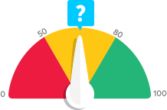
What is your Business Credit Score?

Slide 2
Business Credit
Business credit is credit in a business’s name
It is not tied to the owner’s creditworthiness
Instead, business credit scores depend on how well a company can pay its bills
Consumer and business credit scores can vary dramatically

Slide 3
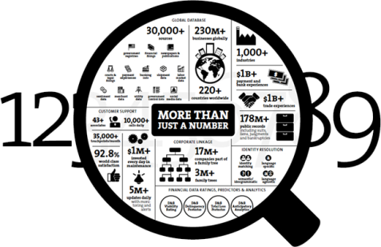
Dun & Bradstreet’s System
Any business wanting a business credit score needs a D-U-N-S number
This is the number by which D&B identifies your company and gets it into their system
No D-U-N-S number?
Then there can be no record at D&B

Slide 4
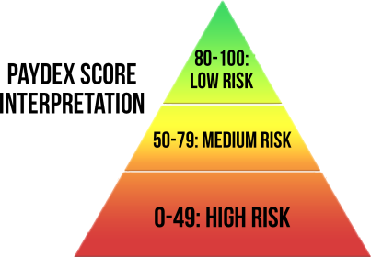
Dun & Bradstreet
Their main score is PAYDEX
But a business will not get a PAYDEX score …
… unless it has at least three trade lines reporting
Plus they must have a D-U-N-S number
A business must have BOTH to get a score or a report from D&B

Slide 5
The D&B Rating
The Rating
The rating contains a Financial Strength Indicator
It is calculated using either the Net Worth or Issued Capital of a company
If both figures are available, then Net Worth will always be used
D&B will show if a business is new or if they never got this information
It also adds a Condition Code or Risk Indicator
This measures the amount of risk the creditor can expect, by taking into account key items in a D&B Business Information report which are used to predict the likelihood of a business failure
A company gets the lowest rating (5) if no information is provided

Slide 6
D&B Rating
By definition, a startup company is considered to be high risk …
… because they have no commercial credit score
Your stellar personal credit doesn’t matter here …
… D&B is just trying to figure out if your company can pay its bills
Because D&B doesn’t know that for sure …
… they err on the side of caution

Slide 7
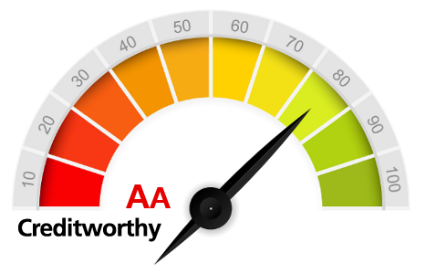
D&B Rating
D&B provides their own rating. It is based on:
information in your company’s interim or fiscal balance sheet
an overall evaluation of your firm’s creditworthiness
The scale goes from 5A to HH; these Rating Classifications show your company size based on worth or equity as computed by Dun & Bradstreet
They assign such a rating only if your company has supplied a current financial statement
If your company is brand new, it probably doesn’t have a financial statement at all

Slide 8
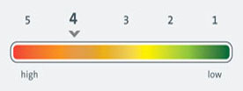
Dun & Bradstreet
The D&B delinquency predictor is meant to show just how likely your company is to be late in paying your debts
This takes historical information to try to predict future outcomes
D&B considers objective and statistically derived data, rather than subjective and intuitive judgments
They use a scoring system to rank and order accounts based on the probability of late payments
However, Predictive Scoring only represents a statistical probability, and not a guarantee
But a new company has no historical information BY DEFINITION

Slide 9
Experian and Equifax
They aren’t going to generate a business credit score for a company …
… until there are some payment experiences
New companies have few, if any, payment experiences
Hence these scores are virtually nonexistent
And you have no known payment history, either
This can make creditors nervous

Slide 10
Experian and Equifax
Unlike D&B, they WILL create a report for a business …
… even if that business has no trade lines reporting
All they want is a business name and address …
… and an SIC code
Those are called business demographics

Slide 11
Experian and Equifax
If Experian and Equifax have your basic business demographics …
… they will populate a report …
… but don’t expect it to have a good score …
… because they will consider a company with no trade lines reporting to be risky BY DEFINITION

Slide 12
Experian
A business with no credit history …
… will have an Intelliscore Plus of medium or even high risk
The Financial Stability Risk will be medium or high risk
The Active Business Indicator will flag a company as being inactive
Such a company will only be approved for – maybe – $1,000 in business credit

Slide 13
Equifax
Equifax will break down why they see a business as being risky
They will not have a 24 month history for a new company …
… or any age to ascribe to its trade lines
But on the positive side, you probably have no inquiries …
… or liens, collections, or bankruptcies

Slide 14
Payment History Matters
How well does your company pay its outstanding invoices?
Are you late, or early, or are you on time?
Do you pay your invoices in part, or in full?
How has your business’s payment performance changed over time?

Slide 15
Payment History Matters
Credit reporting agencies will generally look at the previous 12 months
They will consider your payment trends …
So are you showing continuing payment failures …
… or are you improving?

Slide 16
How can you build a business credit score from scratch?
All is not lost!
Even new companies with no credit scores can build business credit
Following the correct order makes a difference and saves time
It also prevents frustration – the order matters in terms of your likelihood of being approved

Slide 17
Building business credit from scratch
Developing a good payment history is critical
Start with small starter vendors (trade lines)
These trade lines often provide Net 30 terms
You are far less likely to be turned down
They often do not pull your credit reports at all

Slide 18
Secured Credit with Collateral
This is financing obtained with some form of collateral
Creditors like collateral because it gives them some form of security …
… if your company cannot pay its invoices …
… or it goes bankrupt

Slide 19
Secured Credit with Collateral
If your business has no sales yet, you can still have collateral
Collateral can also be:
Stocks or bonds owned by the borrower
A 401(k) account or IRA
It can even be a guarantor’s 401(k) or IRA

Slide 20
Building Payment Experiences
The Holy Grail is to develop payment experiences for your new business
This means using your credit or financing
It means paying everything back …
… on time, and in full
EVERY SINGLE TIME

Slide 21
Building Payment Experiences
These matter the most if a creditor reports to the CRAs
But even nonreporting creditors can help …
… if you ask for a trade reference
Good payment experiences will help raise your score EVERY TIME

Slide 22
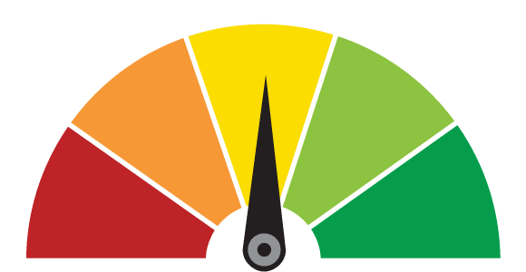
Recap for What is your Business Credit Score to Start?
Get a D-U-N-S number and get into D&B’s system
Expect your early scores to be abysmal
CRAs can’t calculate much so they err on the side of caution
Payment history matters
You can build business credit from scratch
Your mission is to build payment experiences

