Slide 1
SCAMPER : Put to Other Use
Select one topic from the Business Canvas
Identify current status
Identify potential for better – newer utilization / where is there a scope for that topic
Exercise : 15 min. Generate as many ideas as possible using this tool - Share your top 2 ideas

Slide 2
Your Company’s Business Canvas is your Prototype

Slide 3
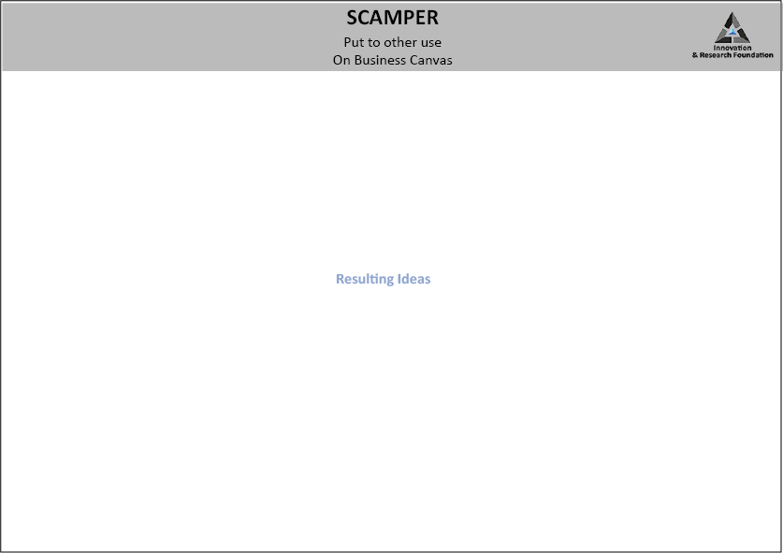
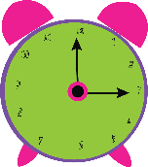
30 mins

Slide 4
SCAMPER
Try each one quickly on the problem statement
S = Substitute?
: Can I substitute something?
C = Combine?
: Can I combine it with something else?
A = Adapt? : Can I adapt something to your subject?
M = Magnify? Modify? : Can I magnify or add to it?, Can I
modify or change it in some fashion?
P = Put to other uses? : Can I put it to some other use?
E = Eliminate? : Can I eliminate something from it?
R = Rearrange? Reverse? : Can I rearrange it?, What happens
when I reverse it?

Slide 5
30 mins

Slide 6
SCAMPER
On Business Canvas
Lets take Revenue Stream e.g.
Restaurant puts to other use its mainstream revenue stream
Today : Limited to Location i.e. serving customer at location
The Example of ideas generated can be, Online
Parties Take away
Institutional contacts
Utilizing potential Underutilized

Slide 7
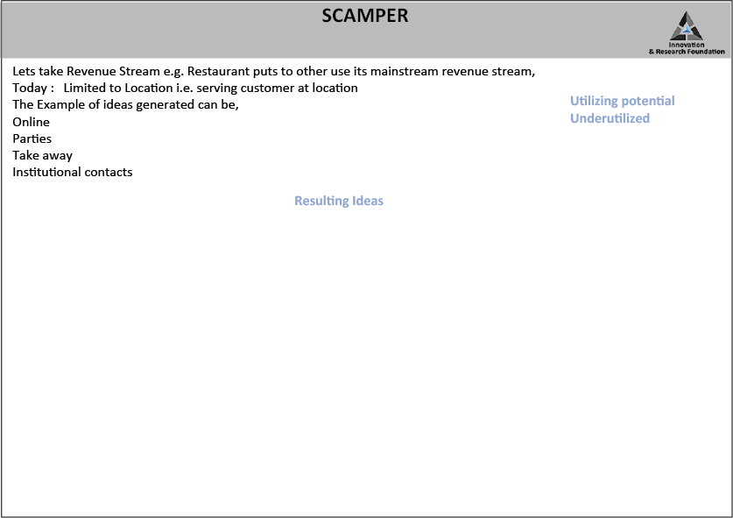
30 mins

Slide 8
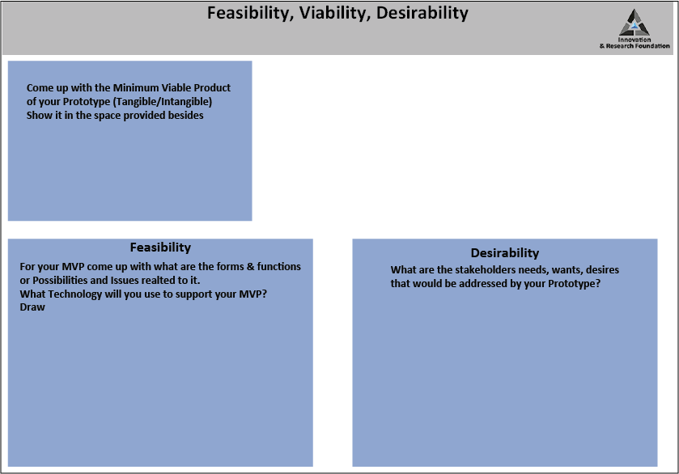
30 mins

