Slide 2
Clinical Services & Quality Management
August, 2020
DBH Effective Documentation
for Dietitians
ED Division

Slide 3
Overview and Objectives:
Overview of Training:
Review the purpose of Documentation and Medical Records
Documentation Do’s and Don’ts
Examples of documentation requirements for your role
Objectives of good clinical documentation practices:
Uphold Discovery’s commitment to patient and family-centered care and best practices
Achieve accuracy, reliability, validity and timeliness
Provide evidence that services were provided
Meet and exceed regulatory, accreditation and payer expectations
Reduce risk and exposure
Demonstrate compliance with quality and safety guidelines

Slide 4
Purpose: Documentation and Medical Records
Medical/Clinical Records are:
Legal documents
Evidence of services provided by staff within the scope of practice of the individual delivering service
Substantiation of medical necessity and appropriate level of care
Data that relates to the clinical goals and/or links to Disordered Eating (e.g., Problem)
Communication with outside readers (e.g., providers, payors, court of law, etc.)
Medical records and documentation include the entire clinical record, including, shift notes, group notes, rounds, suicide assessments and safety plans

Slide 5
Documentation Do’s:
Document in a professional and clear manner
e.g.: “Patient completed group and remained social with staff and peers throughout the shift as evidenced by maintaining eye contact, reporting positive mood and remaining out of room during recreation time.”
Document in a nonjudgmental and objective manner
e.g.: “Patient appeared engaged in session as evidenced by maintaining eye contact, discussion of skills learned during the week and use of technician support during moments of distress.”
Proofread before signing!
Be mindful of, Your vs You’re and Their vs They’re
Use complete sentences
Check spelling

Slide 6
Documentation Do’s:
The use of abbreviations in clinical documentation must be consistent with Discovery Behavioral Health’s Abbreviation Use and Elimination Policy (IM-002).
e.g.: “This writer spoke to patient’s boyfriend (bf) on the phone regarding her recent verbal altercation with staff. Bf shared with writer an incident from weekend.”
Signatures:
Staff without a license or discipline must include a job title:
(e.g., Sandy Stone, Counselor)
Clinical staff must include a license or designation:
(e.g., Peter Roberts, Diet Tech, #12345 (CA), or Peter Roberts, Registered Dietitian #12345 (CA), Primary Therapist)
Annotation:
Use as an addendum when a form is closed (e.g., clarification, late entry, error).
e.g.: Session note was performed and completed at time dated above. Signature late due to Therapist entry error.
e.g..: Late entry for service provided on x/x/xx due to crisis in milieu that required writer’s attention..
Use as evidence of additional reviewer (e.g., Physician indicating they reviewed patient’s lab results. Physician can add annotation to document after it has been uploaded, stating, “Reviewed”.

Slide 7
Documentation Don’ts:
Don’t use judgmental or opinionated language
e.g.: “It seems like she doesn’t know how to listen or follow program guidelines.”
Don’t use jargon/subjective language/opinions of patient
e.g.: “Patient looked irritated, is OCD about her clothes and seems rude to everyone.”
Avoid labeling the patient that may negatively impact them if reviewing their chart.
e.g.: “Patient is a cutter and a purger.” (Alternative: “Patient reported purging and engaging in self-injurious behavior.”)
Don’t diagnose the patient, unless it is within your scope to do so
Don’t diagnose the patient, unless you have performed a comprehensive assessment, and determined the patient meets full criteria for the diagnosis. Supporting documentation must be included in the medical record. Use Rule Outs and/or Provisional Diagnoses, when necessary,
e.g.: Posttraumatic Stress Disorder (provisional), Rule out: Posttraumatic Stress Disorder
According to the Centers for Medicare Services’ Evaluation and Management Services Guide: For a presenting problem without an established diagnosis, the assessment or clinical impression may be stated in the form of differential diagnoses or as a “possible,” “probable,” or “rule out” diagnosis. DSM-5 provides “provisional” when the clinician thinks a particular disorder is present but realizes more information is required to be confident of a specific diagnosis.

Slide 8
Documentation Don’ts:
Don’t copy and paste into patient’s record- Each note needs to be specific to the service provided
Payors have identified this as “cloning” and are prepared to reject claims with cloned documentation
Don’t write another patient’s name in the chart
If another patient must be identified, use initials. Avoid names of family and friends, rather, refer to the relationship (e.g., mother, friend)
Don’t use Annotations for weekly follow up documentation
Don’t assume the medical record is complete if critical records are in a separate medical record (e.g., PHP vs IOP). Each medical record # is a separate episode of care and must include all relevant records

Slide 9
Group Notes: (1 of 5)
Group Description: Include objective of group and interventions performed
Individual Assessment/Intervention:
Must be individualized and demonstrate quality (e.g., not copied and pasted /cloned)
Individual goals are strongly encouraged (e.g.: “Patient's goal is to practice assertiveness in interpersonal relationship this weekend during visiting hours and report experience in next week's group.”)
Include patient reports (e.g., urges/cravings, rating of mood)
Observations of mental and physical status:
Appearance (e.g., level of engagement with staff and peers, grooming, attitude: cooperative, uncooperative)
Behavior (e.g., eye contact: poor, good; psychomotor activity: handwringing; coping skills employed)
Presentation of mood (e.g., sad, angry, elated; self-report congruent or incongruent with observations)
Speech pattern (e.g., rate: increased/decreased, volume: loud, soft)
Behavior (e.g., agitation, impulsivity, violence, self-injurious behaviors)
Every effort should be made to complete notes on the same day as the session!
Refer to division specific policies for specific timeframes.

Slide 10
Group Notes: Details (2 of 5)
OP & RTC:
For patients that miss a group, during the course of a scheduled treatment day, please “uncheck” them from the group attendance.
Explain their absence, and ensure there is documentation that matches.

Slide 11
Group Notes: Details (3 of 5)
Outpatient:
For patients that miss an entire treatment day, (excused or unexcused), or are not scheduled for the programming day, you will remove them from Group Roster or you will not add them to the Roster. Unexcused absences can be explained via an Absence Note.
(This will allow for more accurate billing)
Absence Note

Slide 12
Group Notes: Details (4 of 5)
Golden Thread function:
Use the Golden Thread feature to identify which Problem, Objective, and intervention is being addressed in the group (it can be one Problem, or it can be all) - whichever is accurate, I.e., do not click all Problems, if you only addressed the Problems for “Disordered Eating” and “Malnutrition”.

Slide 13
Group Notes: Content (5 of 5)
Requires Improvement Individual Assessment is generic, does not include any subjective data on patient and does not reference Problem and/or Group Topic. Improper use of abbreviations.
Good Individual Assessment provides brief mental status, observation of patient’s behavior, and how the patient responded to activity and eventually stabilized.. Missing: Identification of Problem that is being addressed and/or how it relates to Group Topic. Improper use of abbreviations.
Excellent Individual Assessment provides brief mental status, observation of patient’s behavior, patient quote, and connects back to Eating Disorder Problem and/or Group Topic. Proper use of abbreviations.

Slide 14
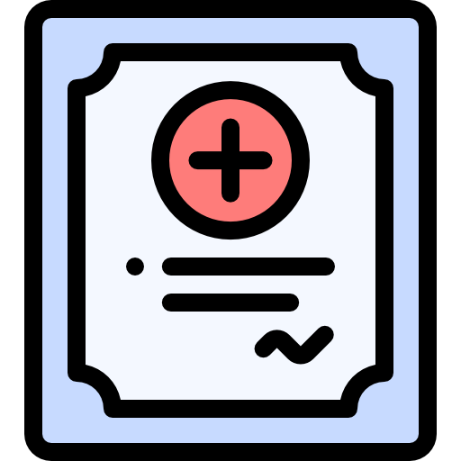
Treatment Planning: Identification of Problem List (1 of 2)
Related assessments reviewed for data:
( e.g., H&P, Biopsychosocial, Nursing Assessment, collateral records, etc.)
Initial Dietary
Assessment
The Problem List
(built collaboratively between therapist and dietitian)

Slide 15
Treatment Planning: Identification of Problem List (2 of 2)
The Problem List
Defer
Not a current focus of treatment, a/o requires further assessment
EMR will not generate a TP
Refer
Out of scope, a/o requires specialist
Treat
Active Treatment Plan
In collaboration with the therapist, the Dietitian is responsible for adding one Problem to the Problem list
One Dietary Treatment Plan should be created based on the one dietary Problem
The Problem list and Diagnoses should match
Example: If patient has a Problem identified for Disordered Eating, then there should be a diagnosis, or a “rule out” diagnosis” for Eating Disorder
The Problem list includes information collected from all assessments and patient concerns (e.g., “Problems”) that have been identified
The Problem list and treatment plan(s) should be developed based on a multidisciplinary assessment and “may include, diagnoses, medical conditions, functional limitations, living environment, and/or symptoms” (AHIMA, 2020).

Slide 16
Treatment Planning: Requirements at a glance
Signatures:
Signatures must be captured within 72 hours of admission
(patient, guarantor (if minor), dietitian)
Signatures on Treatment Plans is best practice! (Reserve Attestations for when patients and/or guarantor are unavailable)
Needs Assessment:
Treatment plans must include language from the Needs, Strengths, Preferences, Goals (NSPG) section of Patient BPS (Check for dietary Goals and/or Needs)
Goals:
Include at least one goal stated in the patient’s words for each Problem
Highly recommend to also include the Clinical Interpretation of the goal
Statuses and Status Updates:
Initial Status must be added to each intervention when the Treatment Plan (TP) is created. This allows for you to enter a Target Date for each intervention
Patient can sign the TP and TP Statuses at the same time when the TP is created (Golden List Thread View)
Status Updates are required 30 days from admission date and every two weeks thereafter
Client must sign at each Status Update. Guarantors must show evidence of review by signing a Family Attestation Form
Status Updates allow you to update the Target Date, enter commentary on patient’s progress, and change the Status from the drop down menu (if applicable)

Slide 17
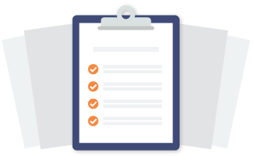
Treatment Planning: Clinical Information Reviewed (1 of 2)
Clinical information reviewed to formulate treatment plan
Prior to checking off an item below, it is your responsibility to ensure the information is accurate!
Ideally, all available assessments and evaluations are reviewed prior to the creation of the Treatment Plan. However, all assessments and evaluations do not need to be incorporated into each Treatment Plan.
Examples:
Do not check off “History and Physical”, if there is no History and Physical in the chart.
The below example makes sense for an ANXIETY Treatment Plan, but would not make much as much sense for a Malnutrition Treatment Plan.

Slide 18
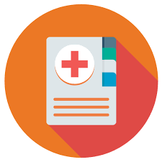
Treatment Planning: Clinical Information Reviewed (2 of 2)
The below example makes sense for a MALNUTRITION Treatment Plan, but would not make as much sense for a Family Conflicts/Social Support
Involvement Treatment Plan.
The below example makes sense for a DISORDERED EATING Treatment Plan, but would not make much sense for a Substance Misuse Treatment Plan.

Slide 19
Progress Notes: (1 of 2)
Reminders!
Use the Golden Thread to identify which Problems, Objectives, and Interventions were addressed in a specific session (Remember, you only want to check off the ones that were addressed in the session!)
Make sure the times do not overlap with other sessions (patients can’t be two places at once).
For conjoint sessions, only one clinician should document a note. Eg., if a therapist and dietitian hold a conjoint session with a mutual patient, only one clinician is to write a note and can document that the dietitian was present, under “additional attendees”. Duplicate notes can be viewed as “double billing”. Using this example, the dietitian can write a “contact note”, indicating the conjoint session (non-billable) by emphasizing the coordination of care.
If patient is on a 1:1 observation, and accompanied by another staff member during session, please document that.

Slide 20
Progress Notes: (2 of 2)
Tips for Telehealth!
Make sure to identify Telehealth sessions appropriately!
Here are a few scenarios to help:
Dietitian and patient are physically present in dietitian’s Discovery Behavioral Health company office and patient’s family “zooms in” for a session, due to being outside the geographic area of the treatment center = Family Support System Dietary Session Progress Note
Dietitian is in their Discovery Behavioral Health company office and receives a call that their patient is feeling symptomatic and is unable to make it to session, but is requesting a virtual session (from home if outpatient, from room if residential) = Telehealth
Both Dietitian and patient are in their respective homes, due to a “stay-at-home” order and are meeting virtually via Zoom = Telehealth

Slide 21
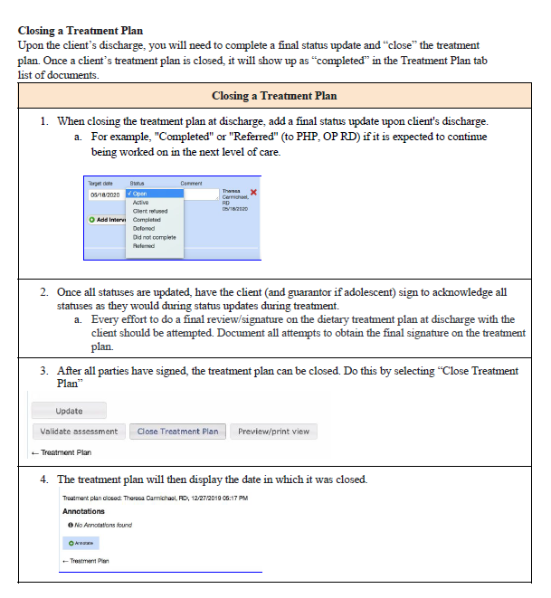
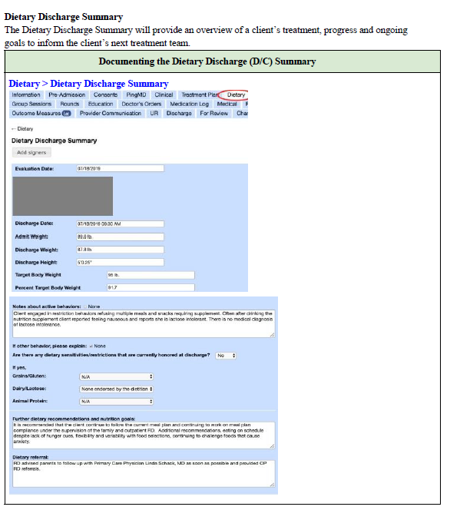
Discharge Planning:

Slide 22
Suicide Prevention Protocols and Policy:
“Asking people about their thoughts and behaviors to assess their risk for suicide is the first, critical step in suicide prevention.”
(The Columbia Lighthouse Project, 2020)
Suicide Screen, Suicide Assessment, Suicide Reassessment and Safety Plan:
Familiarize yourself with the Suicide Assessment Policy and flowchart
All staff are trained to perform the Suicide Screen, Assessment & Reassessment
When clinical staff is available, (e.g., onsite), you are the initial point of contact for staff. When clinical staff is unavailable, (e.g., offsite), reassure staff that they can seek direction and support from their supervisor and/or on-call clinician
Patients identified as moderate and high risk level will require increased observations, suicide reassessment and safety planning
For patients identified as high risk, you will communicate with the entire team by creating and documenting an Urgent Issue in the EMR
According to the Columbia Lighthouse Project, “Anyone, anywhere, can do that with the questions provided in the Columbia Protocol, also known as the Columbia-Suicide Severity Rating Scale (C-SSRS)”

Slide 23
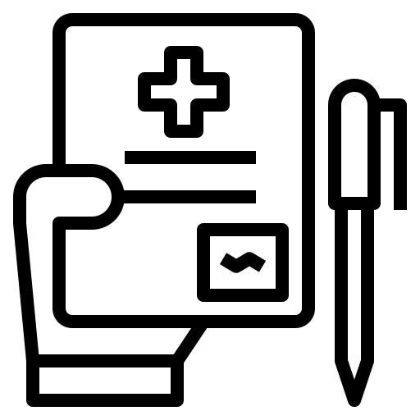
Suicide Prevention Protocols and Policy:
Responding to Suicidal Behavior: If a patient reports suicidal thinking or behavior or information is obtained through collateral sources (e.g., a family member), you will want to:
Complete a Suicide Reassessment (e.g., Frequent Screener) with the patient and determine risk level based on patient’s answers and key provided in the Suicide Reassessment.
Complete the Safety Plan included in the Suicide Reassessment
⋆ If the Suicide Assessment or Reassessment determines patient is a high risk level, and/or you have concerns about the patient's safety, and patient refuses to formulate a safety plan, ensure patient is placed on one-to-one staff observation and contact your supervisor for further direction
Document, document, document!

Slide 24
Thank you
for your time!

