Slide 1
Needs vs. Wants

Slide 2
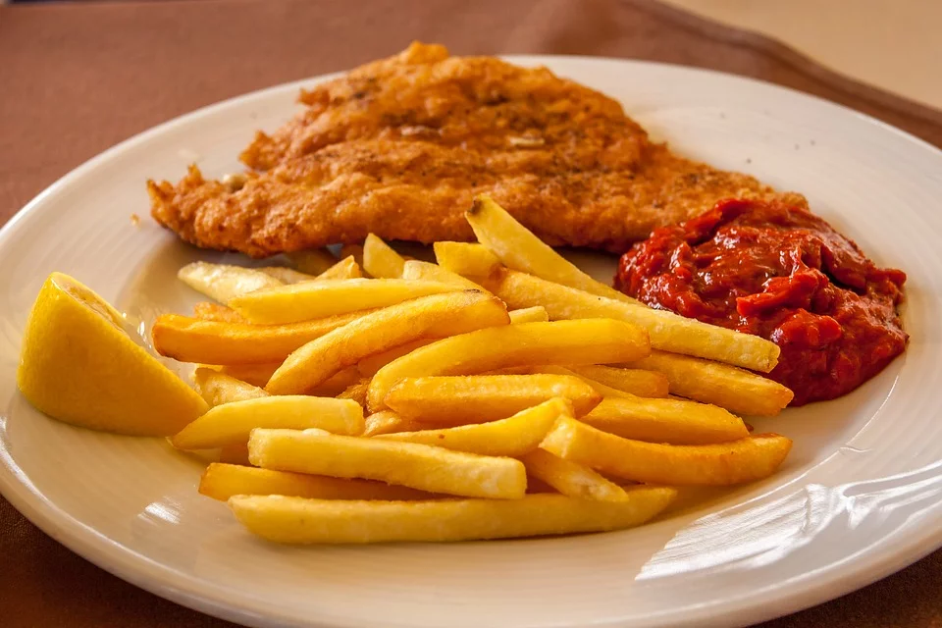
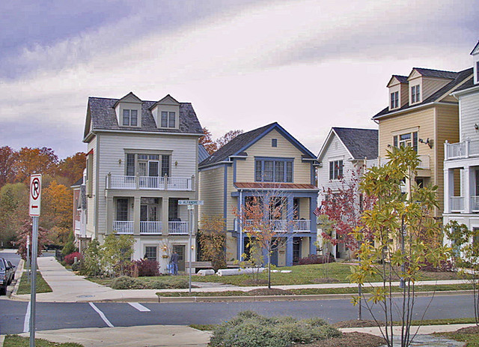
Needs- things we must have to survive.

Slide 3
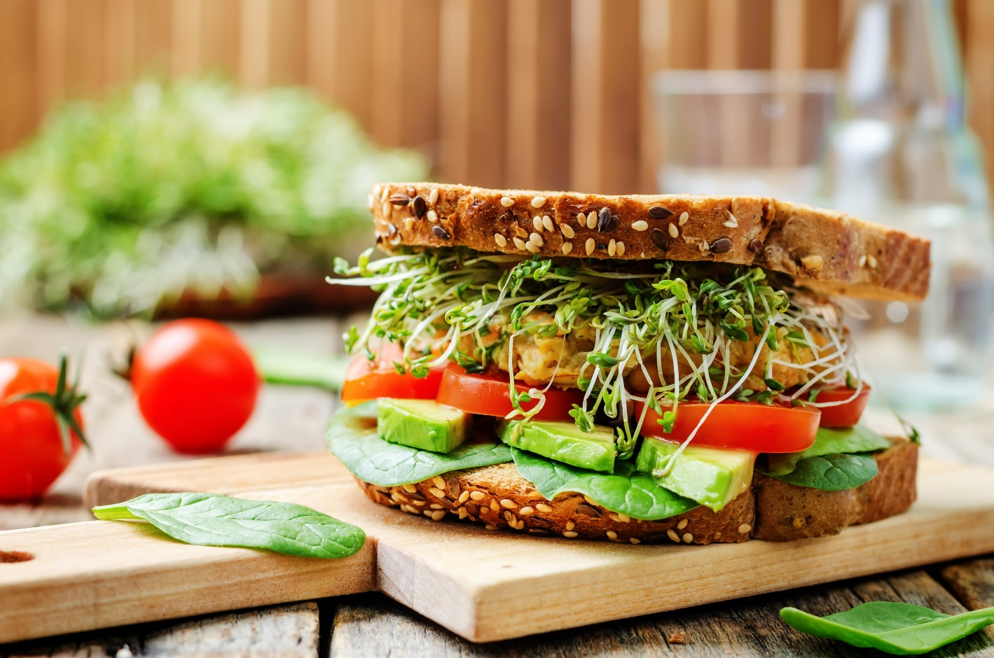
We NEED food.

Slide 4
We NEED water.

Slide 5
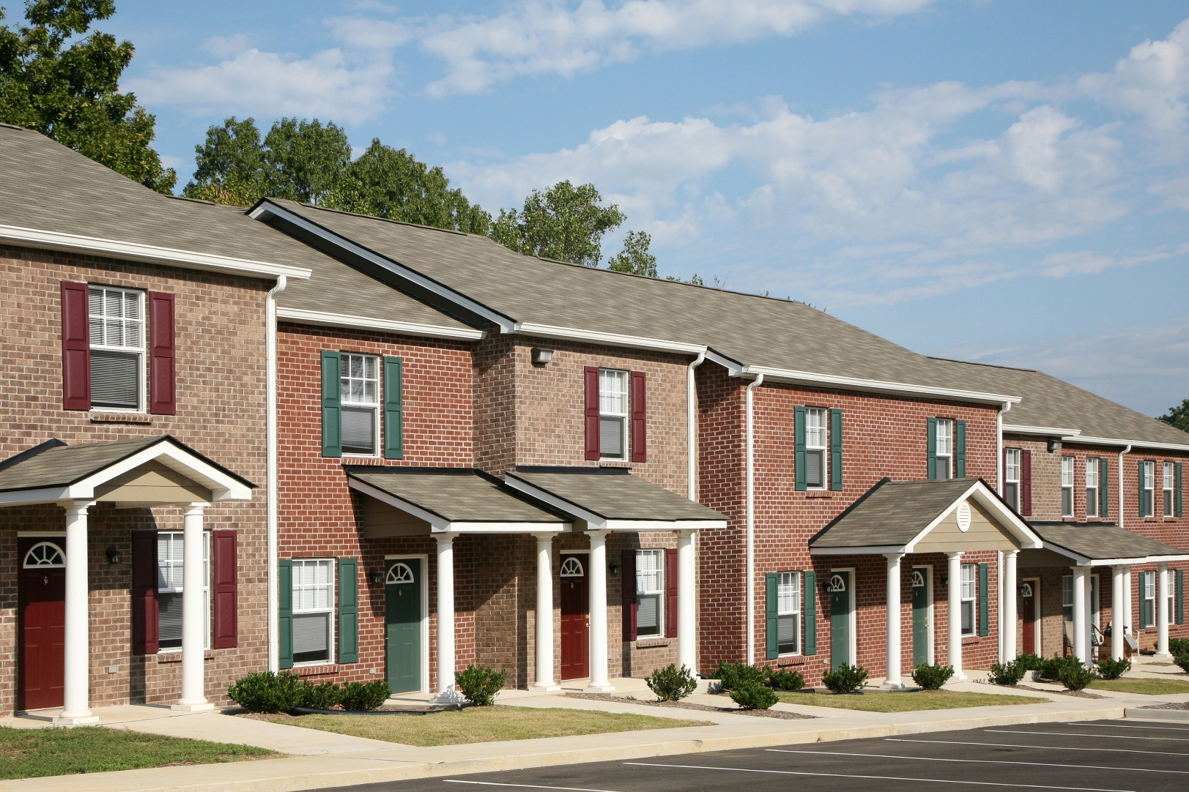
We NEED shelter.

Slide 6
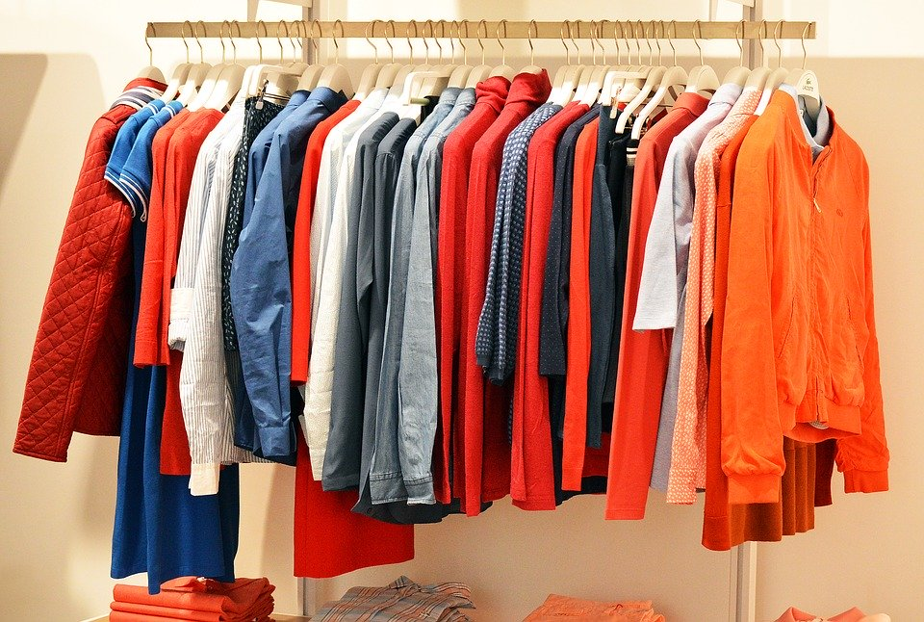
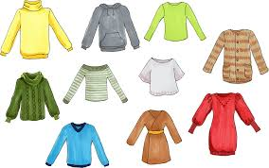
We NEED clothes.

Slide 7
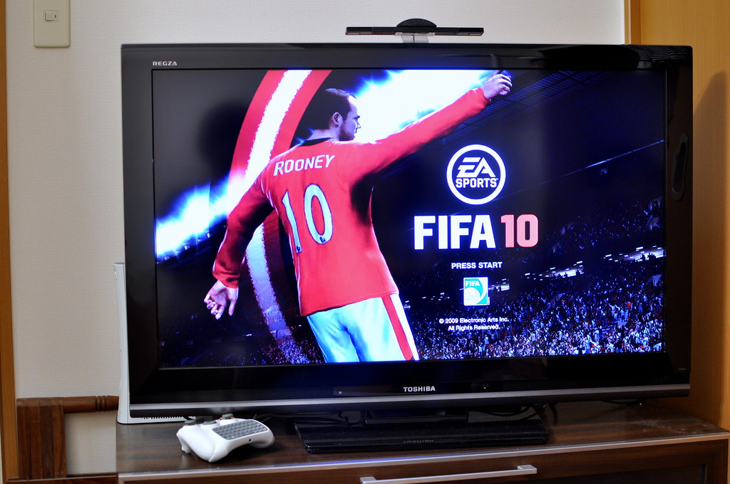
Wants- things we would like to have, but do not need.

Slide 8
We WANT to have smart phones.

Slide 9
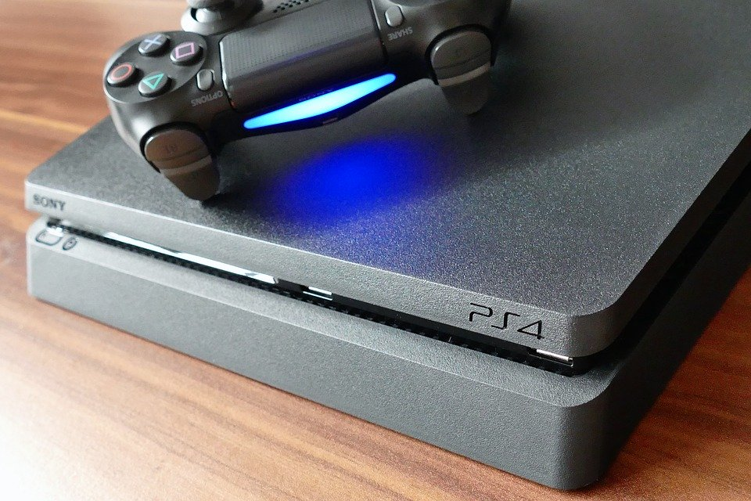
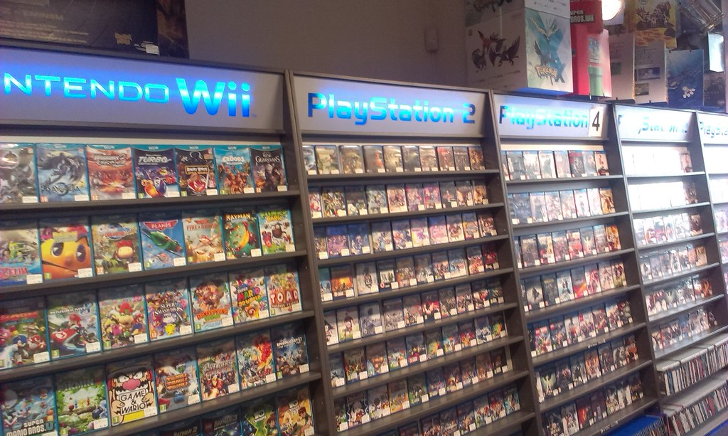
We WANT to buy that new video game.

Slide 10
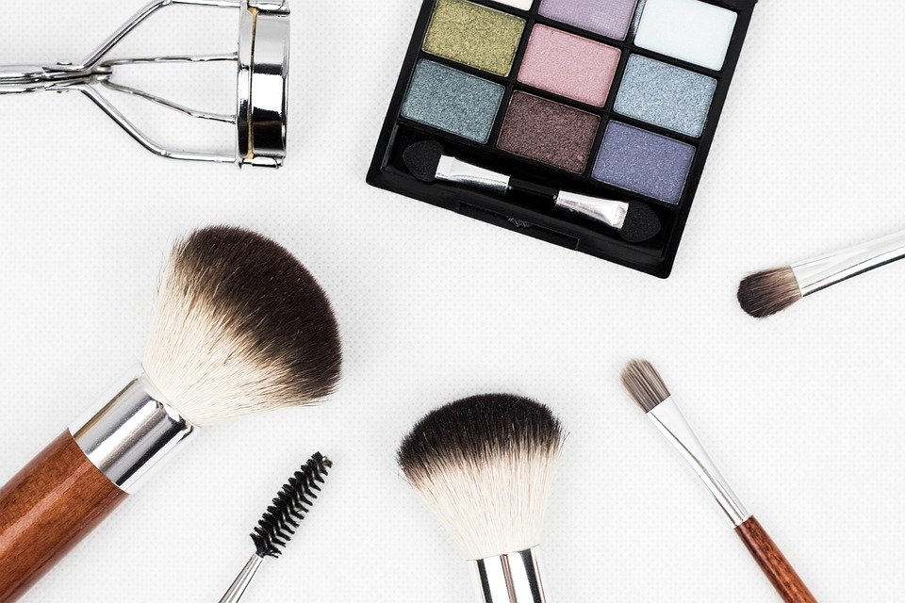
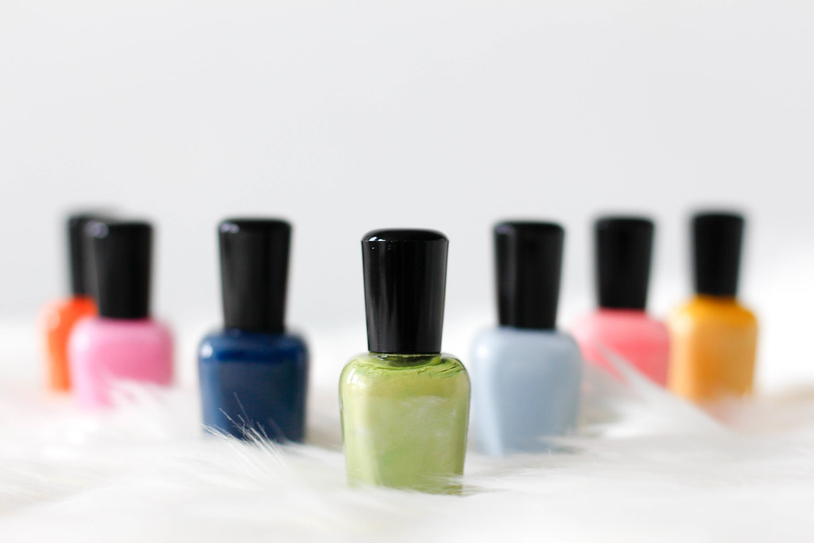
We WANT to buy make up and nail polish.

Slide 11
Sometimes many WANTS seem like NEEDS… but they are not.

Slide 12
Can you think of things that you NEED to survive?

Slide 13
Can you think of some things that you WANT, but do not need?

Slide 14
WANT or NEED?

Slide 15
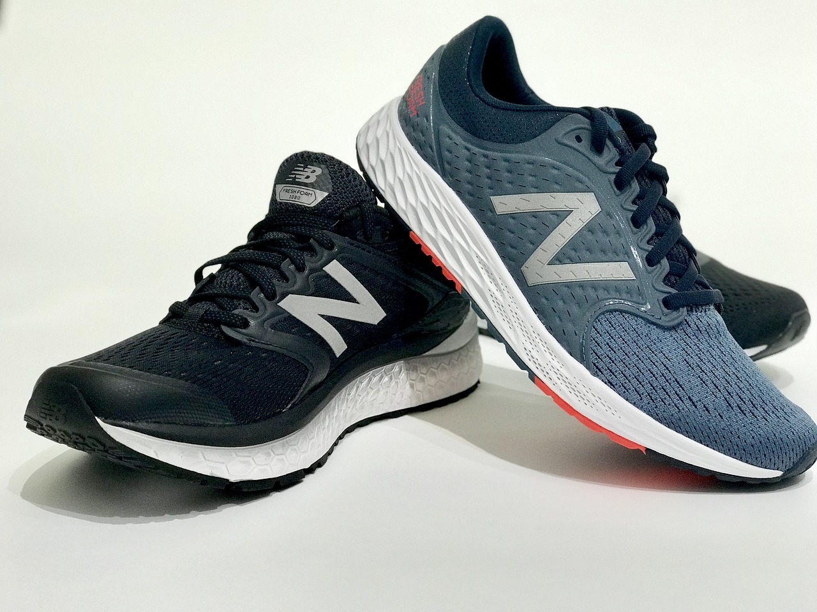
WANT or NEED?

Slide 16
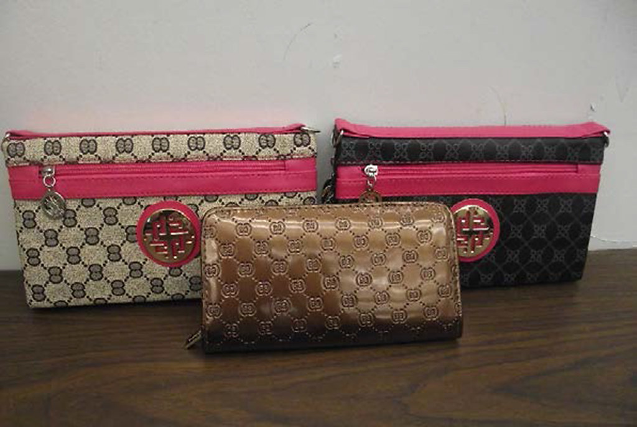
WANT or NEED?

Slide 17
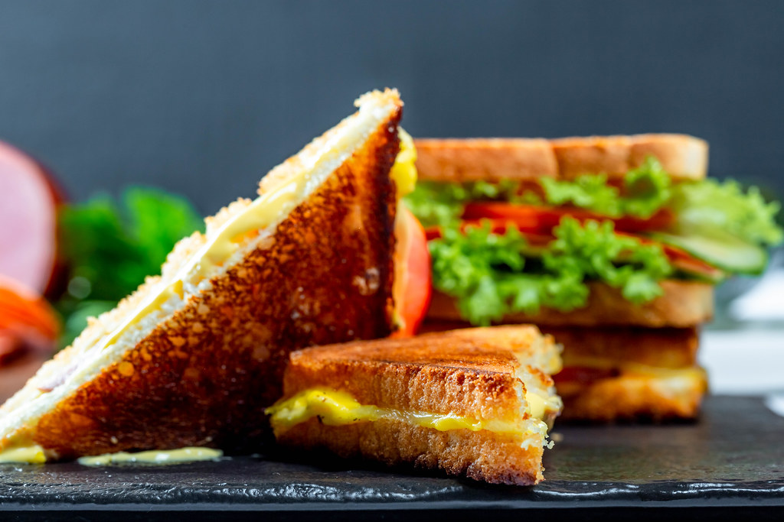
WANT or NEED?

Slide 18
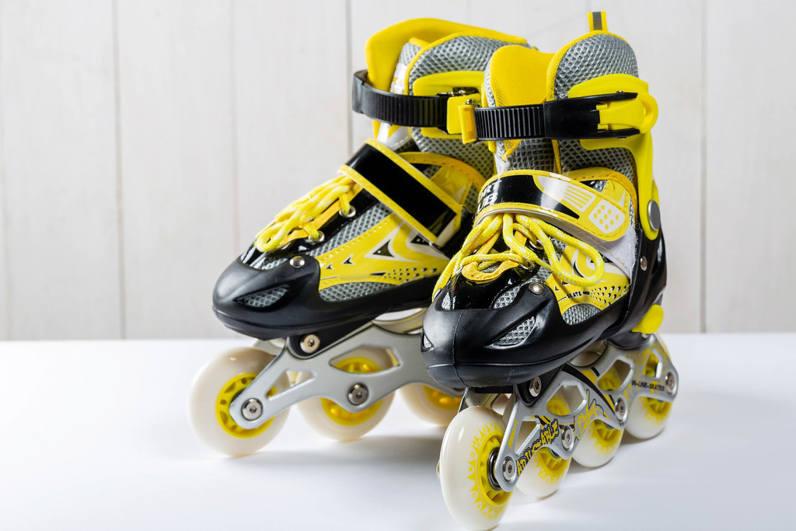
WANT or NEED?

Slide 19
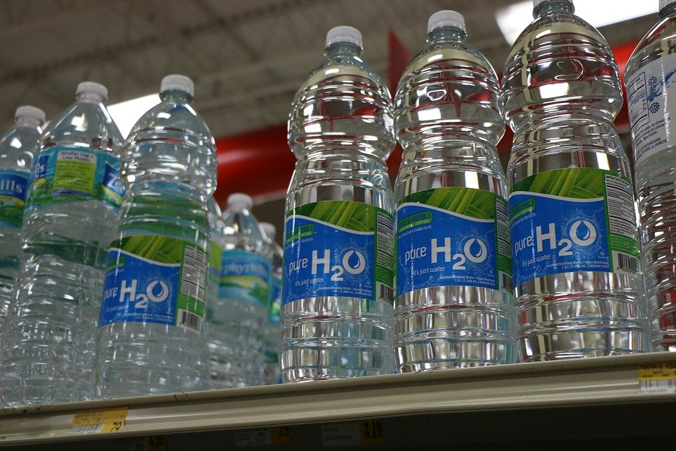
WANT or NEED?

Slide 20
WANT or NEED?

Slide 21
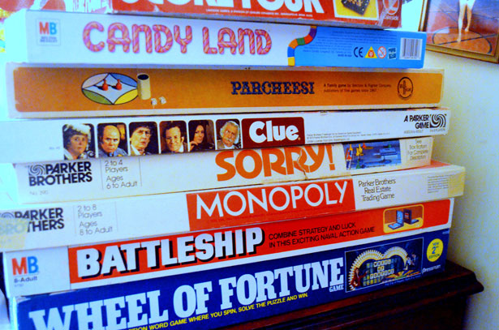
WANT or NEED?

Slide 22
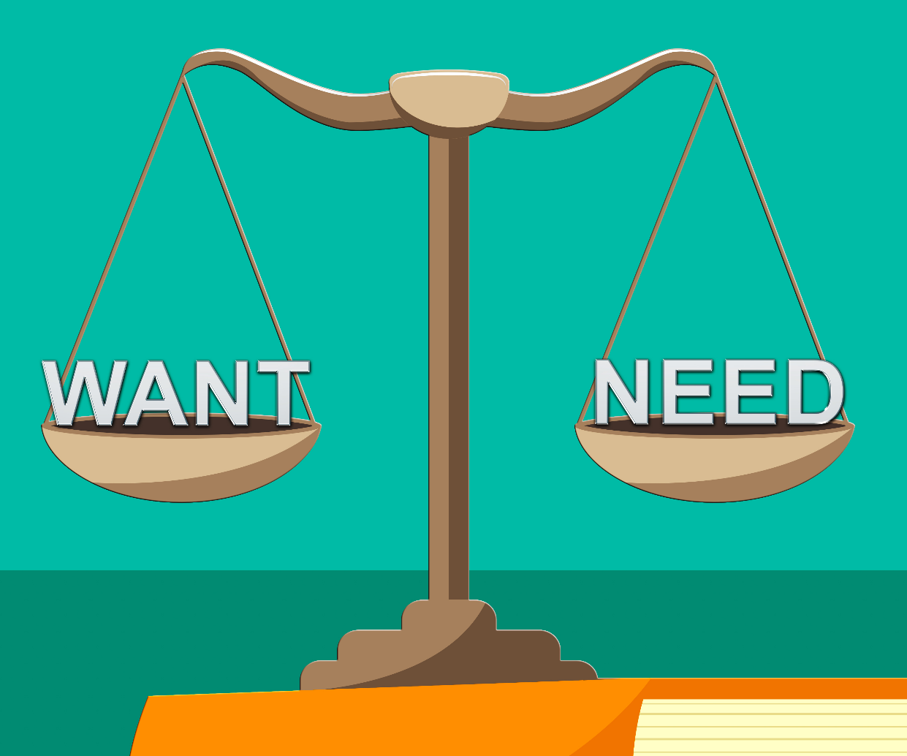
Review: What are wants vs. needs?

