Slide 1
Journey Mapping Design Tool
Tracing the journey of a customer as they experience a product or journey.

Slide 2
Creating a Journey Map
A journey map, allows you to visualize a process beginning to end. This simple framework will help you to more easily imagine the entire flow of an experience, whether it’s how a service may work or all the touch points of a customer’s journey with a product. This doesn’t need to be an in-depth, detailed representation, but rather a quick-and- dirty way of thinking out how a process unfolds.
A Customer Journey map could be interpretation of the overall story from an individual’s perspective of their relationship with an organization, service, product or brand, over time and across channels.
Step 1 : Touch Points
Step 2 : Sequence
Step 3 : Emotional Journey over time

Slide 3
LINDA’S JOURNEY MAP Browse information or learn more on a general topic

Slide 4
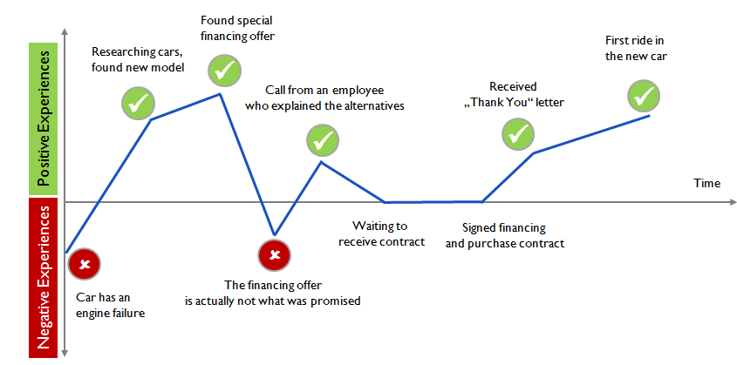
CUSTOMER JOURNEY EXAMPLE : CAR PURCHASE

Slide 5
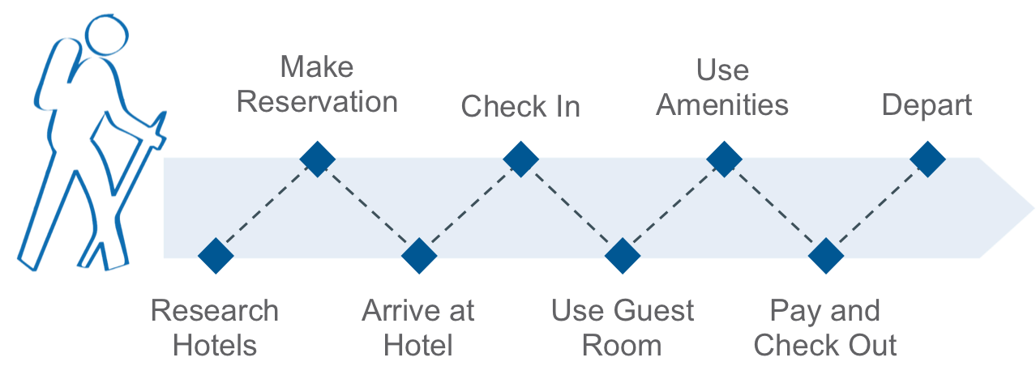
A Customer Journey map is a visual or graphic interpretation of the overall story from an individual’s perspective of their relationship with an organization, service, product or brand, over time and across channels.

Slide 6
CUSTOMER JOURNEY MAP

Slide 7
CUSTOMER JOURNEY MAP WITH EMPATHY

Slide 8
01
Cast aside your Biases, Listen and Observe
02
Listen to People’s Personal Stories
03
Contradictions between what People say and do
Let them relate their success and failures.
Stories encompass the implicit rules that governs and organize people’s lives and reveal what they find normal, acceptable and true.
They reveal moral codes, sources of pride, shames, shoulds and should-nots.
Let subjects tell their own story, and listen for the things that elicit emotions, cause them concern or frustration.
“If you want to find out what people really need, you have to forget about your problems and worry about their lives.” (Dale Carnegie)
Opportunities for innovation lie within the disconnect between action and words.

Slide 9
04
Watch for “Work Arounds”
05
Distinguish between Needs and Solutions
06
Look beyond the Obvious
Your research may seem so routine and familiar that you feel there is nothing new to be learned.
Boredom and frustration easily set in.
Stay alert!
The epiphanies and insights emerge from the nuances.
People make do and work around the shortcomings of products and situations.
In everyday life, we all come up with “work arounds”, clumsy or clever, that we usually are totally unaware of. You must take note.
Needs open up possibilities, solutions constrain them.
If you start with a solution then you may overlook the possibility of coming up wth an entirely new and revolutionary product or service.

