Slide 1
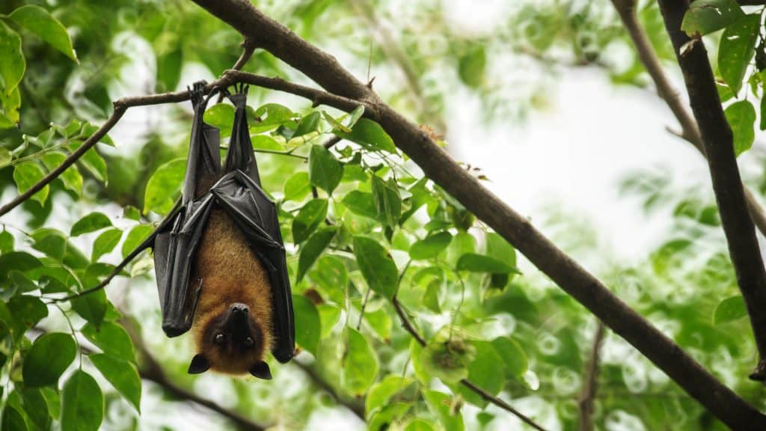
Animals in The Understory Layer
Bats

Slide 2
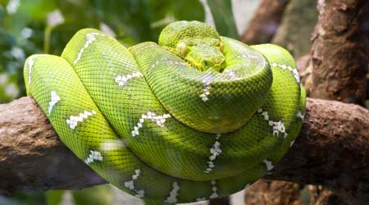
Boa Constrictor

Slide 3
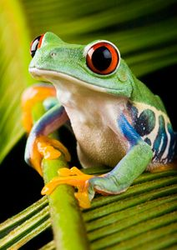
Frog

Slide 4
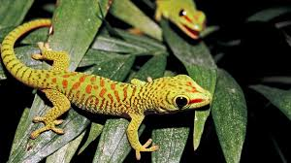
Lizard

Slide 5
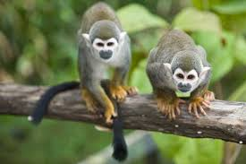
Monkeys

Slide 6
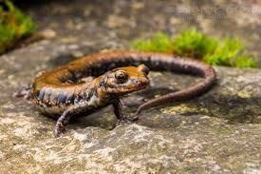
Salamander

Slide 7
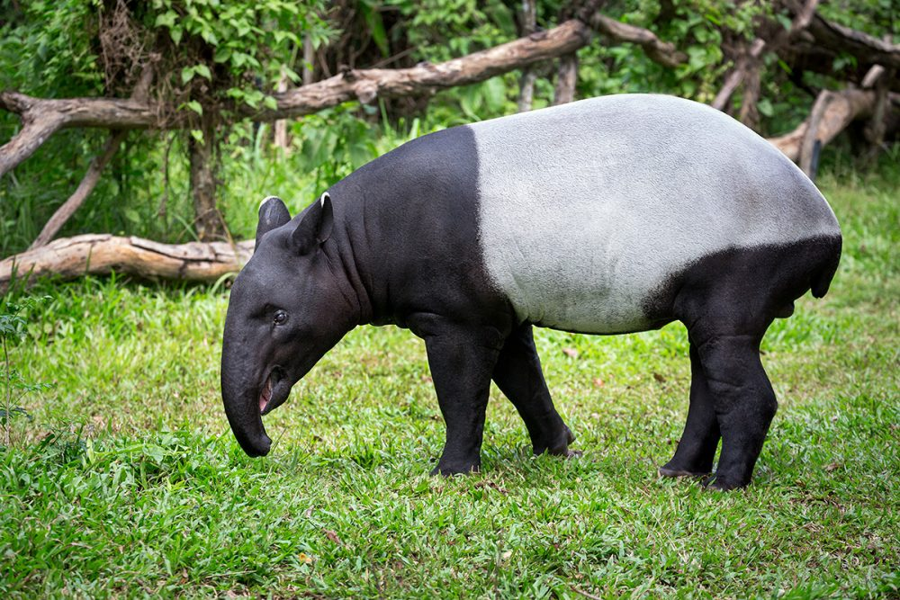
Tapir

Slide 8
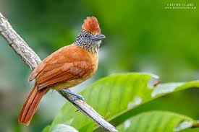
Ant Shrike

Slide 9
Plants in the Understory Layer
Orchid Flower

