Slide 1
Taking Charge of Your Finances 100%
MODULE THREE
Seeding The Most Profitable Investment

Slide 2

“The likeness of those who spend their wealth in the Way of Allah, is as the likeness of a grain (of corn); it grows seven ears, and each ear has a hundred grains. Allah gives manifold increase to whom He pleases. And Allah is All-Sufficient, All-Knower.” [Al-Baqarah 2:261]

Slide 3
Benefits of Charity In the Hereafter
Shades its giver from the intense heat then
Makes ones reckoning lighter
Makes one’s scale of good deeds lighter
Helps cross over the sirat
Elevates one’s grade in paradise
“Give sadaqah whether it is minor or major for there are ten good qualities in the sadaqah, five in this life and five in the Hereafter…”
Abu al Laith As Samarqandi

Slide 4
Benefits of Charity in this Life
Cleanses the Money
Cleanses the body from sins
Repels disasters and illnesses
Brings happiness to the poor
Brings blessings to the wealth and increase in provisions

Slide 5
Cleanses the Money
Allah’s Messenger (SAW) said
“Verily , selling entails unnecessary speech, vowing and lying. Therefore cleanse it with Sadaqah”

Slide 6
Cleanses the body from sins
“Take Sadaqah (charity) from their wealth in order to purify them and santify them with it”
Quran 9:103

Slide 7
Repels disasters and illnesses
“Heal your sick with Charity”
~Prophet Mohammed SAW

Slide 8
Brings happiness to the poor
The Best of acts are those that bring happiness to the righteous believers

Slide 9
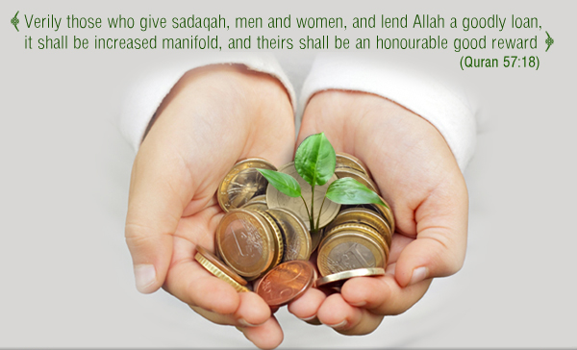
Brings blessings to the wealth and increase in provisions
“And whatsoever you spend of anything in Allah’s cause , He will replace it”
Quran 34:39

Slide 10
Qualities of the goodly loan
About the money itself :
It must be form pure money not from the dishonest or impure parts

Slide 11
Qualities of the goodly loan…
2. Between the spender and Allah:
Must be given with a good heart, without hesitation when giving it, seeking the good pleasure of Allah.

Slide 12
Qualities of the goodly loan
3 Between the spender and the taker:
It should not be followed with reminders about it or with any type of injury

Slide 13
Who?
Abu Hurayrah may Allaah be pleased with him said, "A man came to the Prophet , and said, 'O Messenger of Allah, I have a dinar.' He said, 'Spend it on yourself.' The man said, 'I have another (dinar).' He said, 'Spend it on your child.' The man said, 'I have another.' He said, 'Spend it on your wife/family.' The man said, 'I have another.' He said, 'Spend it on your servant.' The man said, 'I have another.' He said, 'You know better where to spend it.'"
[Al-Bayhaqi and Abu Ya‘la - Al-Albaani graded it hasan (good)]
The Prophet SAW said
“Charity given to the poor is Charity , while charity given to the relative is twofold: A Charity and a Silah (refering to keeping ties of kinship)”
(Al Bukhari, Muslim)

Slide 14
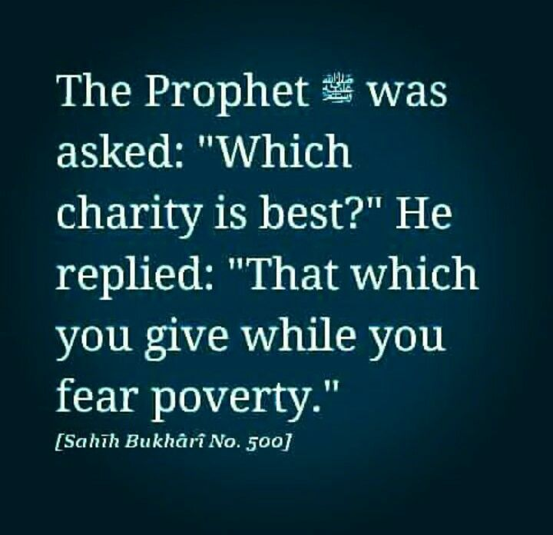
When?

Slide 15
What?
Give from the best of your wealth , not the old or the sick or the lame...
Give not only old and worn out clothing and personal effects; stale food items. Give new as well, fresh, gently used items and especially from what you love.

Slide 16
How?

Slide 17
Your Wealth Nursery….what will you plant?
Build(donate towards) a mosque
Support an orphan
Support a student of knowledge
Build a well (donate towards)
Gifting/Providing copies of the Quran for public use
…

Slide 18
End of
MODULE THREE
Seeding the Most Profitable Investment
QUESTIONS?
TAKEAWAYS?

