Slide 1
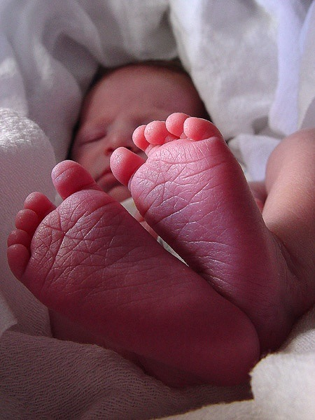
Introduction to Osteopathy in the Embryology
Field
The science of
motion in form

Slide 2
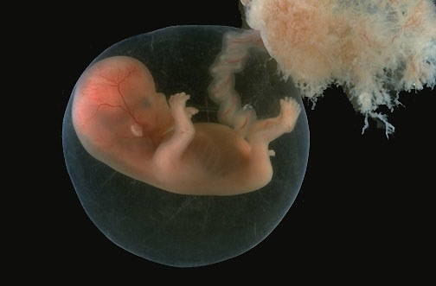

Slide 4
History of Embryology
1400 B.C. Indices of the description of development
350 BC Socrates describes some development
1827 discovery of first chromosomes
1910 First collections of embryos
1948 Stages of development described

Slide 5
History Continued
1970 First In vitro fertilization accomplished
1978 first successful in vitro birth
1973-4 Blechschmidt collections
2003 first mapping of genomes finding much more stuff (see article)

Slide 6
Currents in Thought
Preform (it just grew that way)
Epigenesis (growth but with differentiation)
Continuity (transitions)
Phylogenesis (creation of species)
Induction (one leads to another)
Germ Layers
Morphogenic fields

Slide 7
Evolution of form
Matter rises from a primordial chaos to transform into, by transitional levels, elements that become more and more complex (H. Reeves)
This organisation supposes the existence of an initial information.
Notes:
Voir lecture de Still sur la forme, la vie et le développement de la forme èa partir de mother earth.
Lire texte de nerve power.

Slide 8
Andrew Taylor Still
As a skilled Mechanic, imperfection in forms of all parts was a world that He did not comprehend, because His works never possessed a flaw nor fault in form… Harmony only dwells where obstructions do not exist… Remove all obstructions, and when it is intelligently done, Nature will kindly do the rest.

Slide 9
Anne Wales D.O.
the bones, ligaments and fascias of the body may be considered as an integrated system providing form, support and stability. Millenium Journal AOA 2000 reprinted from 1951

Slide 10
Gordon Zinc D.O.
We must evaluate the entire body as a structural and functional unit, reciprocally interrelated and inter influential. 1969

Slide 11
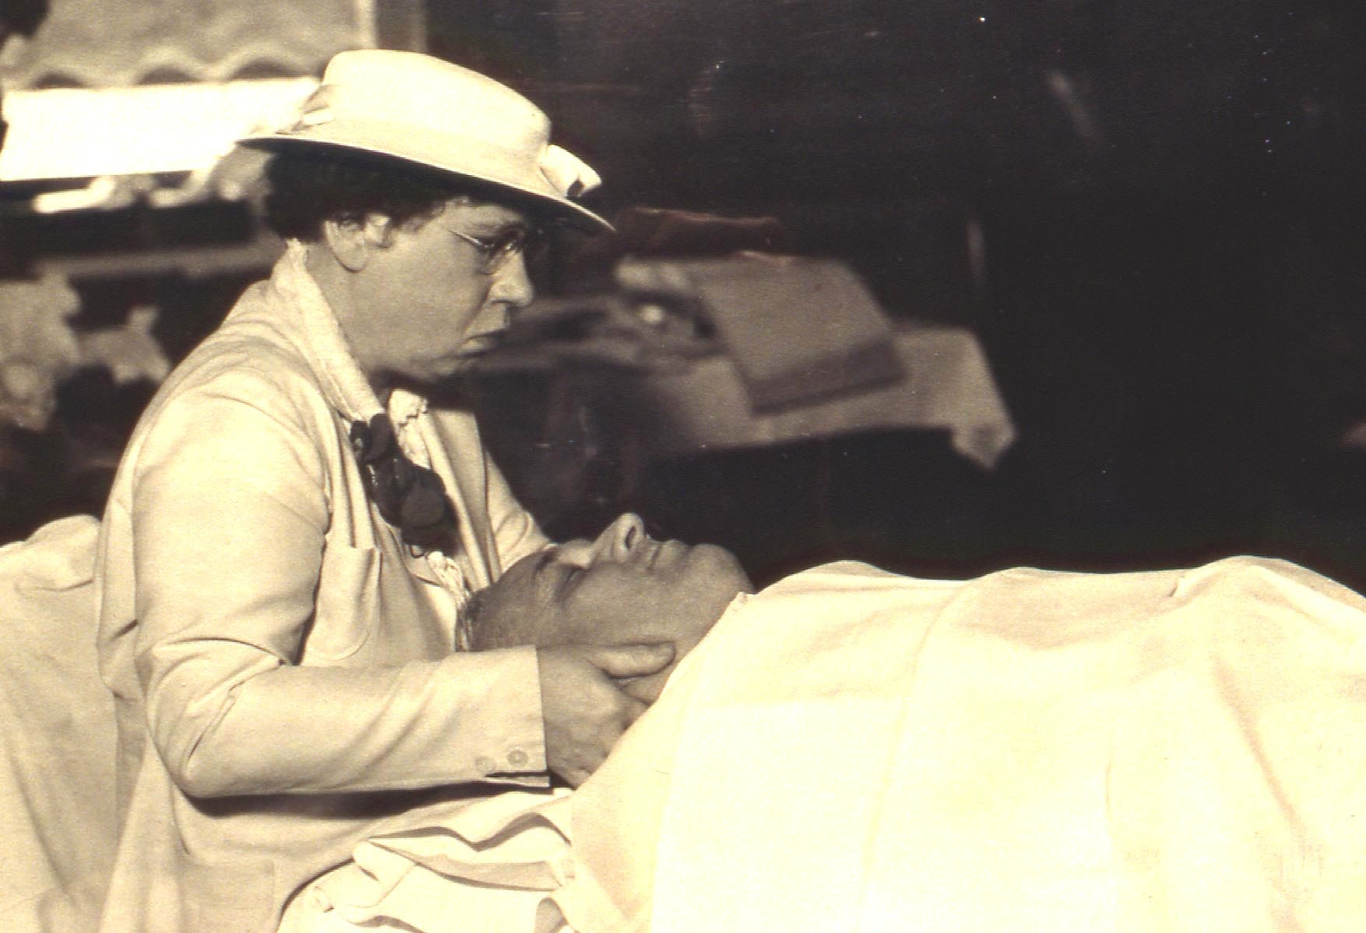
Notes:
Charlotte Weaver treating a patient’s cranium.

Slide 12
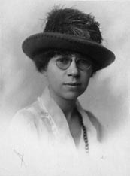
Notes:
Young Charlotte? Looks like Margaret.

Slide 13
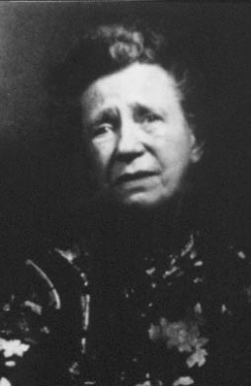
Notes:
Charlotte Weaver

Slide 14
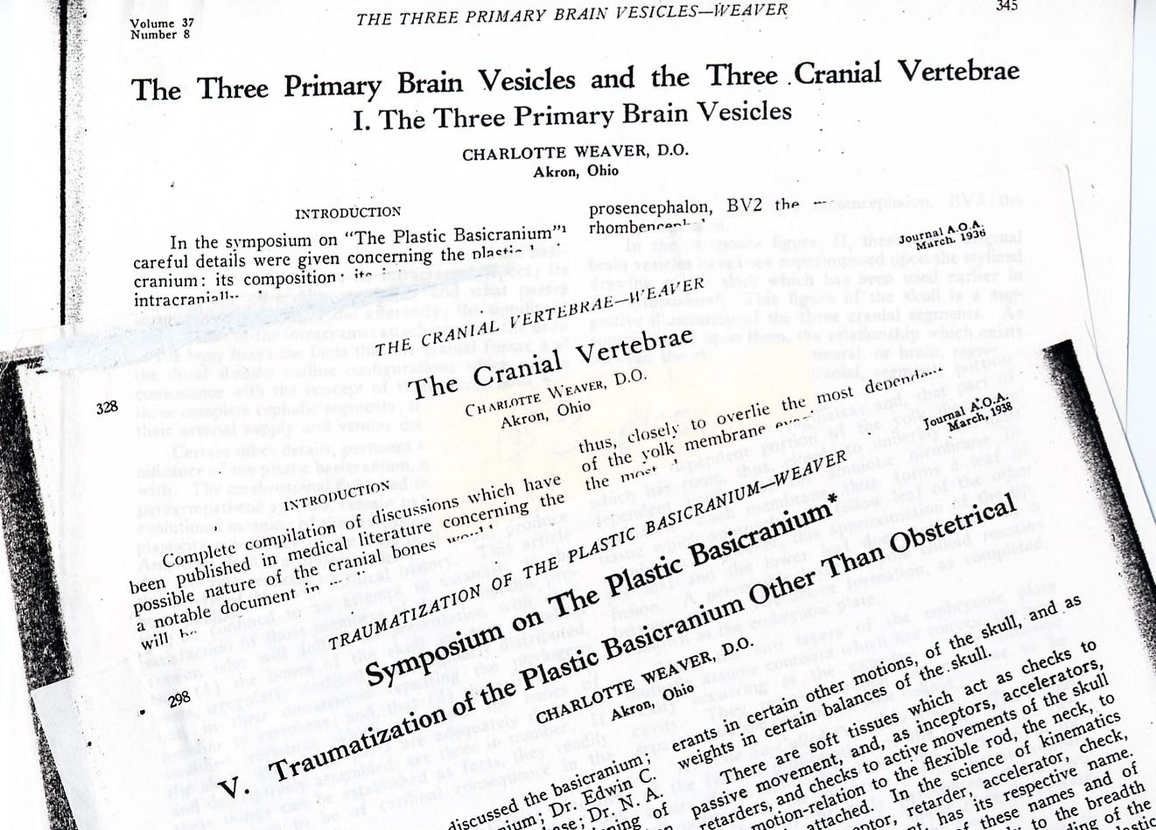
Notes:
The JAOA articles.

Slide 15
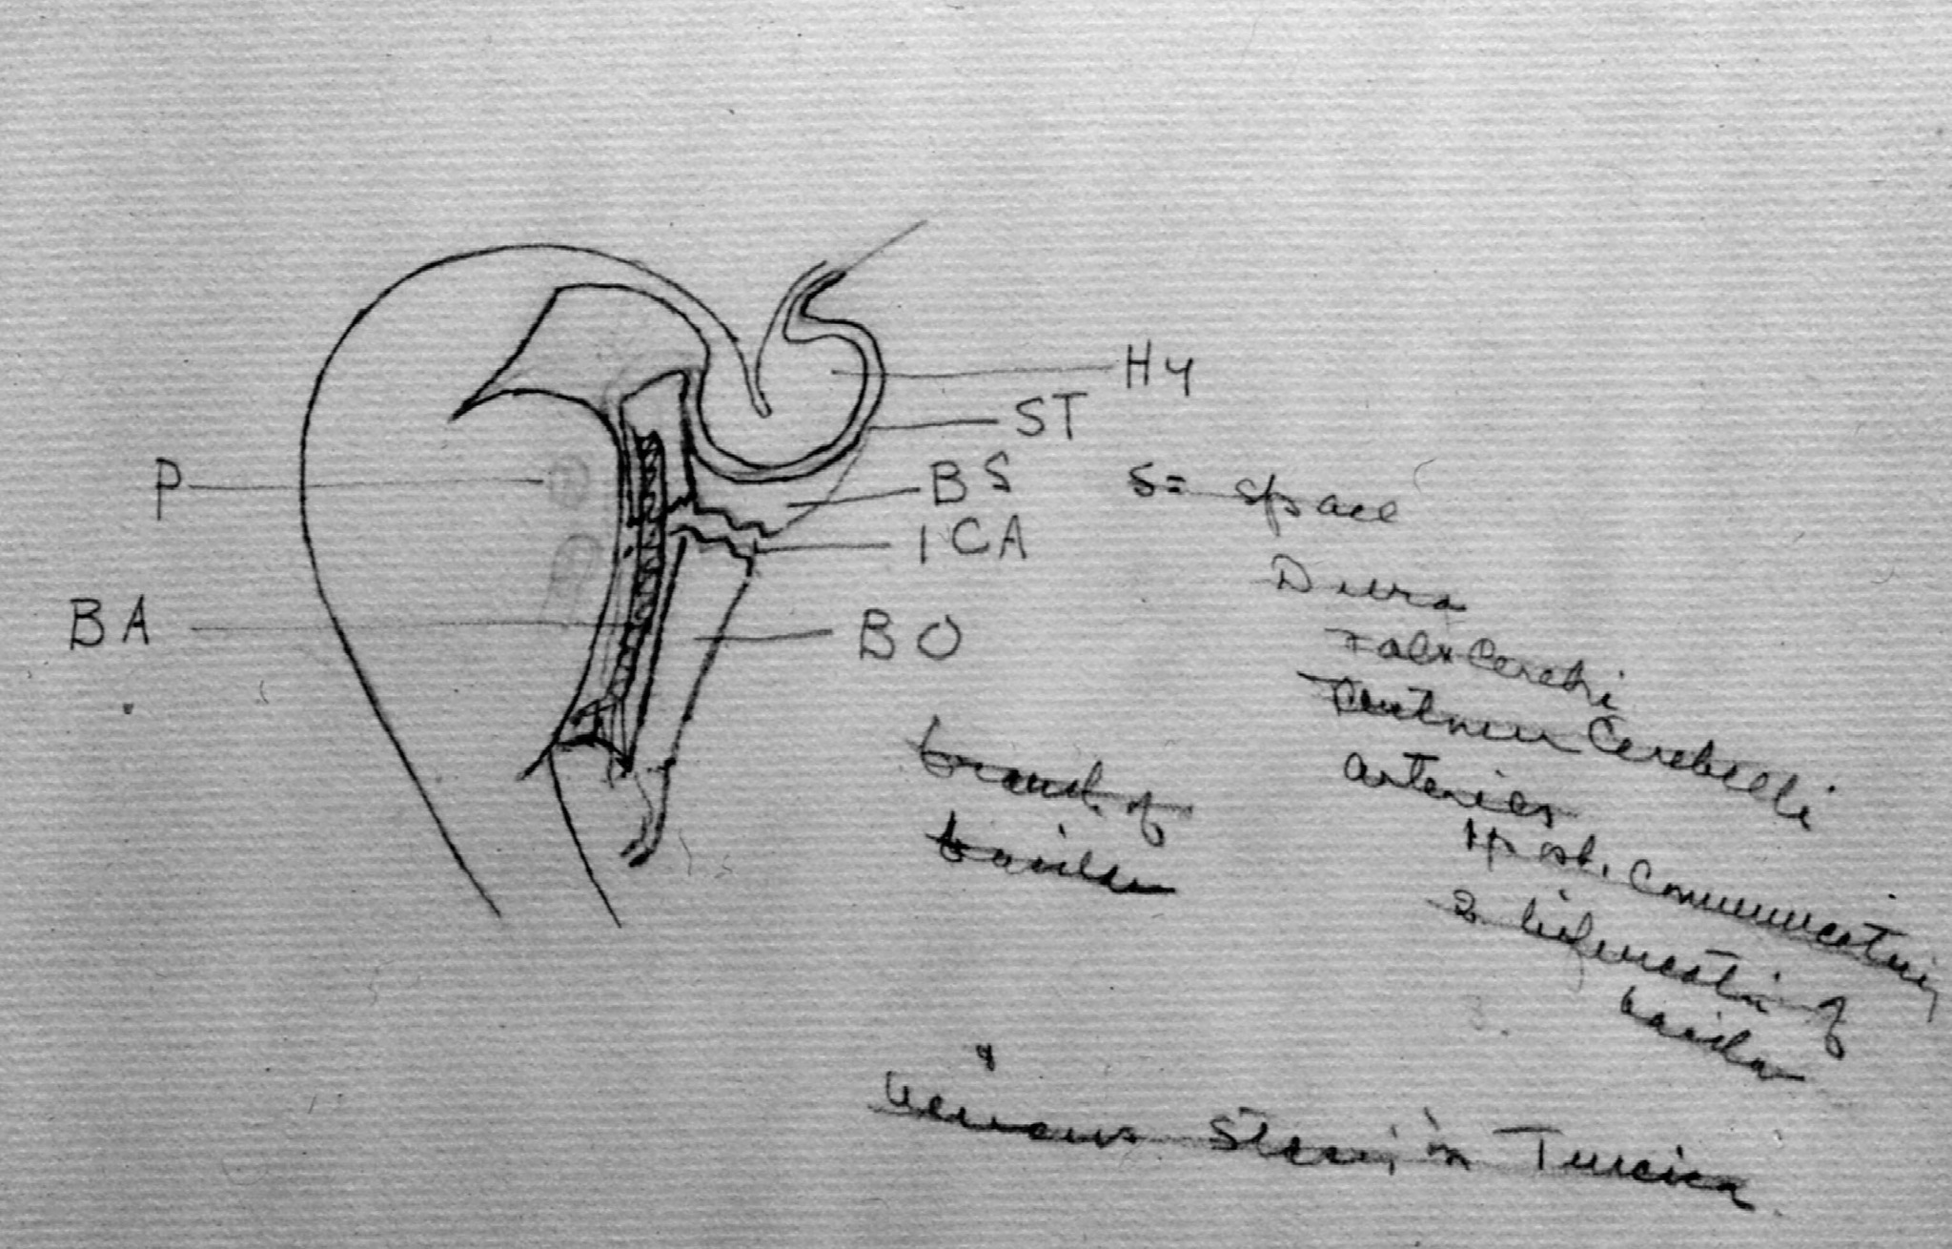
Notes:
See if audio tape of Margaret’s talk will clarify this drawing.

Slide 16
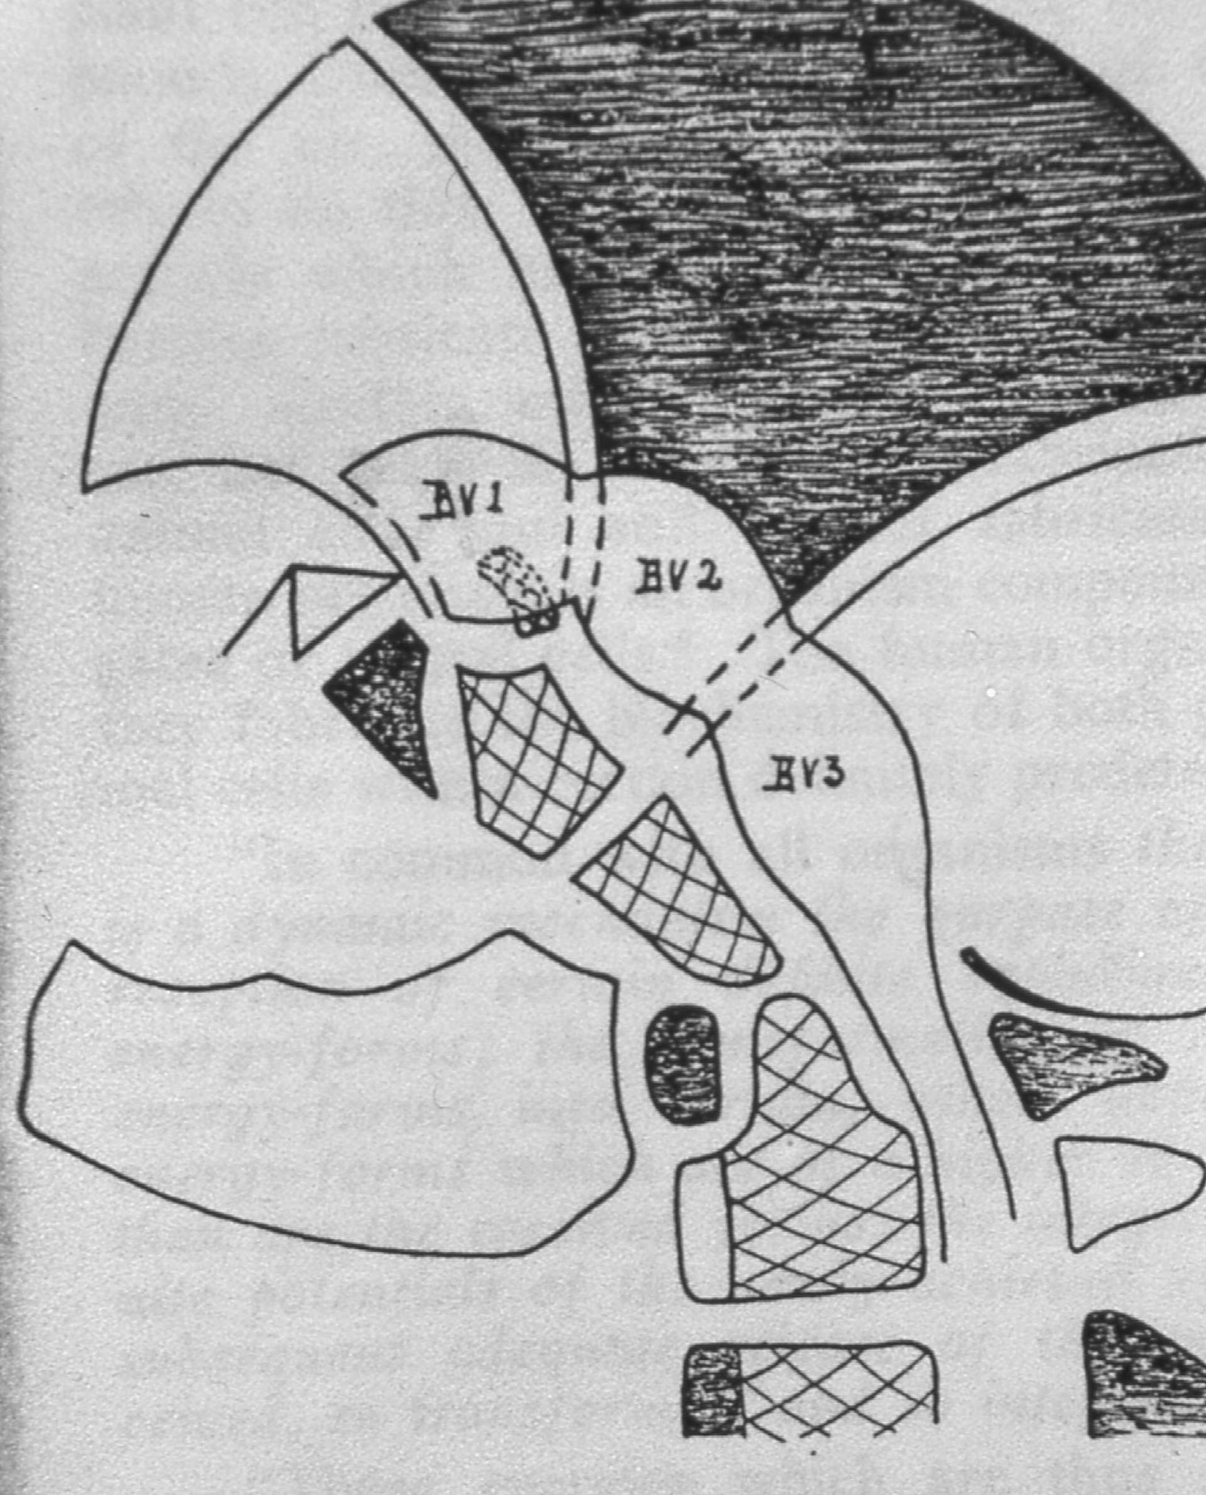
Notes:
Check audio

Slide 17
Basic principles that govern embryogenesis
Notion of time and space continuum: each phase is necessary for the following sequences
This brings the notion of fulcrums, transition phases and formations
Accompanied by programmed cellular death and cycles of induction, growth, differentiation, transformation and evolution.
Presence of constant interaction between fields, fluids and tissues.
Included within these fields are morphogenic fields (Saunders, Opitz) and early or late metabolic fields (Blechsmidt)

Slide 18
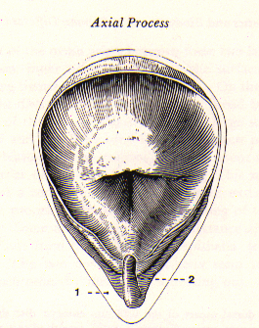
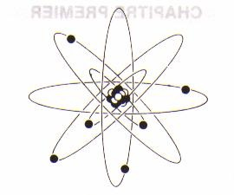
Notion of Fulcrum
Notes:
Il existe différents types de fulcrum utilisé par la nature èa diverse moment et dans diverses dimensions dont des fulcrum au niveau vibratoire des fulcrum au niveau liquidien et des fulcrum tissulaire.
La chaine centrale représente la mise en phase, l ’intersection de ces différentes dimensions et permet l ’équilibre réciporque èa chaque niveau et entre les niveaux.
Voir article de Schooley selon enseignement de Sutherland dans osteopathie in the cranial Field 1 iere édition. Texte sur le fulcrum et le Potency.
Refférer èa texte de Schooley dans Magoon LIRE EXTRAITS

Slide 19
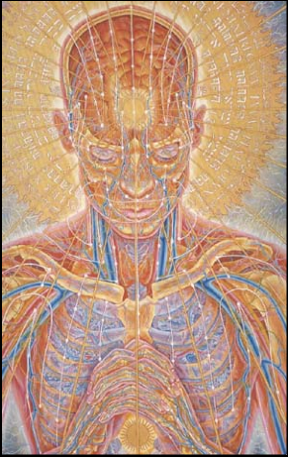

Slide 20
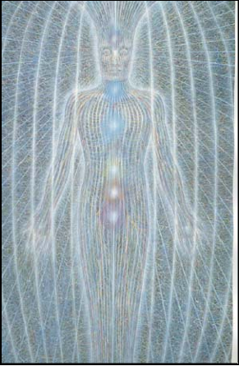

Slide 21
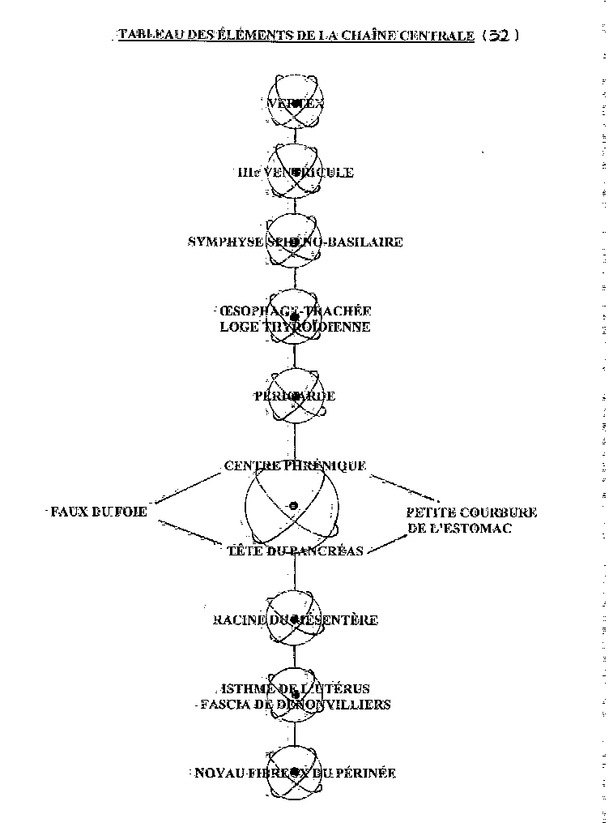
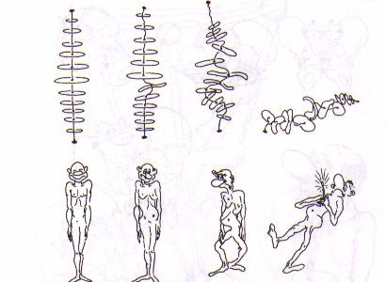
Central Chain, Philippe Druelle D.O.

Slide 22
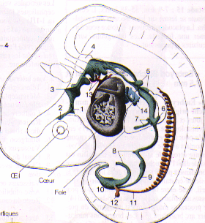

Slide 23
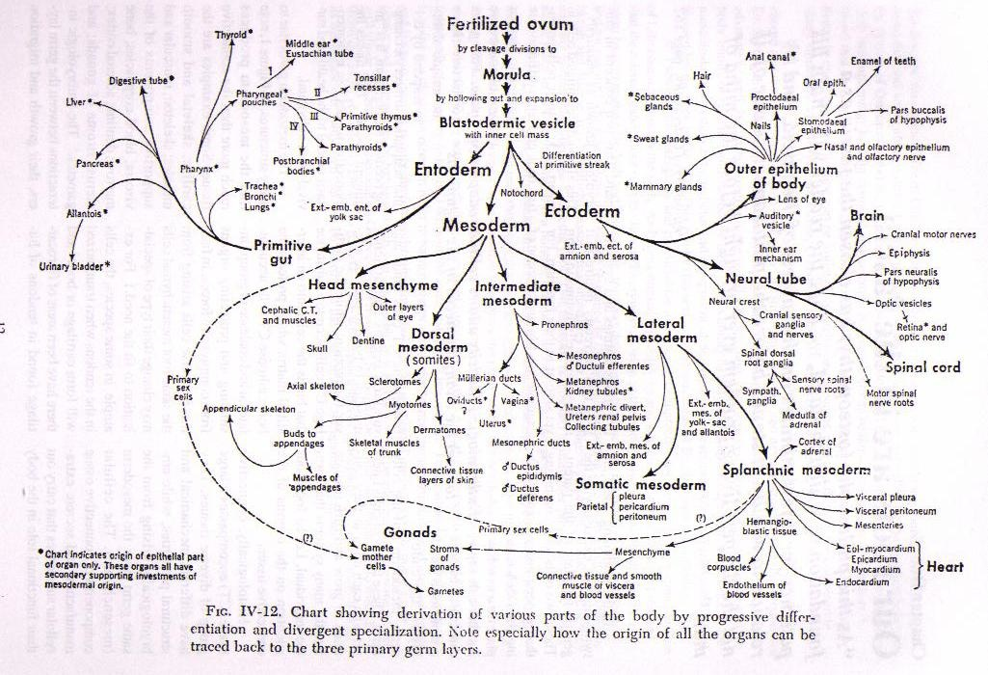
Notes:
Voir handout ou illustration de polypotance des cellules embryonnaires et pouvoir transféré du début sans perte de puissance ou d ’information.
Devenir des différentes souches embryonnaires : prendre temps pour expliquer un peu.

Slide 24
Why embryology and osteopathy ?
To identify the manifestation of the True Nature of a Being within its matter, form and motion
To study the different functional units that are developed and that become active during the embryological development.
To establish anatomical and physiological links between the motions encountered during embryogenesis versus PRM expression.

Slide 25
Other considerations
body parts that go beyond anatomo-physiological to understand certain existing interrelations between links or context (ex: lesional or temporal link)
To appreciate the adaptation and compensation ability or potential of an individual
To learn on the quality of integration of diverse influences to the point of relative resolution of peace. (species, civilisation, family, personal, etc)

Slide 26
Also…
Our osteopathic practice can gain from a more complete and comprehensive visualization of the different processes that took place in the elaboration of the organism and its manifestations
It can also benefit from a better understanding and palpation sense of the fields, fluids and tissues in their specificities and interactions.

Slide 27
Finally…
The study of the different stages of embryological development, its associated fulcrums and transition phases, represents an important dimension of our osteopathic assessment and treatment methodology in the embryo, fetus, newborn, child and
Adults…..

