Slide 1
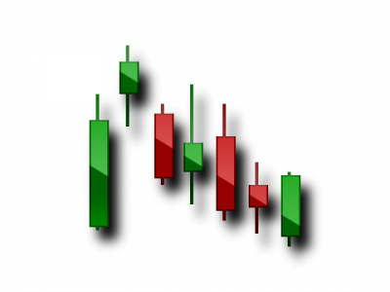
TIGER IYE
EDUCATION PART 4
INSTRUCTOR
QUENN V. GARRIS JR.

Slide 2
! YOUR MINDSET IS EVERYTHING !
OUR CRAFT
MENTAL - 70 %
WAITING - 20 %
TRADING- 10 %
STAY OUT YOUR OWN WAY

Slide 3
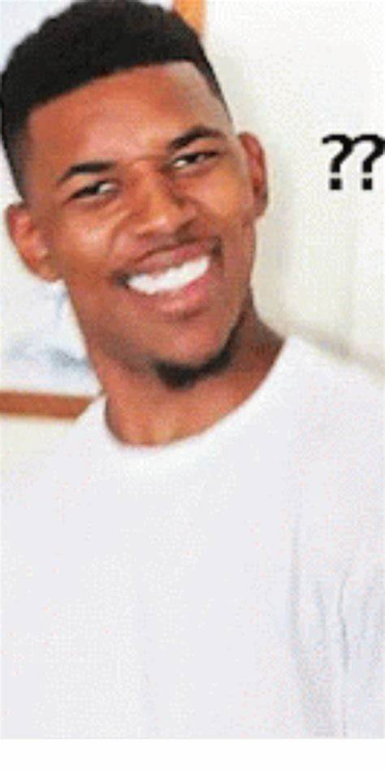
BUT I THOUGHT THIS WAS TRADING???
WHAT ARE WE TALKING ABOUT???

Slide 4
RISK MUTHA FUCKING MANAGEMENT

Slide 5
A FEW POINTERS TO START...
DON’T FOCUS ON MONEY… Yes it’s the reward but you have to win the trade first & that’s not easy!
Always consider the RISK of every trade before getting distracted by the profits.
CUT YOUR LOSERS SHORT!
LET YOUR PROFITS RUN BUT DON’T GET GREEDY!!!

Slide 6
THINK OF ALL ASPECTS OF THE TRADE BEFORE OPENING A POSITION

Slide 7
THINGS TO THINK ABOUT ?
HOW MUCH AM I RISKING ?
WHAT IS MY TAKE PROFIT, GOAL, & EXIT POINT ?
WHAT CURRENT MARKETS ARE OPEN WHILE PLACING THIS TRADE ?
HAS PREVIOUS PRICE ACTION SHOWN AN ENTRY,EXIT, & REASON TO PLACE THIS TRADE ?
DO I HAVE AT LEAST 3 CONFIRMATIONS SCREAMING FOR ME TO ENTER ?
HOW BIG IS THE SPREAD ?

Slide 8
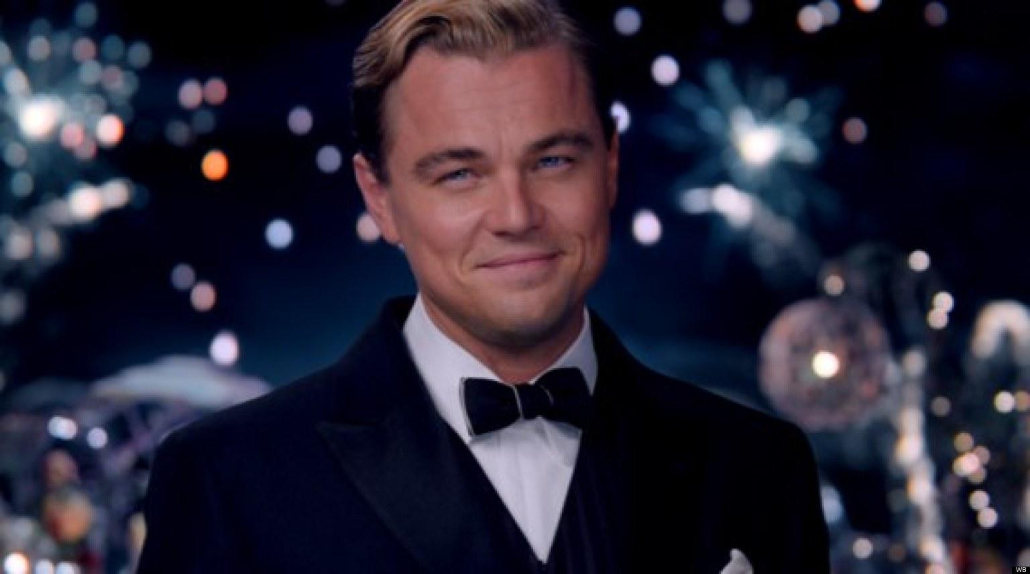
LAST BUT NOT LEAST...
& I MEAN THIS IN THE NICEST WAY...
SAVE THE DRAMA…
FOR YO MAMA...
THE MARKET DOESN’T CARE ABOUT US SO TRY YOUR BEST TO KEEP ALL EMOTIONS AWAY!!!

Slide 9
YOU’RE ALMOST AT THE START LINE KEEP GOING.... AT THE END THERE’S A SPECIAL GIFT IF YOU COMPLETED THE ENTIRE THING.
COUPON CODE LETTER: P

