Slide 1
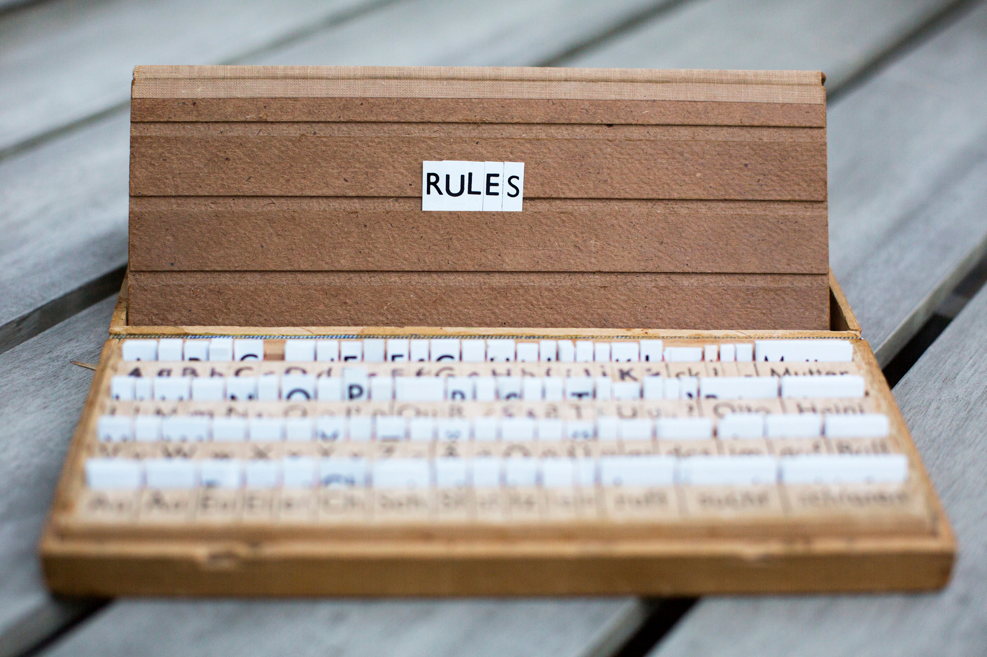
School Rules

Slide 2
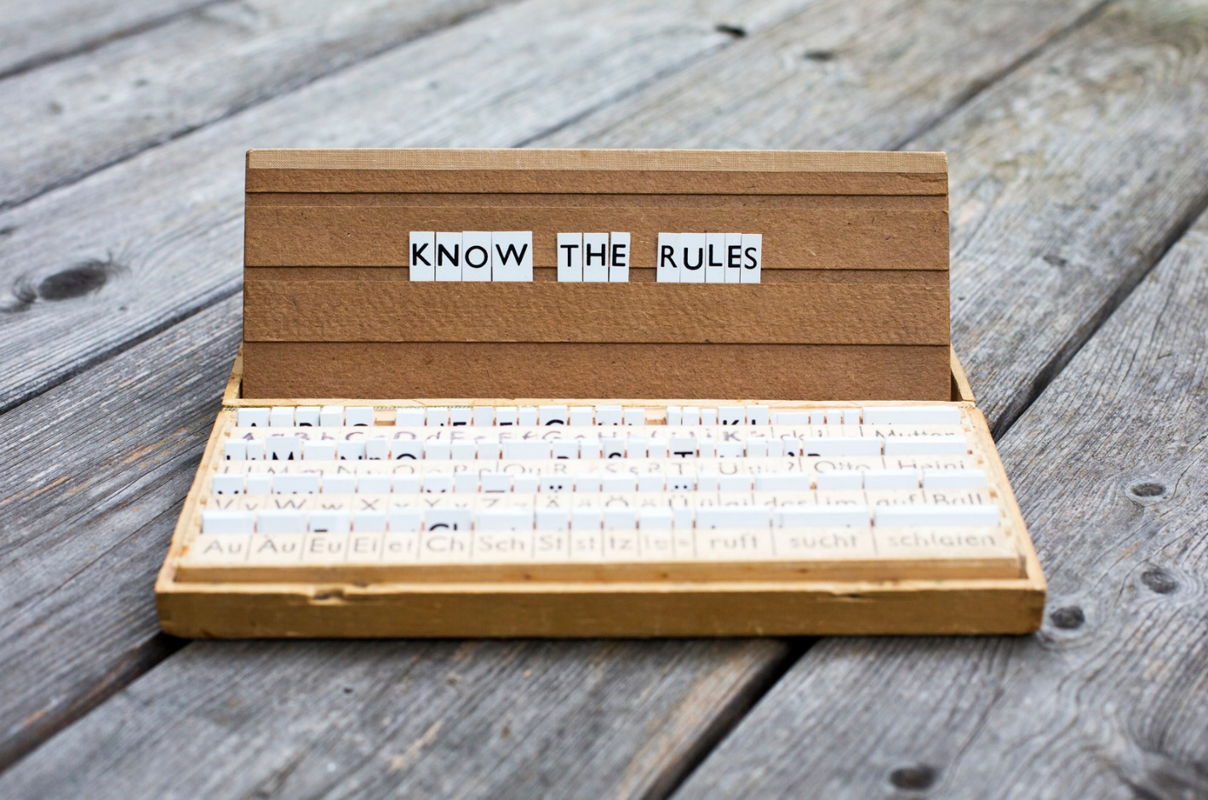
At school there are rules we must all follow.

Slide 3
It is important to follow the rules, to keep everyone safe.

Slide 4
Be on time to class.

Slide 5
Come ready to learn. Be prepared for class.

Slide 6
You should ways walk in the hallways.

Slide 7
Use an inside voice while you are in the building.

Slide 8
Treat other people nicely.

Slide 9
Use appropriate language.

Slide 10
Ask before touching things that belong to other people.

Slide 11
Keep your hands, feet, and body to yourself.

Slide 12
Wear clothing that is appropriate for school and the weather.

Slide 13
Raise your hand when you have a question or comment.

Slide 14
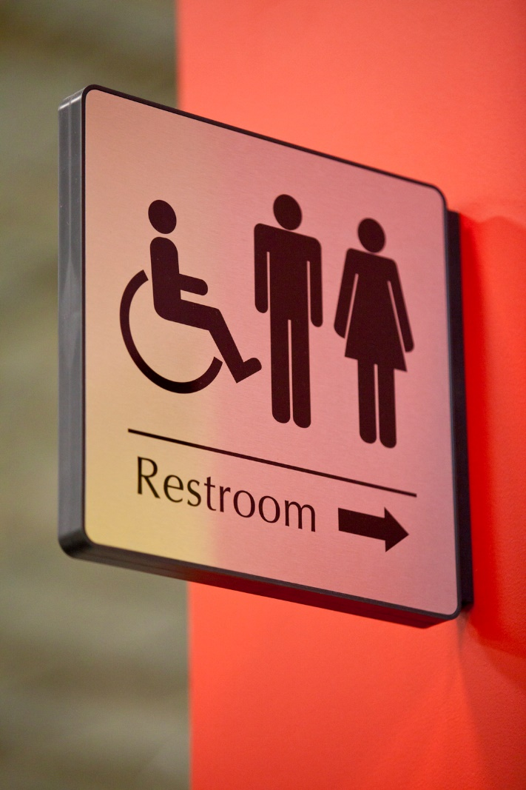
Ask the teacher before leaving the classroom. It is important we know where you are.

Slide 15
No cell phones during class. It is not respectful and it is distracting.

Slide 16
When the teacher is talking, you should be listening.

Slide 17
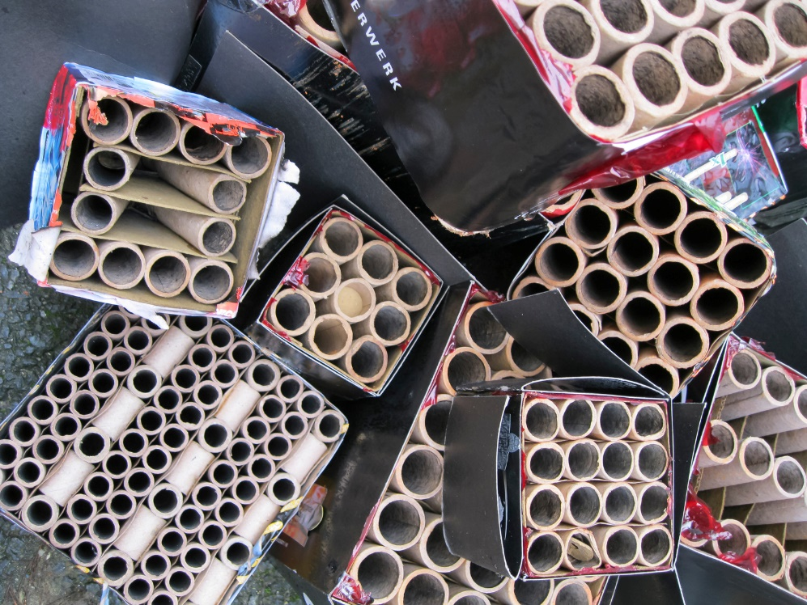
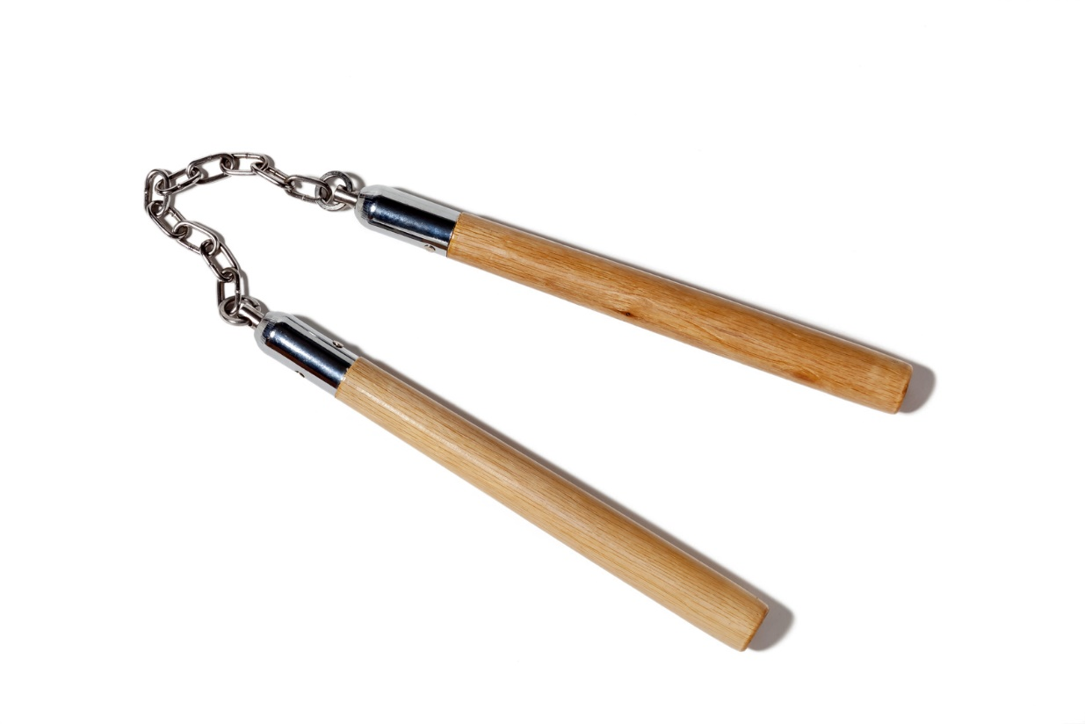
Do not bring anything inappropriate to school.

Slide 18
Trash should go IN the trash can, not on the floor.

Slide 19
It is important to follow directions.

Slide 20
Let’s Review!
Can you remember any of the rules?
Are there any rules you think we need to add to this list?
Why are rules important to have?
Are there any rules you think are more important?
Any rules you don’t understand or agree with?

