Slide 1
DAY 22
Wind Power Generation

Slide 2
TABLE OF CONTENTS
01
04
02
05
03
Introduction
MATLAB Model
Renewable Energy
Application
Wind Power System

Slide 3
Wind Power Generation

Slide 4
Renewable Energy
Solar Energy
Wind Energy
Hydro Energy
Tidal Energy
Geothermal Energy
Biomass Energy

Slide 5
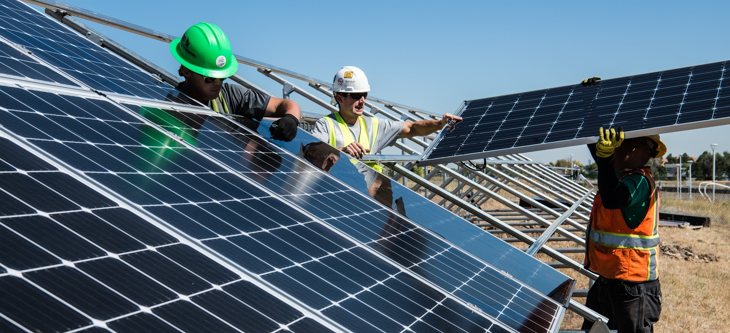
Solar Energy

Slide 6
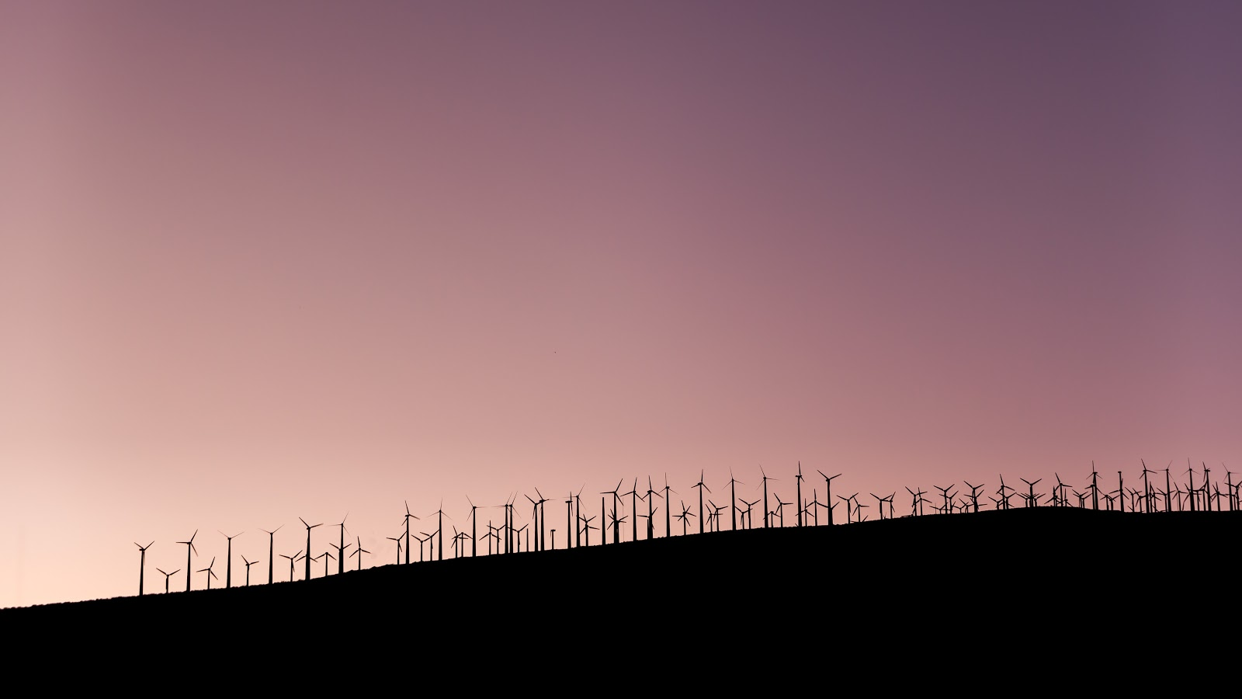
Wind Energy

Slide 7
Top 10 Wind Farm Projects in india
Rank | Power plant | Producer | Location | State | MWe
1 | Muppandal windfarm^{[33]} | Muppandal Wind | Kanyakumari | Tamil Nadu | 1500
2 | Jaisalmer Wind Park^{[34]} | Suzlon Energy | Jaisalmer | Rajasthan | 1064
3 | Brahmanvel windfarm^{[35]} | Parakh Agro Industries | Dhule | Maharashtra | 528
4 | Dhalgaon windfarm^{[36]} | Gadre Marine Exports | Sangli | Maharashtra | 278
5 | Vankusawade Wind Park | Suzlon Energy Ltd. | Satara District. | Maharashtra | 259
6 | Vaspet | ReNew Power | Vaspet | Maharashtra | 144
7 | Tuljapur | Siemens Gamesa, ReNew Power | Osmanabad | Maharashtra | 126
8 | Beluguppa Wind Park | Orange Renewable | Beluguppa | Andhra Pradesh | 100.8
9 | Mamatkheda Wind Park | Orange Renewable | Mamatkheda | Madhya Pradesh | 100.5
10 | Anantapur Wind Park | Orange Renewable | Nimbagallu | Andhra Pradesh | 100

Slide 8
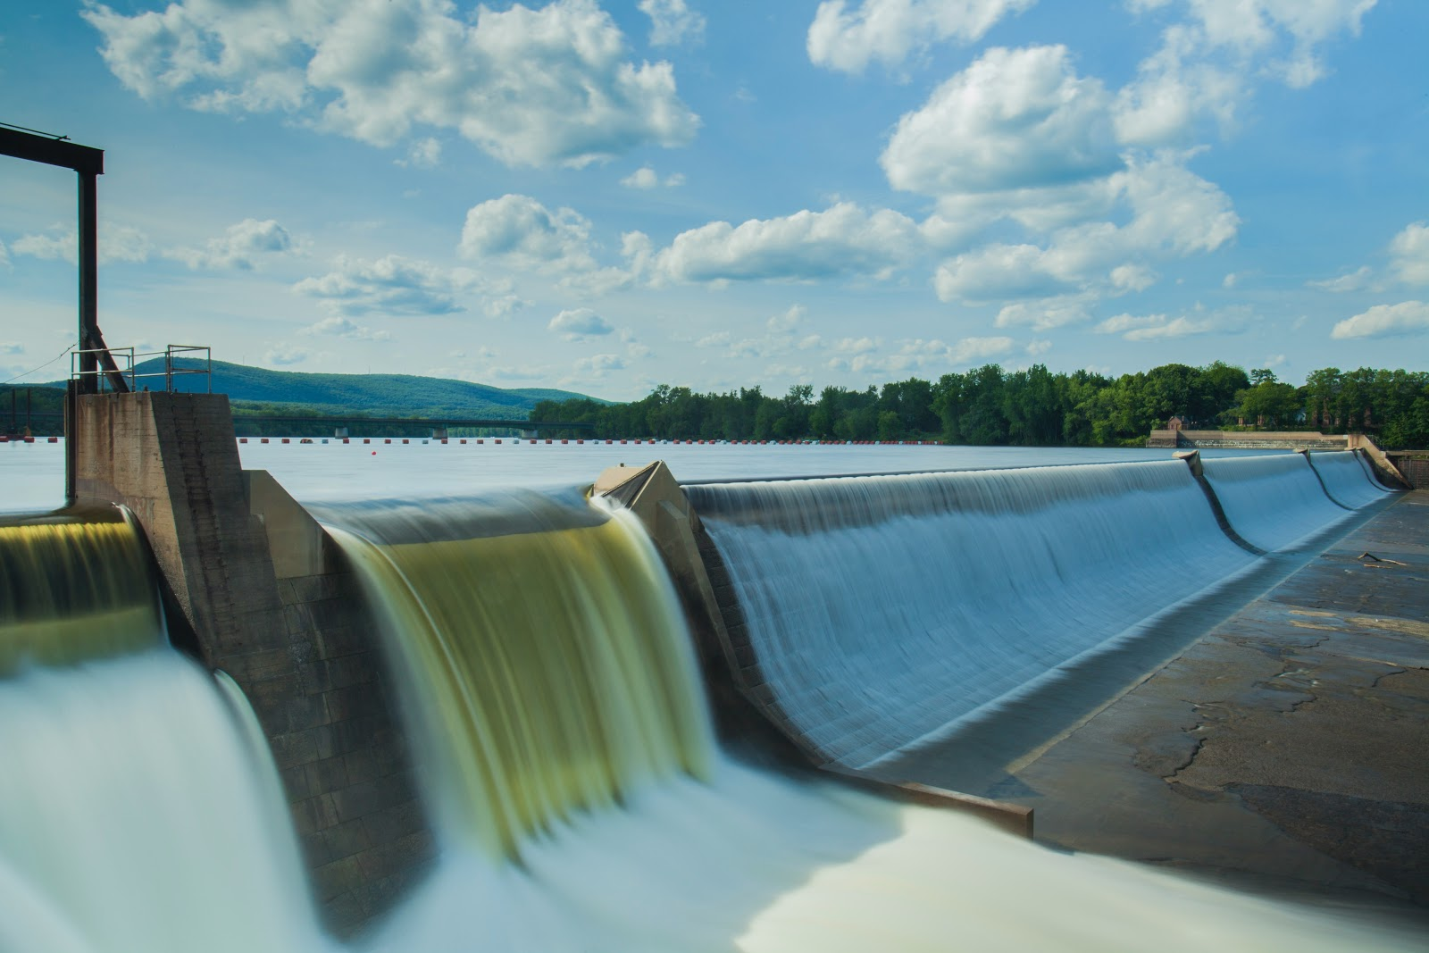
Hydro Energy

Slide 9
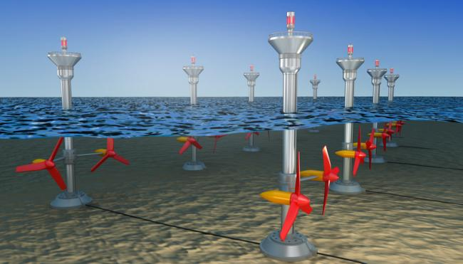
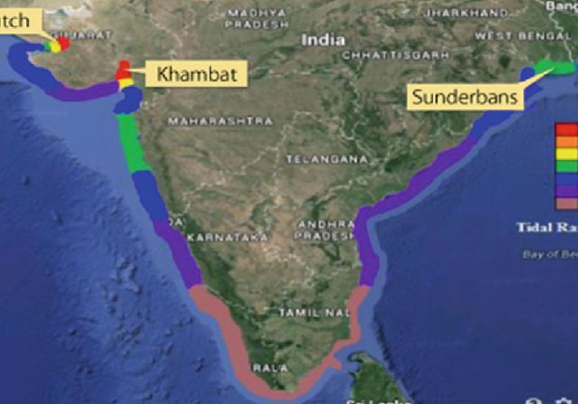
Tidal Energy

Slide 10
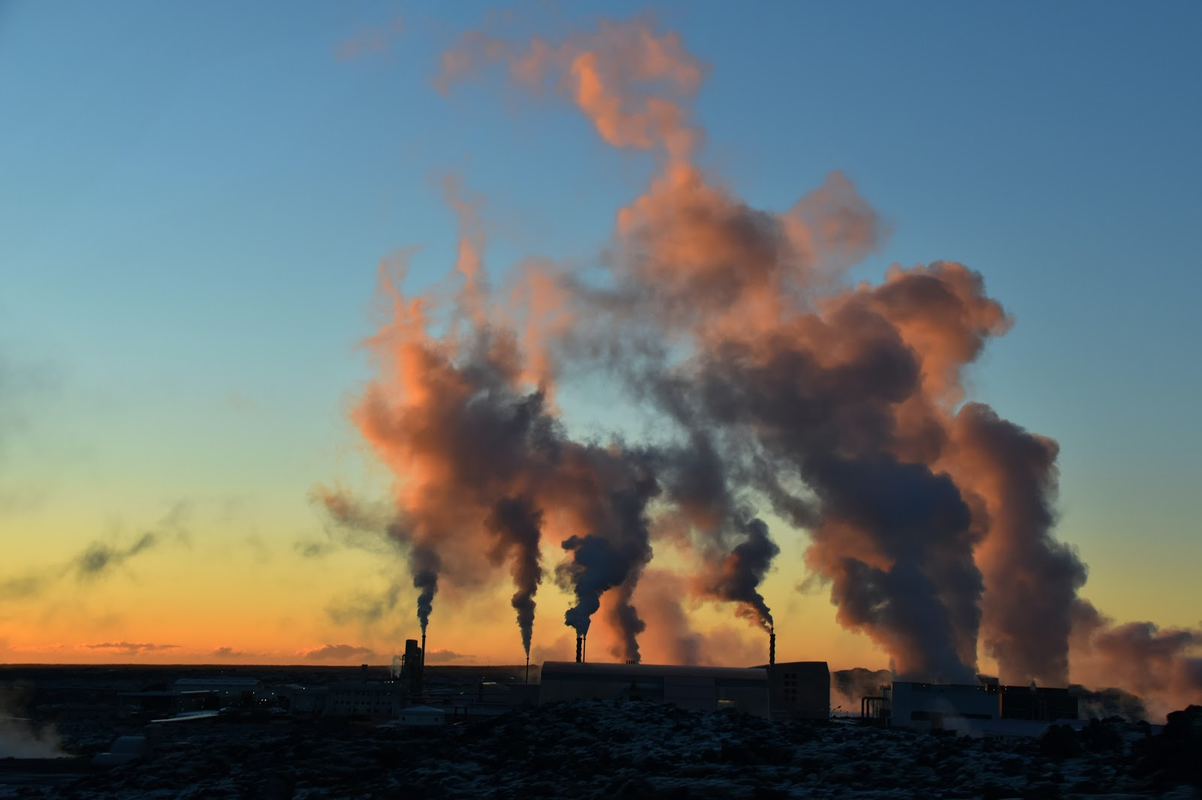
Geo Thermal Energy

Slide 11
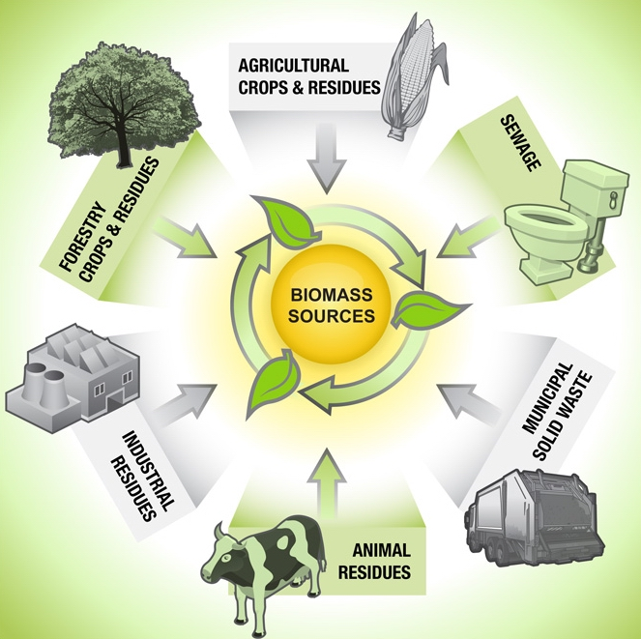
Bio – Mass Energy

Slide 12
Indian RES Power Generation
Solar power (36,910.53 MW)
Wind power (38,433.55 MW)
Biomass (10,145.92 MW)
Small hydro (4,740.47 MW)
Waste-to-energy (168.64 MW)

Slide 13
Wind Power System
Wind Energy
Wind Power
Wind Turbine

Slide 14
Wind Power System

Slide 15
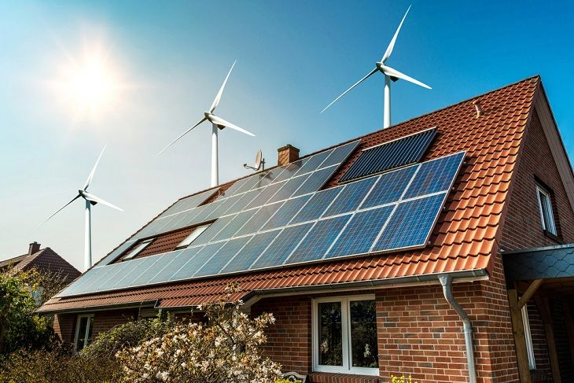
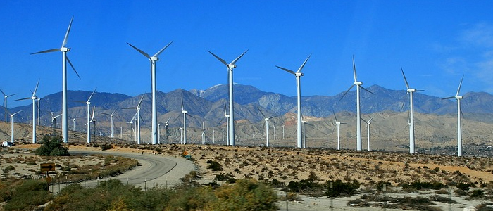
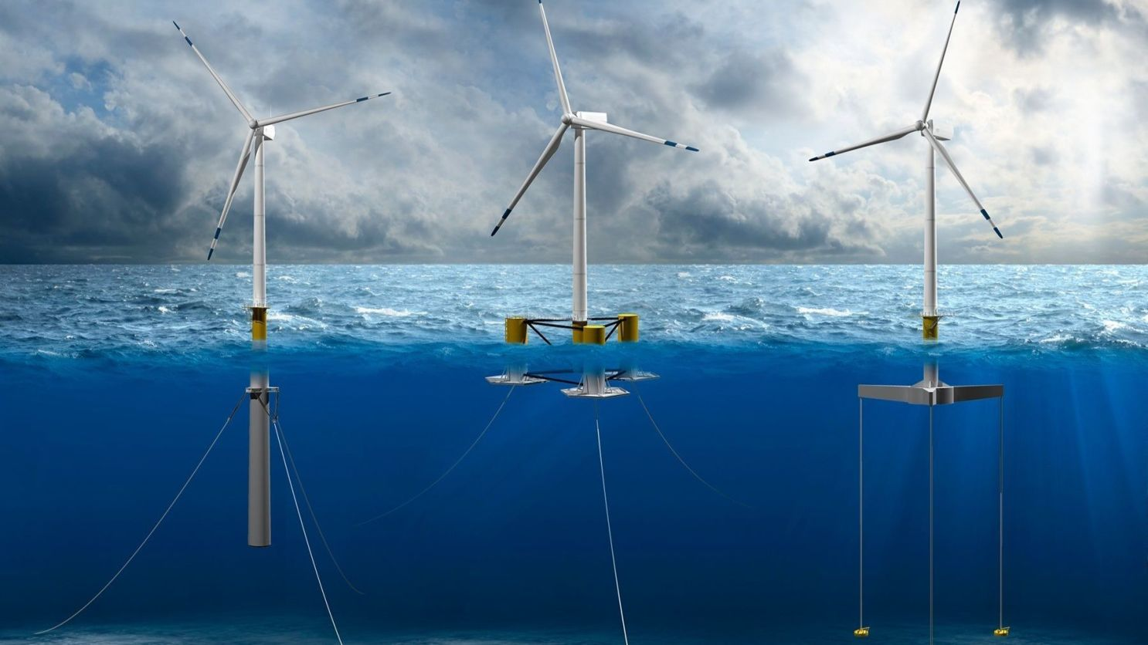
Land-Based Wind Energy
Distributed Wind Energy
Offshore Wind Energy

Slide 16
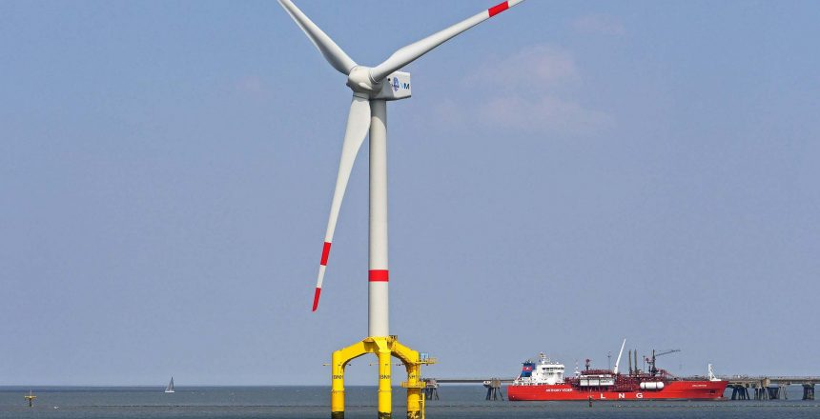
Parts of Windmill
Blade
Nacelle
Tower

Slide 17
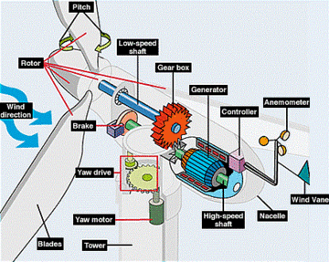
Parts of Wind Turbine

Slide 18
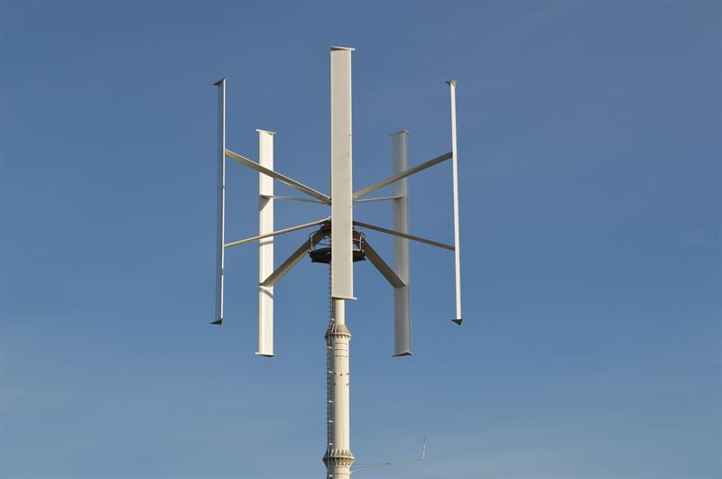
Type of Wind Mills
Vertical Axis Windmill
Horizontal Axis Windmill

Slide 19
Types of horizontal axis windmills
Post mill
Smock mill
Tower mill
Fan mill

Slide 20
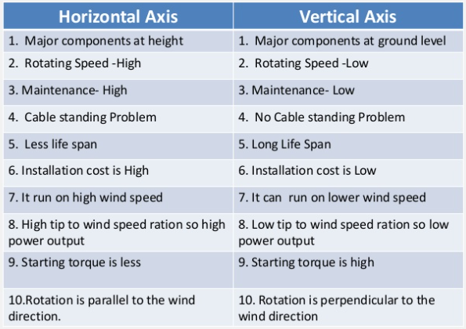

Slide 21
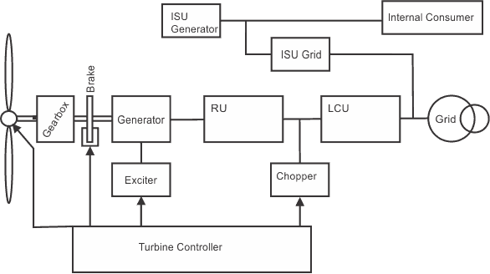
Functional Block Diagram

Slide 22
Tower Hight Vs Wind Speed
Where: P = Power output, kilowatts Cp = Maximum power coefficient, ranging from 0.25 to 0.45, dimension less (theoretical maximum = 0.59) ρ = Air density, lb/ft3 A = Rotor swept area, ft2 or π D2/4 (D is the rotor diameter in ft, π = 3.1416) V = Wind speed, mph k = 0.000133 A constant to yield power in kilowatts. (Multiplying the above kilowatt answer by 1.340 converts it to horse- power [i.e., 1 kW = 1.340 horsepower]).

Slide 23
Wind Energy Site Assessment
Motivation
Site Description
Wind Characteristics
Microsite and Analysis

Slide 24
How to choose the Site for Wind Power Generation
1. High annual average wind speed:
2. Availability of anemometry data:
3. Availability of wind V(t) Curve at the proposed site:
4. Wind structure at the proposed site:
5. Altitude of the proposed site:
6. Terrain and its aerodynamic:
7. Local Ecology
8. Distance to road or railways:
9. Nearness of site to local centre/users:
10. Nature of ground:
11. Favorable land cost:

Slide 25
Top Manufacturer
Siemens Gamesa Renewable Energy
Suzlon
Vestas
Inox Wind
GE Renewable Energy
Envision
Senvion

Slide 26
Advantages and Disadv
Free
Renewable
Non-Polluting
Minimum Operating Cost
No Fuel Needed
Shortest Pay-Back Time
High Initial Investment
Thread for Birds
Wind Strength <> Electricity Not Constant
Financial - risk - Not enough Energy from wind to replace traditional resources
Life time of Turbines is 20 Years
Hard to estimate wind power

Slide 27
THANKS

