Slide 1
Torn Paper Effect
©Presentation-Process.com
All rights reserved. Not for distribution.

Slide 2
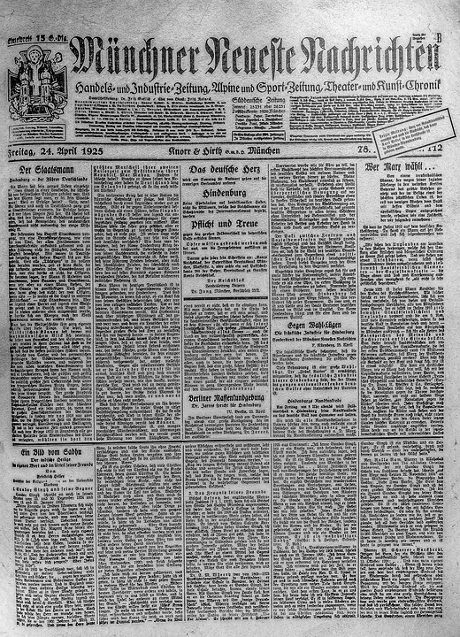
Photo used for Effect
Notes:
https://pixabay.com/photos/newspaper-old-1925-daily-newspaper-2608394/

Slide 3
Torn Paper Effect
Notes:
https://pixabay.com/photos/newspaper-old-1925-daily-newspaper-2608394/

