Slide 1
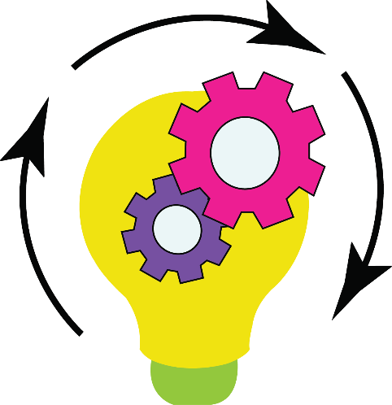
d. Idea Generation
Idea generation is the most fun stage in design thinking. You have to come up with solutions/answers also known as ideas to the problem/challenge you have from the problem/challenge stage. Generations means, coming up with. Idea Generation stage asks you to generate as many ideas as possible. Your ideas can be good, bad, right, wrong, wild, weird, funny, distinct, full of variety, quality, large number, feasibility, viability. Ideas in short are the proposed solution/answers you come down to in the idea generation stage.

Slide 2
“ The best way to have a good idea
is to have lots of ideas.”
Linus Pauling

