Slide 1
RTL Technologies +91 88855 89062 www.rtlonlinetraining.com
What is Oracle Fusion Cloud?
Oracle Fusion is one of the ERP Application in Oracle Cloud.
Oracle Fusion Applications has got following domains
Financials
HCM
SCM
CRM Sales Cloud
GRC

Slide 2
What is Fusion ERP Cloud?

Slide 3
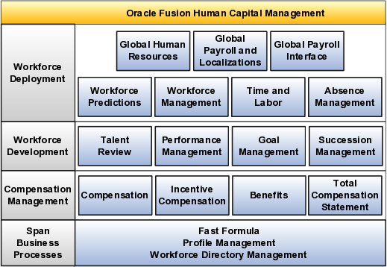
What is Fusion HCM Cloud?

