Slide 1
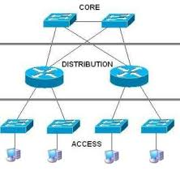
Cisco Three Layer Model

