Slide 1
How to Wash Your Hands

Slide 2
It is important to wash your hands. It keeps them clean. It also helps you not get sick or spread germs.

Slide 3
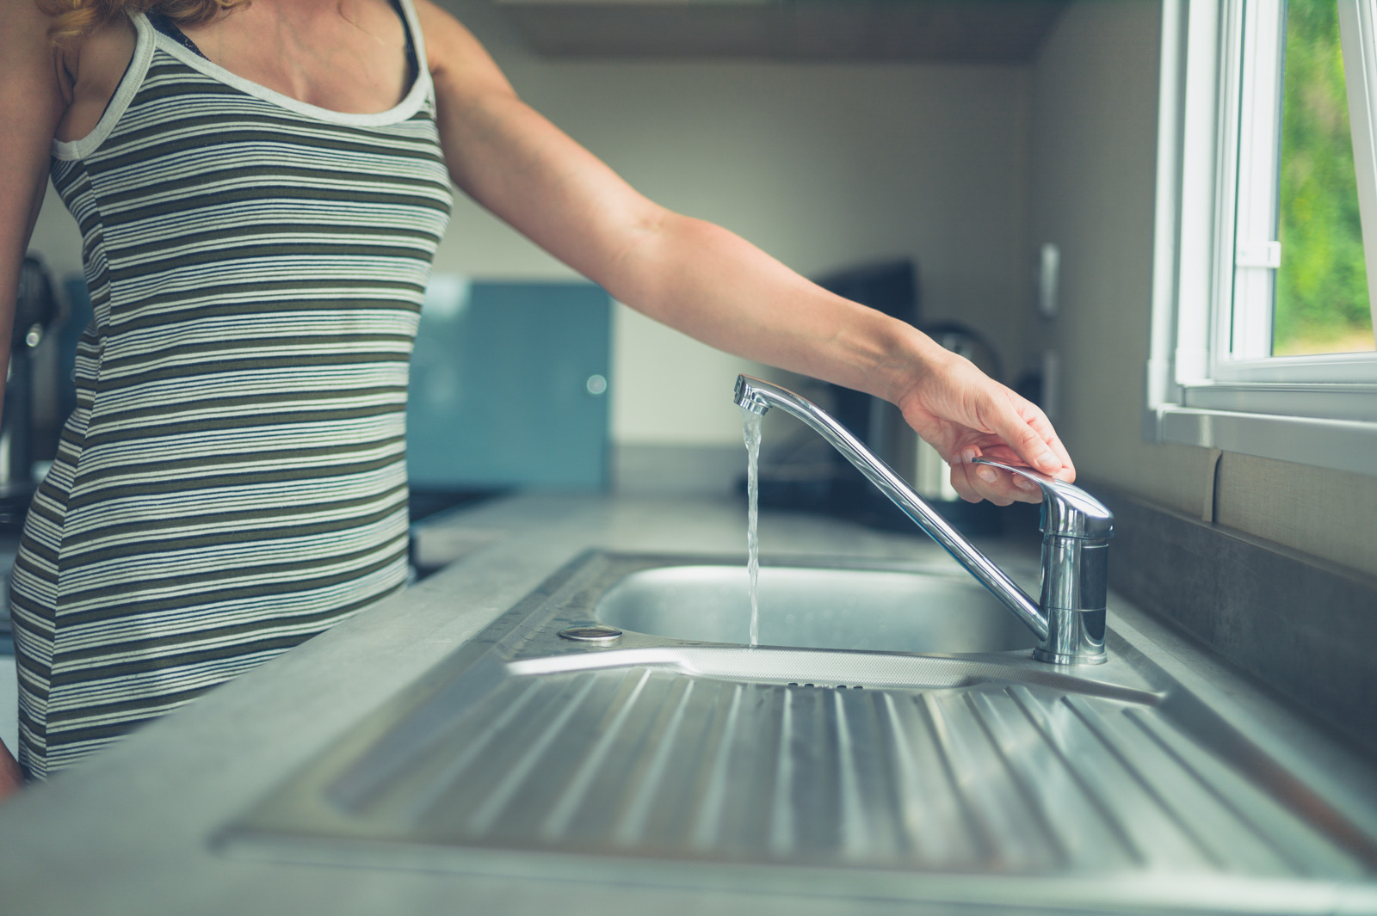
Turn on the water.

Slide 4
Make sure it is not too hot or too cold.

Slide 5
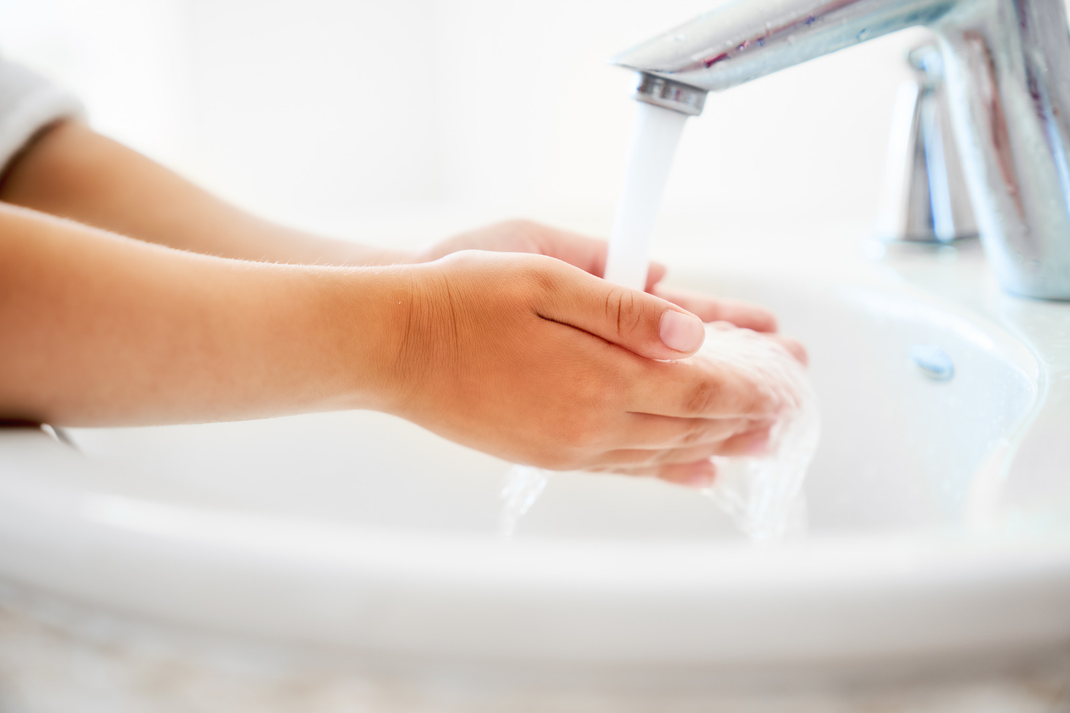
Wet your hands.

Slide 6
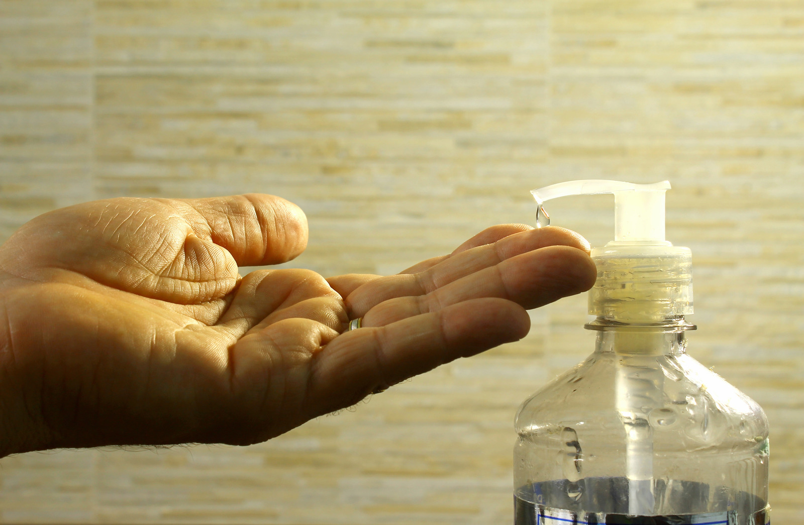
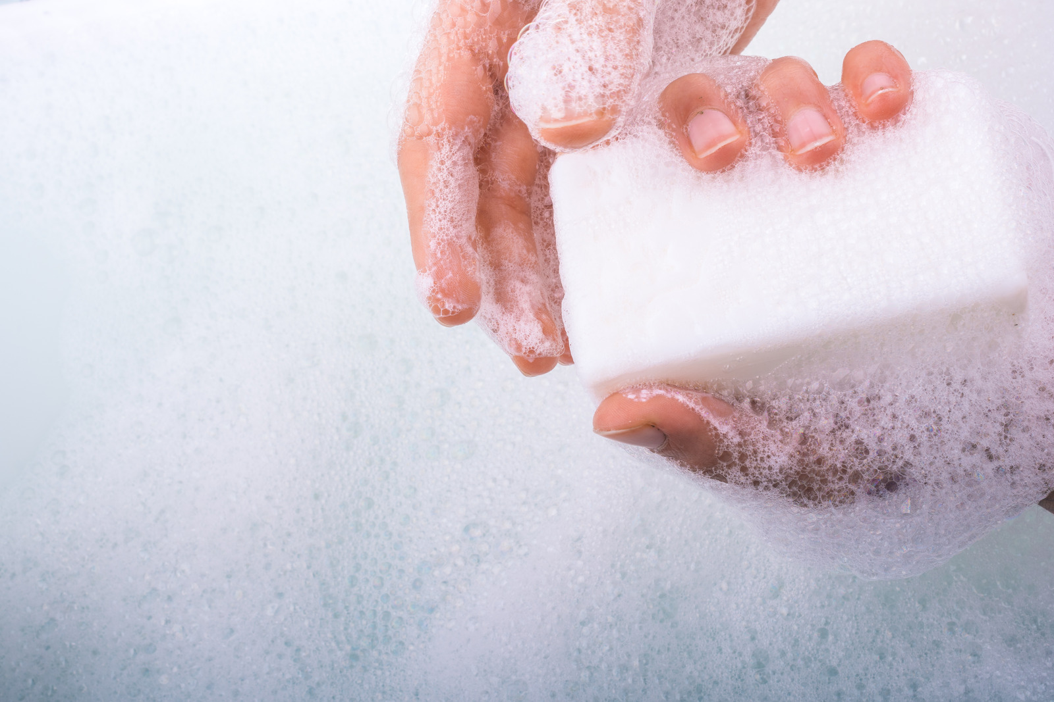
Put soap into your hands.

Slide 7
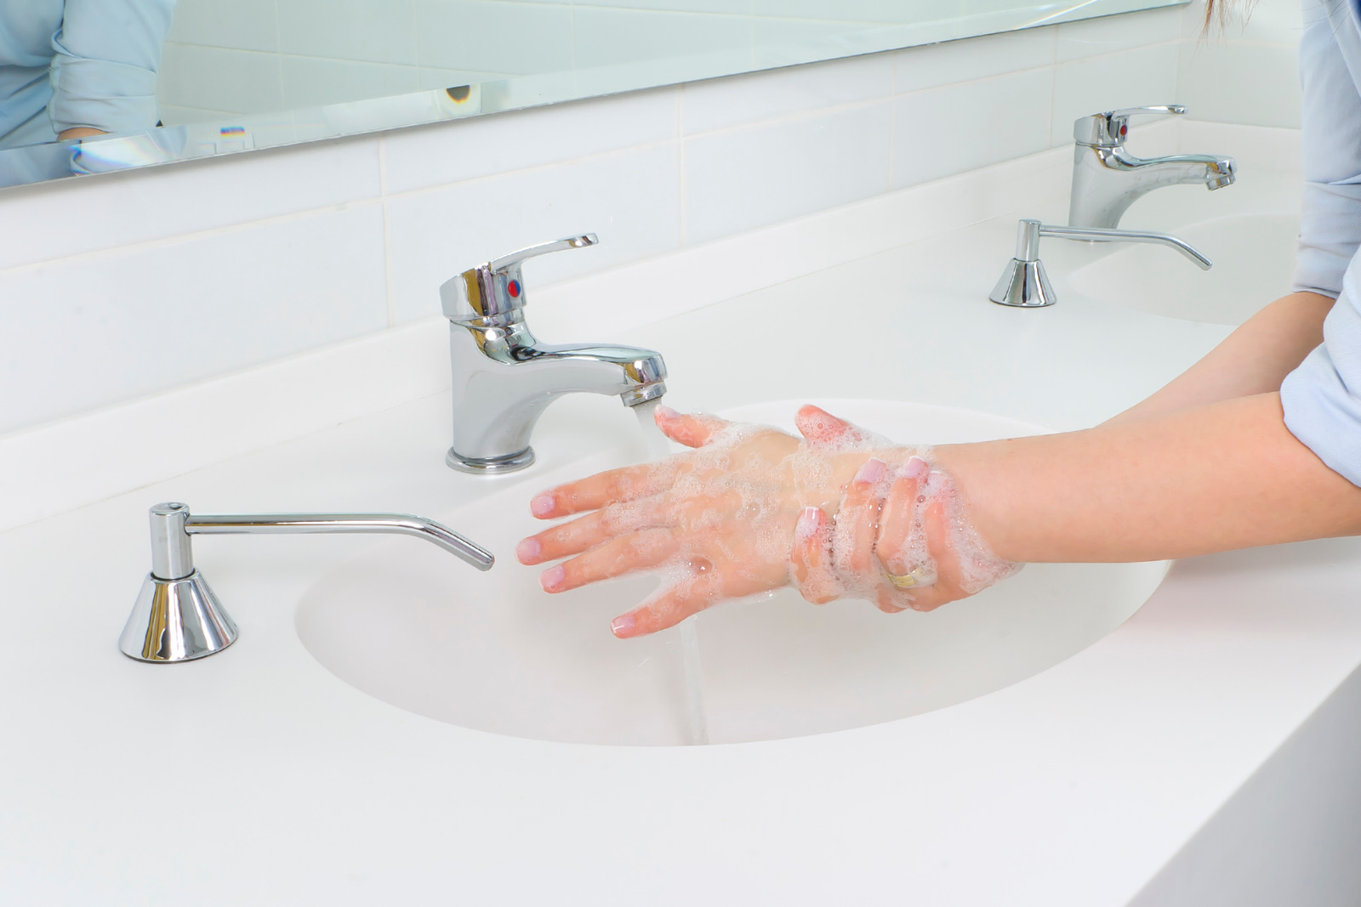
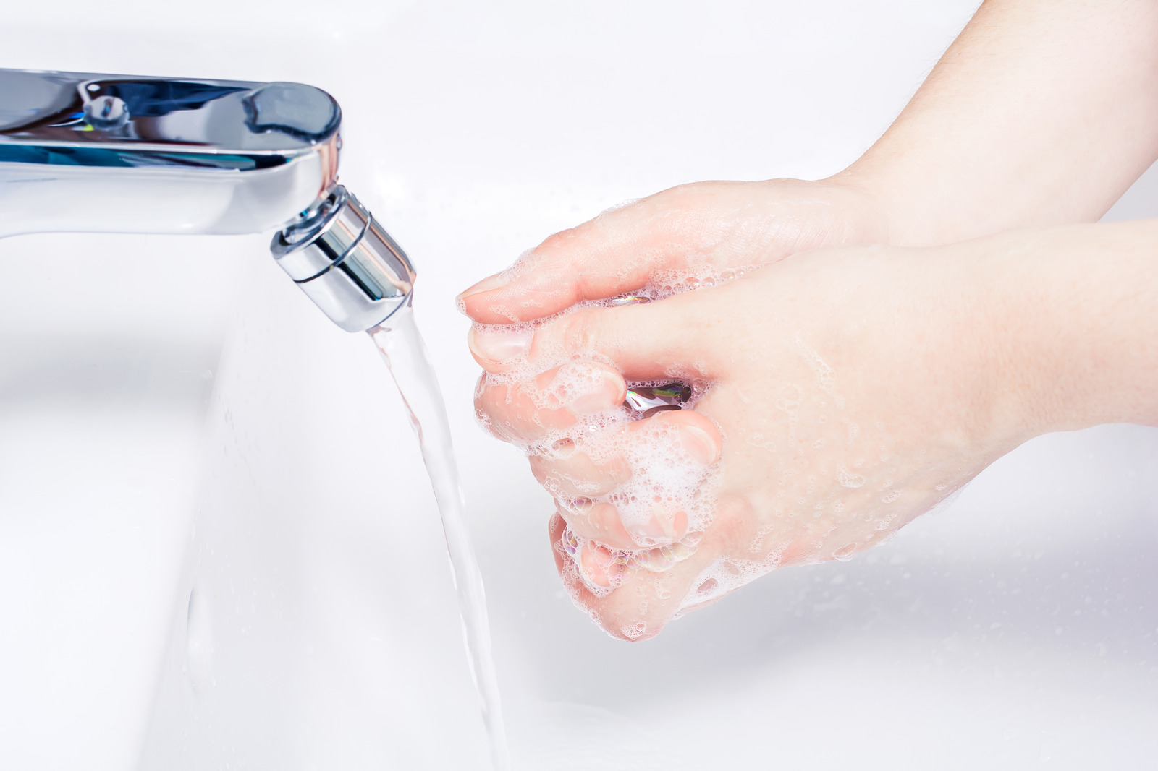
Lather soap into hands and wrists.

Slide 8
Wash soap off your hands.

Slide 9
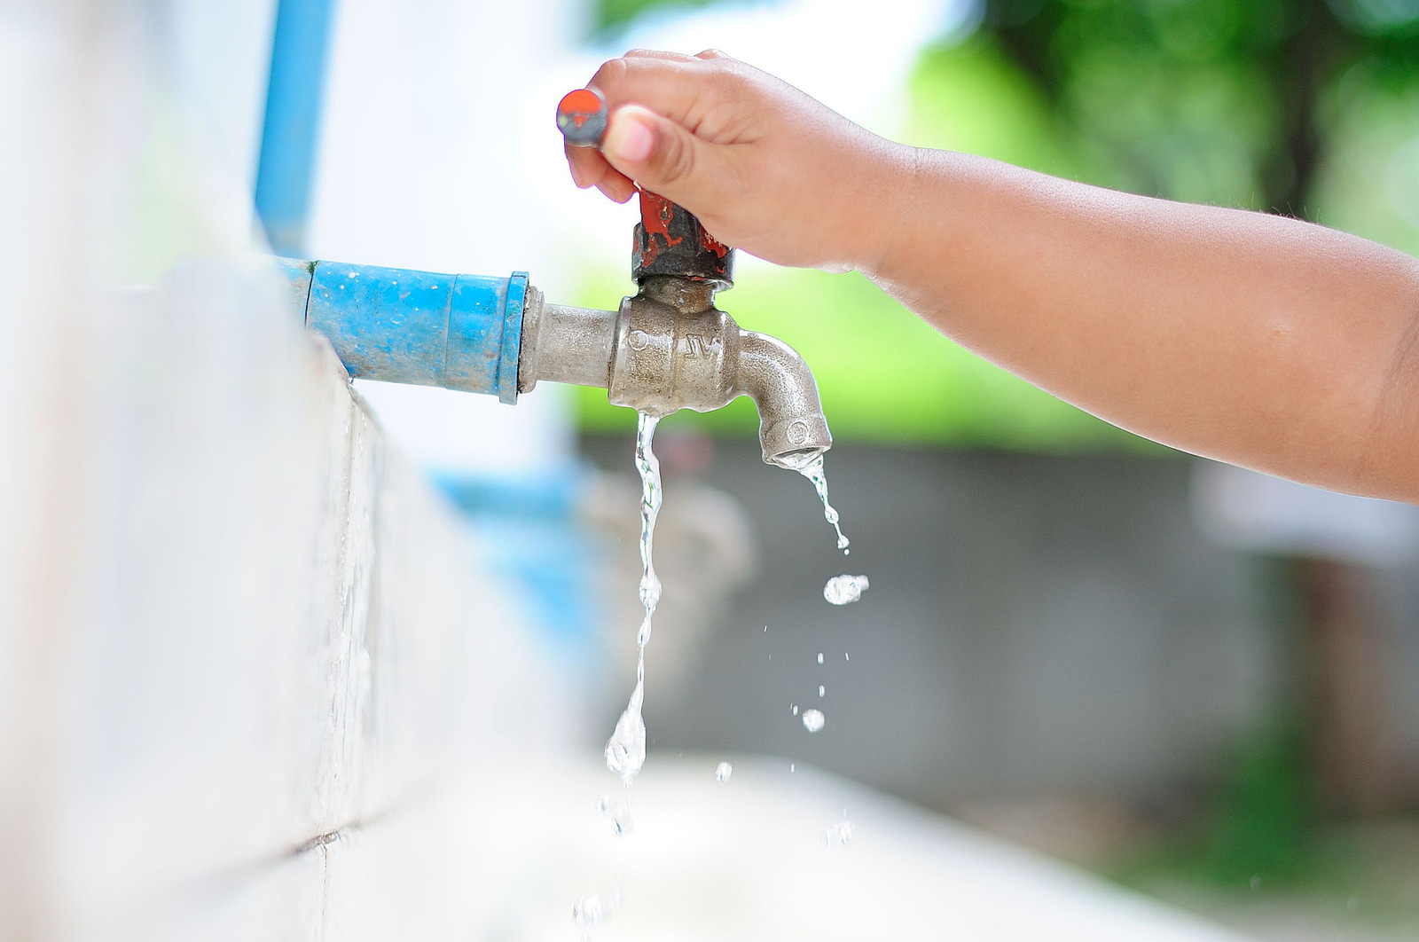
Turn the water off.

Slide 10
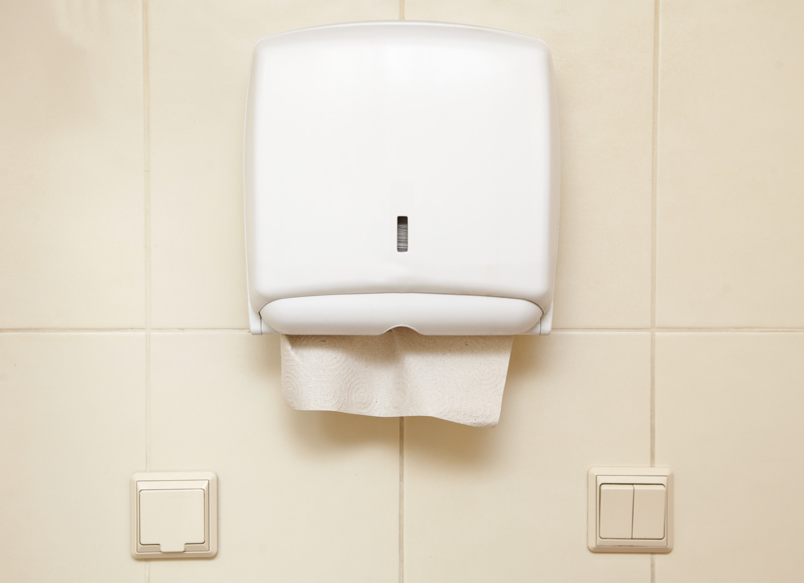
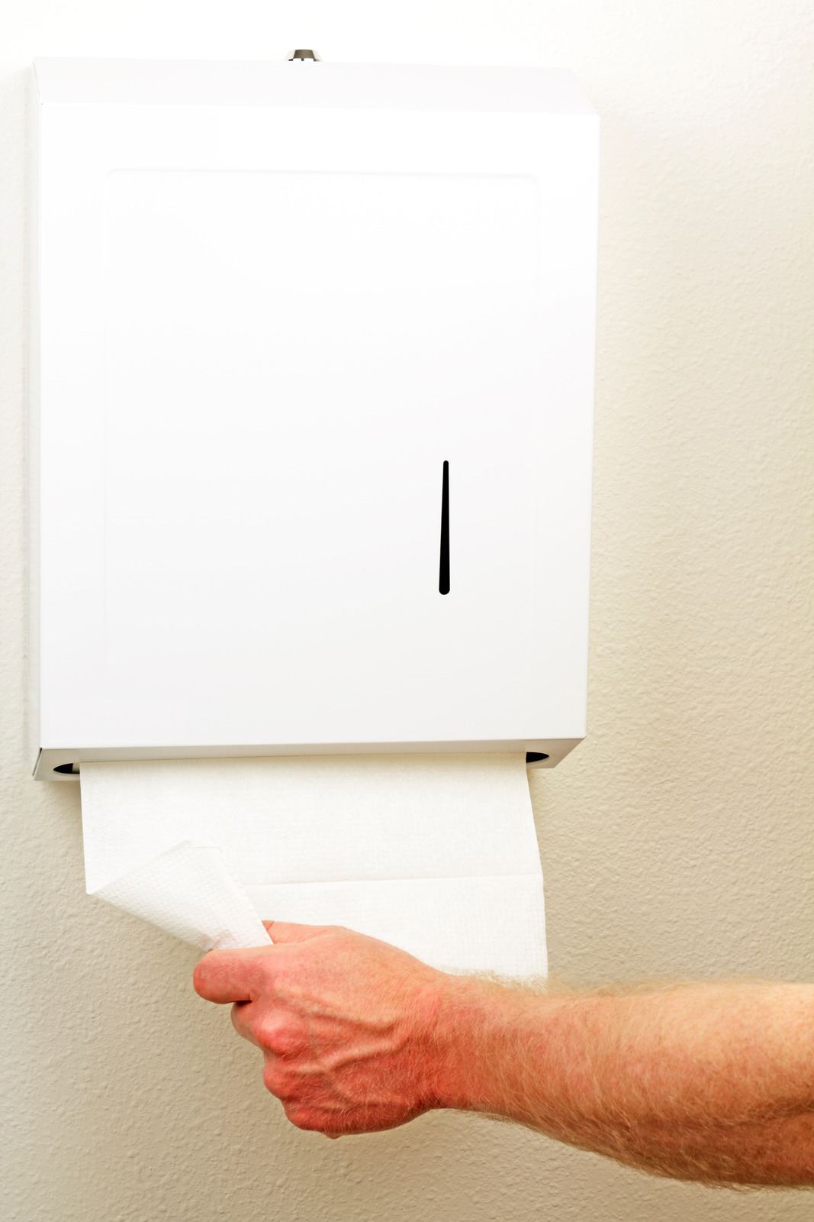
Get a paper towel.

Slide 11
Wipe your hands.

Slide 12
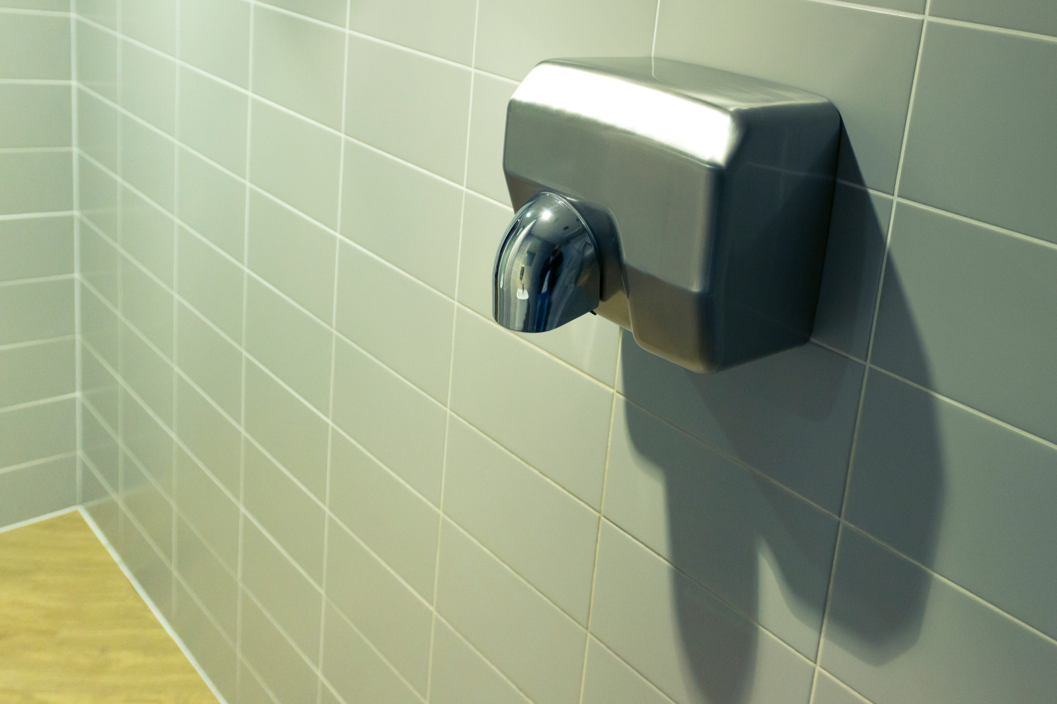
You can also use an air dryer, if there is one.

Slide 13
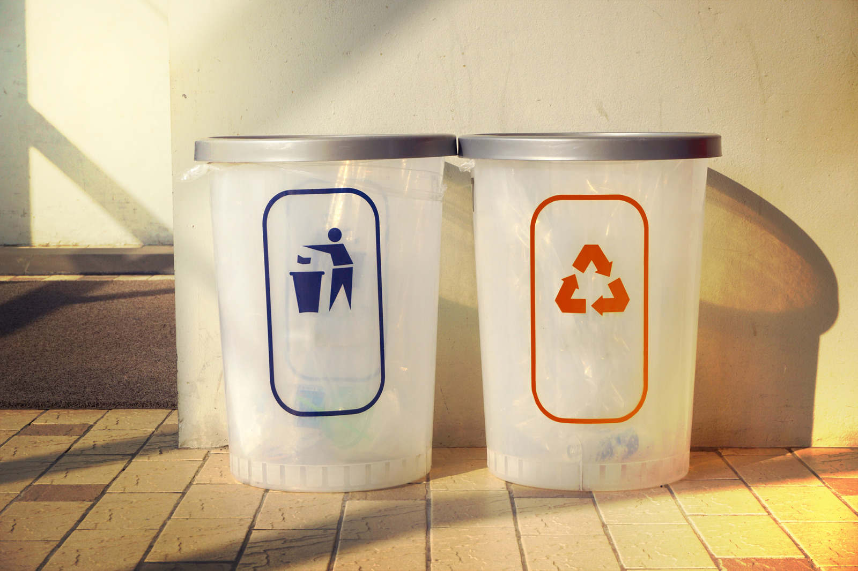
Put the paper towel in the trash.

Slide 14
All done! Review:
Do you remember the steps to washing your hands?
When do we wash our hands?
Why is it important to wash our hands?
Let’s practice!

