Slide 1


Programs and Events at
Brighton Farmers’ Market
SUNY Farmers Market Manager
Professional Certification

Slide 2

Notes:
Brighton Farmers’ Market is a lively market in the Town of Brighton, a suburb just outside the boundaries of the City of Rochester. Our market is just 4.5 miles from the large and famous Rochester Public Market, with which we have a friendly and collaborative relationship.

Slide 3
The mission of the Brighton Farmers’ Market is:
To support local farmers, especially those using sustainable and organic methods of agriculture;
To help build a stronger local food system;
To bring the fresh, local, sustainably produced food from these farms to members of our community;
To build community by bringing people together around the shared experience of valuing and enjoying local food.
Notes:
We are in our 12th year; the Market was organized in 2008 with a specific mission, which informs all our decisions and, we feel, contributes to our success. Our mission is:

Slide 4
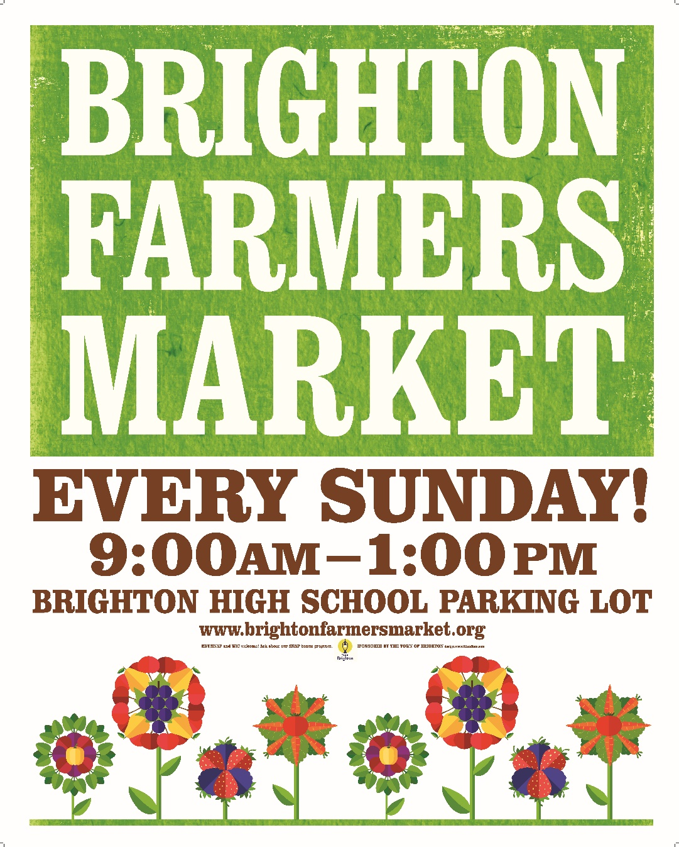
Notes:
We started out in 2008 with 24 vendors; we currently have 50 vendors. We have only food and agriculture-related vendors; we don’t have crafts and other types of products. It’s a producer-only market; with very limited exceptions, all products must be produced by the farmer or producer that participates in the market. Our market is held on Sunday mornings, 9 am to 1 pm, in the Brighton High School parking lot, centrally located in our town.

Slide 5
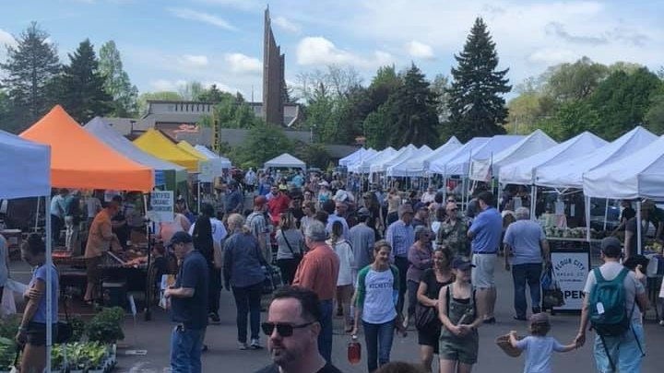
Notes:
The market runs year-round -- the summer market opens on Mother’s Day every year and runs through the Sunday before Thanksgiving; we move to an indoor winter market for the remainder of the year.

Slide 6
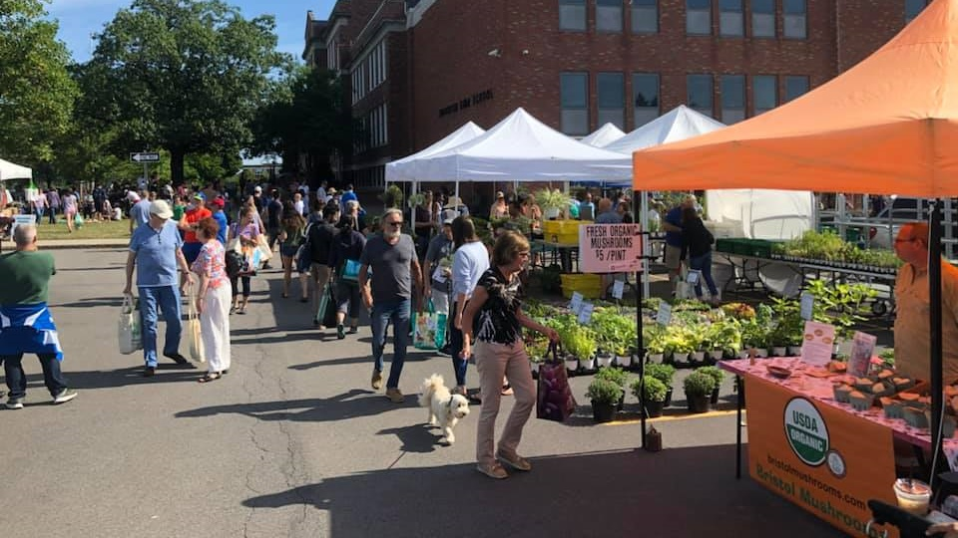
Notes:
Our market is sponsored by the Town of Brighton, which is very supportive of the market, recognizing the importance of the market to the community. We set up each week in the parking lot of the Brighton High School; the school district has been a very generous and welcoming host to us throughout the years. We are fortunate; the market has grown and become very popular, with many customers coming from beyond our town.

Slide 7
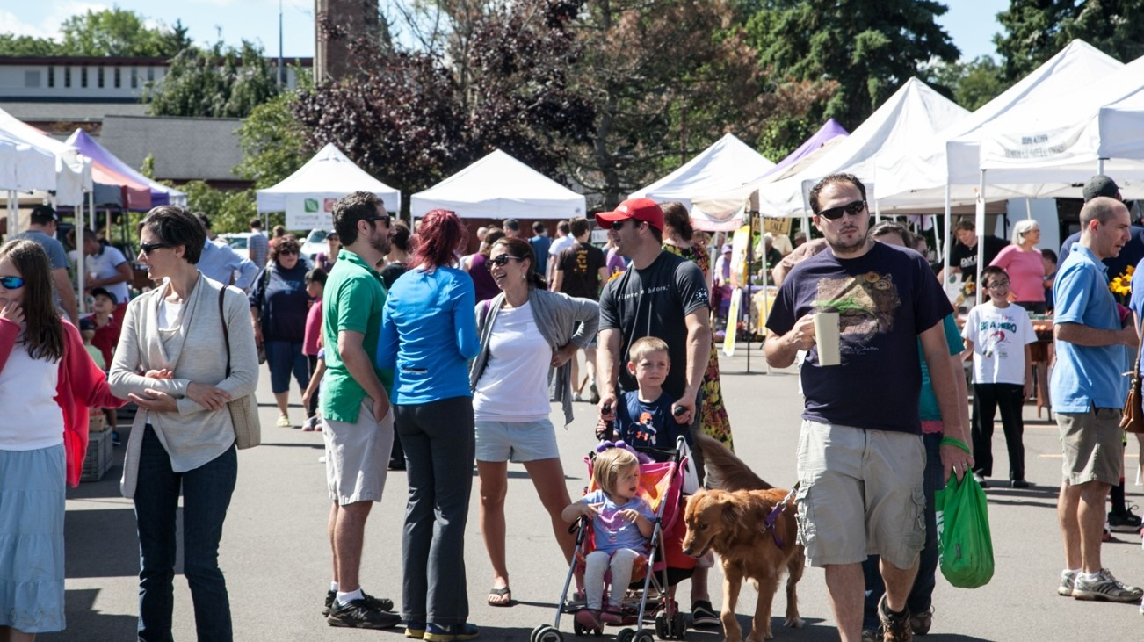
Notes:
The Brighton community is very supportive of our market and our vendors.

Slide 8
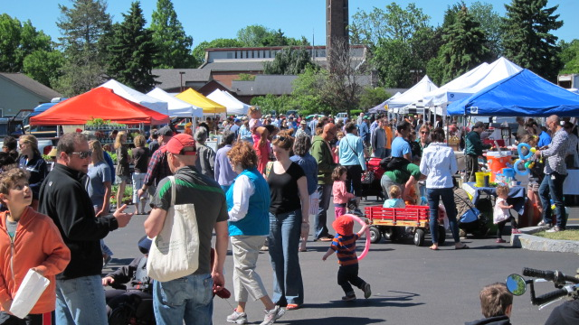

Slide 9

Notes:
Diane asked me to talk about the programs and events that our market has implemented to help bring customers into the market. We have a number of weekly, monthly, annual, and occasional programs that we feel help strengthen our market. We are lucky that because of the popularity and visibility of the market, we are frequently approached by individuals and groups with interesting and community based projects they wish to promote. In the early years of the market, we actively approached organizations and groups to ask them to join us, but now we are regularly approached by groups that would like to spread their message at the market. Because the market is sponsored by the Town of Brighton, all market finances go through the Town budget. No funding is allocated for special events or marketing, so we don’t pay for any of the events. The Town expects the market to largely pay for itself through vendor fees. Several of our special events are hosted by Town departments or agencies; the market has become the main vehicle for the Town to connect with the community, and it increasingly takes advantage of that opportunity.

Slide 10

Notes:
We have partnerships with two local organizations which have been with us from the first years of the Market and who continue to participate. Having partners whose missions mesh with the market’s mission has strengthened our market while increasing the success of our partners’ work. The first partner, Color Brighton Green, is a volunteer-driven organization that supports sustainability and green energy solutions in our town and collects items that are hard to recycle. The precursor to this group made the initial recommendation to the town to start a farmers’ market, which led to the founding of the market and the continuing partnership with the market.

Slide 11
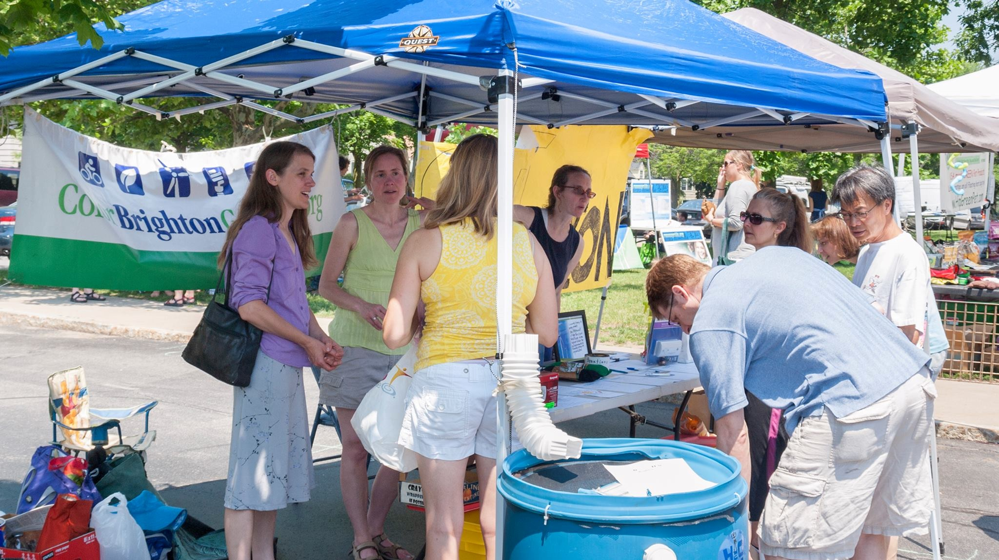
Notes:
Until this year volunteers from Color Brighton Green were a weekly presence at the market; this year they are coming once a month, with a focus on educating the community about specific environmental issues such as electric vehicles, recycling, food waste, etc. As you have probably all experienced, it’s tough to maintain volunteer programs; burn-out is common, but this group has been amazing in its commitment and hard work in the community and at our market.

Slide 12

Notes:
Our other partner and regular participant at the market is the Brighton Food Cupboard, a program of Rochester’s Jewish Family Services, that provides food to low-income members of our community. The Food Cupboard collects donations of food and cash at the market.

Slide 13
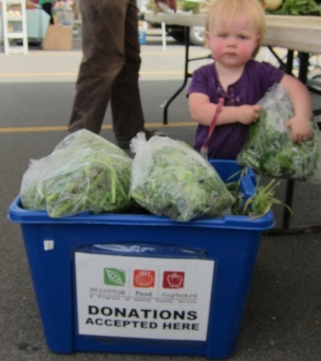
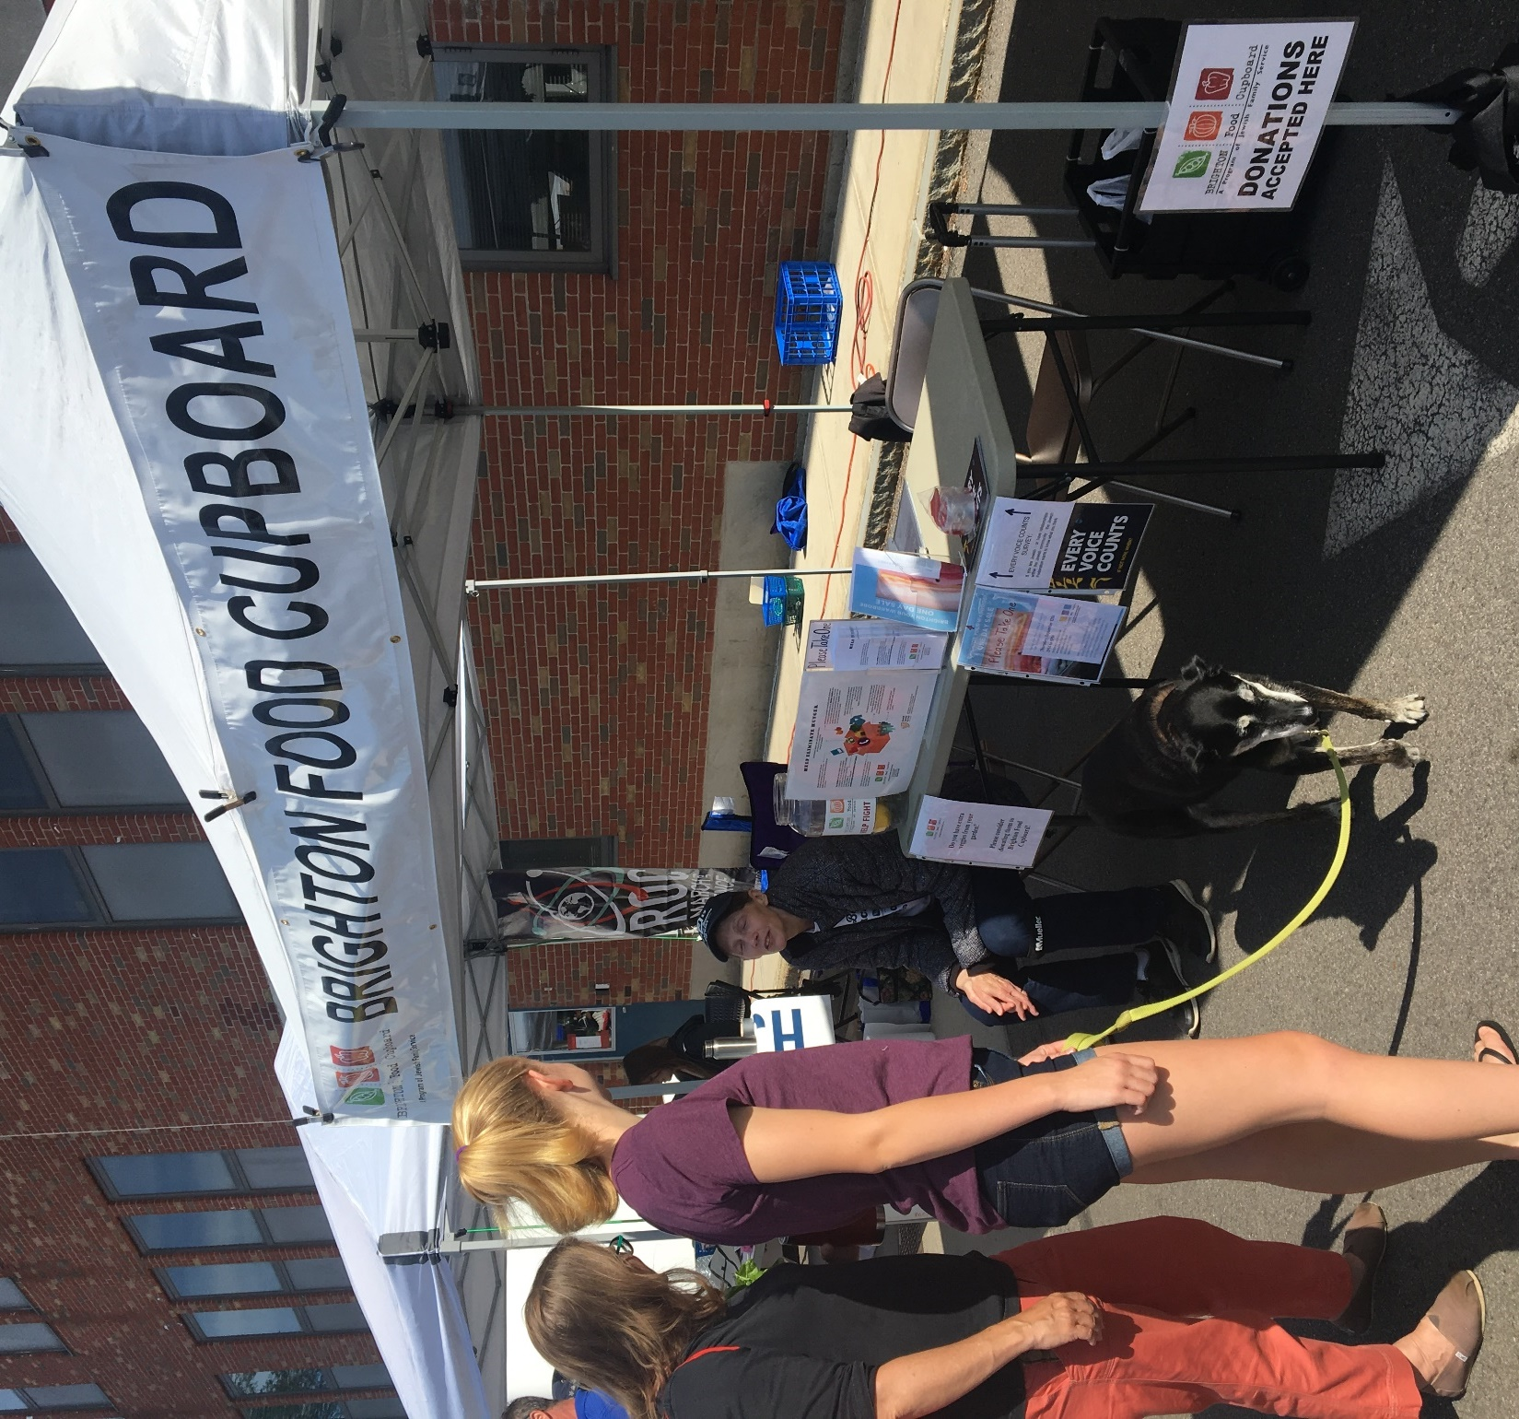
Notes:
Much of the food is donated by our vendors, who are wonderfully generous in their donations. In the last two years the Brighton Food Cupboard has collected over 5,000 pounds of food at the market. This partnership was formed soon after the Food Cupboard was established several years ago; I was asked to serve on the Food Cupboard’s board, and because of the obvious parallels in our missions, I invited the Food Cupboard to be a regular participant in the market. It has a weekly booth at both oru summer and winter markets, staffed by an individual hired bythe Food Cupboard. This is an important partnership for us; we are committed to making these healthy local foods available to all. To further this goal we participate in the SNAP token program, and welcome a committed group of SNAP customers each week to the Market.

Slide 14
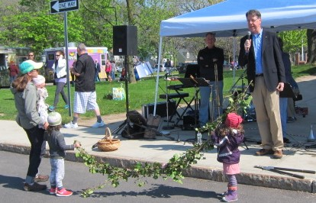
Notes:
As I mentioned before, we have weekly, monthly, annual, and occasional programs and events at the market. The summer season opens on Mother’s Day with our annual Opening Day ceremony. Rather than a ribbon-cutting ceremony, we have a vine-cutting ceremony, presided over by our Town Supervisor. The vine, supported by young children, is usually embellished with radishes and scallions, just to get us off to a spring veggie-flavored start. The band plays a fanfare, and Supervisor Moehle makes a little speech.

Slide 15
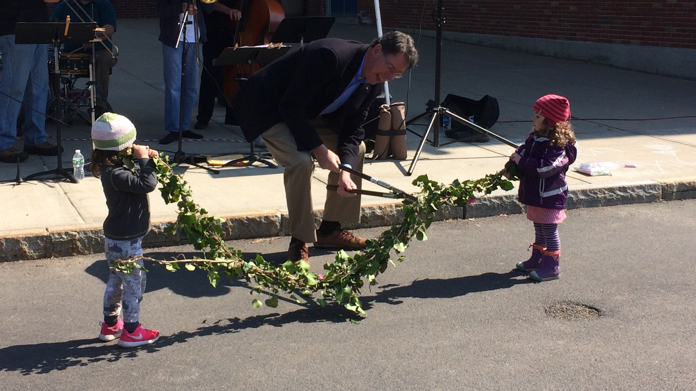
Notes:
The Supervisor then cuts the vine. He is 6 feet 8 inches tall, so cutting the vine requires a flexible back. He makes it a point to visit the market nearly every week and talk with market-goers, which helps strengthen the connection between Town government, the community, and the market. He also posts extensively about his visits to the market each week on social media. Having the local government involved in and supportive of our market has been important to our continuing growth and success.

Slide 16
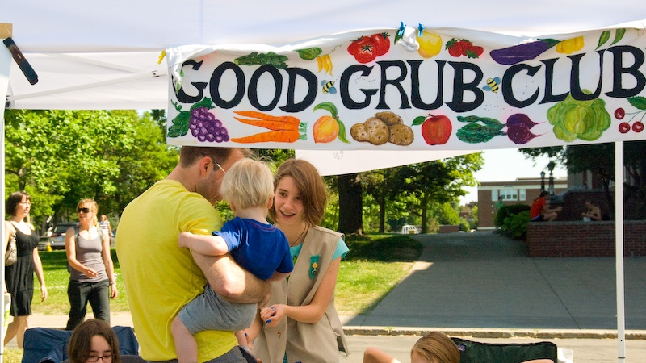
Notes:
Every week we offer a program for young kids, called the Good Grub Club. The goal is to encourage kids to eat the fruits and vegetables available at the market, a little healthy-eating propaganda.

Slide 17

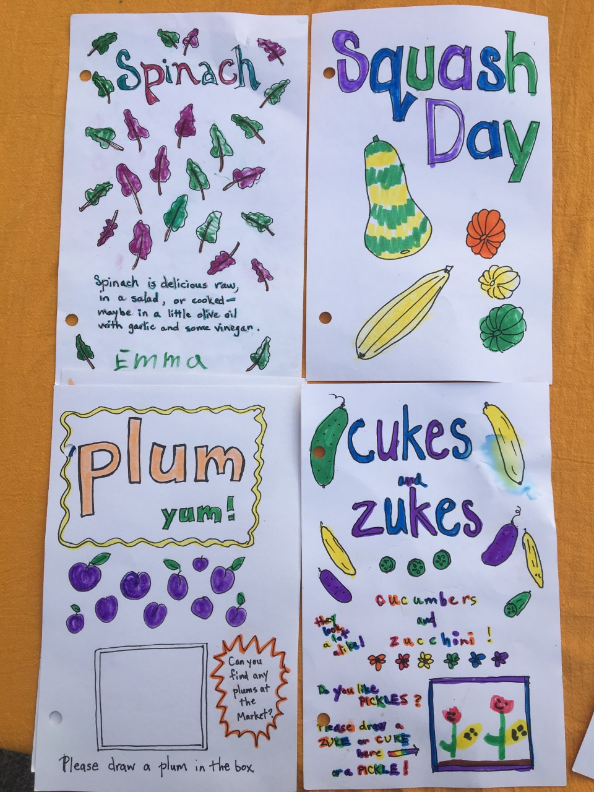
Notes:
At the beginning of the season, each kid gets a booklet cover, which they can color or embellish as they wish. Then each week they can get a page they can color to add to their booklet, featuring a fruit or vegetable available that week at the market.

Slide 18
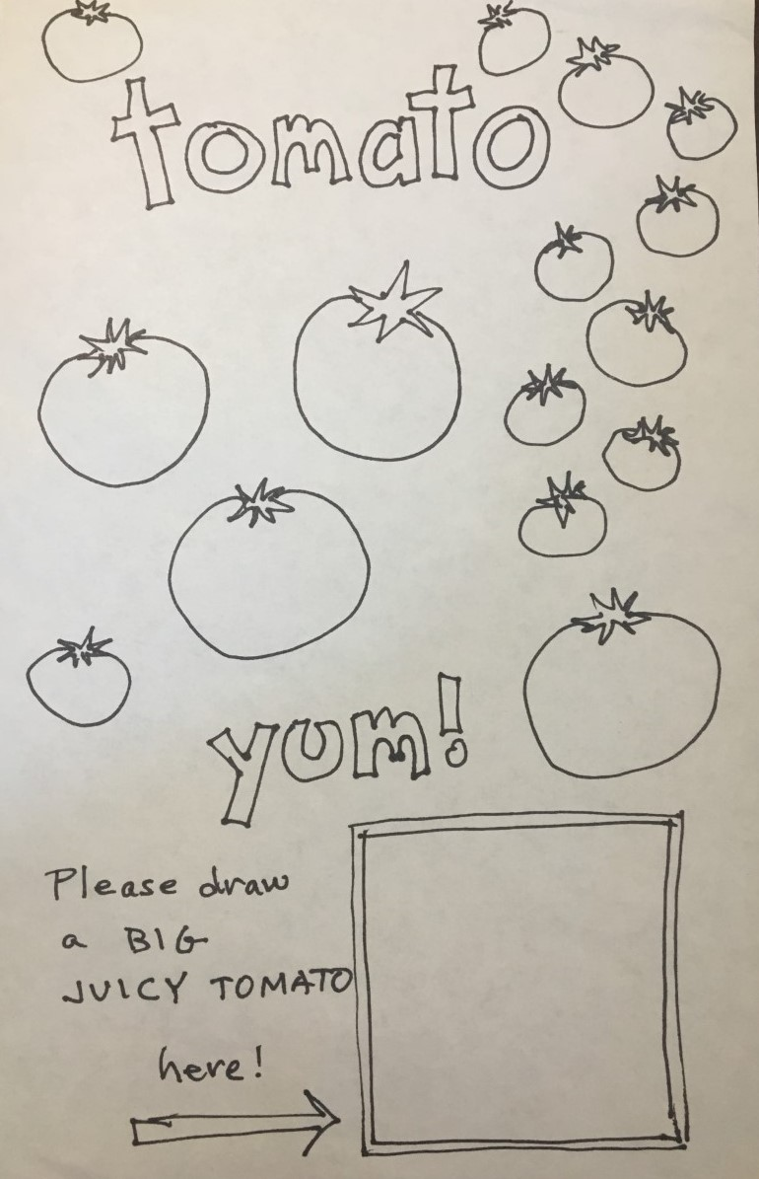
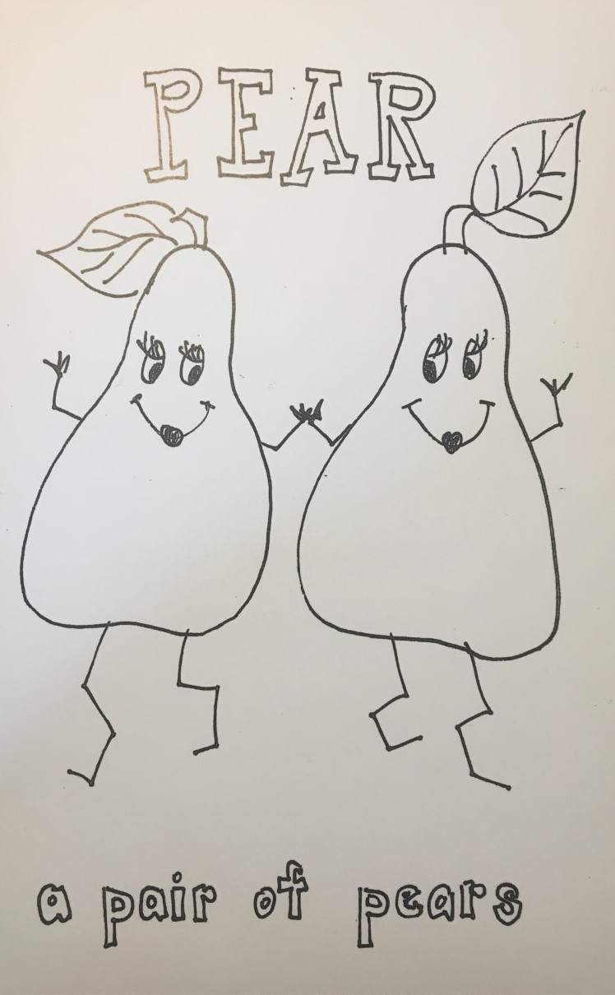
Notes:
We have lots of washable markers for them to use.

Slide 19
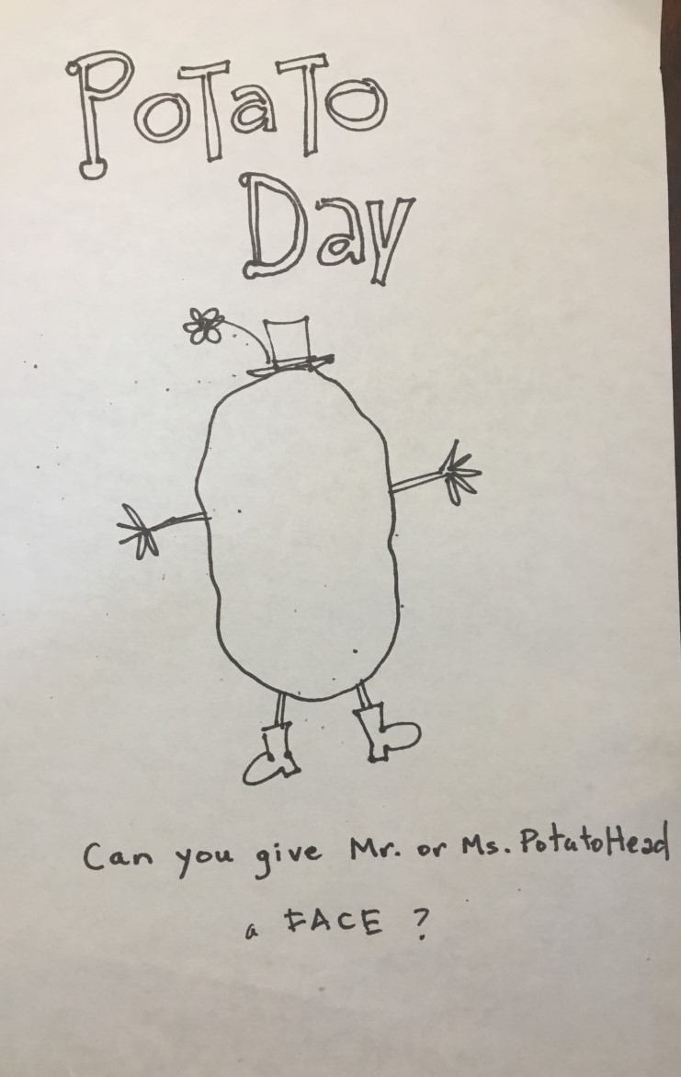
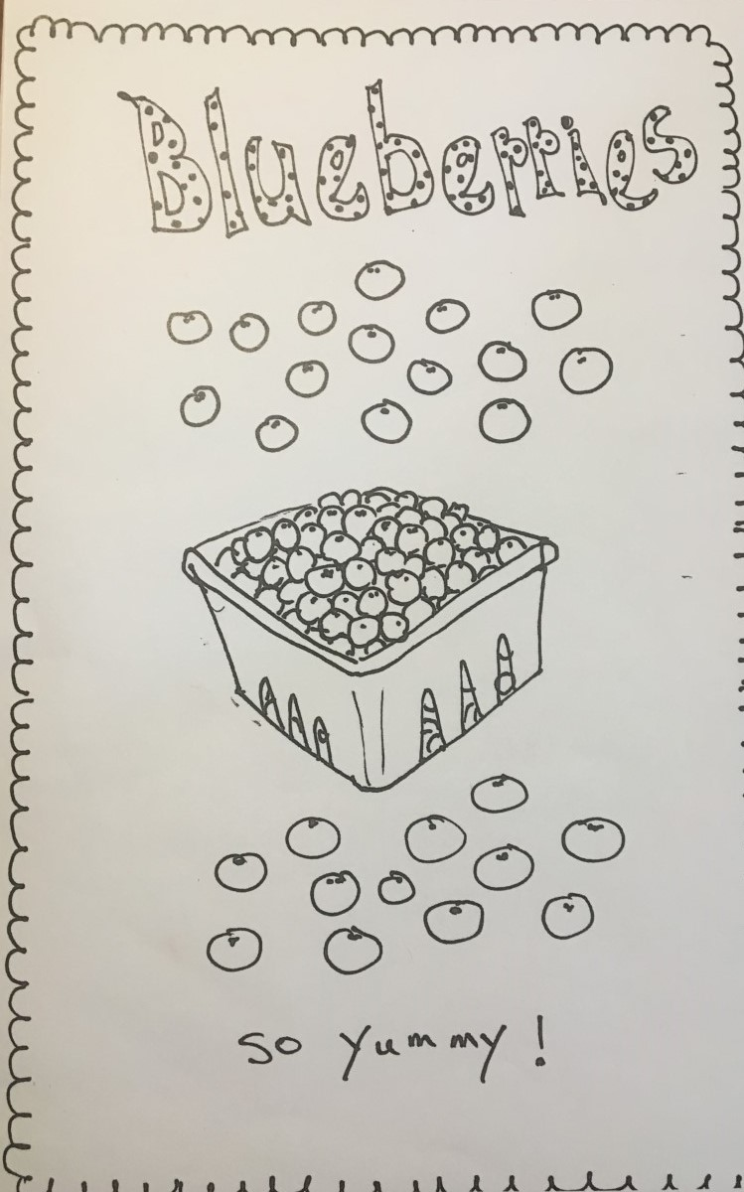
Notes:
We encourage the kids to try the food, ask them if they like it, have they ever tried it, and so on.

Slide 20
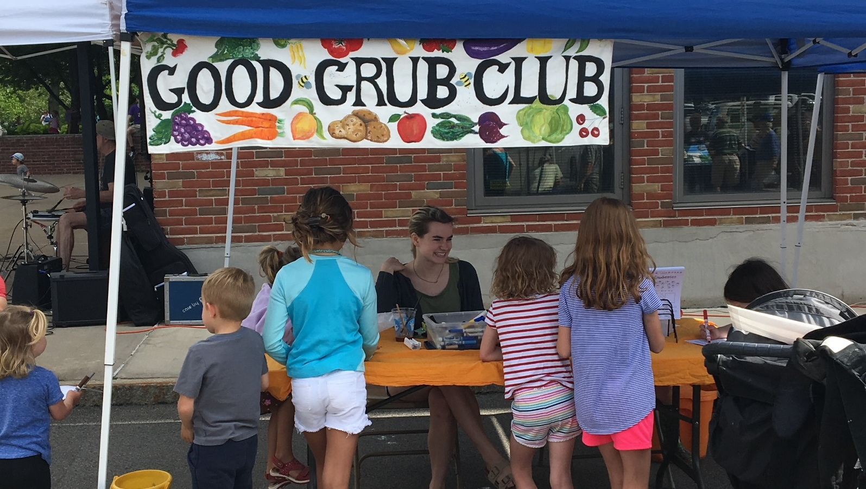
Notes:
We seek student volunteers to staff the booth; little kids like big kids. We have had varying success in attracting student volunteers; some years we’ve had plenty of students, other years it’s been harder to get them. They can use the work to fill community service requirements for school or scouting activities. We contact staff at Brighton High School to let them know about the community service opportunity available at the market.

Slide 21
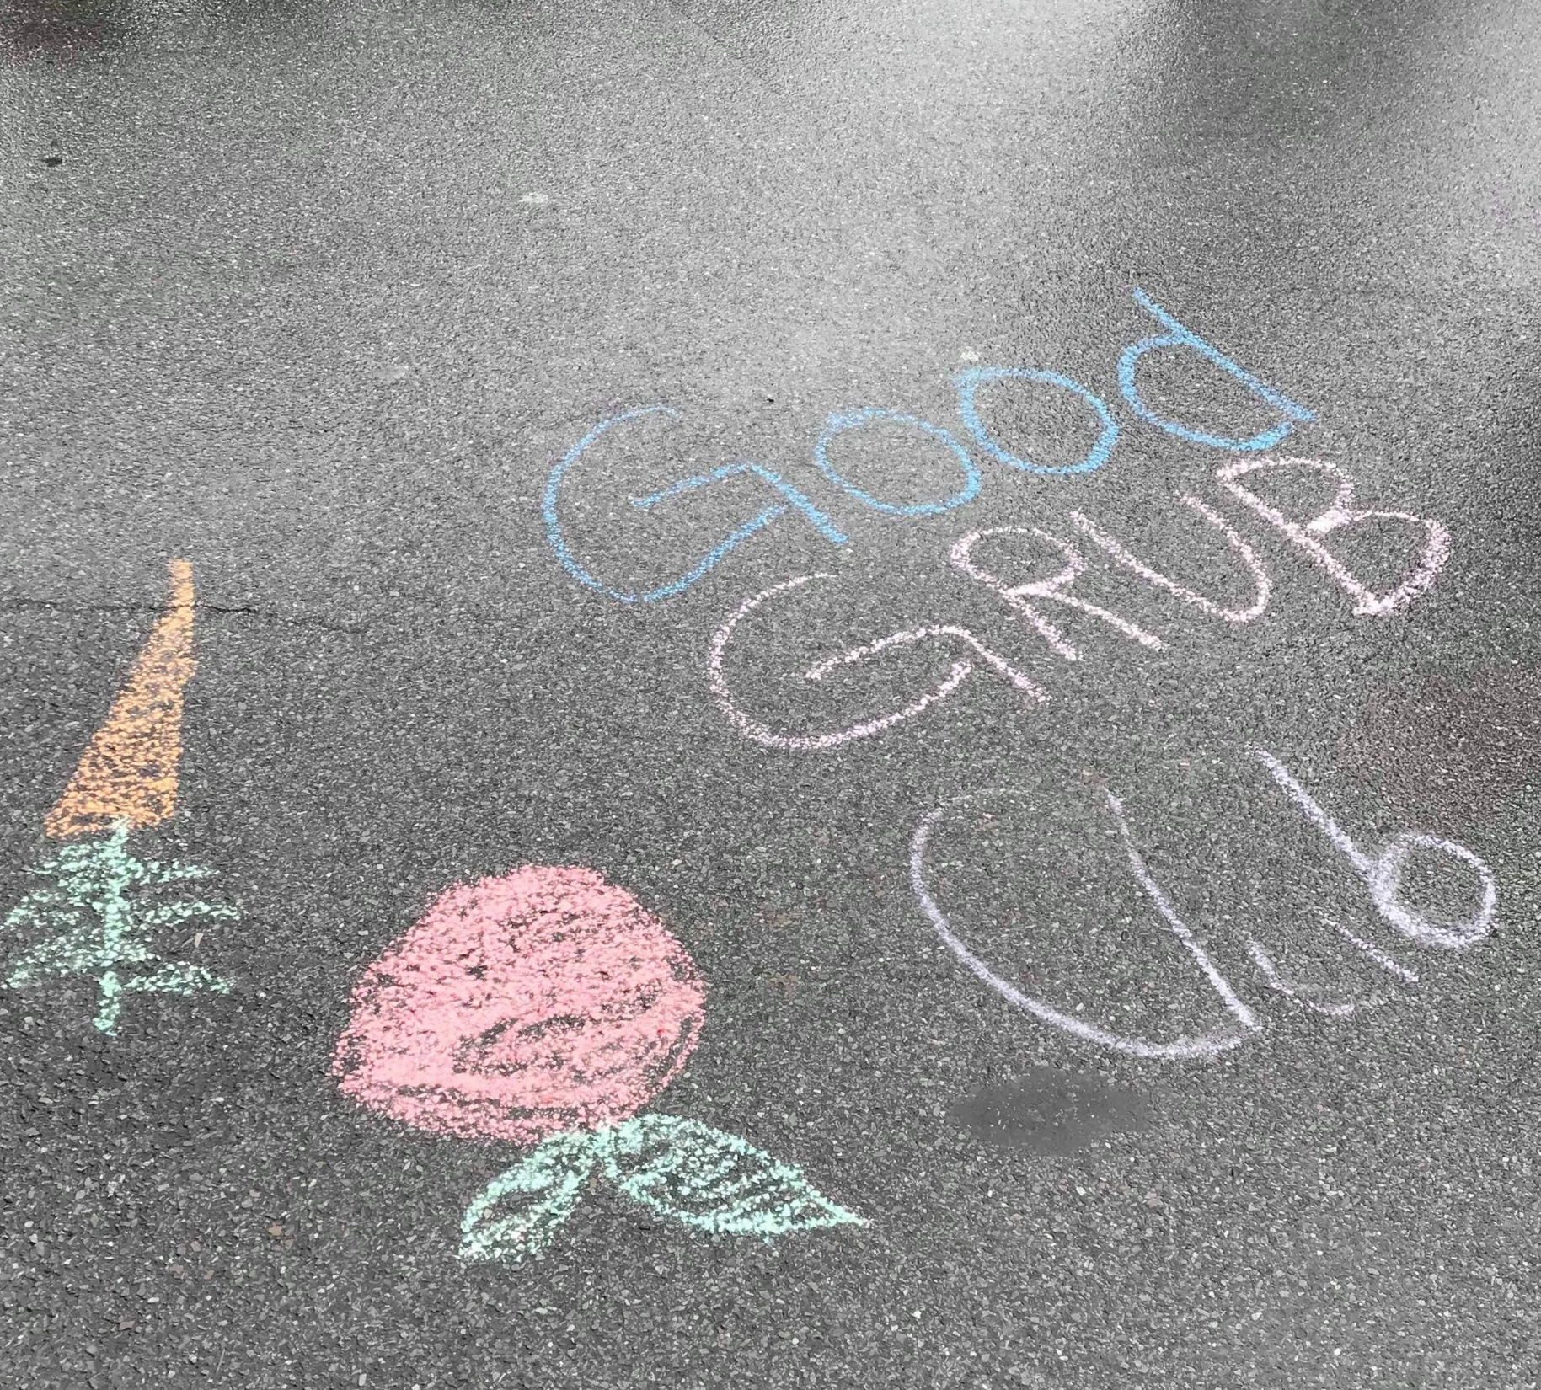
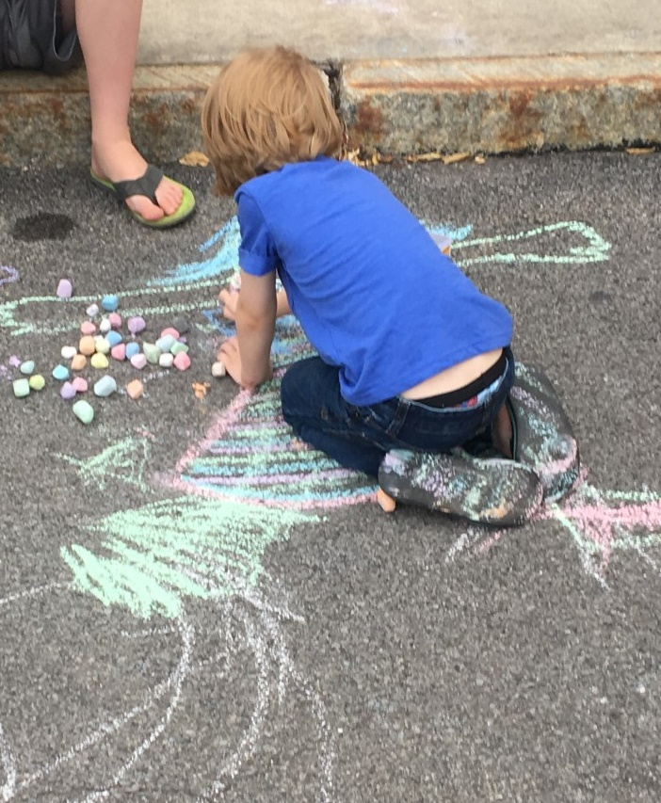
Notes:
We also provide chalk for kids to draw on the pavement, and we go through buckets of chalk.

Slide 22
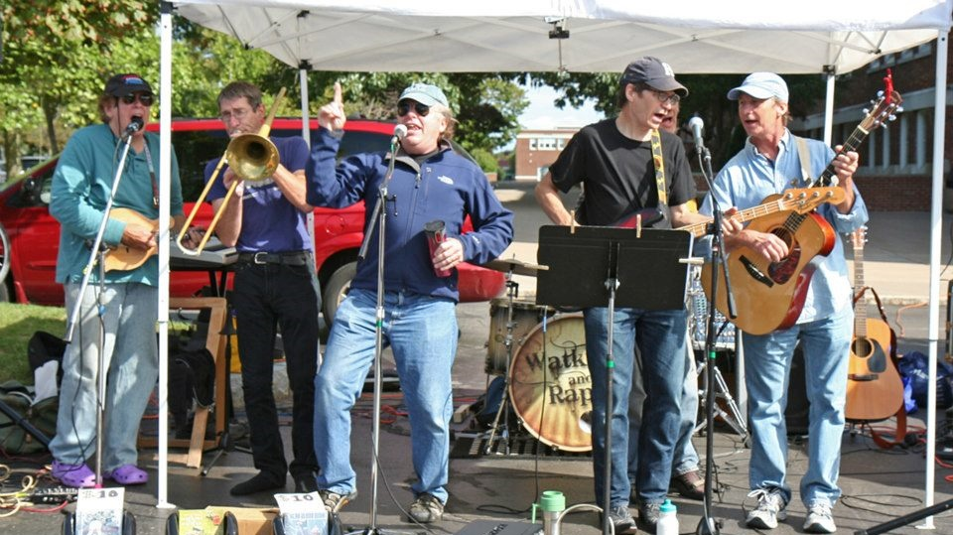
Notes:
As at many markets, music is a regular and important part of our market. We’re very lucky in Rochester to have an abundance of musical talent, and we have some amazing high quality performances.

Slide 23
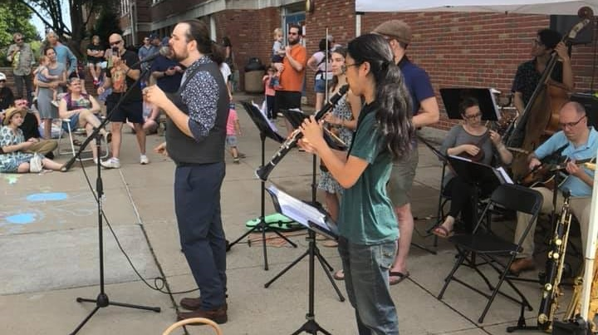
Notes:
Each week a musical group performs, which creates festive energy for the market; people love it -- the market would be much less lively without the music.

Slide 24
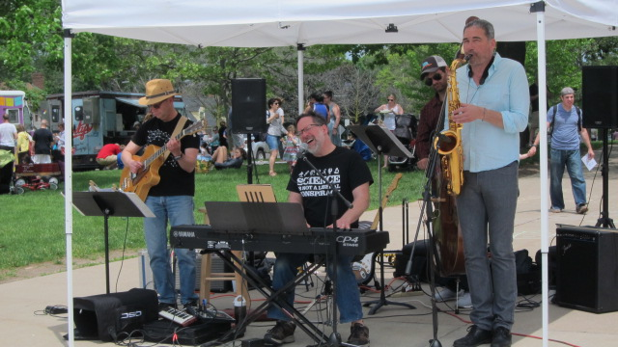
Notes:
We don’t have funding to pay the musicians, but they collect donations from market-goers. I collect donations from all the vendors to put in the musicians’ basket, and I’m told musicians are well-compensated this way. Many of our vendors are very generous with the musicians, recognizing that the music contributes to the market’s success. A volunteer with connections in the local music community schedules the musicians every year.

Slide 25
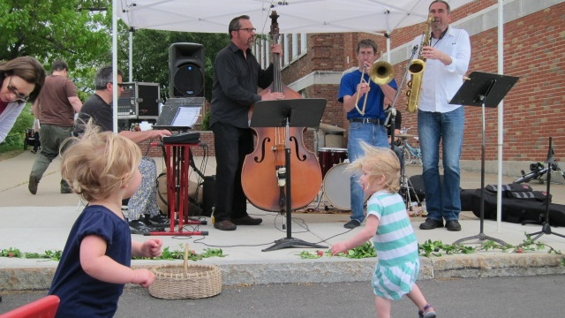
Notes:
People gather around the music tent to listen. A typical sight is to see uninhibited toddlers dancing along with the music in the open space in front of the music tent.

Slide 26
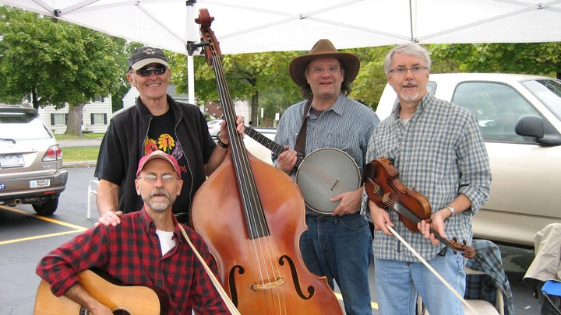
Notes:
Once during the season an old-timey string group plays, and a flash mob of country dancers shows up to dance along with the music.

Slide 27
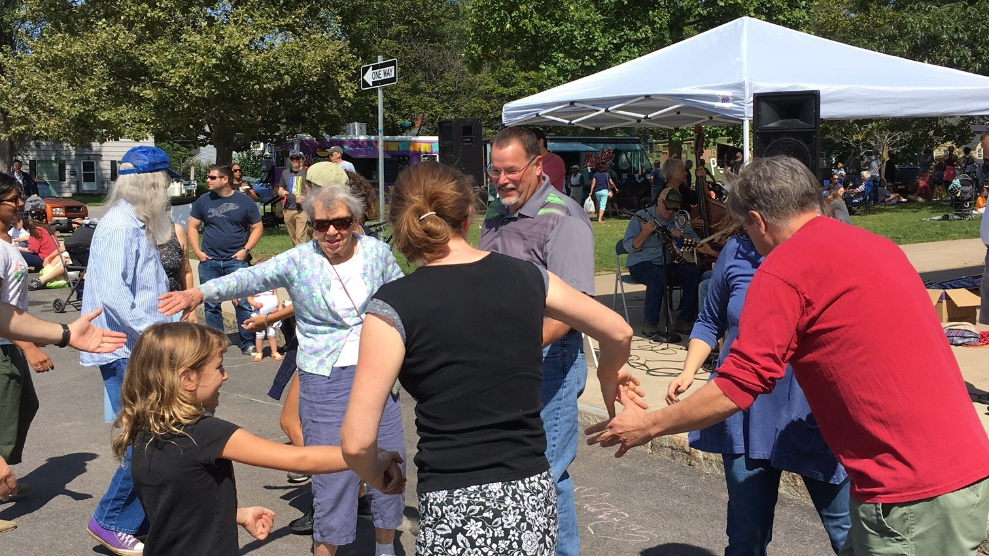
Notes:
Market goers of all ages often join in the fun, including eager kids.

Slide 28
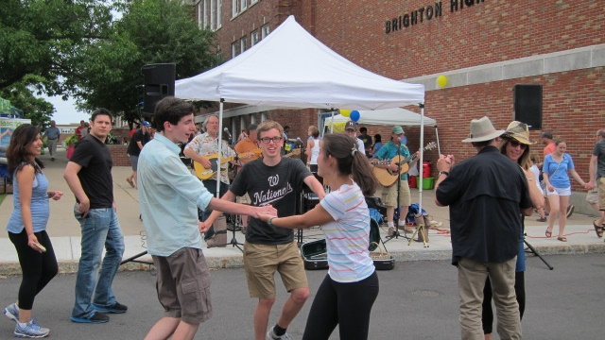
Notes:
We especially love to see young people engaged at the Market.

Slide 29
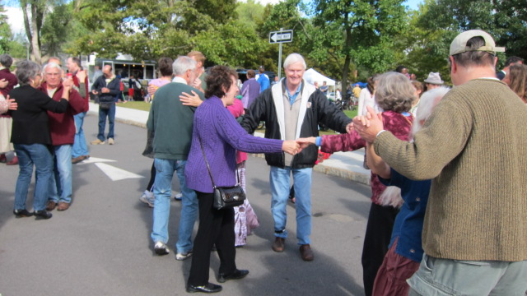
Notes:
We’ve had jazz groups, rock groups, country groups, a group playing Brazilian music, African music, Irish music, and a group called Flexitarians, which consists of whatever really good musicians our friend Rick can dig up that day.

Slide 30
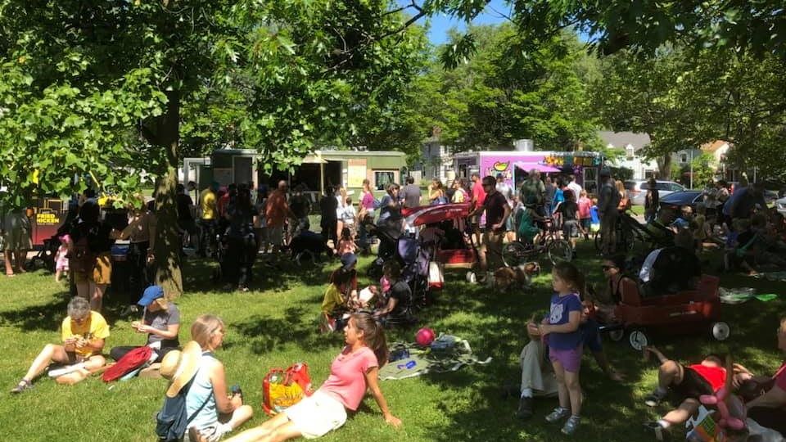
Notes:
The music tent is next to a large grassy area in front of the school which has become a picnic area. Three food trucks and a coffee tent set up on the other side of the lawn, so people can get something to eat, sit on the lawn, and listen to the music. We often see groups of friends and family spend hours on the lawn.

Slide 31
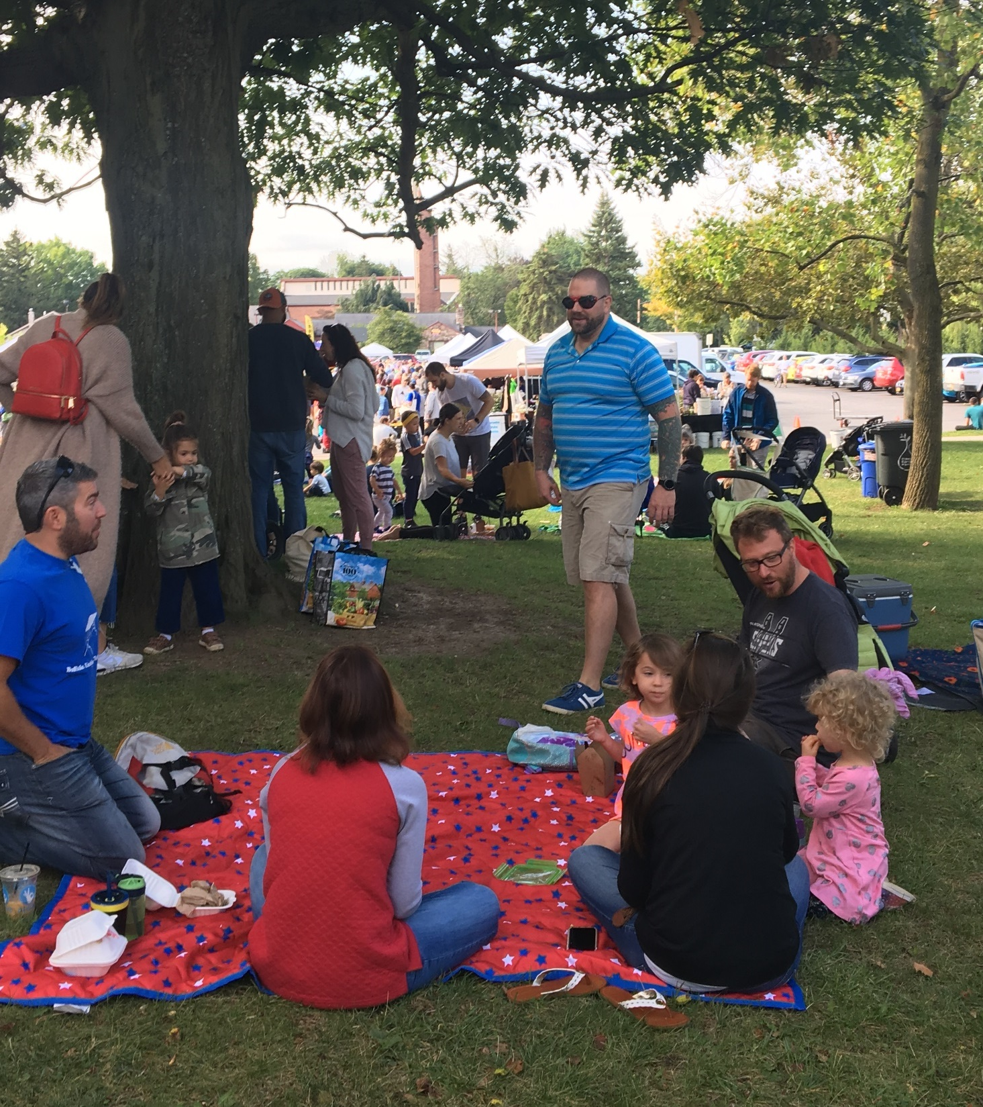
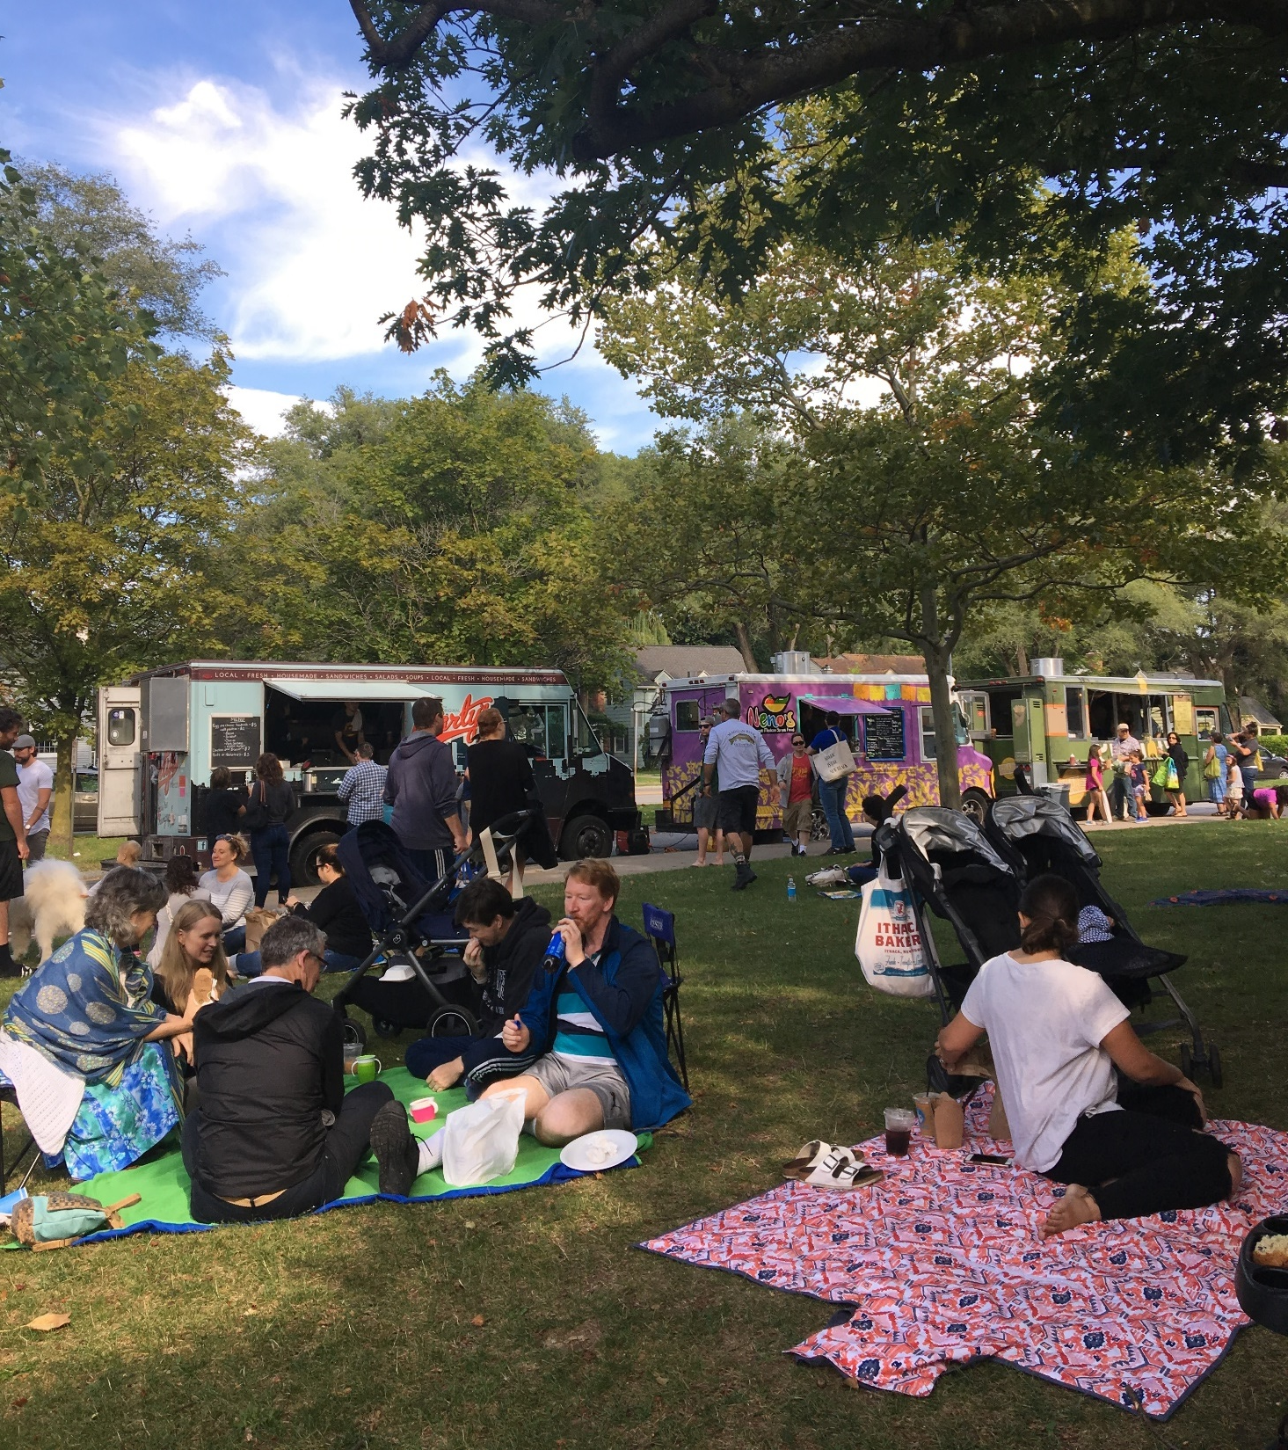
Notes:
Children’s birthday parties have been held there. We wish we had a dedicated space where people can sit at tables and chairs to relax, but people don’t seem to mind this informal way of hanging out with their friends.

Slide 32
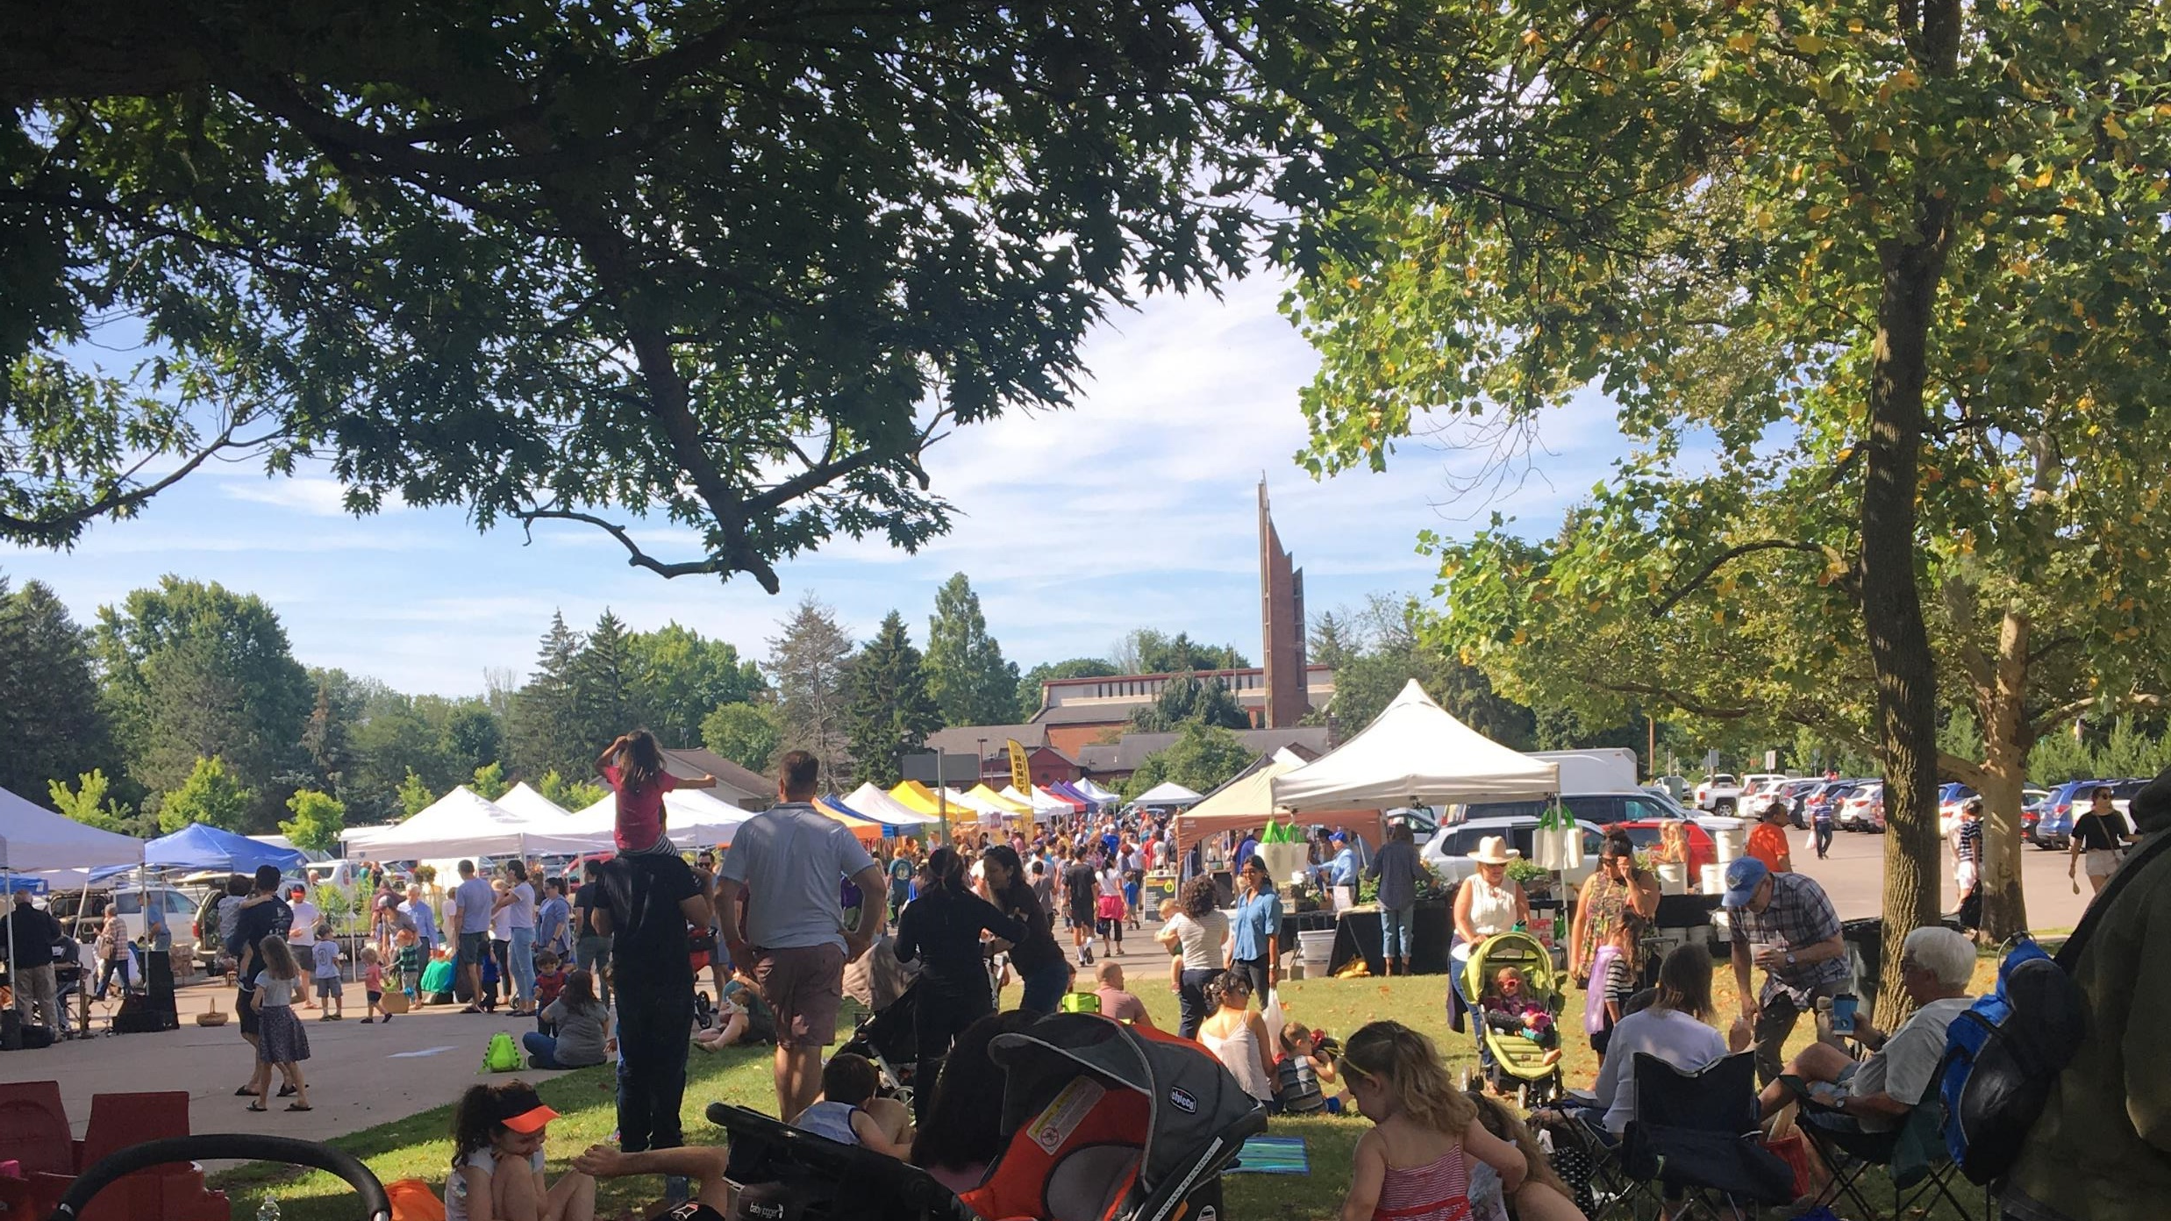
Notes:
There’s a real sense of this area as a community gathering place. Because part of our mission is to build community, we feel that having space like this where people can gather and hang out has contributed to our success.

Slide 33
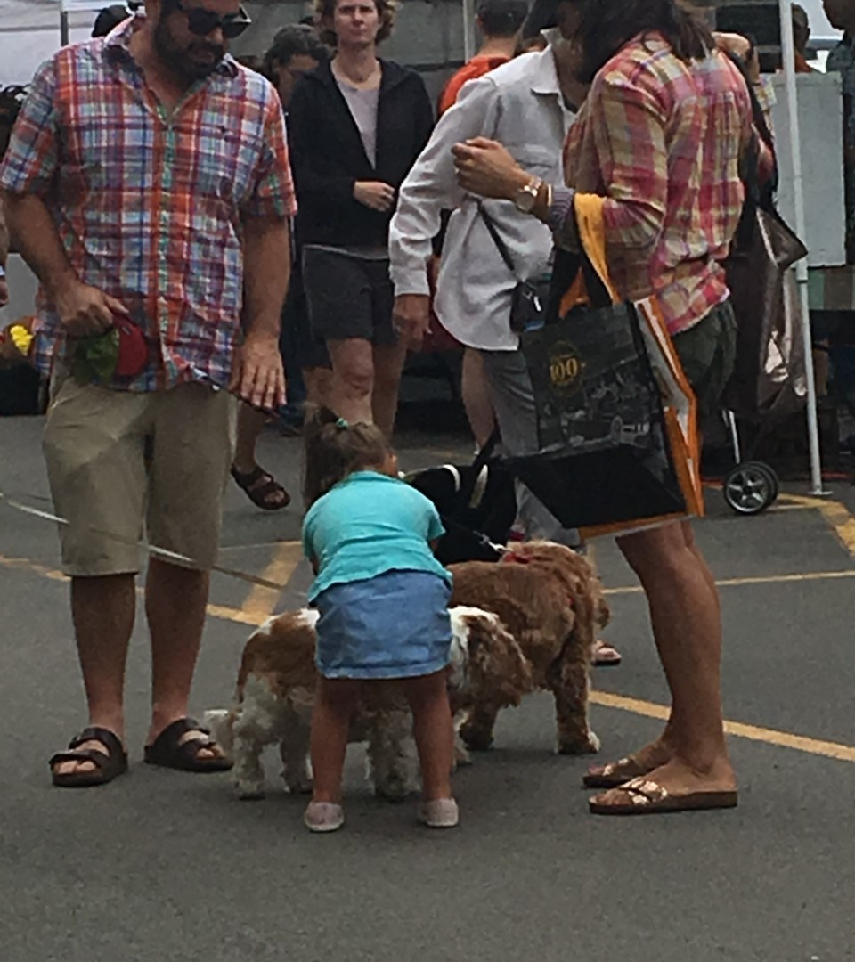
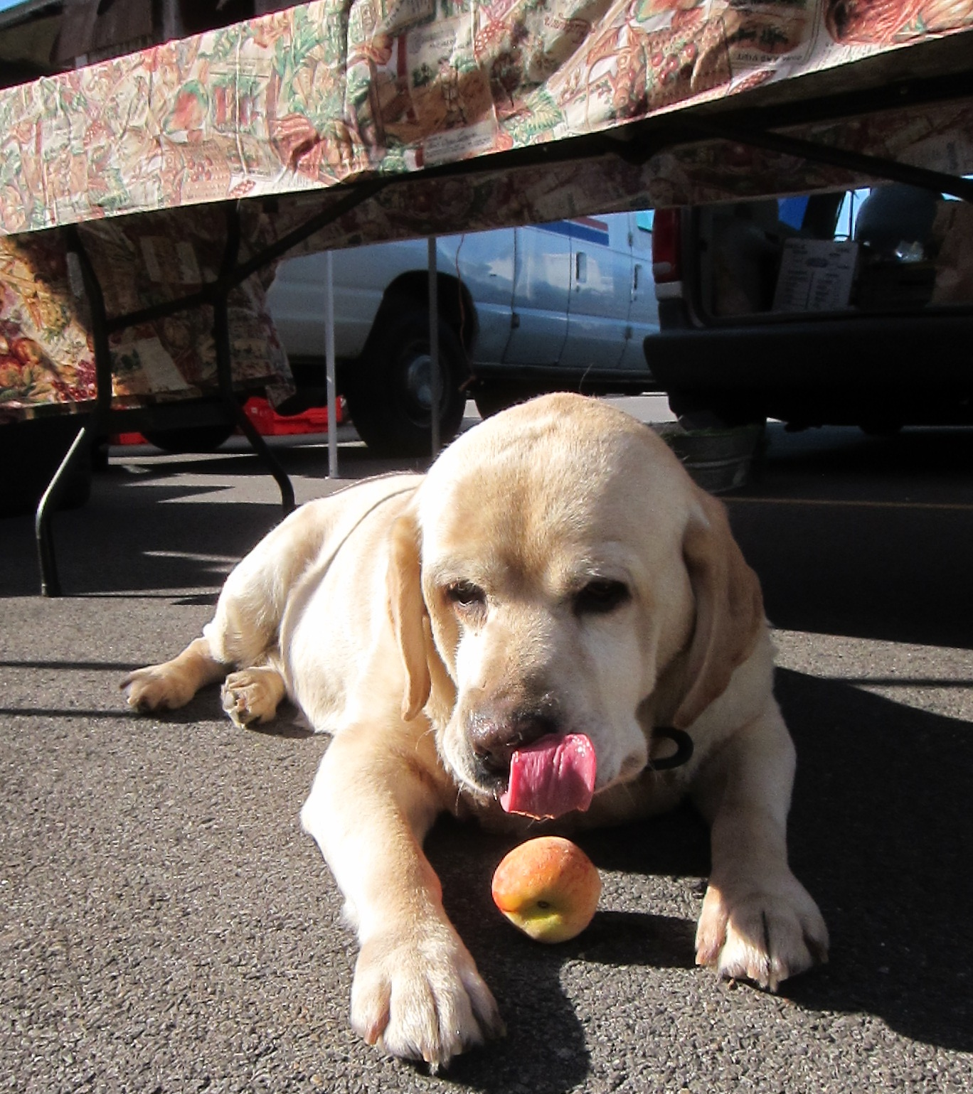
Notes:
We do allow dogs at the market, and there are many dogs every week.

Slide 34
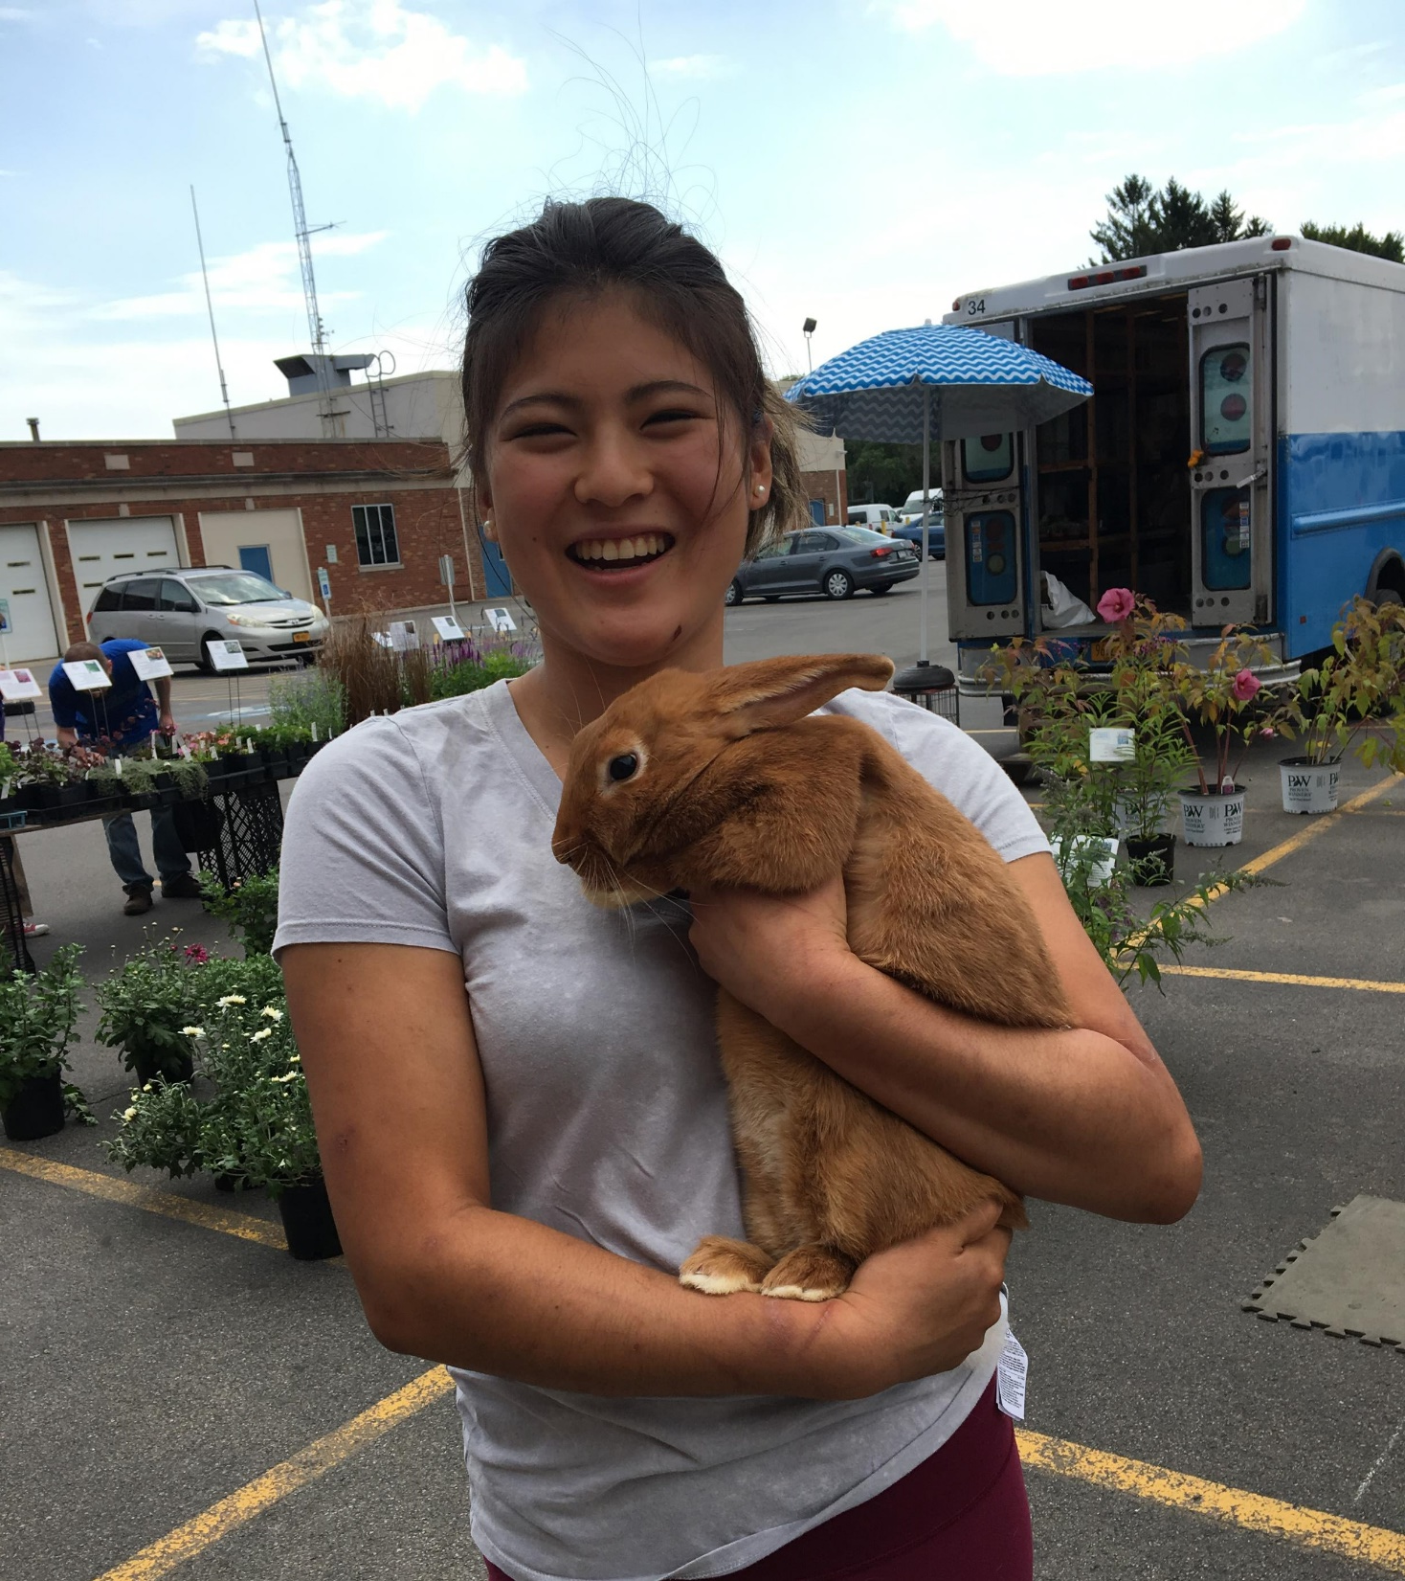
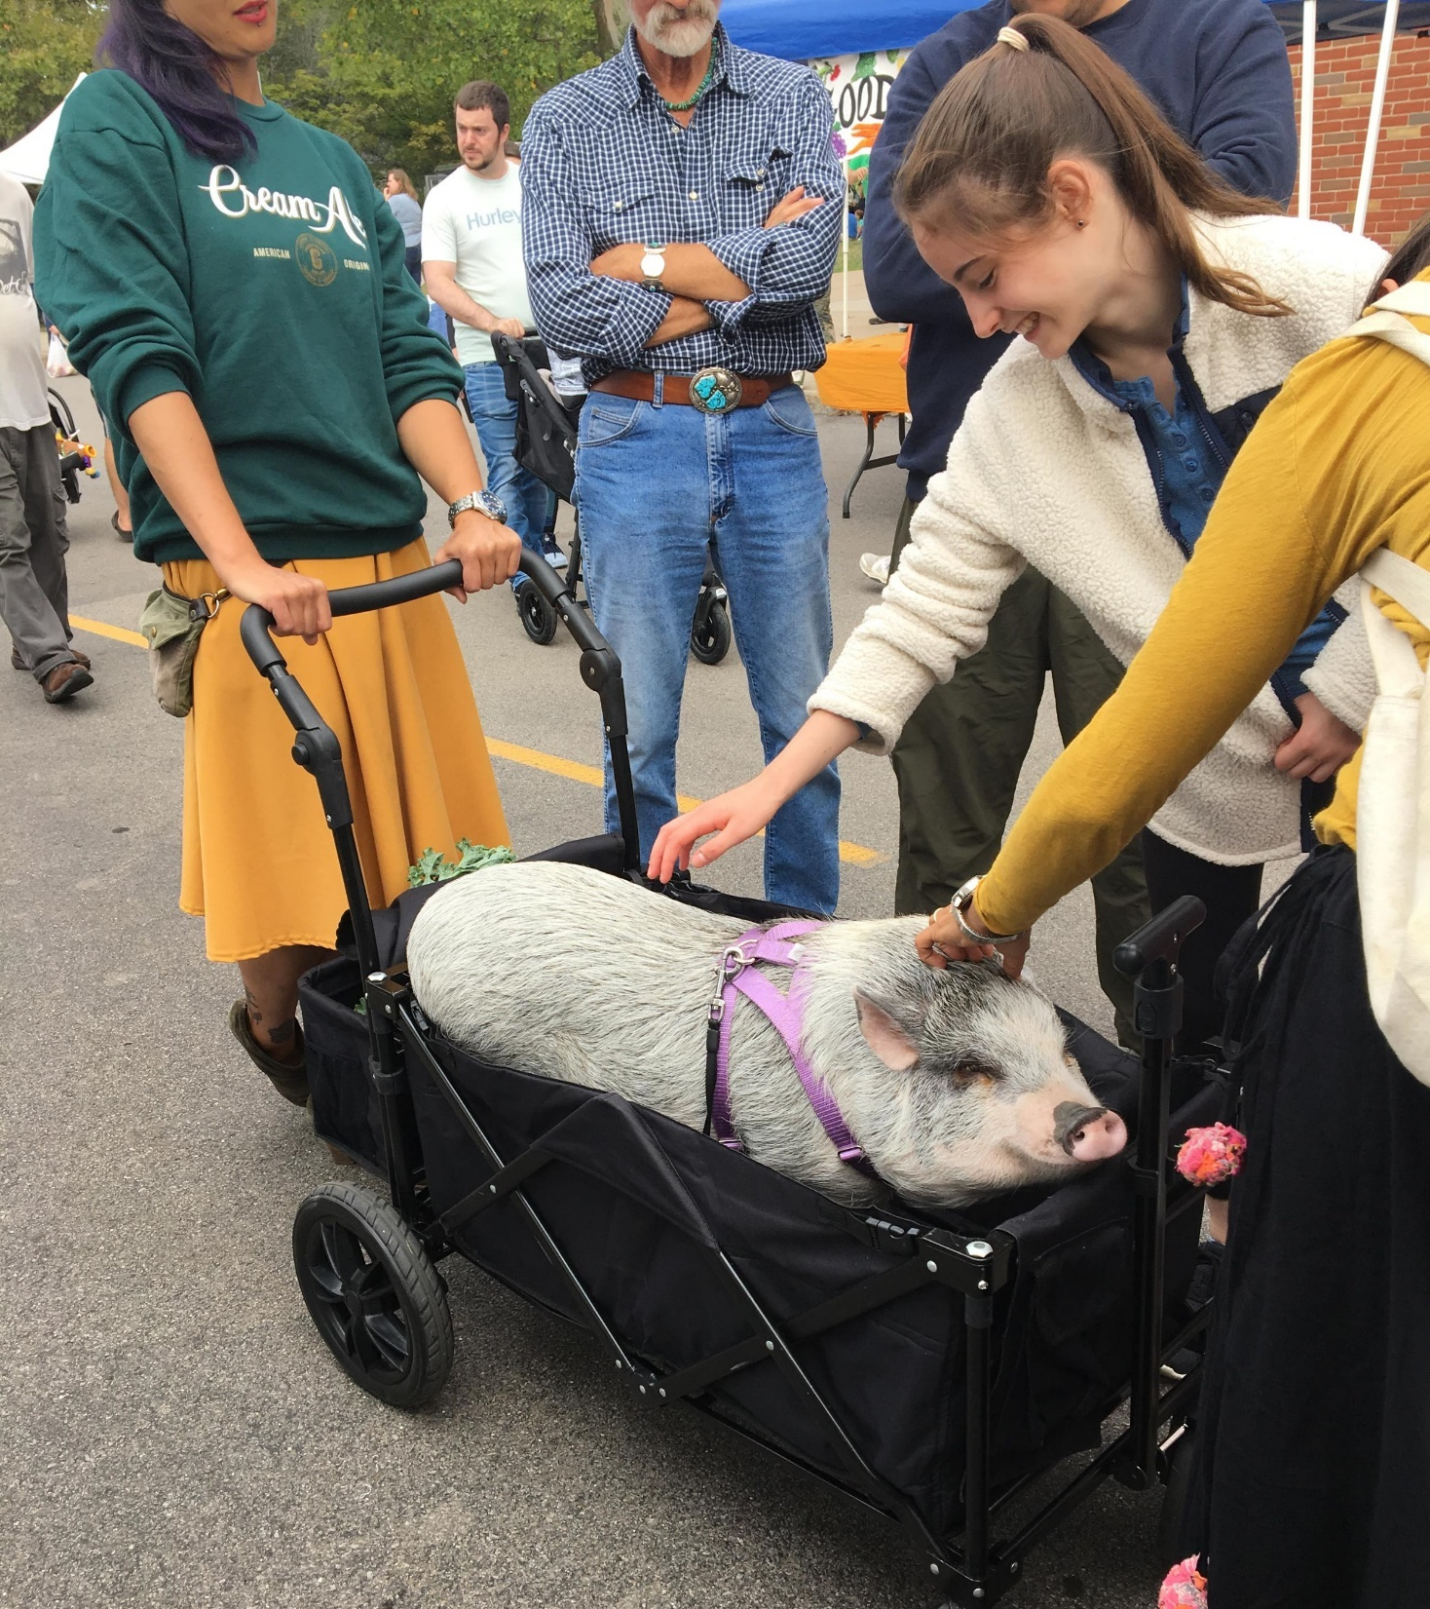
Notes:
And the occasional rabbit and pig.

Slide 35
Special Events
Notes:
We have a number of special events during the season, which are popular with our community and bring more people into the market.

Slide 36
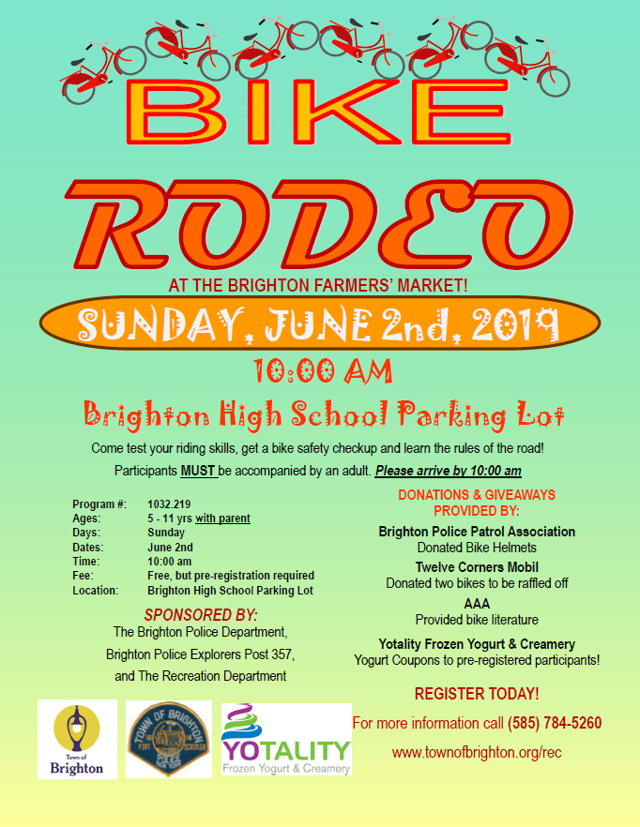
Bike Rodeo
Notes:
In early June there is a Bike Rodeo for children, sponsored by the Town Recreation Department and the Brighton Police Department.

Slide 37
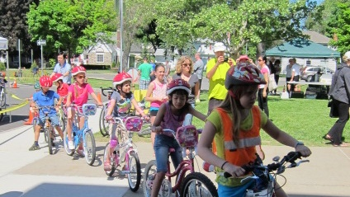
Notes:
Kids are encouraged to bring their bikes to the market.

Slide 38
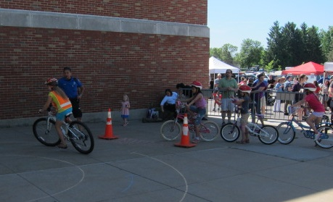
Notes:
The police set up courses for kids to try out their bike skills and give information to kids on bike safety. A police organization donates bike helmets that are given to participating children. It’s a fun event but one that is designed to promote safety for kids.

Slide 39
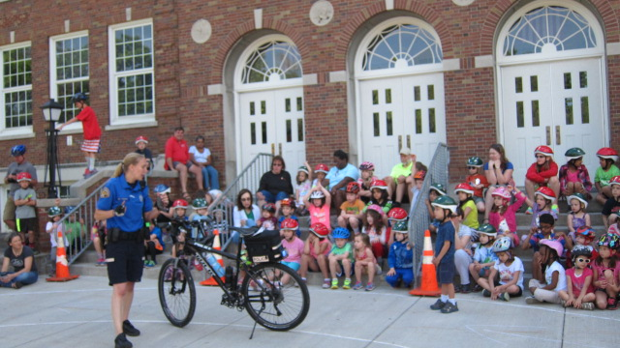
Notes:
As I said, the market is sponsored by the Town of Brighton; it’s under the direction of the Town Recreation Department. The Recreation Department used to schedule the Bike Rodeo at a different location and on a different day, but when the current director of the Recreation Department took over, I encouraged her to schedule the Bike Rodeo to coincide with the market, which has been great for the event and great for us. Combining forces with existing programs in the community is a good way to build synergies that benefit all.

Slide 40
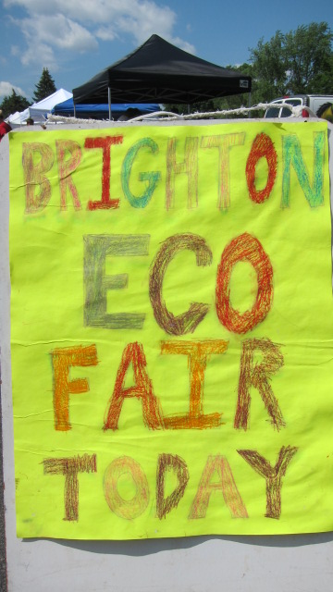
ECO Fair
Notes:
In June we also have the annual Eco-Fair, sponsored by Color Brighton Green, the organization that I mentioned that is one of our partner groups that has been with us from the beginning of the market.

Slide 41
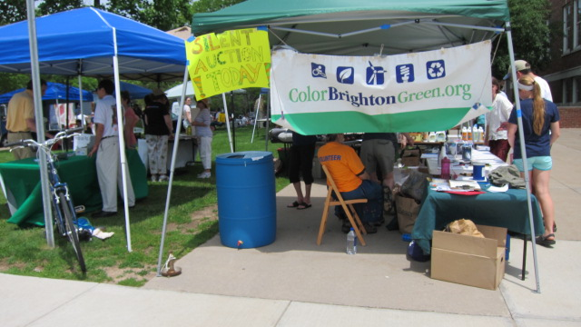
Notes:
Color Brighton Green invites a wide variety of groups to participate in the Eco Fair: businesses offering energy saving and green products and services, organizations and agencies offering information about energy and resource-saving choices, alternative-energy displays, student projects, and activities for children.

Slide 42
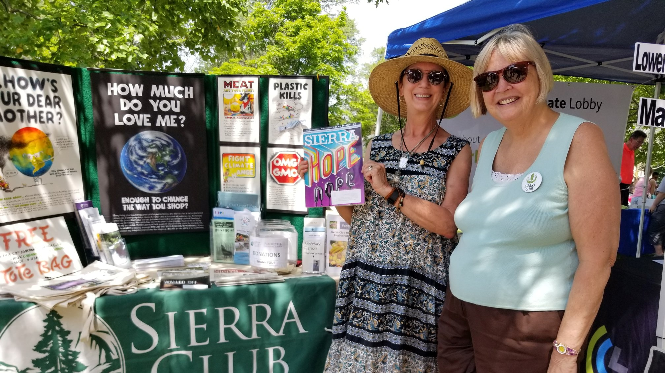
Notes:
The Eco-Fair sets up in the lawn area in front of the school, adjacent to the market, and is usually a popular and well-attended event. We don’t organize the event; we host it and promote it in our marketing materials, but Color Brighton Green does the planning and organizing. That is the case with all our special events; the market’s role is to invite and host the groups and promote their participation through social media and our weekly newsletter, but the groups plan and organize the events, which have become an integral part of the market. Because they are organized by groups outside of the market, rather than by an individual within the market, we feel the events’ sustainability in the future is more assured, thus contributing to the long-term success of the market

Slide 43
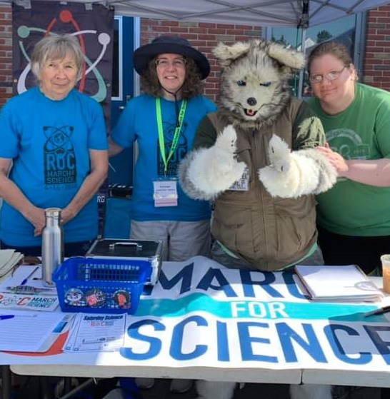
Ask a
Scientist
Notes:
Once a month we have a booth called “Ask a Scientist,” sponsored by the Rochester March for Science. Scientists from a range of specialties join us, usually from one of the local universities.

Slide 44
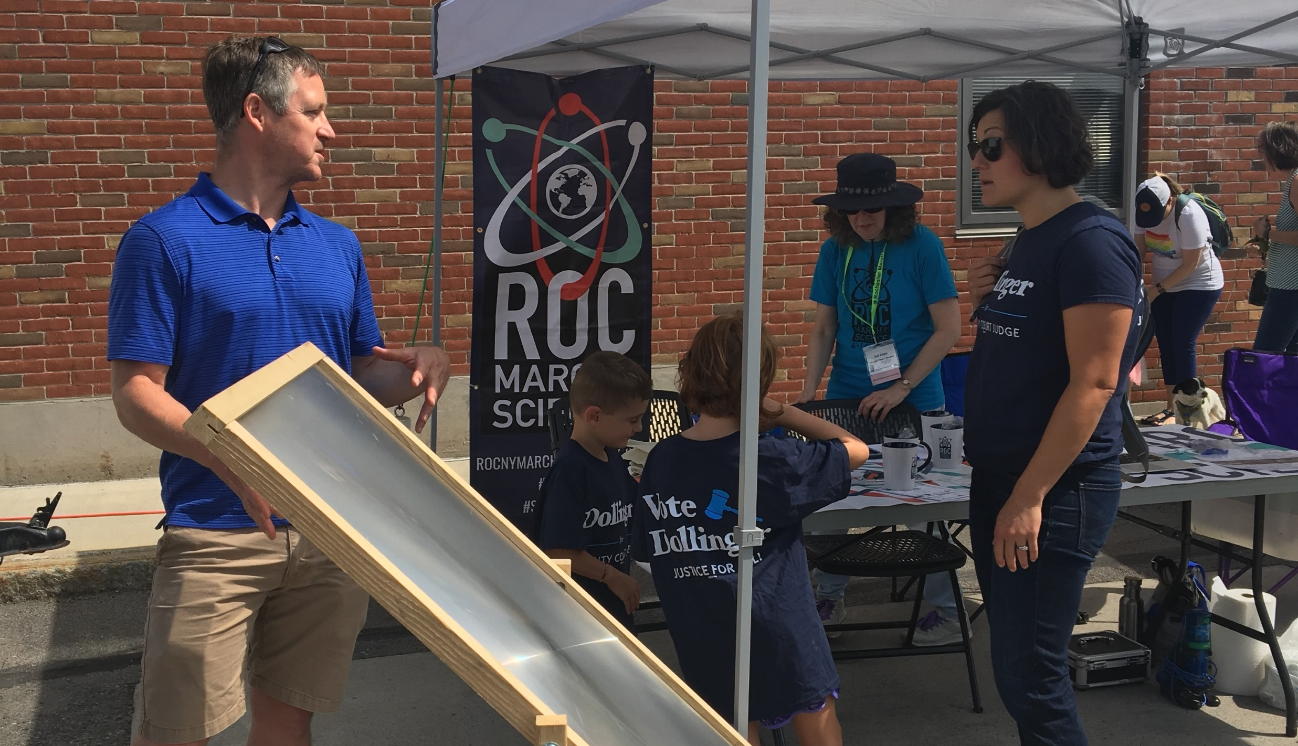
Notes:
They usually bring telescopes, optics experiments, and other cool items, including one time, ice from Antarctica that was 80,000 years old.

Slide 45
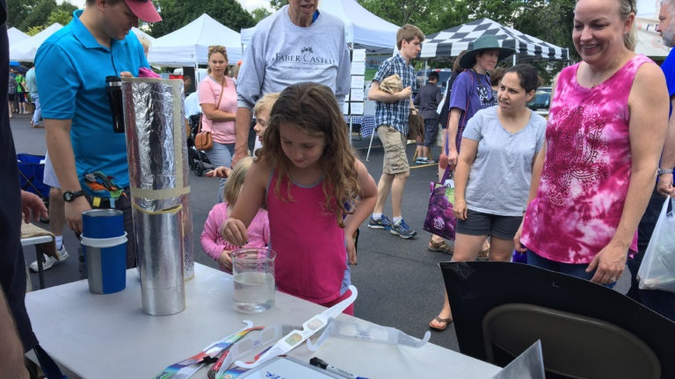
Notes:
Kids are especially encouraged to participate and ask questions of the scientists.

Slide 46
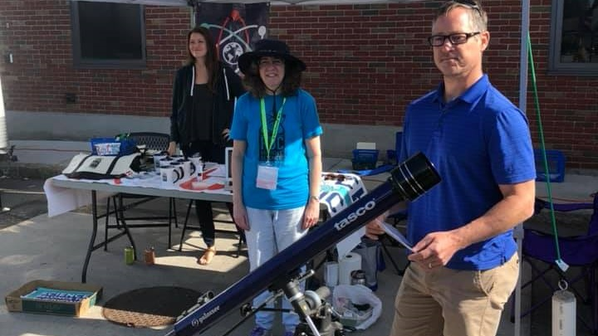
Notes:
This was a project originally suggested by a local scientist. She organized it and scheduled scientists for the first couple years. She originally set it up as a weekly project, which proved overly ambitious. It was hard to get enough sign-ups, and frequently people didn’t show. This year a local organization, Rochester March for Science, took it over and has been running it since as a monthly presence at the market. It has been much more successful this year; sometimes a good idea just needs to be tweaked to work better. In this case, having an established organization take it over from an individual did the trick.

Slide 47
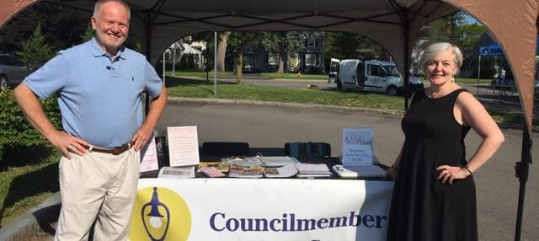
Councilmember on Your Corner
Notes:
Twice a month we have a booth called “Councilmember on Your Corner.” Members of the Town Council staff the booth to talk to members of the community about issues of concern or interest in the town. They sometimes have a theme to discuss, for example the Town Budget, but they also allow time and space for people to raise any issues they wish to discuss.

Slide 48
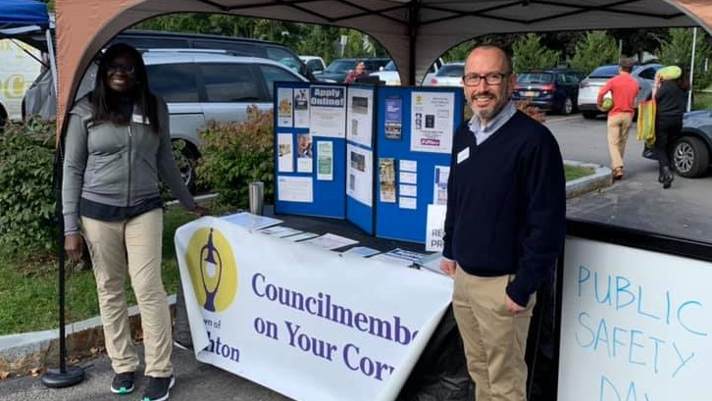
Notes:
Since the town sponsors the market, we feel this is a good opportunity for town government to interact with the community in a casual friendly way. This project is new this year. It was suggested by one of the Town councilmembers, who takes care of the scheduling and materials. It has been well-received by the community and will continue next year.

Slide 49
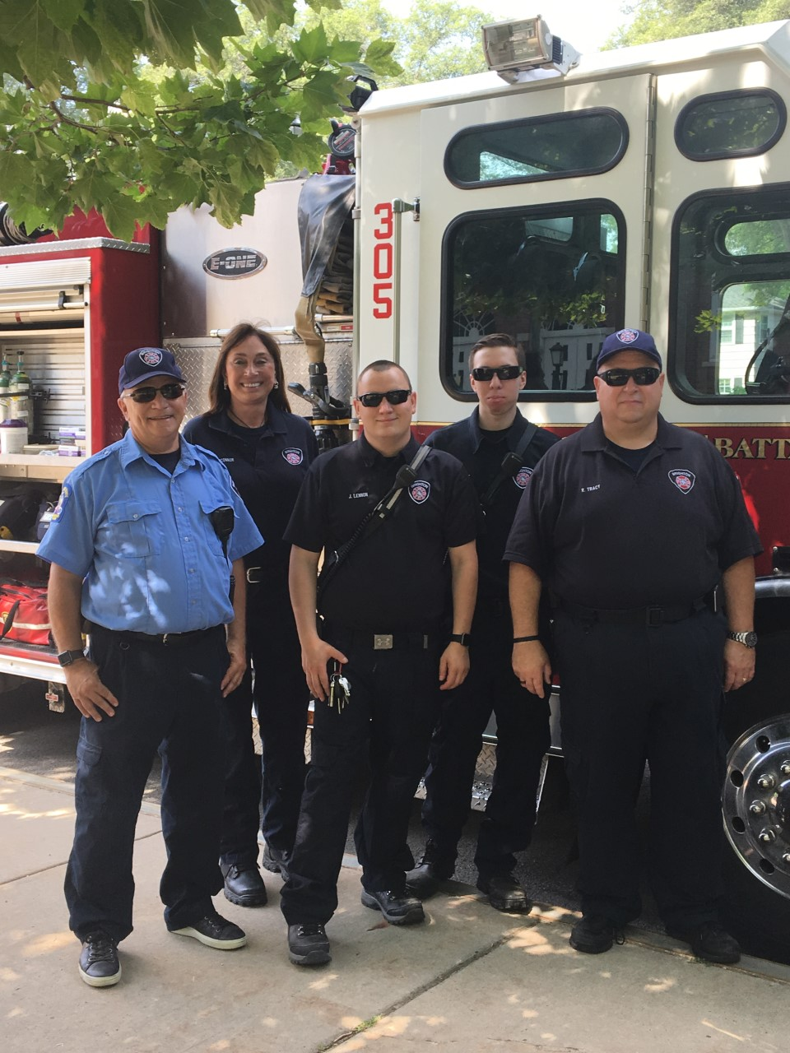
Public Safety Day
Notes:
Every September we have a Public Safety Day. The Brighton Fire Department, Police Department, and Volunteer Ambulance come to demonstrate their equipment and offer information on keeping homes and families safe.

Slide 50
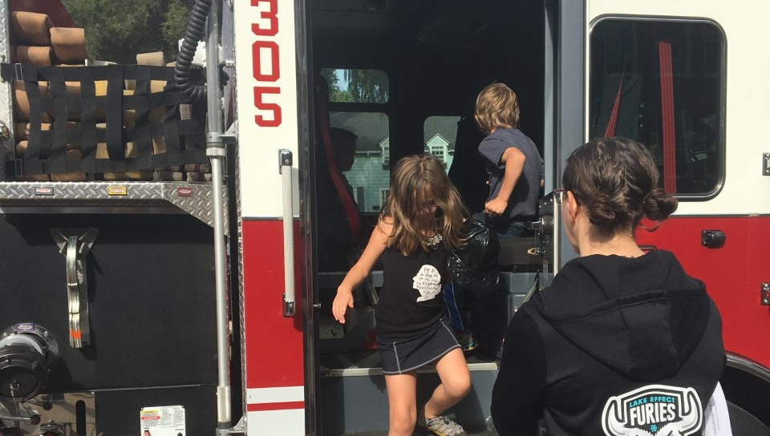
Notes:
Kids love climbing onto the fire trucks or into police cars and talking to the officers and firefighters.

Slide 51

Notes:
Firefighters give plastic fire helmets to the kids. It’s a fun event, and an important collaboration with our market and its work to build community and bridges with community partners.

Slide 52

Notes:
The event allows the Fire Department to generate interest in its annual open house, usually held the week following our event. This is another useful strategy for bringing in groups -- allowing the market to be a vehicle to promote activities important to the participant.

Slide 53

Notes:
In the first years of the market I approached the Fire Department and invited them to join us, which they were happy to do to further their connections with the community. We now have very good relationships with these agencies, and they look forward to the annual event as much as we do. These relationships are also helpful on the rare occasion when we need assistance from the police or the ambulance. Brighton police officers now regularly visit the market where they have become a friendly presence; I learned from Officer John that parmesan cheese is delicious on brussels sprouts. Our friends at the fire department also advertise the market for us on their electronic signs in front of their stations.

Slide 54

Arts at
the Market
Notes:
We have had special events called Arts at the Market, sponsored by a local volunteer group called Friends of the Arts in Brighton, a group whose mission is to promote the arts programs in the Brighton Schools.

Slide 55

Notes:
Student performers played music, sang, danced, and displayed works of art.

Slide 56

Notes:
These were very popular events, but haven’t been continued for the last couple years because of the difficulty organizing student participation during the summer months.

Slide 57

Notes:
We would love to revive this, perhaps in a different form, because it’s such fun to have students perform, and community members love it.

Slide 58

Notes:
The Town Supervisor joined in as Brighton High students danced the Macarena.

Slide 59

Bike Donation Day
Notes:
Every other year we have a Bike Donation Day, sponsored by the Brighton Rotary Club.

Slide 60


Notes:
Community members bring bikes that have been outgrown or are no longer used, and they are donated to a local organization called R Community Bikes. That organization is made up of volunteers who refurbish the bikes and donate them to members of the community who might not otherwise be able to purchase a bike. This year 180 bikes were collected; we almost met our record of 200 bikes collected a couple years ago. It’s a good example of community collaboration; volunteers from both Rotary and R Community Bikes work together to make the event successful. We provide the space and actively promote it.

Slide 61

Community Groups
Notes:
Every week community groups and non-profits join us to promote their missions or generate support. We allow the groups to participate without charge; we do ask them not to sell items but they can accept donations. We don’t schedule for-profit entities or businesses. Because of limited space we usually only schedule one or two community groups per week.

Slide 62

Notes:
The Brighton Public Library comes every year to promote its summer reading program. I originally contacted the library to ask if they would be interested in setting up at the market; now I usually get an email from one of the librarians I know at the beginning of the season, when they are hoping to promote their programs. The Friends of the Library organization has hosted cookbook swaps -- market goers can swap a cookbook they donate for another cookbook.

Slide 63


Notes:
We’ve welcomed all kinds of community groups -- veterans groups, health initiatives, preschools, school clubs, sustainability and environment groups, youth groups, and sports organizations.

Slide 64


Notes:
Because we are located on school property and because school policy does not permit political activity on school grounds we are not able to permit political campaigning, but during election season we see plenty of t-shirts emblazoned with candidates’ names.

Slide 65


Notes:
We do have voter registration tables during election season, staffed by volunteers from a local non-partisan organization.

Slide 66

Notes:
We celebrated Brighton’s 200th anniversary at the Market.

Slide 67


Notes:
In the early years of the market I would contact community groups to ask if they were interested in participating; now that we are more established and have become known as a community gathering place, groups regularly contact us asking to participate.

Slide 68

Winter Market
Notes:
From the first year of our market we have hosted a winter farmers’ market. At first it was once a month during the winter, then every week for two months, but now we meet every week throughout the winter except for holidays.

Slide 69

Notes:
The winter market is held indoors in the gymnasium of a former school building in the town. It is important to our mission of supporting local farmers to give them a place to sell their products during the challenging winter months.

Slide 70


Notes:
Knowing the market will be there, many of our farmers have expanded their production to have product available throughout the winter. Many have built hoop houses to extend their growing ability, and others have added the ability to store crops throughout the winter.

Slide 71


Notes:
We now have a thriving winter market, although considerably smaller than our summer market.

Slide 72


Notes:
Because of space limitations we generally don’t have community groups except for our partners Color Brighton Green and the Brighton Food Cupboard, although we do have music every week.

Slide 73

Notes:
The gymnasium where we meet is not an ideal space; it is small, rough, and because of scheduling at the building we must meet Sunday afternoons, right in the middle of football and nap time. The Town sought and received grant money to restore a Town-owned barn to be a permanent home for our farmers’ market. This space will provide more room, more parking, better facilities, and will allow us to move the market to Sunday mornings from afternoons.

Slide 74


Notes:
Phase I of the project has been completed, but more must be done, and more funding secured, before we will be able to use it. We are hoping to be able to use it for our 2020-21 winter market.

Slide 75
In Summary
Notes:
In summary, we all know that the more we can do to make our markets places where people want to come, the more successful our markets, and our vendors, will be. We have had success at Brighton in part because of the willingness of community groups and town and government agencies to participate at our market.

Slide 76
Link up with partners with shared missions
Build relationships with individuals and organizations in the community
Schedule and promote special events and community group visits
Create space and energy to build community
Notes:
We have promoted this by 1) working with partners whose missions mesh with ours and offering them space at our market, 2) building relationships with individuals and organizations such as the Fire Department, the Police Department, the Town Recreation Department, the Library, Brighton Rotary, and many community groups, and welcoming them into the market, 3) scheduling and hosting regular special events and actively promoting them through our weekly newsletter and social media, 4) creating space and energy to build community. The sense of community now evident at Brighton Farmers’ Market is perhaps the greatest reward I experience in my job of managing this market.

