Slide 1

EARTHWORMS

Slide 2


Slide 3
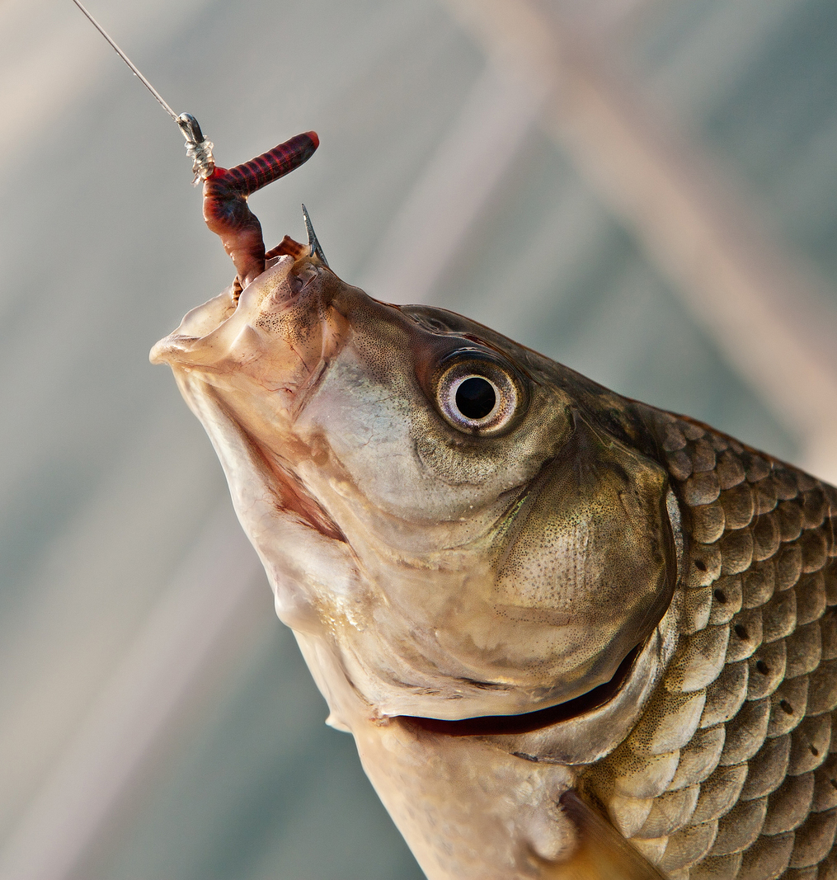
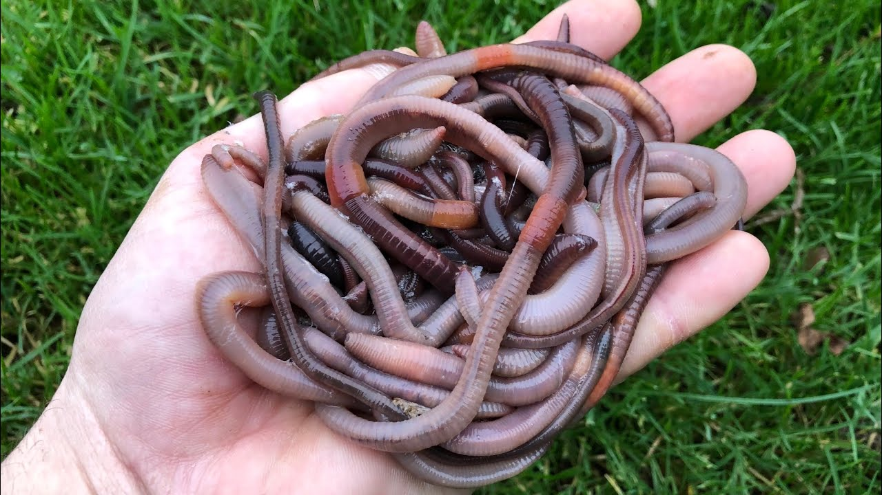
Earthworms are uses as a bait when do the fishing.

Slide 4
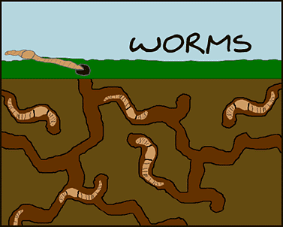
Earthworms makes their homes by eating dirt.
As they eat the dirt and push some away, they make a holes in the ground.

Slide 5
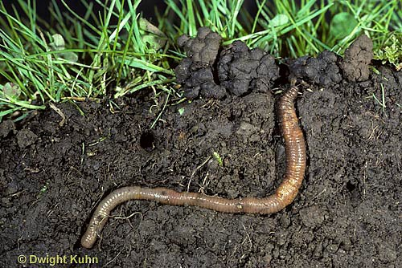
Earthworm’s hole is called burrow.

Slide 6
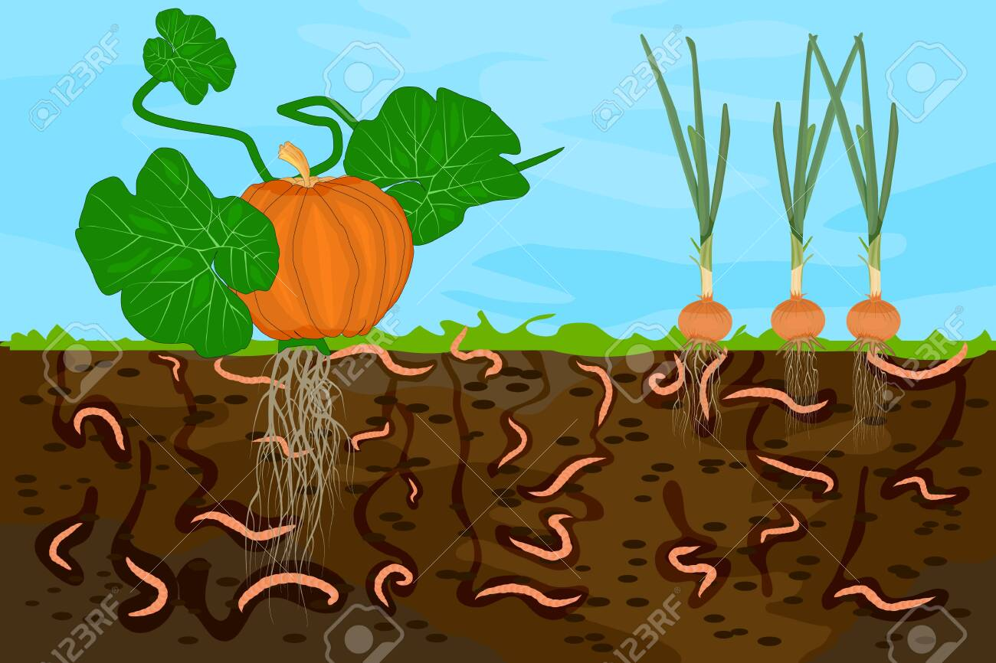
The earthworm is a farmer’s friend but the earthworms doesn’t know that.

Slide 7
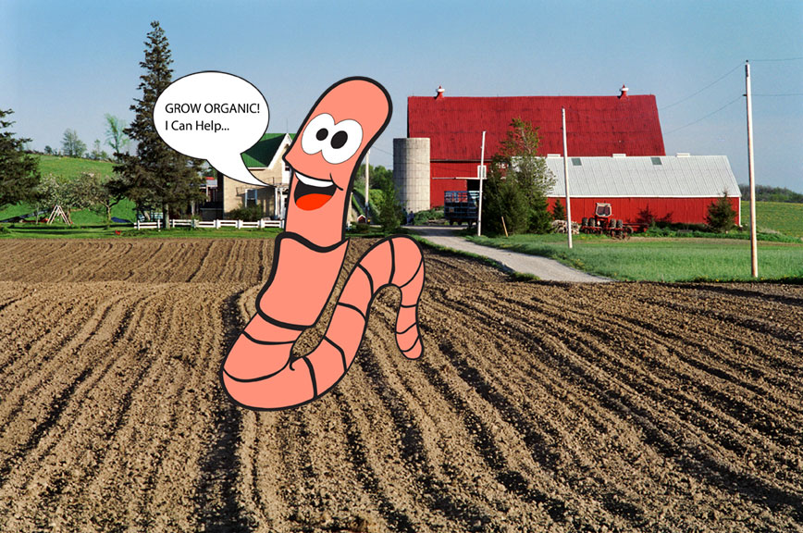

Slide 8
The earthworm helps the farmers by letting the water and air into the ground.

Slide 9
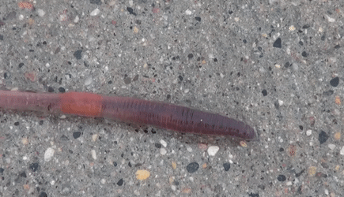
Earthworm has no eyes or ears and they don’t need it

Slide 10

How does an earthworm know to move back into his hole if something is coming?

Slide 11
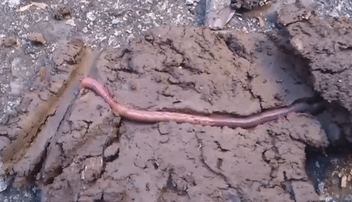
Earthworm can feel the ground shaking if a bird hops near him or if someone walks by.

Slide 12
Earthworm has no nose. He breathes through his skin.

Slide 13
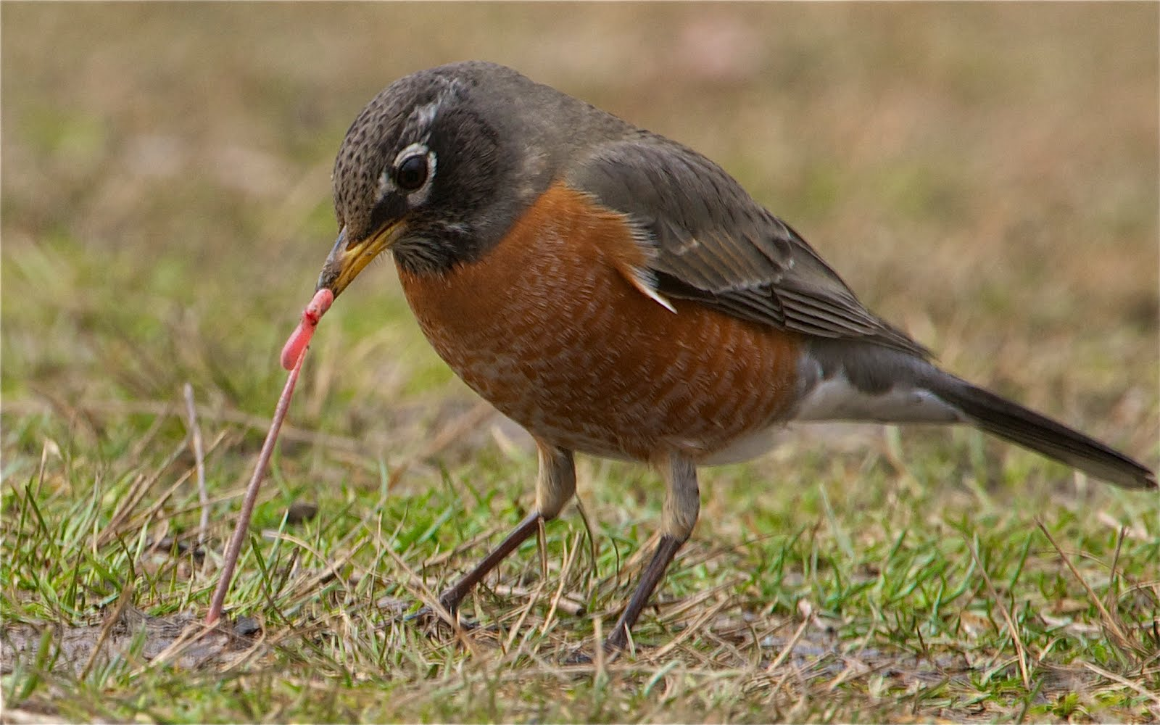
Why does a bird have to pull so hard to get the earthworm out of his hole?

Slide 14
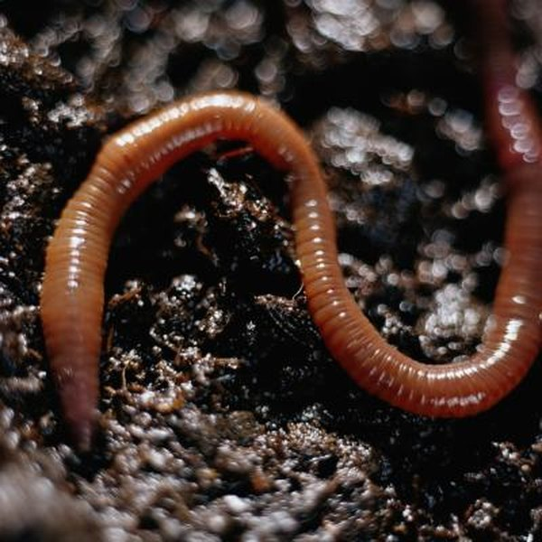
Earthworms have very small bristles on their bodies that sticks to wall.
bristles

Slide 15


