Slide 1
Toddler Through Pre-Reader Program
The Gift of Good Manners

Slide 2
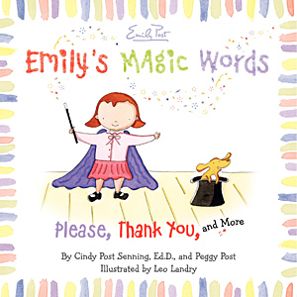
Magic Words
EMILY’S
MAGIC WORDS
by
Cindy Post Senning, Ed.D.
Peggy Post

Slide 3
Magic Words
American Sign Language
Please
Thank you
You’re welcome

Slide 4
Magic Words
American Sign Language
Hello
Good-bye

Slide 5
Magic Words
American Sign Language
Excuse Me
I’m Sorry

Slide 6
Magic Words
American Sign Language
I love you.

Slide 7
Early Greetings
For toddlers (3 years old):
Say, “Hello” clearly.
Look up and smile.

Slide 8
Early Greetings
For pre-schoolers (4 years old)
Say, “Hello” clearly.
Look up and smile.
Hold hands or…
Do a simple handshake.

Slide 9
Early Greetings
For kindergarteners (5 years old)
Say, “Hello” clearly.
Look up and smile.
Give a basic handshake.

Slide 10
Early Table Manners
Wash up before coming to the table.
Napkins in laps.
Finger foods.
Using utensils.

