Slide 1
Pay and Benefits

Slide 2
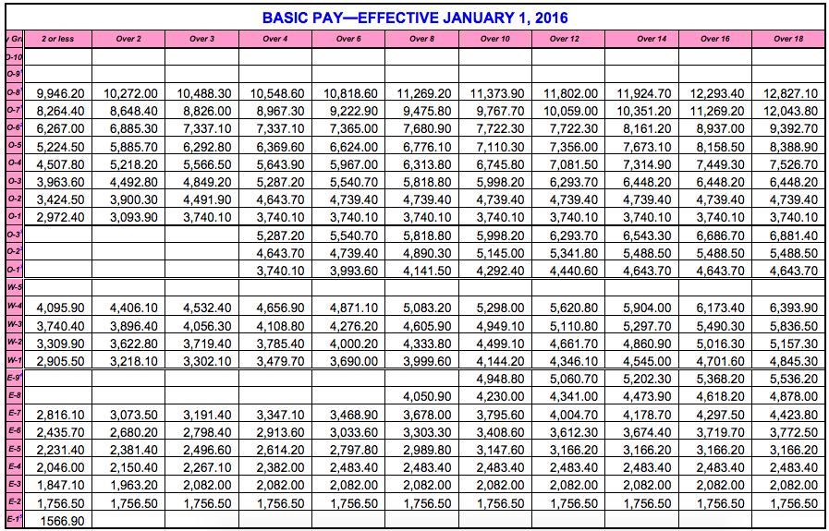

Slide 3
Military Active Duty Pay
Base Pay (Taxed)
  E-1 through O-10 ($1,479.30 - $15,583.20 a month)
  E-5 at 4 years = $2,669.10
  E-7 at 20 years = $ 4,566.60
  0-4 at 20 years = $ 7,684.80
Basic Allowance for Subsistence (BAS) (Not Taxed)
  Officer: $253.63 Enlisted: $368.29
Basis Allowance for Housing (BAH) (Not Taxed)
  Based on Location, Rank, and Dependents
  Cleveland E-5 with family = $1590.00
Special Duty, Hazardous Duty, Hardship, Hostile Fire/Imminent Danger

Slide 4
Military Reserve Duty Pay
Inactive Duty Training (Drill Weekend once a month)
  E-1 through O-7 ($197.25 - $1,680.92 for 2 days a month)
  E-5 at 4 years = $355.88
  E-7 at 20 years = $608.88
  0-4 at 20 years = $1,024.64
Annual Training, Active Duty Operation Support, and Mobilizations

Slide 5
Military Medical and Dental
www.tricare.mil
Tricare (Health Insurance) Prime (Free, require PCM referrals. Low Co-Pay on medication for family members. Available to retirees at cost and in certain areas)
  Extra and Standard (Deductibles, but more freedom & available to retirees)
  Meets requirements for minimum essential coverage under the Affordable Care Act.
Tricare Reserve Select
  Premium Based, available to Reservists and family members
  Single: $47.82 Family: $217.51 (Monthly premiums)
Dental Planes (Different Premiums $50 – $300 depending on individuals covered.)
  Active Duty Dental Program (No cost to Marines on active duty.)
  TRICARE Dental Program (Premium Based, for families and Reservists)
  TRICARE Retiree Dental Program (Premium Based, also available to eligible family)

Slide 6
Military Benefits
Death Gratuity
  $100,000 (tax free)
Survivor Benefits
Servicemembers Group Life Insurance (SGLI)
  $400,000 (tax free)
Thrift Savings Plan (TSP)
  Retirement savings
  Retirement after 20 years of service (in some cases 15 years)

Slide 7
THE DD FORM 214
The DD FORM 214 certifies the member’s release from Active Duty. It could be for separation after having served a term, a retirement, or a discharge.

Slide 8
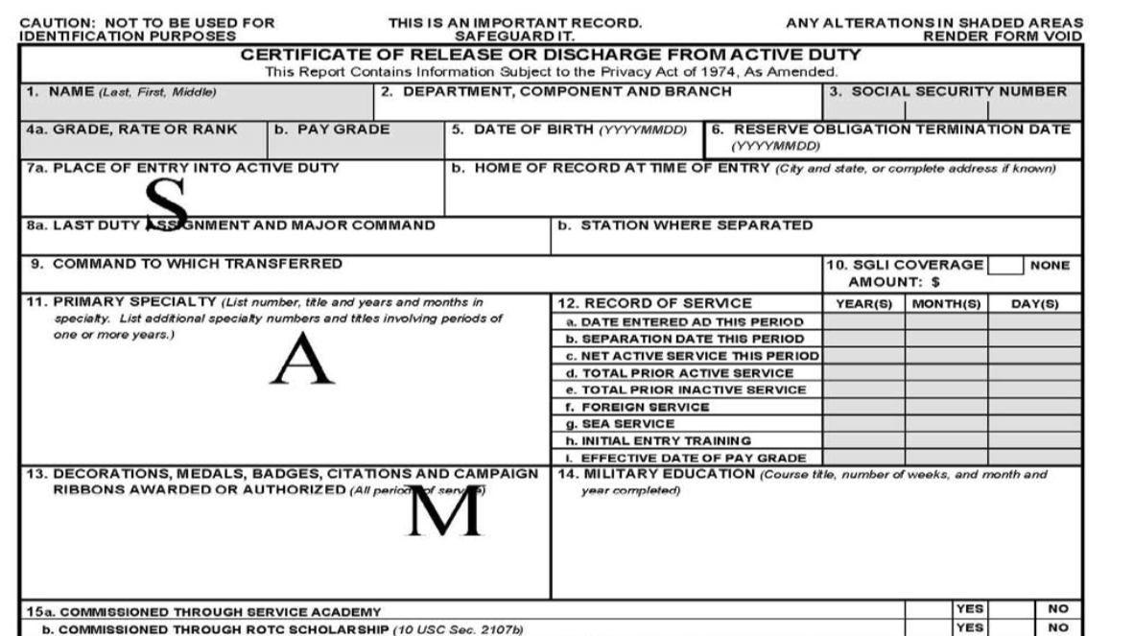

Slide 9
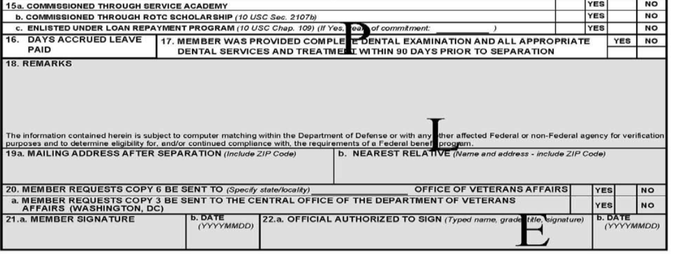

Slide 10
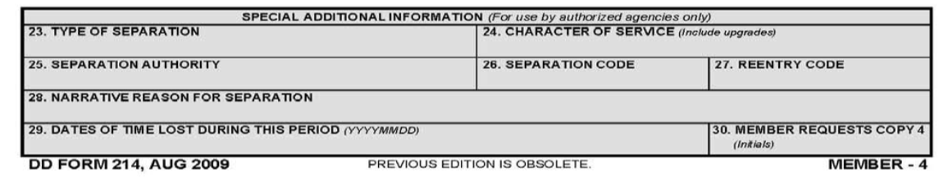
This is the area of the DD FORM 214 that shows the reason for separation.

