Slide 1
What it Takes to Go Big in Business
Susan Welch

Slide 2
The 7-Figure Foundation Principles:
You’re Not Selling a Product,
You’re Building a Brand

Slide 3
Principle #1: Build a Brand, Not a Product
Building a brand brings you so many more benefits than simply selling a product. Those benefits include:
Higher profit margins
Repeat customers
Raving fans to market and launch new products to
Free marketing
Higher business valuation (should you ever decide to sell)

Slide 4
Principle #2: Choose a Market You Have an Interest In
Working in a market that you love is critical, for several reasons:
You’ll better understand what people like and don’t like about existing products
You’ll be a natural tester for your products
You’ll automatically think of content ideas to promote the products
You’ll be able to better evaluate samples
It’ll be easier for you to market your products
You’ll be more excited about your business and your brand
You’ll sell higher-quality products

Slide 5
Principle #3: Give the Market What It Wants
The riskiest way to build a business is to invent something brand-new.
One of the fastest ways to succeed is to improve upon a product that is already selling well, because this indicates existing market potential—in other words, an easy sales opportunity.
And you don’t have to guess what the market wants, though—Amazon tells you. Go to www.amazon.com ,and look for their best-selling products!

Slide 6
很多朋友问做Amazon要准备哪些资料？
一、公司营业执照的彩色扫描件
二、法人身份证的彩色扫描件
三、能进行国际付款的信用卡，不能过期
四、联系人的邮箱电话以及公司的地址和联系电话

Slide 7
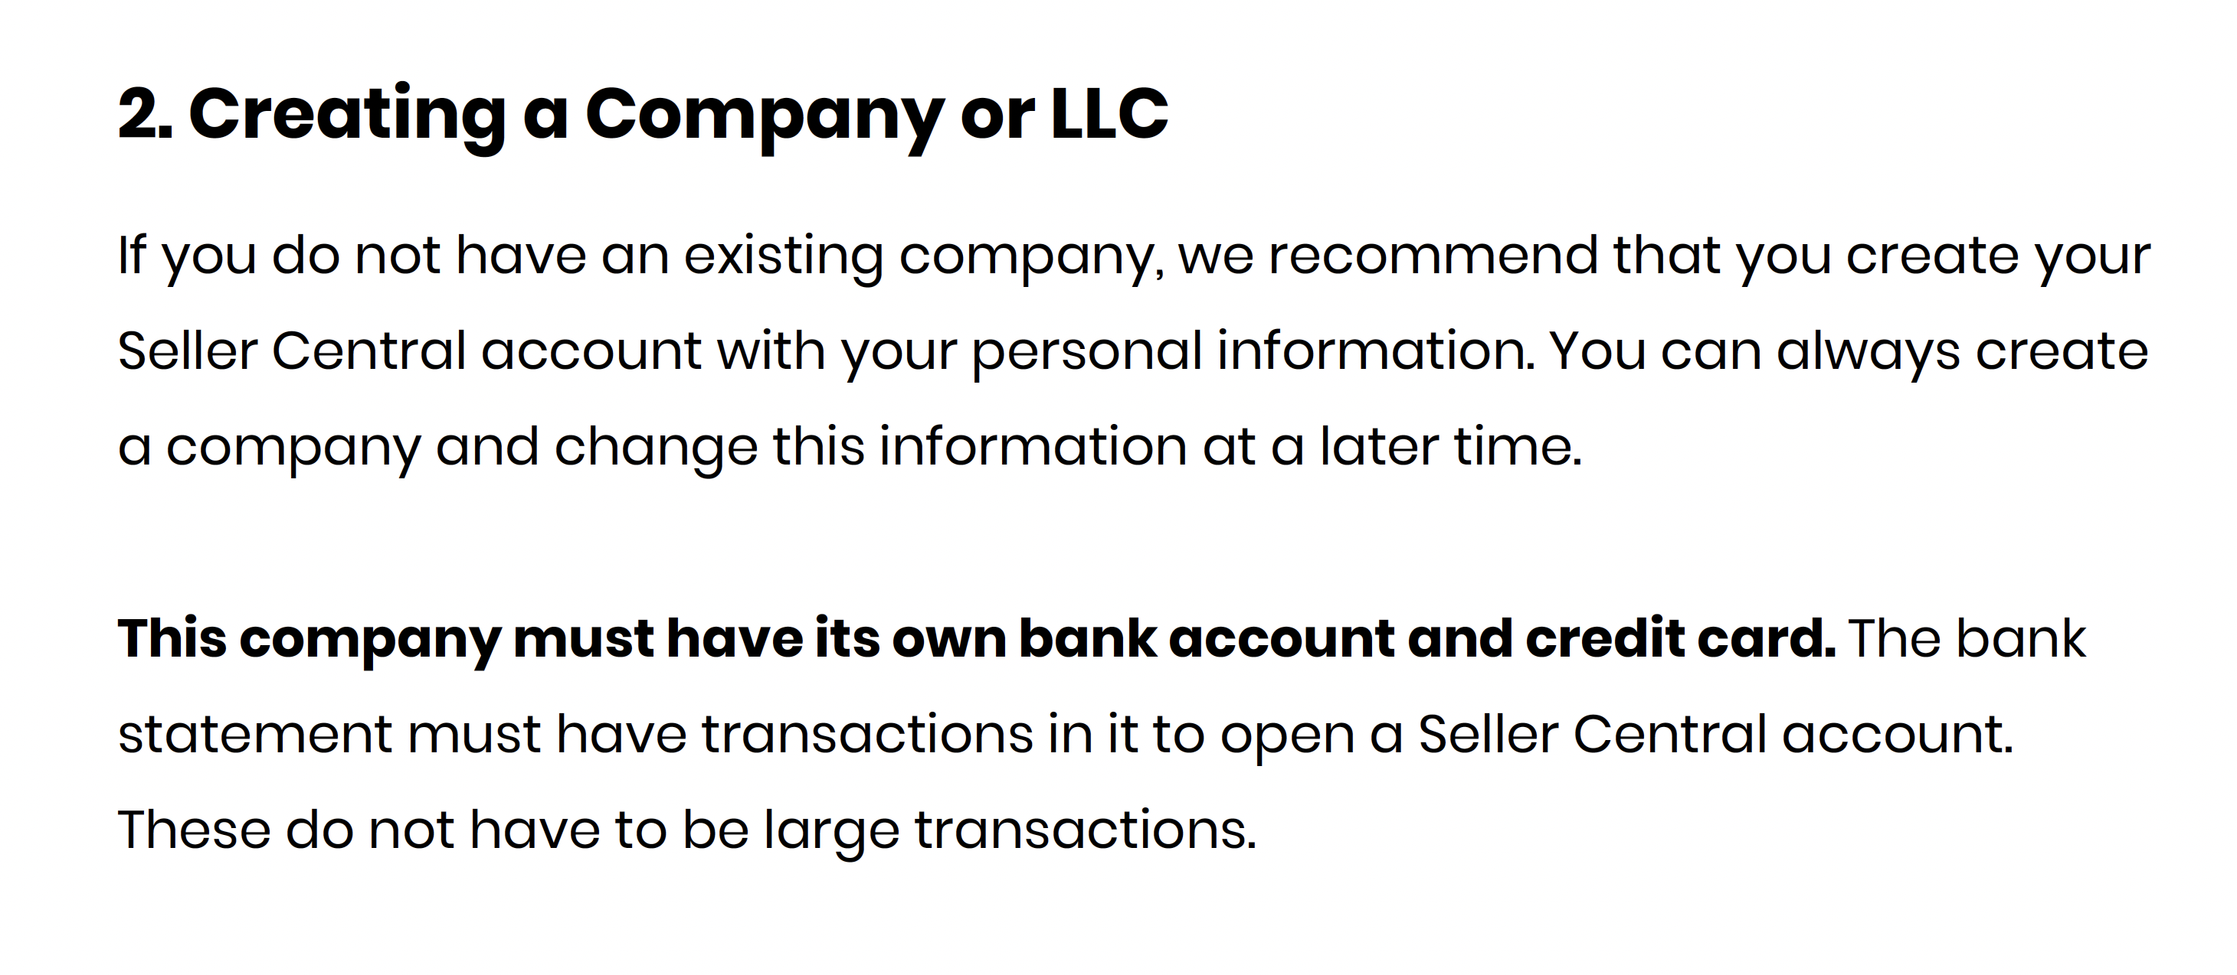
在美华人，有SSN就能注册

Slide 8
What You Need to Set Up Your Account
Make sure to have the following things, in order to set up your Amazon SellerCentral account:
Email Address: A unique address just for your Seller Central account
Name: Either your name or your business name
Address: Either your address or your business address
Deposit Method: Bank Account or 3rd party service for receiving your Amazon payment
Charge Method: Credit card for paying the monthly fee (note: once you start selling, the fees can be taken from your Amazon account instead of your credit card)
Documentation: To prove your identification
Deposit method and credit card number
(note: JPG files are no longer allowed )

Slide 9
How to Sell From Your Soul
If you could only help one person, who would that be? What is her age? Problems? Struggles? What does she need from you? How does she feel after you help her. How do you feel? Journal it out.
What does your life look like when you’re massively compensated for your work? Journal it out.

Slide 10
Starting a Business as an Act of Service
JOURNAL INNERWORK:
What is my brand here to give?
Who needs my products, and how would my products help them?
What would my products do for them?
How does that change their lives and what does that do for them?
What happens to them if they don’t find my products?
Gently observe your limiting beliefs. What limiting beliefs do you have around your abilities. It is your job to disprove them by forming new beliefs.

Slide 11
It is time to feel more confident and step into the next level of belief in yourself.
How it will feel to have the thriving business you desire? (Write it in the present tense.)
How will you feel when you wake up in the morning excited for your day and go to bed each night knowing your did beautiful work?
Share something helpful to your ideal client online today (and everyday). Could be a quote, riff, rant, etc.
Feel the feeling of your Ideal customers purchasing it... now.

Slide 12
Secrets to Success
Make sure that you are doing the following several things to help ensure your success with this course:
Avoid trying to be perfect
Don’t forget to focus on quality!
Always take action, move forward, and make progress every day —even when it’s uncomfortable
Never, ever give up
Follow the system, and ask for help along the way
Keep in mind that since this is entrepreneurship, risk = reward

