Slide 1
BLOG POST STRUCTURE that converts

Slide 2
Substance + content
Blog post format
Content upgrades
Share buttons
SEO

Slide 3
Substance + content
1

Slide 4
Your content should have a purpose beyond driving traffic…
Make sure that your content leads people to a sale for a current or future product.
Remember the 3 S’s for creating killer content:
Solve a specific problem
Sell your business!
Showcase your expertise
Your end goal is to increase revenue, not to get more share counts!

Slide 5
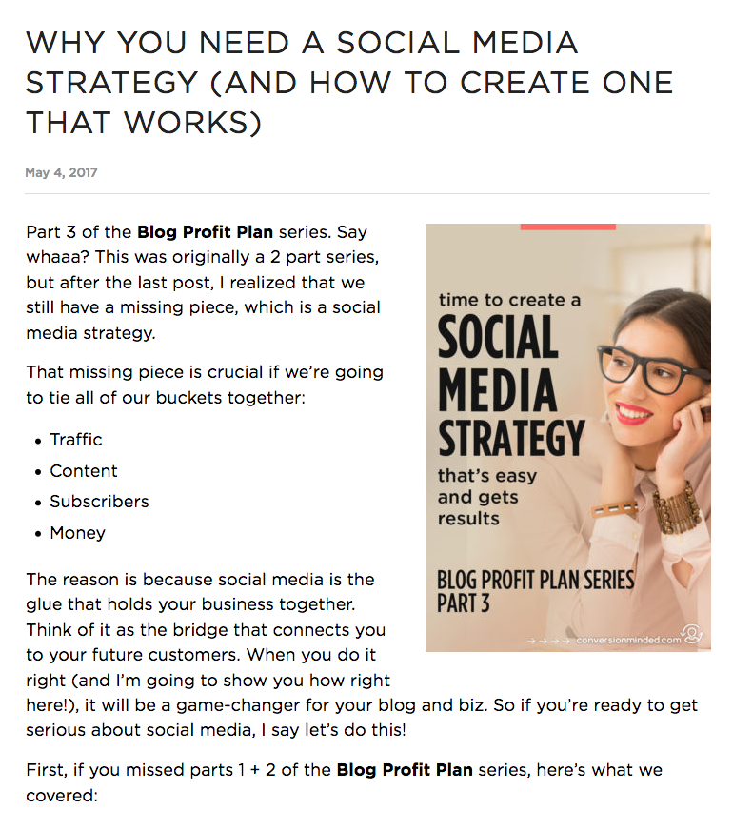
Your Posts Need to Lead People to a Sale.
A blog post about how to start a creative business would do nothing to pre-sell my Smart Social Media course.
Now, if in the future I create a Launch Your Business course, talking about how to start a business makes sense.
But, for this course, writing about why you need a social media strategy makes more sense because it leads people into a sales funnel.

Slide 6
Aim to make your blog post a comprehensive resource.
You want to go deep on your topic rather than just skim the surface.
Look at posts you researched and think How can I make them better?
Show people HOW, not WHAT.
Make it actionable and truly helpful.
Be engaging and conversational.

Slide 7
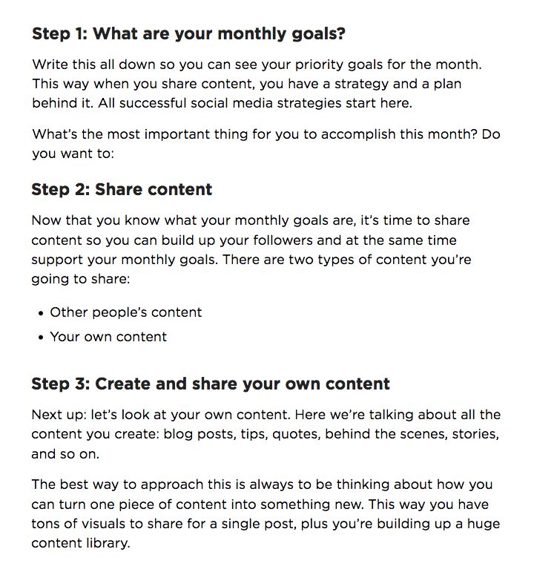
Strike a balance between…
List posts: 10 tools to do X,Y,Z
Crowd-sourced posts
In-depth posts that show people how to do something

Slide 8
Strike a balance between…
List posts: 10 tools to do X,Y,Z
Crowd-sourced posts
In-depth posts that show people how to do something
Don’t tell people WHAT to do, show them HOW to do it (aka: how hard it is to do it and why they need you). Go deep on your topic rather than just skim the surface.

Slide 9
Blog post format
2

Slide 10
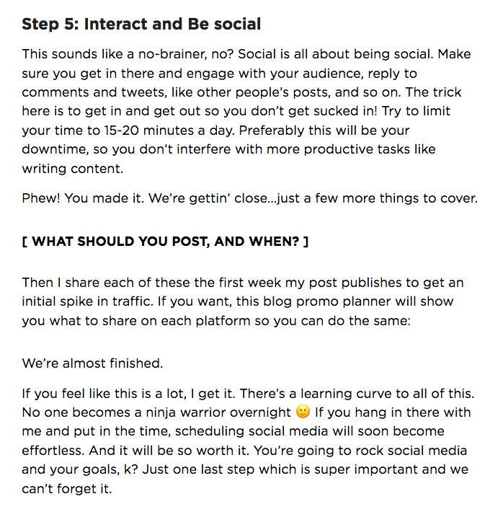
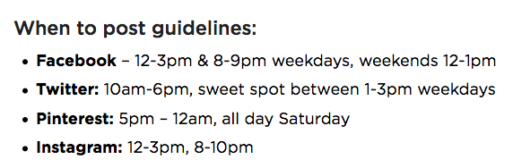
Make it easy for people to digest your content.
Outline your post first.
Aim for 2,000 words.
Use subheadings and bullet points to break up text.
Incorporate bucket brigades in your copy.

Slide 11
Make it easy for people to digest your content.
Outline your post first.
Aim for 2,000 words.
Use subheadings and bullet points to break up text.
Incorporate bucket brigades in your copy.
Use short words, short sentences, and short paragraphs.
Long paragraphs look like a lot of work. Long words are a lot of work, even if you’re saying exactly the same thing (difficult vs hard).

Slide 12
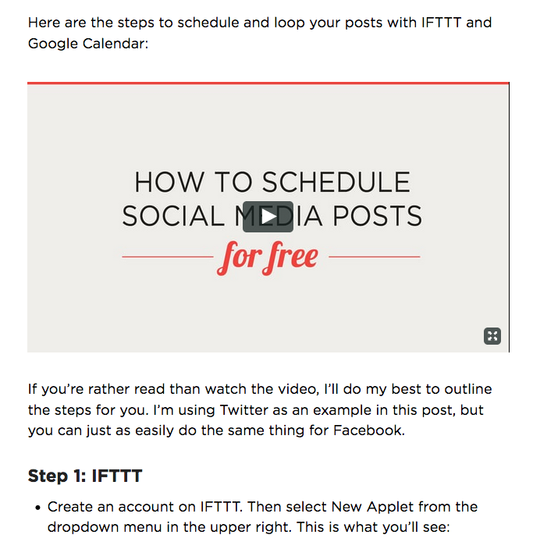
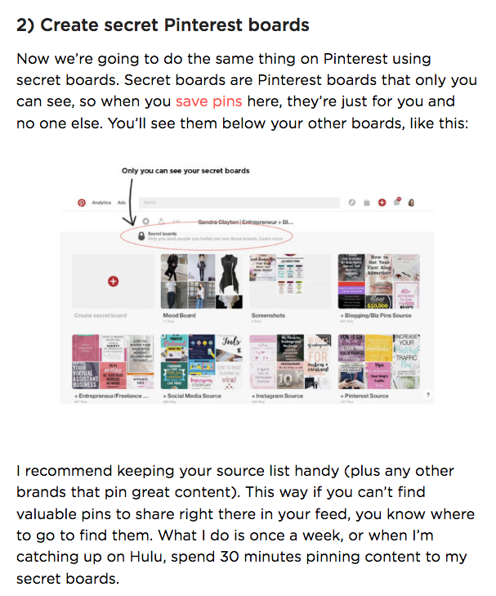
Include visual content to explain your post.
Step-by-step photos and directions
Visuals and graphs
Icons and illustrations
Even create a video

Slide 13
Add content upgrades
3

Slide 14
A blog post is the first step in your potential customer’s journey with you…
Getting traffic and visitors is not the end goal. Have a SALES end goal in mind for your post, before you write it.
Bridge the gap between your free content (post) and paid content, services, or products.
Be explicit with what you want people to do next.

Slide 15
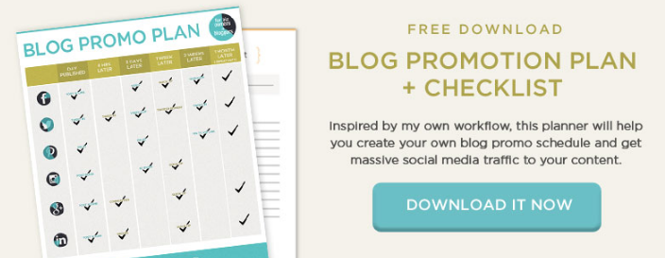
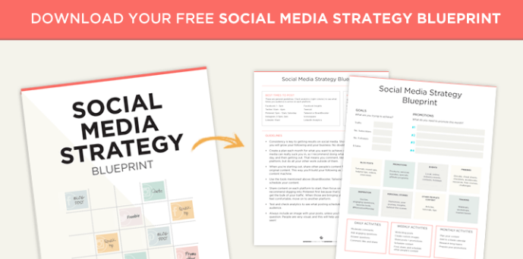
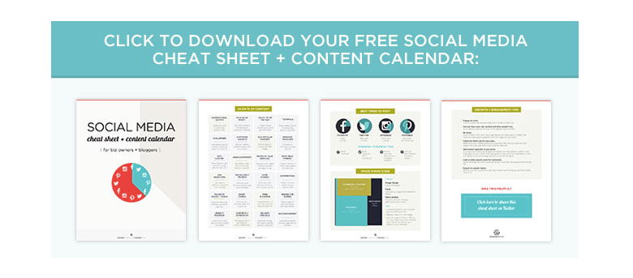
Use content upgrades (lead magnets) to encourage people to sign up…
Include eye-catching calls to action that show people what they will receive.
Give readers multiple opt-ins and reminders to download.

Slide 16
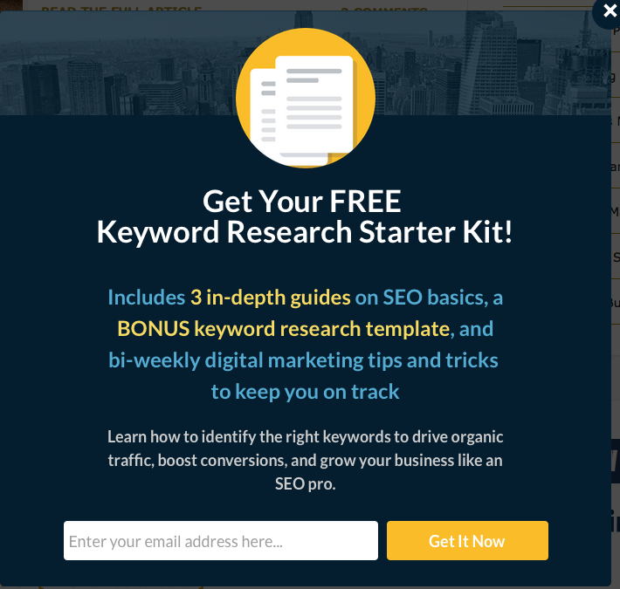
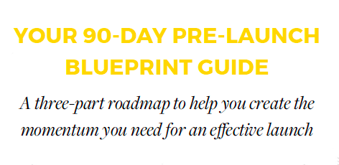
A lead magnet can be a simple one-page cheat sheet or an in-depth Ebook…
Cheat sheets, blueprints, checklists, swipe files, templates, free trainings, free resources, challenges, Ebooks, workbooks, kits, and more.
Source: XO Sarah
Source: Olyvia.co
Source: The Content Factory
Source: Hubspot
Source: Amy Porterfield

Slide 17
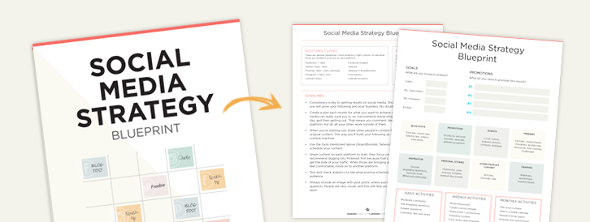
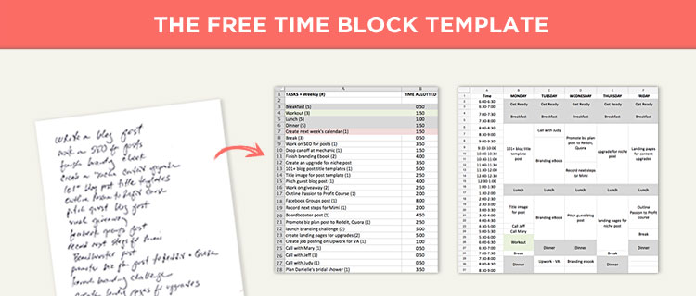
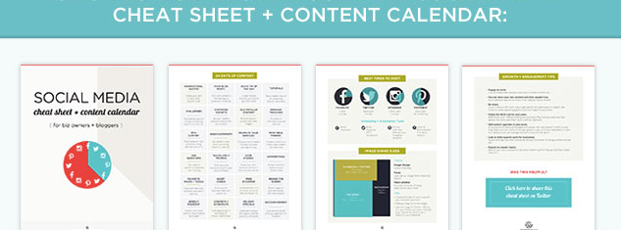
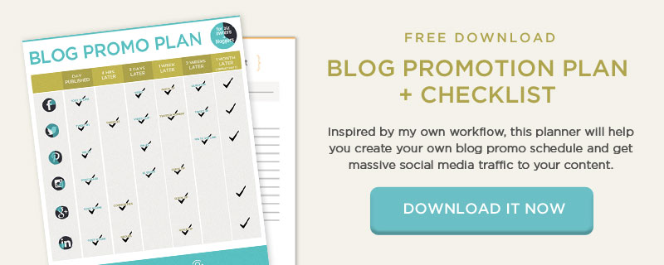
My highest-converting lead magnets are four pages or less.
2-Page Blueprint
2-Page Template
4-Page Cheat Sheet
2-Page Planner + Checklist

Slide 18
Targeted. Speaks to one specific person and addresses their most pressing pain point.

Slide 19
Targeted. Speaks to one specific person and addresses their most pressing pain point.
Actionable. Is easy to digest and implement. Checklists, cheat sheets, and swipe files work well.

Slide 20
Targeted. Speaks to one specific person and addresses their most pressing pain point.
Actionable. Is easy to digest and implement. Checklists, cheat sheets, and swipe files work well.
Simple. Provides the simplest steps to get from a to z. Covers one topic rather than multiple topics.

Slide 21
Targeted. Speaks to one specific person and addresses their most pressing pain point.
Actionable. Is easy to digest and implement. Checklists, cheat sheets, and swipe files work well.
Simple. Provides the simplest steps to get from a to z. Covers one topic rather than multiple topics.
Delivers results. Gives people actionable steps they can move forward with and see results.

Slide 22
Targeted. Speaks to one specific person and addresses their most pressing pain point.
Actionable. Is easy to digest and implement. Checklists, cheat sheets, and swipe files work well.
Simple. Provides the simplest steps to get from a to z. Covers one topic rather than multiple topics.
Delivers results. Gives people actionable steps they can move forward with and see results.
Builds trust. Establishes your authority and primes people to buy from you in the future.

Slide 23
Targeted. Speaks to one specific person and addresses their most pressing pain point.
Actionable. Is easy to digest and implement. Checklists, cheat sheets, and swipe files work well.
Simple. Provides the simplest steps to get from a to z. Covers one topic rather than multiple topics.
Delivers results. Gives people actionable steps they can move forward with and see results.
Builds trust. Establishes your authority and primes people to buy from you in the future.
Sparks curiosity. Offers enough to ignite curiosity without giving away the farm. Opens a door to future products.

Slide 24
Targeted. Speaks to one specific person and addresses their most pressing pain point.
Actionable. Is easy to digest and implement. Checklists, cheat sheets, and swipe files work well.
Simple. Provides the simplest steps to get from a to z. Covers one topic rather than multiple topics.
Delivers results. Gives people actionable steps they can move forward with and see results.
Builds trust. Establishes your authority and primes people to buy from you in the future.
Sparks curiosity. Offers enough to ignite curiosity without giving away the farm. Opens a door to future products.
Is high value. Provides real value. Is something that people would actually consider paying for.

Slide 25
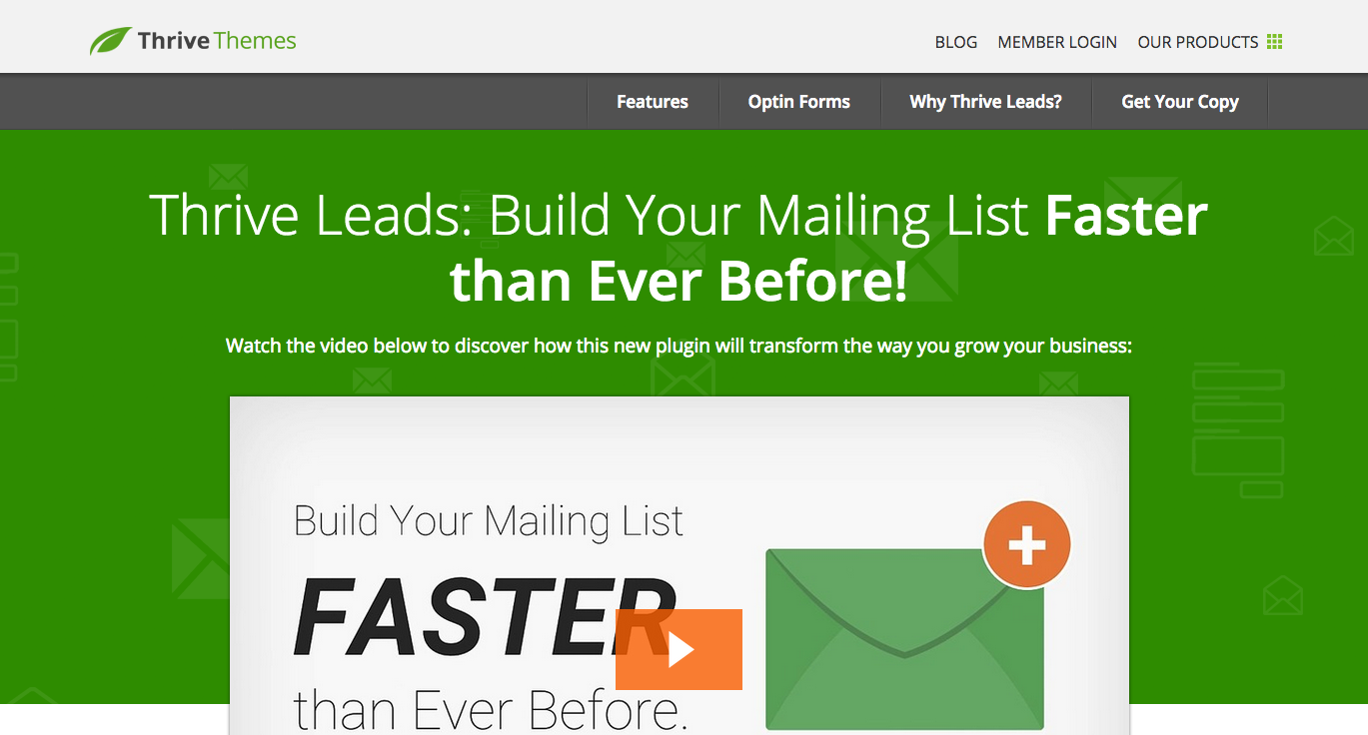
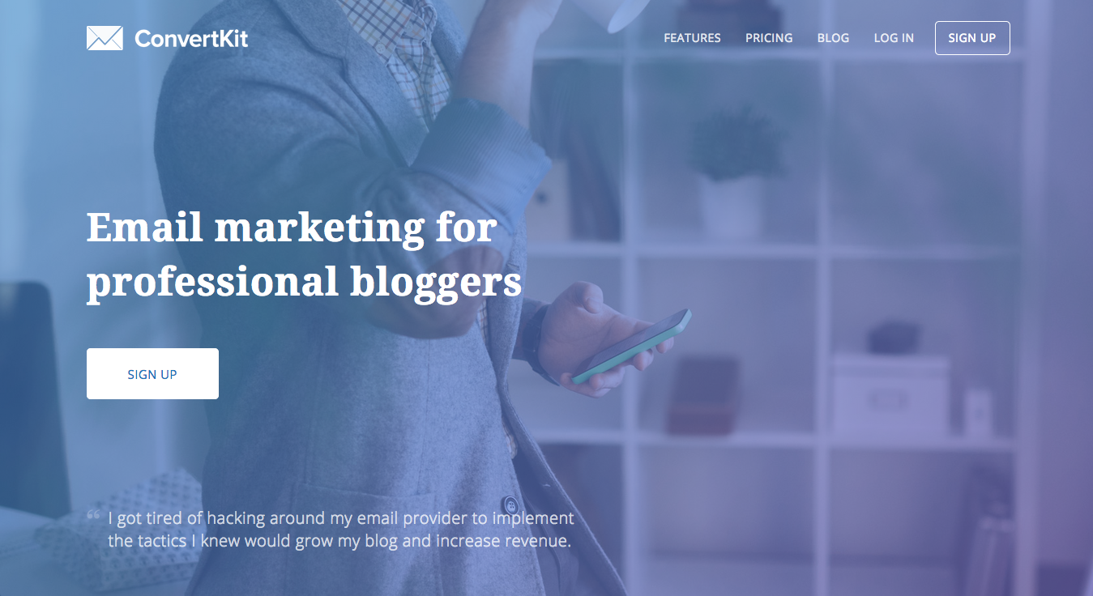
What you need to make content upgrades work…
A button or call to action: (Canva or Photoshop)
Opt-in form (SumoMe or Thrive Leads)
An email marketing service: (ConvertKit)

Slide 26
Have a plan for what you will email your new subscribers…
Remember, your emails should help your new subscribers solve a problem AND lead people to a future sale.
Weekly posts and updates
Workshops, webinars, and masterclasses
An roundup of your most popular posts
Exclusive tips for subscribers only

Slide 27
4
Add share buttons

Slide 28
5
SEO your blog posts and social media posts

Slide 29
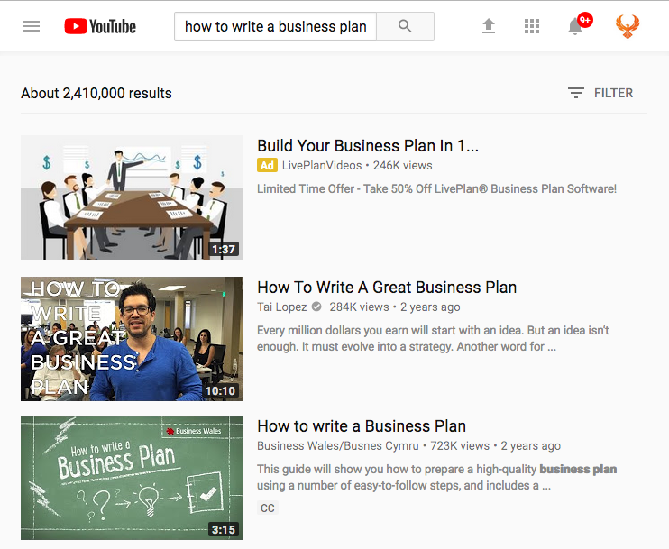
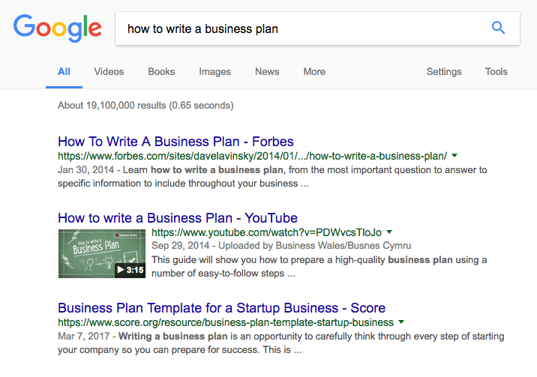
SEO helps people find you on social media AND on Google
This same video shows up on page 1 of YouTube and Google for the keyword how to write a business plan.

