Slide 2
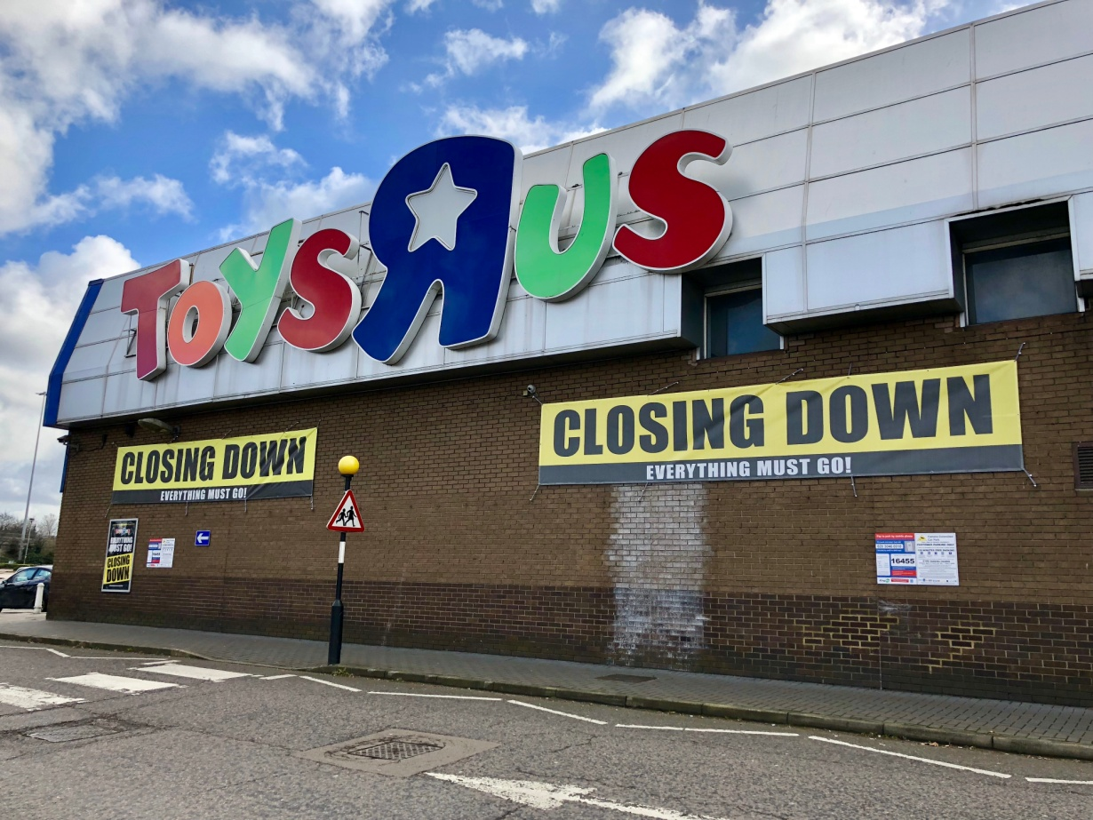
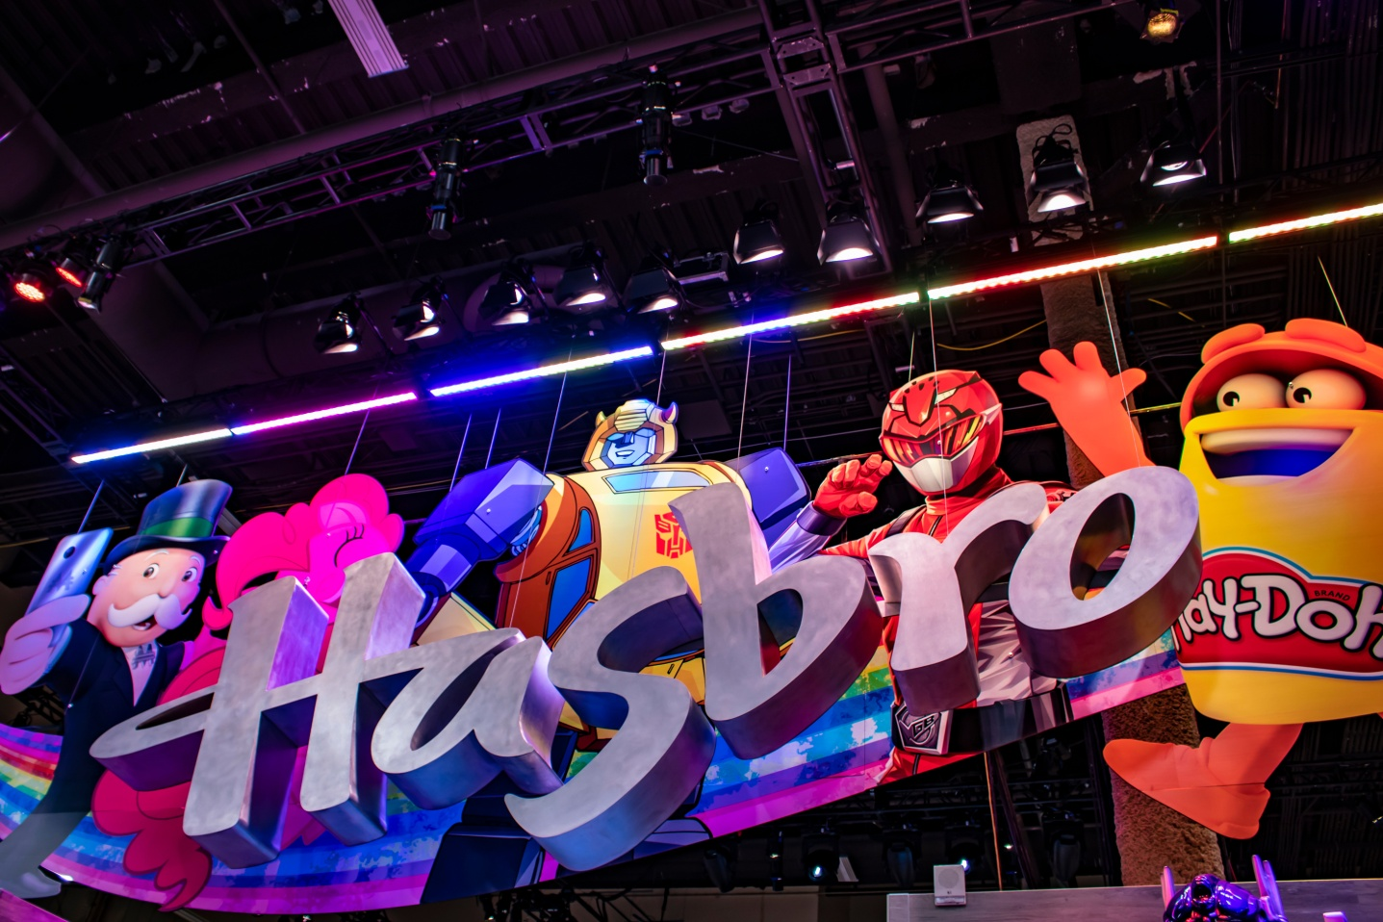
Two Very Different Toy Stories

Slide 3
The Differences
Hasbro
Toys R Us
Thriving
Had a comprehensive strategy for a digital world
Bankrupt
Did not have a strategy for a digital world

Slide 7
