Slide 1
Securing the Network Design
Dr. Mohammad Adly

Slide 2
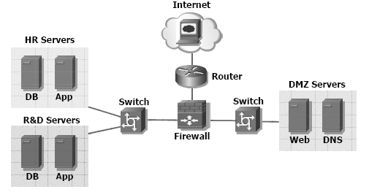
Network Sections
Public
Internet
Semi-public (DMZ)
Web server
Mail server
DNS server
Private
Internal Systems

Slide 3
Defense in Depth DID
Protect the firewall
Border Router
Limit the visibility of traffic between systems
If one of our systems is compromised, minimize the consequences as much as possible

Slide 4
Thank you

