Slide 1
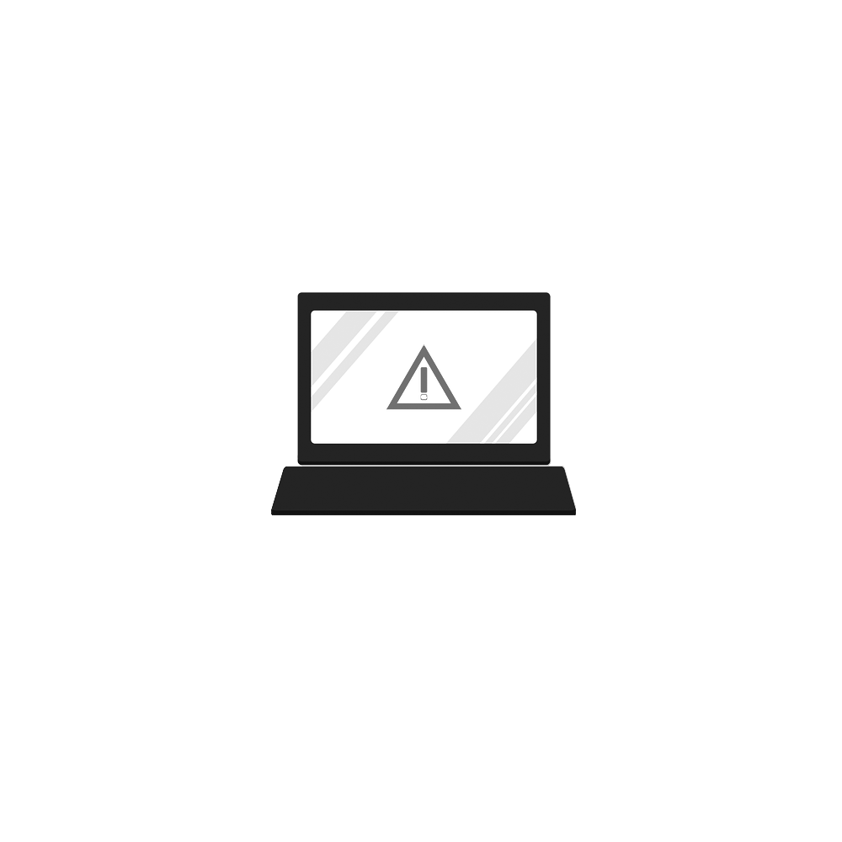
Blue Team: Defending Against Hackers
Introduction

Slide 2
:~# whoami
Bachelor’s degree in Security and Risk Analysis at Pennsylvania State University
Apart of the information security field for 10+ years
Currently hold Security+ with plans to acquire more certifications soon
Specialize in defensive security but spent many years practicing offensive security as well

Slide 3
Target Audience
Who is this course for?
Minimum Requirements: Basic understanding of operating systems and networking
Recommended Requirements: Experience with Windows/Linux, networking, and some basic programming knowledge. Any infosec experience is very helpful.
I designed this course for individuals who are novice to intermediate in cybersecurity. I found a solid balance between older security principles and newer technologies. Information security encompasses a vast amount of topics and subfield so I boiled it down to what I believe is the most important and actionable information.
Note: the original syllabus for this class was longer, but had to reduce size

Slide 4
Recommendations
Focusing on free/open-source products
I am not affiliated with any of the recommendations in any direct or indirect way
My opinions are my own and do not reflect any institution that I am affiliated with
Technology changes quickly. One recommendation today might not be the best one by tomorrow. However, I will do my best to continually update the content
Do your homework

Slide 5
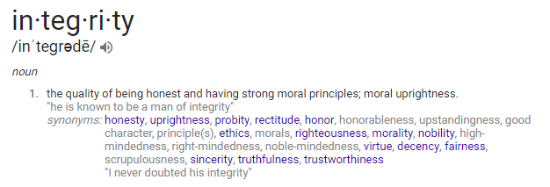
CIA Triad
Confidentiality, Integrity, Availability/Accountability
Confidentiality
Integrity
Availability
Sources: Google Search

Slide 6
CIA Triad
Examples
Confidentiality: Encryption
Integrity: Hashing
Availability: Data redundancy (backups)
Accountability: Logging
Confidentiality
Integrity
Availability

Slide 7
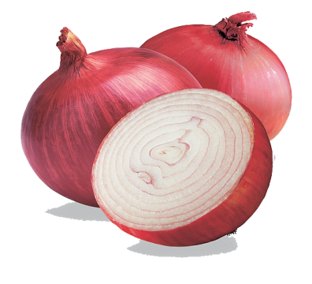
Security Principles
It’s not if, but when
Keep everything up-to-date
Reduce attack surface as much as possible
Principle of least privilege
A chain is only as strong as its weakest link (nothing is impenetrable)
Security vs. Convenience
Default deny all (Whitelisting > Blacklisting)
80/20 rule
SecurityControl$ <= Asset$
Security != Obscurity

Slide 8
Final Words
It’s A Marathon, Not A Sprint
Infosec is a field that requires constant learning and development
It can seem overwhelming at first. Repetition is mastery
Be aware of imposter syndrome
Nobody is a master of every subfield in information security
Google will always be your best friend
Remain humble and celebrate the success of others. Mistakes will happen. The security community is very dependent, team-oriented, and often friendly

Slide 9
Disclaimer
Please read carefully…
THE WORK IS PROVIDED “AS IS.” The author does not warrant or guarantee that the functions contained in the work will meet your requirements, that its operation will be uninterrupted or error free, or that the work will qualify as an expert witness. The author shall not be liable to you or anyone else for any inaccuracy, error or omission, regardless of cause, in the work or for any damages resulting therefrom. Under no circumstances shall the author be liable for any indirect, incidental, special, punitive, consequential, or similar damages that result from the use of or inability to use the work. The limitation of liability shall apply to any claim or cause whatsoever whether such claim or cause arises in contract, tort or otherwise.

