Slide 1
Where CRAs Get Your Data

Slide 2
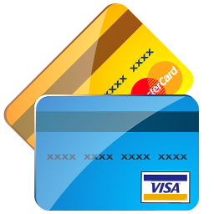
Business Credit
Business credit is credit obtained in a business’s name
It’s independent of the owner’s credit history and scores
Business credit reporting agencies rely on objective data to calculate their scores
Objective and useful business credit data comes from a variety of sources

Slide 3
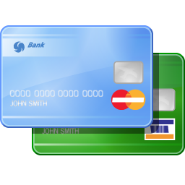
Business Credit
A business credit profile is independent of a consumer credit profile
It relies on somewhat different data
But it all points to risk
What is the risk of your company defaulting on its payments?

Slide 4
Business Credit Data
All of the credit reporting agencies have the same mission
They measure whether your business can pay its bills on time
The differences are in the details
Some CRAs weigh public records more heavily
Others weigh payment history more heavily

Slide 5
Public Records
Credit reporting agencies want to know your business’s experiences in the public sphere
This includes:
Bankruptcies
Liens
Judgments
This information generally comes from court documents
In the US, PACER provides information on federal court cases (www.pacer.gov/)
You can also find public record information at BRBPub (http://www.brbpub.com/)

Slide 6
Public Records
Credit reporting agencies are looking for:
Filing dates
Whether a bankruptcy, etc. has been resolved
Closing dates
The basics on court cases, to determine if your company could be sued by another party at a later date

Slide 7
IRS Information
In general, this is tax lien filings
They aren’t connected to courts
Instead, they have a filing location like a county
The IRS also has information on whether your company is a sole proprietorship, partnership, corporation, etc.
This gives information on the makeup of your company

Slide 8
Voluntary Reporting by Creditors
Credit reporting agencies like Experian (http://www.experian.com/business-information/data-contribution.html) strongly suggest companies report to them
They suggest creditors report because:
If borrowers know a company reports, those borrowers might pay faster to maintain better scores
It is a means of rewarding good credit to conscientious borrowers who pay back on time
Reporting alerts other creditors that a company has borrowed and thereby might be about to overextend itself, which means it might not be able to promptly pay its obligations

Slide 9
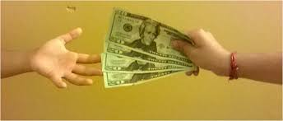
Self-Reporting by Borrowers
Every time you fill out a credit application for your business, you are providing data for credit reporting agencies
This includes:
Industry classification
Amount of time in business
Number of employees

Slide 10
Self-Reporting by Borrowers
The first time you self-report is when you apply for a D-U-N-S number
You provide information such as:
The company’s physical location
Whether a company has a DBA (doing business as)
Headquarters and any other company locations

Slide 11
Self-Reporting by Borrowers
D&B creates the D&B Rating
The rating contains a Financial Strength Indicator
It is calculated using either the Net Worth or Issued Capital of a company
If both figures are available, then Net Worth is always used
D&B will show if a business is new or if they never got this information
It also adds a Condition Code or Risk Indicator
This measures the amount of risk the creditor can expect, by taking into account key items in a D&B Business Information report which are used to predict the likelihood of a business failure
A company gets the lowest rating (5) if no information is provided

Slide 12
Shared Data
Credit reporting agencies receive payment data and other company details from lenders, suppliers and creditors where your company has accounts
This is from vendors which report
Even vendors which do not report can provide data …
… if you ask for a trade reference
A trade reference is subjective; the other information is all objective

Slide 13
UCC Filings
If your business got approval for financing and you pledged collateral to secure that funding…
… then the lender will file a UCC-1 financing statement with the Secretary of State
This creates a lien as against that asset
Credit reporting agencies collect this public information
They add it to a company’s credit report

Slide 14
Collection Filings
If your business has any collection filings, the listing includes:
date
collection agency name
status
amounts disputed and collected
and the closed date, if applicable

Slide 15
The Federal Government
Credit reporting agencies collect reported Federal government data
This includes:
any company grants
loans
contracts, and debarment
Debarment is an exclusion from certain items such as contracts, due to transgressions like fraud

Slide 16
The Media
Credit reporting agencies gather information from these sources
This includes communication platforms such as:
press releases
news stories
Sources can be online or offline

Slide 17
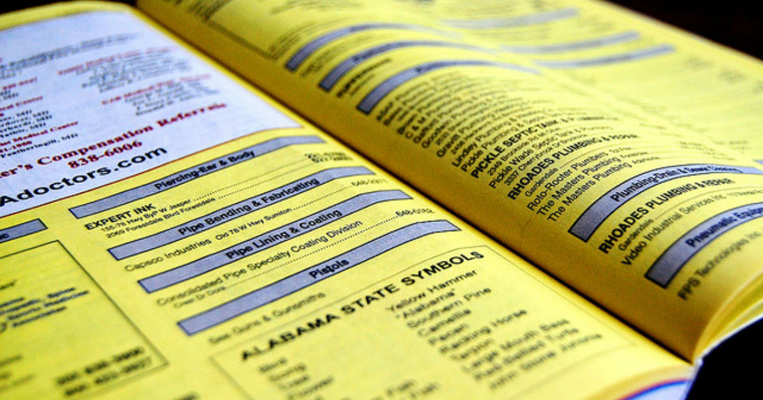
Directories
Directories of companies are another source of information
This includes the Yellow pages
Directories can be either online or offline

Slide 18
Business registrations
When you register your business with the state you provide details such as:
your company’s incorporation
the date of the incorporation
the current status of the filing

Slide 19
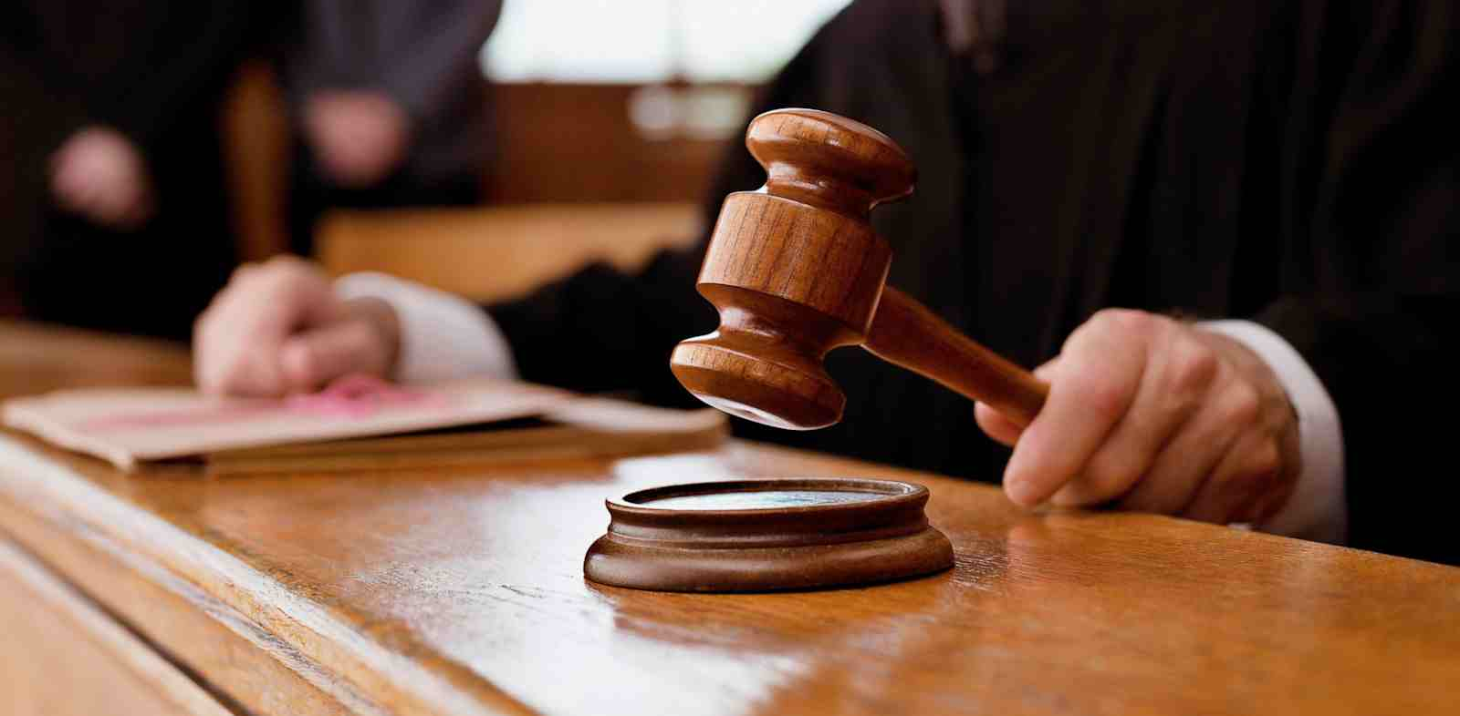
Business registrations
These can be listed in courts at the following levels:
State
City
County

Slide 20
Incorporation Filings
If applicable for this type of business, the filing goes on public record with the state’s corporations division
Other submitted data includes:
corporate financial reports
shareholder specifics

Slide 21
Web Mining
Credit reporting agencies will be looking for your company online
This includes:
Google
Your company’s website, if any
Your presence elsewhere online, like on Facebook or Yelp

Slide 22
Web Mining
Having your own website allows you to direct some of the narrative
Your company can put its best online foot forward
If your company website is incomplete or does not exist at all, then the CRAs will fill the gaps with information they get elsewhere
And that might not be favorable information

Slide 23
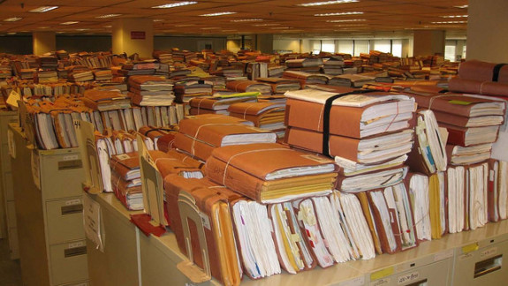
Recap for Where CRAs get your data
Credit reporting agencies work with objective information
It is readily traceable to government records …
… or court records and other organizations
The only subjective information is trade references

Slide 24
Contact Us Today To Learn More About Where CRAs Get Your Data

