Slide 1
MODULE 1
Getting Into the Self-Care Mindset

Slide 2
Goal of this module…
To understand the importance of making time for yourself, and discover how self-care will make an impact in your own life

Slide 3
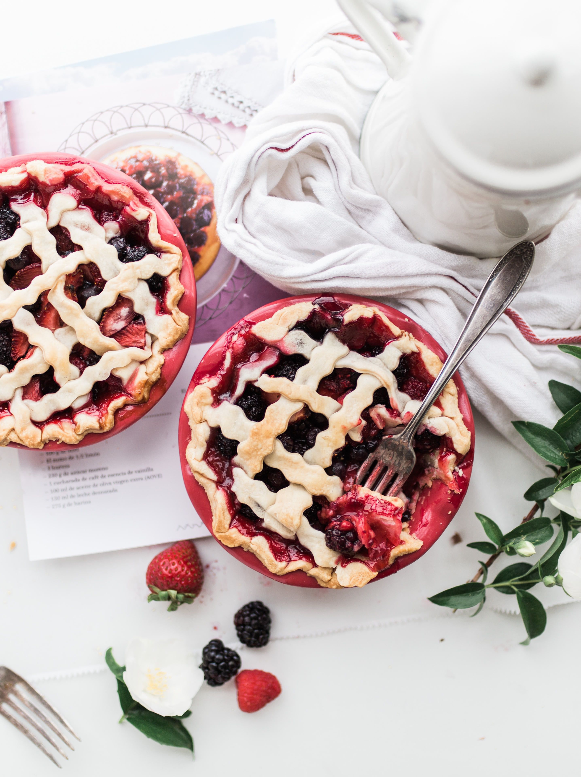
Why Self-Care?
This is arguably the most important step in this course. If you don’t feel that you’re worthy of self-care, or that self-care isn’t worthy of you, then you won’t make it a priority.
Just completing this course is a form of self-care!

Slide 4
Self-care is…
We’ll go more into detail on what exactly self-care is in the next section. For now, let’s focus on why it’s not just important, but essential to your health and well-being.

Slide 5
What’s the #1 reason to add self-care into your routine?
Self-care helps you be more productive, saves you time, keeps your stress levels lower, and helps you not just go through the motions of life, but actually enjoy it too! (okay, that’s a lot more than just one reason)

Slide 6
Tips on adding self-care into your routine
Focus on achieving internal rather than external validation. Remember you’re doing this for yourself, and not just to check off another box, and be successful (or unsuccessful) in another section of your life, in other words…self-care is all about YOU!!! No one else.
Don’t turn it into another “should”. You can’t fail at self-care. If you forget about your self-care goals for a week, month, or even months…you can pick it back up at anytime!

Slide 7
Tips on adding self-care into your routine
Choose to participate in self-care activities that you actually enjoy. Don’t just do them because you think they should help, or be good for you.
Try out self-care related activities that appeal to you at least 5 times before deciding whether you like them or not. If you like them, add them into your regulars (we’ll talk more about that later!) if you don’t, then ditch them!

Slide 8
Bottom line…
You can either go through the motions of life, or show up fully present and alive! Self-care will bridge that gap between living and thriving

Slide 9
Take action now!
Grab your notebook or journal, answer these questions and refer back to them throughout the course to remind yourself why self-care is important to you…

Slide 10
Questions…
What was it that first attracted you to this course?
What do you feel is lacking in your life, that you’d like more of?
How will you make self-care a priority in your life?
How will you recognize when you need more self-care?

Slide 11
Summary
Self-care will only make an impact in your life if you make it a priority
Self-care can completely change the way you experience life
Taking time out for self-care is not selfish!

