Slide 1
HOW WE GOT TO WHO WE ARE

Slide 2
Passing on the “Apostles’ Teaching”
First 300 Years
HOW WE GOT TO WHO WE ARE

Slide 3
Ask hard questions
HOW WE GOT TO WHO WE ARE
Fully reflective understanding
Express…before we leave
Reflect on Q & A’s

Slide 4
HOW WE GOT TO WHO WE ARE
How has the ancient faith been passed along to us?

Slide 5
The ancient faith
Matthew 16:18
Acts 2:42-47
John 17:20-23
2 Thessalonians 2:15
Ephesians 4:11-13
“the deposit” –

Slide 6
Passing along the faith
Planting and growing
Apostles

Slide 7
The New Testament Story
Ben Witherington

Slide 8
Passing along the faith
Planting and growing
Apostles
Death of 1st & 2nd Generations

Slide 9
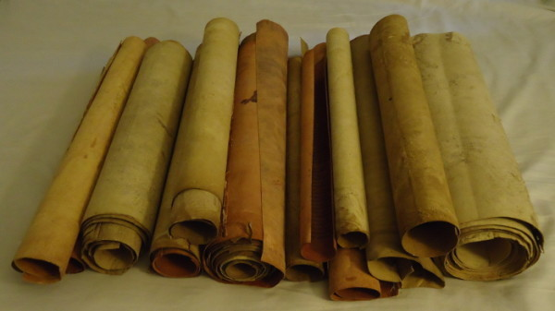
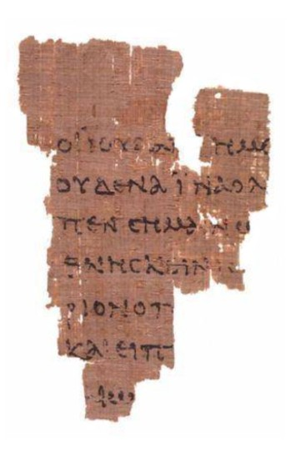
HOW WE GOT TO WHO WE ARE
John Ryland Papyrius
110-170 A.D.

Slide 10
Passing along the faith
Planting and growing
Apostles
Death of 1st & 2nd Generations
Second Century

Slide 11
Church History
Everett Ferguson

Slide 12
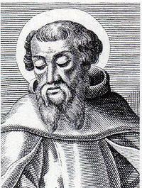
Irenaeus
200 A.D.

Slide 13
Passing along the faith
Planting and growing
Reforming
Coming Together

Slide 14
Passing on the “Apostles’ Teaching”
First 300 Years
HOW WE GOT TO WHO WE ARE

Slide 15
HOW WE GOT TO WHO WE ARE

