Slide 1
DBH VIRTUAL PROVIDER TRAINING​
Clinical Documentation in the Virtual Setting
Presenter: Andrea Piazza, Director of Virtual Programming​

Slide 2
Content Synopsis
OVERVIEW OF KEY IDEAS
General Overview of telehealth documentation
Navigating Kipu
Documenting for telehealth for each role
How to minimize documentation tips
Where to locate documentation guides and information

Slide 3
Overview
OVERVIEW OF KEY IDEAS
Welcome to Discovery Behavioral Health’s training on clinical documentation in the virtual setting. We will review the general documentation guidelines and where you can locate them. We will focus on the information pertinent to virtual programming documentation. We will then review some strategies for minimizing documentation. We will also review how and where to document within the KIPU system.

Slide 4
Learning Objectives
GENERAL DOCUMENTATION CONSIDERATIONS FOR TELEHEALTH
NAVIGATING KIPU
EFFECTIVE DOCUMENTATION FOR VIRTUAL AT DBH
TIPS FOR MINIMIZING DOCUMENTATION
WHERE TO GO FOR FURTHER DOCUMENTATION SUPPORT

Slide 5
What is important to know about documenting for telehealth in general?
5 Questions You Will be Able to Answer
How do I navigate the DBH EMR?
How do I document for virtual programming?
How can I document strategically?
Where can I find additional resources on virtual documentation?

Slide 6
General Overview
A patient's health record is a way to communicate a patient's care with the various stakeholders involved
Record retention policies protect patient records
Telehealth reimbursement guidelines vary greatyly depending on practice, state, services, payers, etc. and impact documentation

Slide 7
Kipu
Our primary EMR
Let's walk through how to use it from a technology stand point a bit more

Slide 8
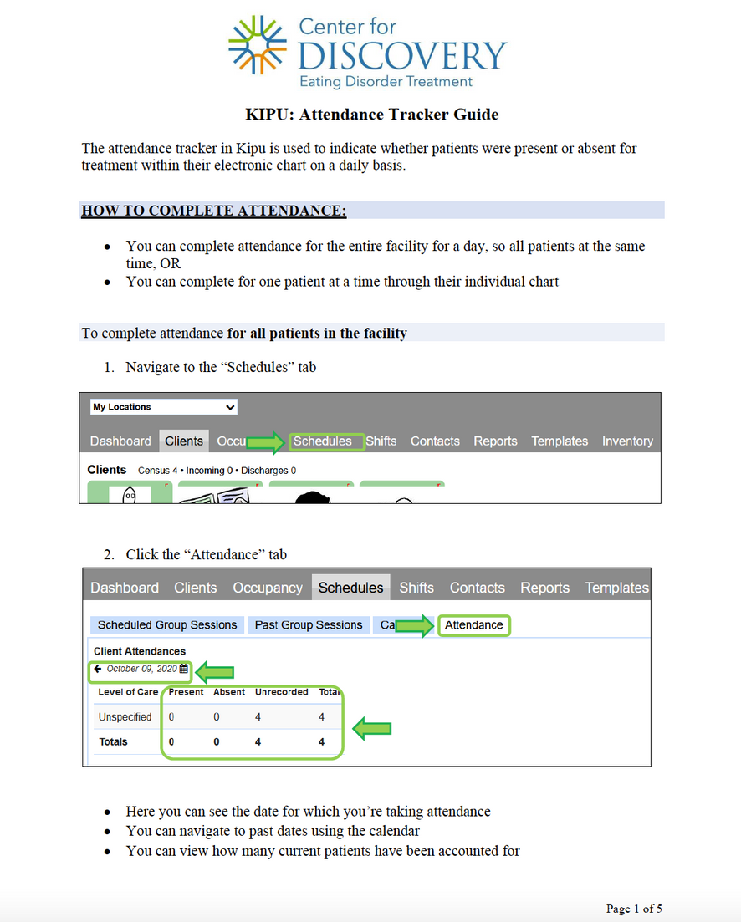
Kipu
How to document in Kipu

Slide 9
Lessons from CSQM
How to document in Kipu
1. Effective Documentation Master Presentation
Tips for Telehealth!: Make sure to identify Telehealth sessions appropriately!
Here are a few scenarios to help:
Therapist and patient are physically present in therapist’s Discovery Behavioral Health company office and patient’s family “zooms in” for a session, due to being outside the geographic area of the treatment center = Family and/or Conjoint session
Therapist is in their Discovery Behavioral Health company office and receives a call that her patient is feeling symptomatic and is unable to make it to session, but is requesting a virtual session (from home if outpatient, from room if residential) = Telehealth
Both Therapist and patient are in their respective homes, due to a “stay-at-home” order and are meeting virtually via Zoom = Telehealth

Slide 10
Documenting for Telehealth for Each Role
CSQM Resource Center and Presentations

Slide 11
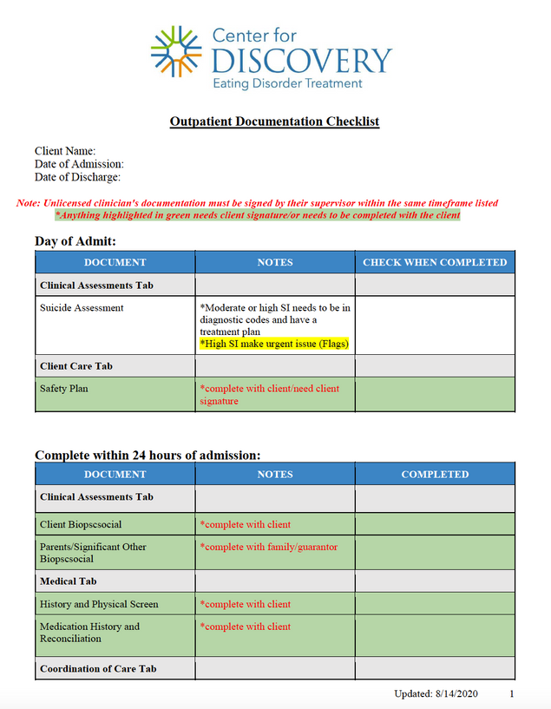
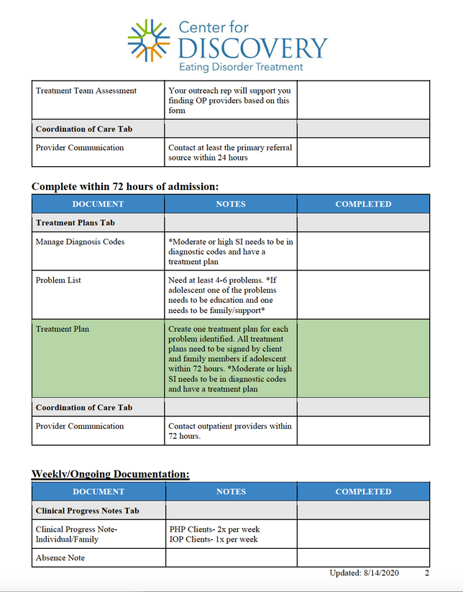
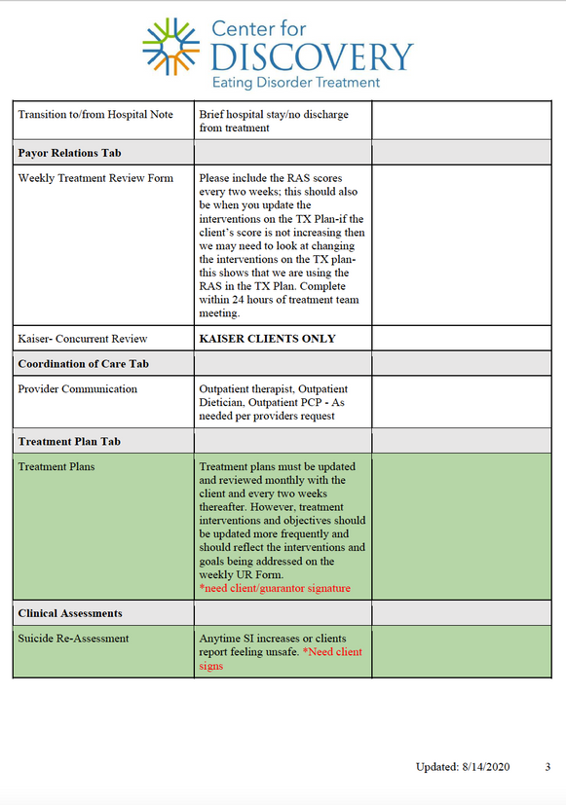
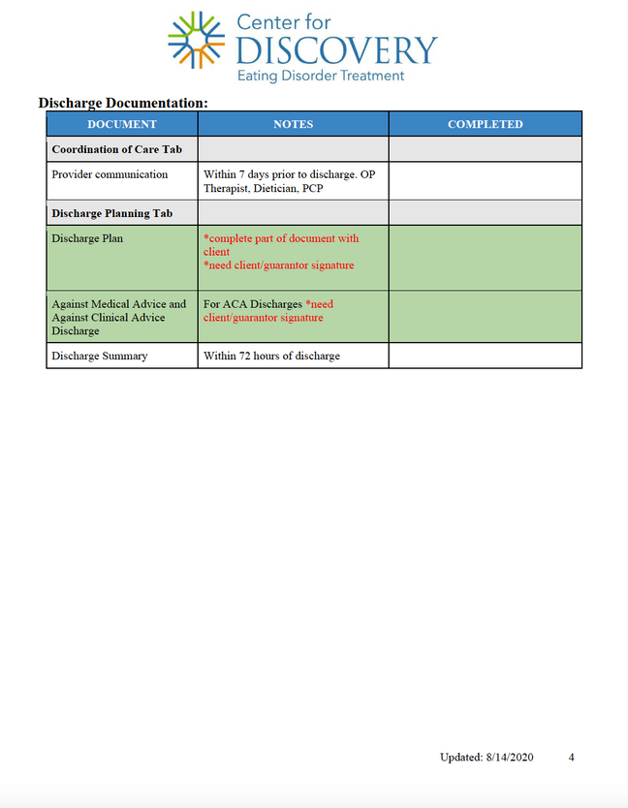
Documentation Check-list
Review Clinical Resources Folder in Sharepoint: https://discoverybehavioralhealth.sharepoint.com/sites/CFD/Shared%20Documents/Forms/AllItems.aspx?FolderCTID=0x012000BCE3FEF440F4CF46AC46D8C9B6C01010&id=%2Fsites%2FCFD%2FShared%20Documents%2FClinical%20Documents%20%2D%20OP%2FClinical%20Resources&viewid=05f9041a%2D0d7d%2D4995%2Db218%2D49b6f375a828
Notes:
https://discoverybehavioralhealth.sharepoint.com/teams/CSQMTeam/Shared%20Documents/Forms/AllItems.aspx?id=%2Fteams%2FCSQMTeam%2FShared%20Documents%2F5%2E%20Clinical%20Quality%20%28%26%20Documentation%29%2F5%2E%20Clinical%20Supervision%2F1%2E%20Clinicians%20Desk%20Reference%202021%2Epdf&parent=%2Fteams%2FCSQMTeam%2FShared%20Documents%2F5%2E%20Clinical%20Quality%20%28%26%20Documentation%29%2F5%2E%20Clinical%20Supervision&p=trueps%3A%2F%2Fdiscoverybehavioralhealth.sharepoint.com%2Fteams%2FCSQMTeam%2FShared%2520Documents%2FForms%2FAllItems.aspx%3Fid%3D%252Fteams%252FCSQMTeam%252FShared%2520Documents%252F5%252E%2520Clinical%2520Quality%2520%2528%2526%2520Documentation%2529%252F5%252E%2520Clinical%2520Supervision%252F1%252E%2520Clinicians%2520Desk%2520Reference%25202021%252Epdf%26parent%3D%252Fteams%252FCSQMTeam%252FShared%2520Documents%252F5%252E%2520Clinical%2520Quality%2520%2528%2526%2520Documentation%2529%252F5%252E%2520Clinical%2520Supervision%26p%3Dtrue&client=safari&rls=en&sxsrf=APq-WBuEkL-BLoHkUa5kTubFt96LOluLDA%3A1645483081310&ei=SRQUYsDIEpPNkPIP__uL8AQ&ved=0ahUKEwiAka6U7pH2AhWTJkQIHf_9Ak4Q4dUDCA0&uact=5&oq=https%3A%2F%2Fdiscoverybehavioralhealth.sharepoint.com%2Fteams%2FCSQMTeam%2FShared%2520Documents%2FForms%2FAllItems.aspx%3Fid%3D%252Fteams%252FCSQMTeam%252FShared%2520Documents%252F5%252E%2520Clinical%2520Quality%2520%2528%2526%2520Documentation%2529%252F5%252E%2520Clinical%2520Supervision%252F1%252E%2520Clinicians%2520Desk%2520Reference%25202021%252Epdf%26parent%3D%252Fteams%252FCSQMTeam%252FShared%2520Documents%252F5%252E%2520Clinical%2520Quality%2520%2528%2526%2520Documentation%2529%252F5%252E%2520Clinical%2520Supervision%26p%3Dtrue&gs_lcp=Cgdnd3Mtd2l6EAMyBwgAEEcQsAMyBwgAEEcQsAMyBwgAEEcQsAMyBwgAEEcQsAMyBwgAEEcQsAMyBwgAEEcQsAMyBwgAEEcQsAMyBwgAEEcQsANKBAhBGABKBAhGGABQsgdY5gxghBFoAXABeACAAQCIAQCSAQCYAQCgAQHIAQjAAQE&sclient=gws-wiz

Slide 12
MINIMIZING DOCUMENTATION & MEDICAL NECESSITY

Slide 13
Tips for Concurrent Documentation
Screen sharing
Templates
Bullet point
Always running on the therapeutic hour - avoiding compounding documentation stress
Set up the note during check-in
Notes:
https://discoverybehavioralhealth.sharepoint.com/teams/CSQMTeam/Shared%20Documents/Forms/AllItems.aspx?id=%2Fteams%2FCSQMTeam%2FShared%20Documents%2F5%2E%20Clinical%20Quality%20%28%26%20Documentation%29%2F5%2E%20Clinical%20Supervision%2F1%2E%20Clinicians%20Desk%20Reference%202021%2Epdf&parent=%2Fteams%2FCSQMTeam%2FShared%20Documents%2F5%2E%20Clinical%20Quality%20%28%26%20Documentation%29%2F5%2E%20Clinical%20Supervision&p=trueps%3A%2F%2Fdiscoverybehavioralhealth.sharepoint.com%2Fteams%2FCSQMTeam%2FShared%2520Documents%2FForms%2FAllItems.aspx%3Fid%3D%252Fteams%252FCSQMTeam%252FShared%2520Documents%252F5%252E%2520Clinical%2520Quality%2520%2528%2526%2520Documentation%2529%252F5%252E%2520Clinical%2520Supervision%252F1%252E%2520Clinicians%2520Desk%2520Reference%25202021%252Epdf%26parent%3D%252Fteams%252FCSQMTeam%252FShared%2520Documents%252F5%252E%2520Clinical%2520Quality%2520%2528%2526%2520Documentation%2529%252F5%252E%2520Clinical%2520Supervision%26p%3Dtrue&client=safari&rls=en&sxsrf=APq-WBuEkL-BLoHkUa5kTubFt96LOluLDA%3A1645483081310&ei=SRQUYsDIEpPNkPIP__uL8AQ&ved=0ahUKEwiAka6U7pH2AhWTJkQIHf_9Ak4Q4dUDCA0&uact=5&oq=https%3A%2F%2Fdiscoverybehavioralhealth.sharepoint.com%2Fteams%2FCSQMTeam%2FShared%2520Documents%2FForms%2FAllItems.aspx%3Fid%3D%252Fteams%252FCSQMTeam%252FShared%2520Documents%252F5%252E%2520Clinical%2520Quality%2520%2528%2526%2520Documentation%2529%252F5%252E%2520Clinical%2520Supervision%252F1%252E%2520Clinicians%2520Desk%2520Reference%25202021%252Epdf%26parent%3D%252Fteams%252FCSQMTeam%252FShared%2520Documents%252F5%252E%2520Clinical%2520Quality%2520%2528%2526%2520Documentation%2529%252F5%252E%2520Clinical%2520Supervision%26p%3Dtrue&gs_lcp=Cgdnd3Mtd2l6EAMyBwgAEEcQsAMyBwgAEEcQsAMyBwgAEEcQsAMyBwgAEEcQsAMyBwgAEEcQsAMyBwgAEEcQsAMyBwgAEEcQsAMyBwgAEEcQsANKBAhBGABKBAhGGABQsgdY5gxghBFoAXABeACAAQCIAQCSAQCYAQCgAQHIAQjAAQE&sclient=gws-wiz

Slide 14
Final Thoughts
Notes:
https://discoverybehavioralhealth.sharepoint.com/teams/CSQMTeam/Shared%20Documents/Forms/AllItems.aspx?id=%2Fteams%2FCSQMTeam%2FShared%20Documents%2F5%2E%20Clinical%20Quality%20%28%26%20Documentation%29%2F5%2E%20Clinical%20Supervision%2F1%2E%20Clinicians%20Desk%20Reference%202021%2Epdf&parent=%2Fteams%2FCSQMTeam%2FShared%20Documents%2F5%2E%20Clinical%20Quality%20%28%26%20Documentation%29%2F5%2E%20Clinical%20Supervision&p=trueps%3A%2F%2Fdiscoverybehavioralhealth.sharepoint.com%2Fteams%2FCSQMTeam%2FShared%2520Documents%2FForms%2FAllItems.aspx%3Fid%3D%252Fteams%252FCSQMTeam%252FShared%2520Documents%252F5%252E%2520Clinical%2520Quality%2520%2528%2526%2520Documentation%2529%252F5%252E%2520Clinical%2520Supervision%252F1%252E%2520Clinicians%2520Desk%2520Reference%25202021%252Epdf%26parent%3D%252Fteams%252FCSQMTeam%252FShared%2520Documents%252F5%252E%2520Clinical%2520Quality%2520%2528%2526%2520Documentation%2529%252F5%252E%2520Clinical%2520Supervision%26p%3Dtrue&client=safari&rls=en&sxsrf=APq-WBuEkL-BLoHkUa5kTubFt96LOluLDA%3A1645483081310&ei=SRQUYsDIEpPNkPIP__uL8AQ&ved=0ahUKEwiAka6U7pH2AhWTJkQIHf_9Ak4Q4dUDCA0&uact=5&oq=https%3A%2F%2Fdiscoverybehavioralhealth.sharepoint.com%2Fteams%2FCSQMTeam%2FShared%2520Documents%2FForms%2FAllItems.aspx%3Fid%3D%252Fteams%252FCSQMTeam%252FShared%2520Documents%252F5%252E%2520Clinical%2520Quality%2520%2528%2526%2520Documentation%2529%252F5%252E%2520Clinical%2520Supervision%252F1%252E%2520Clinicians%2520Desk%2520Reference%25202021%252Epdf%26parent%3D%252Fteams%252FCSQMTeam%252FShared%2520Documents%252F5%252E%2520Clinical%2520Quality%2520%2528%2526%2520Documentation%2529%252F5%252E%2520Clinical%2520Supervision%26p%3Dtrue&gs_lcp=Cgdnd3Mtd2l6EAMyBwgAEEcQsAMyBwgAEEcQsAMyBwgAEEcQsAMyBwgAEEcQsAMyBwgAEEcQsAMyBwgAEEcQsAMyBwgAEEcQsAMyBwgAEEcQsANKBAhBGABKBAhGGABQsgdY5gxghBFoAXABeACAAQCIAQCSAQCYAQCgAQHIAQjAAQE&sclient=gws-wiz

Slide 15
SUMMARY
Clinical documentation is the backbone of clinical care that allows the various stakeholders to communicate for the patient's benefit. There are specific considerations we need to keep in mind for documentation when virtual. We reviewed where to find additional information on appropriate documentation, how to document effectively in the company wide electronic medical record and what is required as far as documentation. We also touched on ways to minimize documentation and some other tips for documenting when virtual.

Slide 16
Thank You!
For Questions:
Apiazza@discoverybh.com

Slide 17
Resources
“Key Substance Use and Mental Health Indicators in the ...” The National Survey on Drug Use and Health, Substance Abuse and Mental Health Services Administration, Oct. 2021, https://www.samhsa.gov/data/sites/default/files/reports/rpt35319/2020NSDUHFFR1PDFW102121.pdf.
HPSA and MUA/P: HPSA scoring criteria: Guidance portal. HPSA and MUA/P: HPSA Scoring Criteria | Guidance Portal. (n.d.). Retrieved January 28, 2022, from https://www.hhs.gov/guidance/document/hpsa-and-muap-hpsa-scoring-criteria
Two-thirds of primary care physicians can't get mental health services for patients. Commonwealth Fund. (2009, April 14). Retrieved January 28, 2022, from https://www.commonwealthfund.org/press-release/2009/two-thirds-primary-care-physicians-cant-get-mental-health-services-patients?redirect_source=%2Fpublications%2Fpress-releases%2F2009%2Fapr%2Ftwo-thirds-of-primary-care-physicians-cant-get-mental-health-services-for-patients
Behavioral Health Workforce Projections. (2020, December). Retrieved from Health Resources & Services Administration (HRSA).
Hilty DM, Yellowlees PM, Parish MB, et al. Telepsychiatry: Effective, evidence-based and at a tipping point in healthcare delivery. Psych Clin N Amer 2015;38(3):559-592.
Shore, J. H., & Yellowlees, P. (2018). Telepsychiatry and Health Technologies: A Guide for Mental Health Professionals. Arlington, VA: American Psychiatric Association Publishing.
https://www.healthdata.org/infographic/covid-19-pandemic-has-had-large-and-uneven-impact-global-mental-health
Ostrowski, J., & Collins, T.P. (2016). A Comparison of Telemental Health Terminology Used across Mental Health State Licensure Boards).
National Consortium of Telehealth Resource Centers. How patients can engage in telehealth. https://www.telehealthresourcecenter.org/wp-content/uploads/2020/03/How-Patients-Can-EngageTelehealth-FINAL.pdf
Hilty, D. M., Gentry, M. T., McKean, A. J., Cowan, K. E., Lim, R. F., & Lu, F. G. (2020). Telehealth for rural diverse populations: telebehavioral and cultural competencies, clinical outcomes and administrative approaches. mHealth, 6, 20. https://doi.org/10.21037/mhealth.2019.10.04
https://www.amazon.com/Burnout-Secret-Unlocking-Stress-Cycle/dp/198481706X

Slide 18
Training Completed!!!!!!!

