Slide 1
STOCKPICKING vs. INDEX FUND INVESTING IN 2021
S&P 500 & DAX
DIVIDEND YIELDS
Higher dax, we are going to analyse 70 German stocks soon, so subscribe!
2021 INVESTING SITUATION
INDEX FUNDS RETURNS
STOCK PICKING POSSIBILITIES
INDEX FUNDS RISKS
STOCK PICKING RISKS
CONCLUSION (Investing must always be about what is best for you!

Slide 2
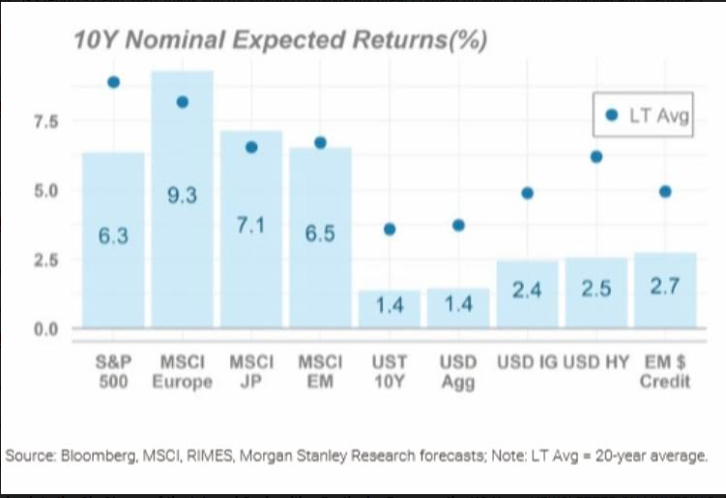
STOCKPICKING vs. INDEX FUND INVESTING IN 2021
S&P 500 & DAX
DIVIDEND YIELDS
Higher dax, we are going to analzye 70 german stocks soon, so subscribe!
2021 INVESTING SITUATION
INDEX FUNDS RETURNS
STOCK PICKING POSSIBILITIES
INDEX FUNDS RISKS
STOCK PICKING RISKS
CONCLUSION (Investing must always be about what is best for you!

Slide 3
STOCKPICKING vs. INDEX FUND INVESTING IN 2021
RETURNS FOR THE S&P 500 EXPLAINED
3 COMPONENTS:
CURRENT EARNIGNS VS PRICE
GROWTH ORGANIC
GROWTH INFLATION
2021 INVESTING SITUATION
INDEX FUNDS RETURNS
STOCK PICKING POSSIBILITIES
INDEX FUNDS RISKS
STOCK PICKING RISKS
CONCLUSION (Investing must always be about what is best for you!

Slide 4
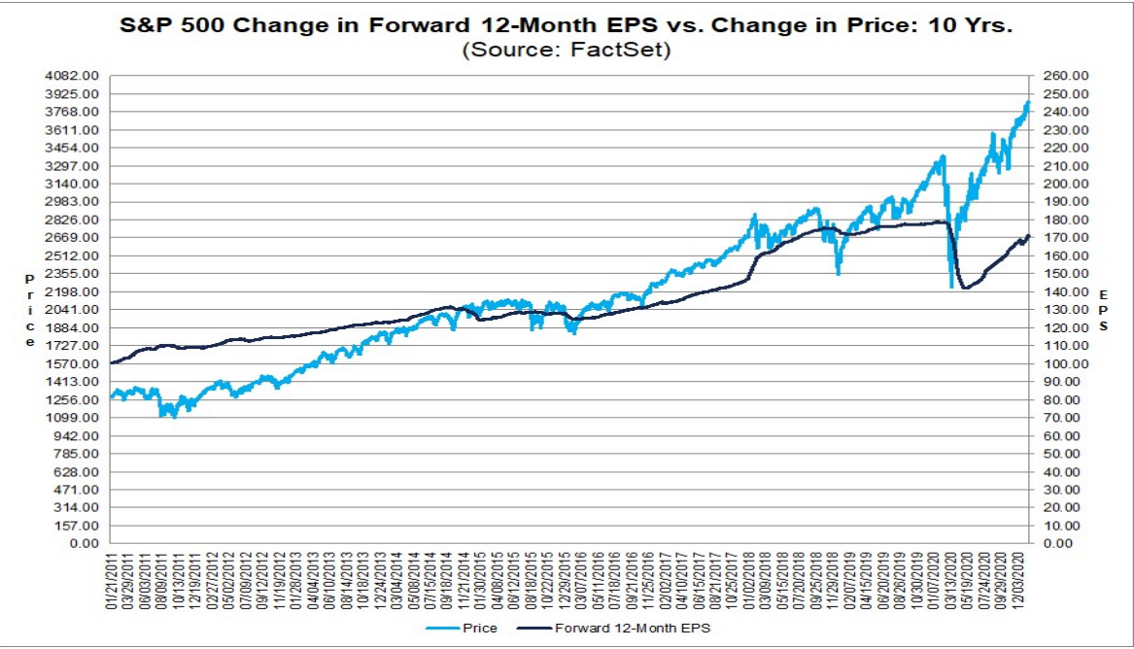
STOCKPICKING vs. INDEX FUND INVESTING IN 2021
RETURNS FOR THE S&P 500 EXPLAINED
2021 INVESTING SITUATION
INDEX FUNDS RETURNS
STOCK PICKING POSSIBILITIES
INDEX FUNDS RISKS
STOCK PICKING RISKS
CONCLUSION (Investing must always be about what is best for you!

Slide 5
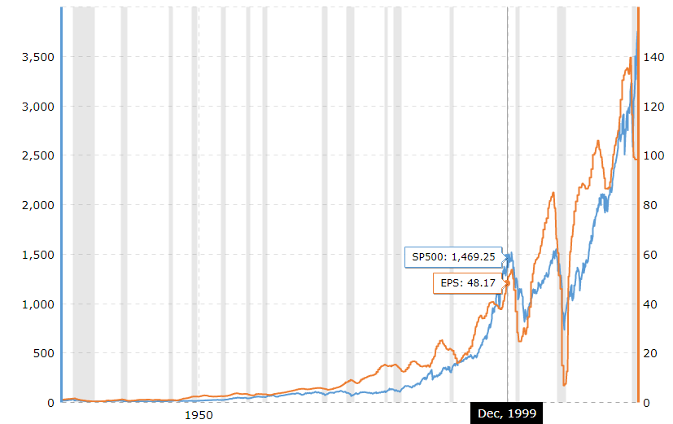
STOCKPICKING vs. INDEX FUND INVESTING IN 2021
RETURNS FOR THE S&P 500 EXPLAINED
2021 INVESTING SITUATION
INDEX FUNDS RETURNS
STOCK PICKING POSSIBILITIES
INDEX FUNDS RISKS
STOCK PICKING RISKS
CONCLUSION (Investing must always be about what is best for you!

Slide 6
STOCKPICKING vs. INDEX FUND INVESTING IN 2021
RETURNS FOR THE S&P 500 EXPLAINED
3 COMPONENTS:
CURRENT EARNIGNS VS PRICE
GROWTH ORGANIC
GROWTH INFLATION
2021 INVESTING SITUATION
INDEX FUNDS RETURNS
STOCK PICKING POSSIBILITIES
INDEX FUNDS RISKS
STOCK PICKING RISKS
CONCLUSION (Investing must always be about what is best for you!

Slide 7
STOCKPICKING vs. INDEX FUND INVESTING IN 2021
RETURNS FOR THE S&P 500 EXPLAINED
3 COMPONENTS:
CURRENT EARNIGNS VS PRICE
S&P 500 = 3714 POINTS
EARNINGS = 140
PRICE TO EARNINGS = 26.52
EARNINGS YIELD = 100/26.52
3.77%
2021 INVESTING SITUATION
INDEX FUNDS RETURNS
STOCK PICKING POSSIBILITIES
INDEX FUNDS RISKS
STOCK PICKING RISKS
CONCLUSION (Investing must always be about what is best for you!

Slide 8
STOCKPICKING vs. INDEX FUND INVESTING IN 2021
RETURNS FOR THE S&P 500 EXPLAINED
3 COMPONENTS:
CURRENT EARNIGNS VS PRICE (3.77%)
GROWTH ORGANIC
GROWTH INFLATION
2021 INVESTING SITUATION
INDEX FUNDS RETURNS
STOCK PICKING POSSIBILITIES
INDEX FUNDS RISKS
STOCK PICKING RISKS
CONCLUSION (Investing must always be about what is best for you!

Slide 9
STOCKPICKING vs. INDEX FUND INVESTING IN 2021
RETURNS FOR THE S&P 500 EXPLAINED
2021 INVESTING SITUATION
INDEX FUNDS RETURNS
STOCK PICKING POSSIBILITIES
INDEX FUNDS RISKS
STOCK PICKING RISKS
CONCLUSION (Investing must always be about what is best for you!

Slide 10
STOCKPICKING vs. INDEX FUND INVESTING IN 2021
RETURNS FOR THE S&P 500 EXPLAINED
2021 INVESTING SITUATION
INDEX FUNDS RETURNS
STOCK PICKING POSSIBILITIES
INDEX FUNDS RISKS
STOCK PICKING RISKS
CONCLUSION (Investing must always be about what is best for you!
140/50 = 2.8
2.8^ 0.05= 5.2%
50 years – 6.6%

Slide 11
STOCKPICKING vs. INDEX FUND INVESTING IN 2021
RETURNS FOR THE S&P 500 EXPLAINED
3 COMPONENTS:
CURRENT EARNIGNS VS PRICE (3.77%)
GROWTH ORGANIC (2%)
GROWTH INFLATION (3%)
TOTAL RETURN S&P 500 = 8.77%
2021 INVESTING SITUATION
INDEX FUNDS RETURNS
STOCK PICKING POSSIBILITIES
INDEX FUNDS RISKS
STOCK PICKING RISKS
CONCLUSION (Investing must always be about what is best for you!

Slide 12
STOCKPICKING vs. INDEX FUND INVESTING IN 2021
RETURNS FOR THE S&P 500 EXPLAINED
3 COMPONENTS:
CURRENT EARNIGNS VS PRICE (3.77%)
GROWTH ORGANIC (2%)
GROWTH INFLATION (1%)
TOTAL RETURN S&P 500 = 6.77%
2021 INVESTING SITUATION
INDEX FUNDS RETURNS
STOCK PICKING POSSIBILITIES
INDEX FUNDS RISKS
STOCK PICKING RISKS
CONCLUSION (Investing must always be about what is best for you!

Slide 13
STOCKPICKING vs. INDEX FUND INVESTING IN 2021
RETURNS FOR THE S&P 500 EXPLAINED
3 COMPONENTS:
CURRENT EARNIGNS VS PRICE (3.77%)
GROWTH ORGANIC (2%)
GROWTH INFLATION (3%)
TOTAL RETURN S&P 500 = 8.77%
2021 INVESTING SITUATION
INDEX FUNDS RETURNS
STOCK PICKING POSSIBILITIES
INDEX FUNDS RISKS
STOCK PICKING RISKS
CONCLUSION (Investing must always be about what is best for you!

Slide 14
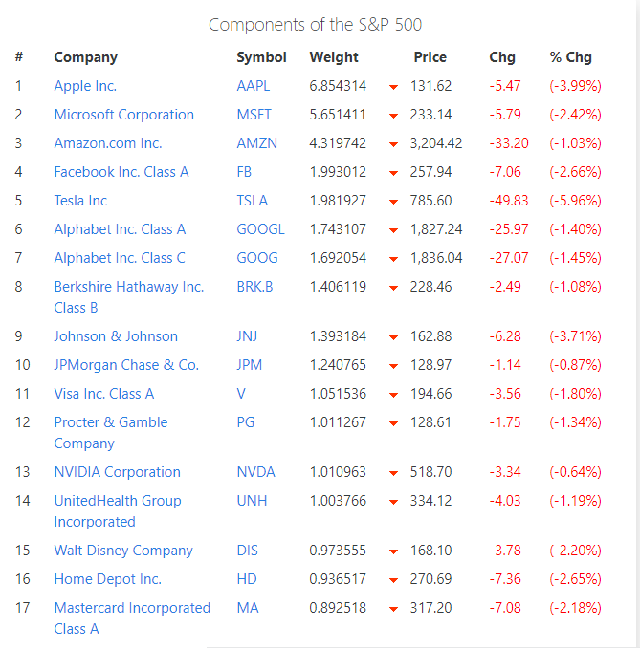
STOCKPICKING vs. INDEX FUND INVESTING IN 2021
RETURNS FOR THE S&P 500 EXPLAINED
3 COMPONENTS:
CURRENT EARNIGNS VS PRICE (3.77%)
GROWTH ORGANIC (2%)
GROWTH INFLATION (3%)
TOTAL RETURN S&P 500 = 8.77%
2021 INVESTING SITUATION
INDEX FUNDS RETURNS
STOCK PICKING POSSIBILITIES
INDEX FUNDS RISKS
STOCK PICKING RISKS
CONCLUSION (Investing must always be about what is best for you!

Slide 15
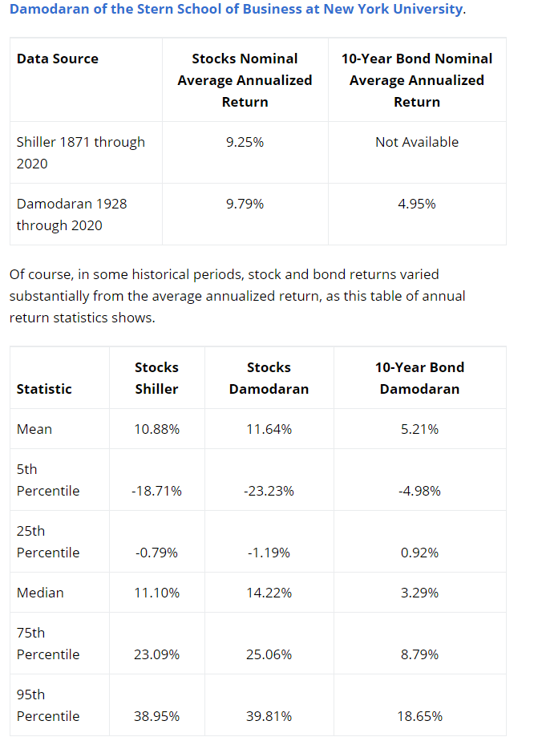
STOCKPICKING vs. INDEX FUND INVESTING IN 2021
RETURNS FOR THE S&P 500 EXPLAINED
3 COMPONENTS:
GROWTH ORGANIC (2%)
GROWTH INFLATION (3%)
TOTAL RETURN S&P 500 =
2021 INVESTING SITUATION
INDEX FUNDS RETURNS
STOCK PICKING POSSIBILITIES
INDEX FUNDS RISKS
STOCK PICKING RISKS
CONCLUSION (Investing must always be about what is best for you!

Slide 16
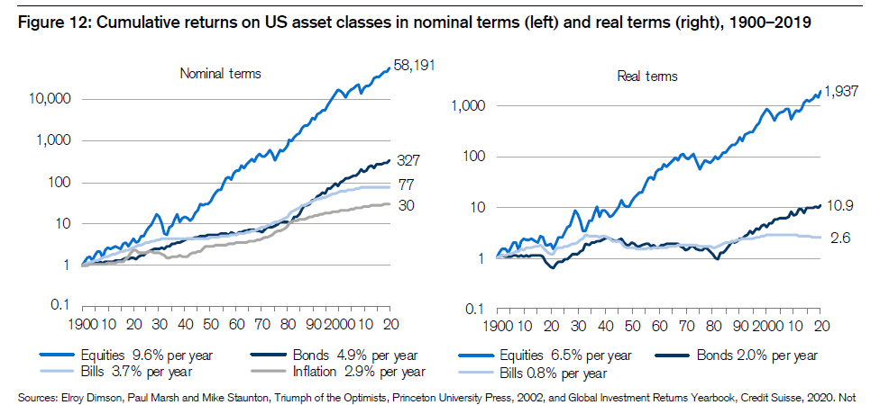
STOCKPICKING vs. INDEX FUND INVESTING IN 2021
RETURNS FOR THE S&P 500 EXPLAINED
3 COMPONENTS:
GROWTH ORGANIC (2%)
GROWTH INFLATION (3%)
TOTAL RETURN S&P 500 =
2021 INVESTING SITUATION
INDEX FUNDS RETURNS
STOCK PICKING POSSIBILITIES
INDEX FUNDS RISKS
STOCK PICKING RISKS
CONCLUSION (Investing must always be about what is best for you!

Slide 17
STOCKPICKING vs. INDEX FUND INVESTING IN 2021
TOTAL RETURN S&P 500 = 8.77%
2021 INVESTING SITUATION
INDEX FUNDS RETURNS
STOCK PICKING POSSIBILITIES
INDEX FUNDS RISKS
STOCK PICKING RISKS
CONCLUSION (Investing must always be about what is best for you!

Slide 18
STOCKPICKING vs. INDEX FUND INVESTING IN 2021
TOTAL RETURN S&P 500 = 8.77%
3 COMPONENTS:
CURRENT EARNIGNS VS PRICE (3.77%) – lower PE ratios than 26!
GROWTH ORGANIC (2%) – Good businesses with growth!
GROWTH INFLATION (3%) – Average pricing power
2021 INVESTING SITUATION
INDEX FUNDS RETURNS
STOCK PICKING POSSIBILITIES
INDEX FUNDS RISKS
STOCK PICKING RISKS
CONCLUSION (Investing must always be about what is best for you!

Slide 19
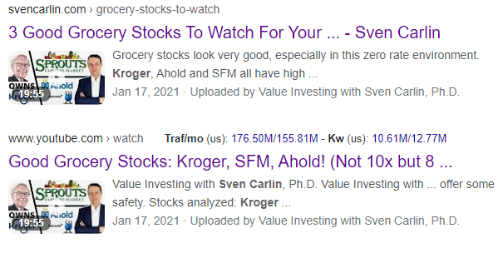
STOCKPICKING vs. INDEX FUND INVESTING IN 2021
TOTAL RETURN S&P 500 = 8.77%
3 COMPONENTS:
CURRENT EARNIGNS VS PRICE (3.77%) – lower PE ratios than 26!
GROWTH ORGANIC (2%) – Good businesses with growth!
GROWTH INFLATION (3%) – Average pricing power
KROGER STOCK!
PE = 15 = 6.5%
GROWTH = 1%
INFLATION = 3%
10.5%
2021 INVESTING SITUATION
INDEX FUNDS RETURNS
STOCK PICKING POSSIBILITIES
INDEX FUNDS RISKS
STOCK PICKING RISKS
CONCLUSION (Investing must always be about what is best for you!

Slide 20
STOCKPICKING vs. INDEX FUND INVESTING IN 2021
TOTAL RETURN S&P 500 = 8.77%
3 COMPONENTS:
CURRENT EARNIGNS VS PRICE (3.77%) – lower PE ratios than 26!
GROWTH ORGANIC (2%) – Good businesses with growth!
GROWTH INFLATION (3%) – Average pricing power
KROGER STOCK!
PE = 15 = 6.5%
GROWTH = 1%
INFLATION = 3%
10.5%
2021 INVESTING SITUATION
INDEX FUNDS RETURNS
STOCK PICKING POSSIBILITIES
INDEX FUNDS RISKS
STOCK PICKING RISKS
CONCLUSION (Investing must always be about what is best for you!

Slide 21
STOCKPICKING vs. INDEX FUND INVESTING IN 2021
INDEX FUNDS – AUTOMATIC
STOCKPICKING – NOT AUTOMATIC – requires work!
2021 INVESTING SITUATION
INDEX FUNDS RETURNS
STOCK PICKING POSSIBILITIES
INDEX FUNDS RISKS
STOCK PICKING RISKS
CONCLUSION (Investing must always be about what is best for you!

Slide 22
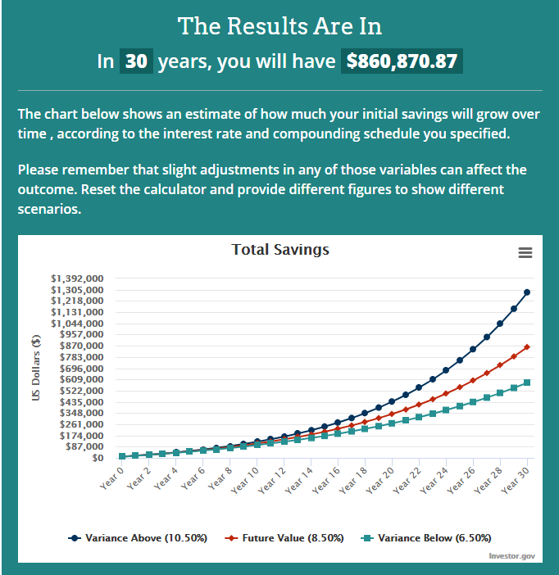
STOCKPICKING vs. INDEX FUND INVESTING IN 2021
INDEX FUNDS – AUTOMATIC
STOCKPICKING – NOT AUTOMATIC – requires work!
2021 INVESTING SITUATION
INDEX FUNDS RETURNS
STOCK PICKING POSSIBILITIES
INDEX FUNDS RISKS
STOCK PICKING RISKS
CONCLUSION (Investing must always be about what is best for you!

Slide 23
STOCKPICKING vs. INDEX FUND INVESTING IN 2021
INDEX FUNDS – AUTOMATIC
STOCKPICKING – NOT AUTOMATIC – requires work!
DIVIDEND S&P 500 – 1.5%
DIVIDEND S&P 500 in 2030 3% on cost!
STOCKS THAT PAY NOW 3% and 9% in 2030!
2021 INVESTING SITUATION
INDEX FUNDS RETURNS
STOCK PICKING POSSIBILITIES
INDEX FUNDS RISKS
STOCK PICKING RISKS
CONCLUSION (Investing must always be about what is best for you!

Slide 24
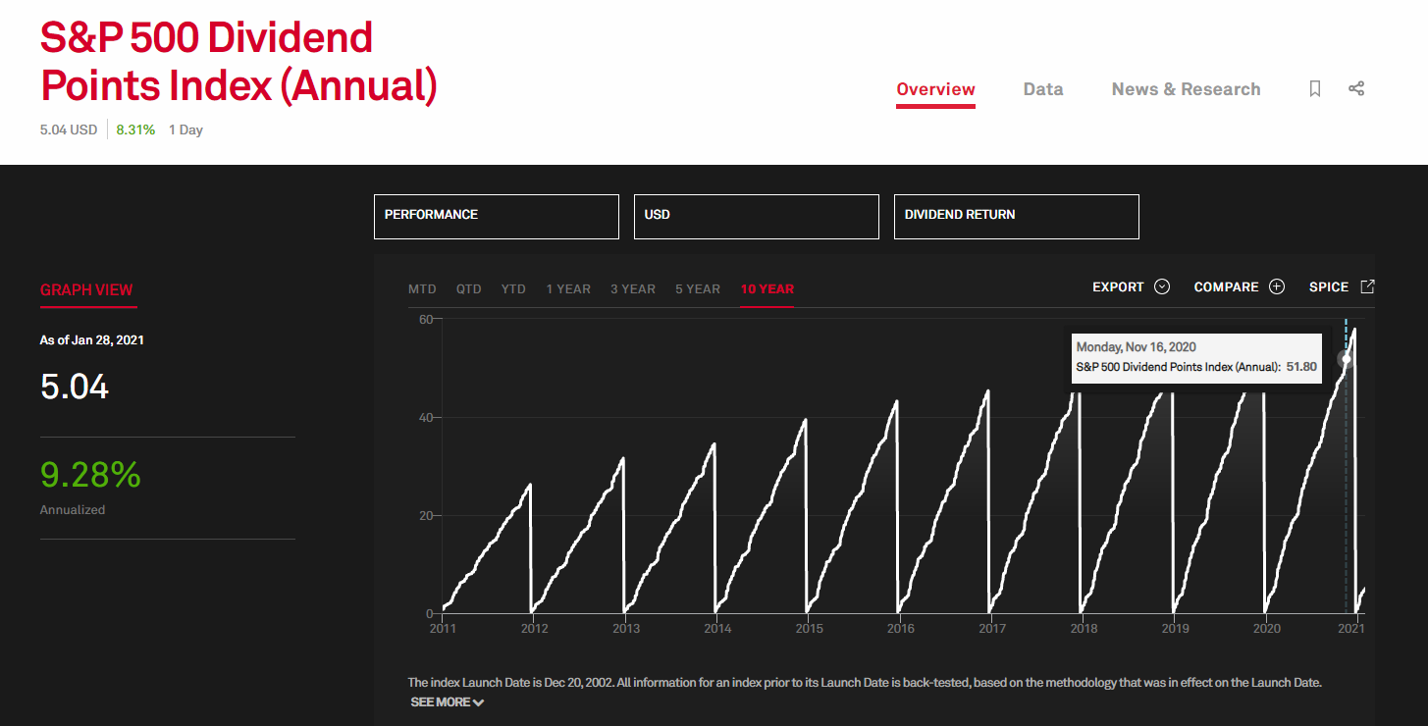
STOCKPICKING vs. INDEX FUND INVESTING IN 2021
RISKS
Not bust, low cost, tax advantages!
RISKS=
-
2021 INVESTING SITUATION
INDEX FUNDS RETURNS
STOCK PICKING POSSIBILITIES
INDEX FUNDS RISKS
STOCK PICKING RISKS
CONCLUSION (Investing must always be about what is best for you!

Slide 25
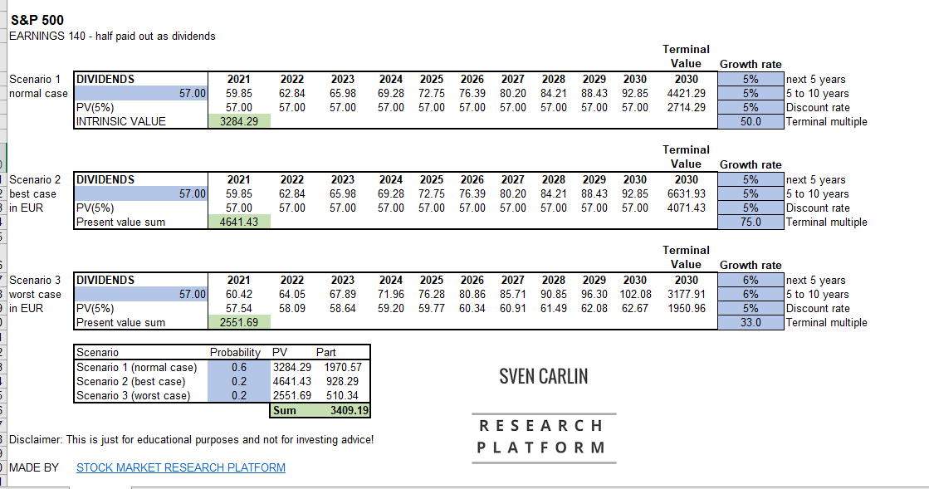
STOCKPICKING vs. INDEX FUND INVESTING IN 2021
RISKS
No bust, low cost, tax advantages!
RISKS=
-
2021 INVESTING SITUATION
INDEX FUNDS RETURNS
STOCK PICKING POSSIBILITIES
INDEX FUNDS RISKS
STOCK PICKING RISKS
CONCLUSION (Investing must always be about what is best for you!

Slide 26
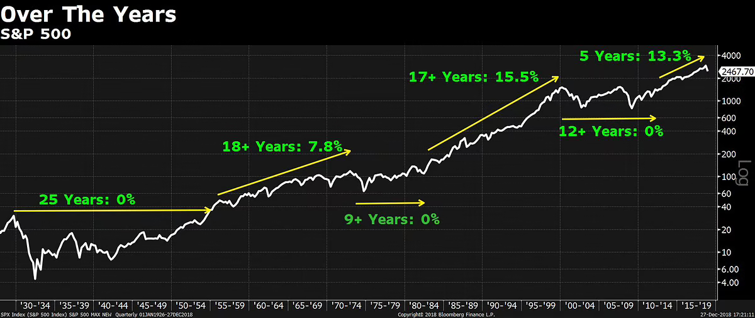
STOCKPICKING vs. INDEX FUND INVESTING IN 2021
RISKS
No bust, low cost, tax advantages!
RISKS=
- SHOW LONG TERM
2021 INVESTING SITUATION
INDEX FUNDS RETURNS
STOCK PICKING POSSIBILITIES
INDEX FUNDS RISKS
STOCK PICKING RISKS
CONCLUSION (Investing must always be about what is best for you!

Slide 27
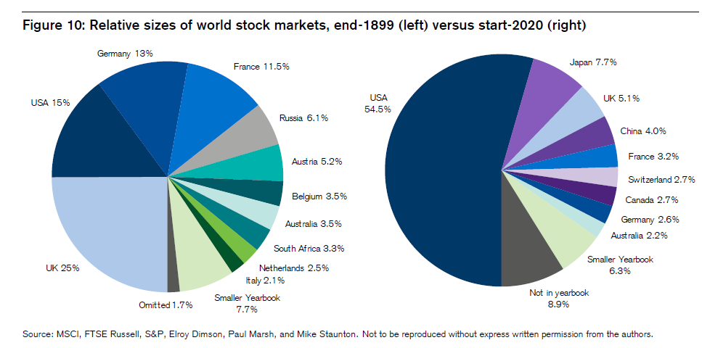
STOCKPICKING vs. INDEX FUND INVESTING IN 2021
RISKS
No bust, low cost, tax advantages!
RISKS=
- SHOW LONG TERM
2021 INVESTING SITUATION
INDEX FUNDS RETURNS
STOCK PICKING POSSIBILITIES
INDEX FUNDS RISKS
STOCK PICKING RISKS
CONCLUSION (Investing must always be about what is best for you!

Slide 28
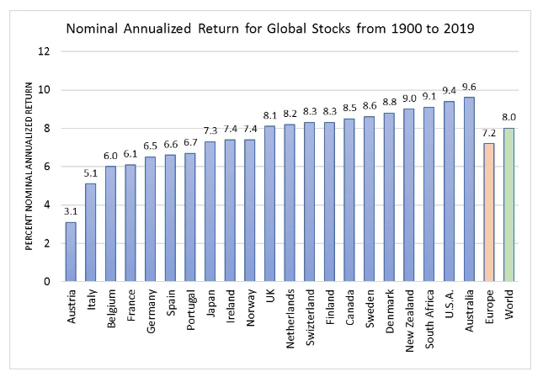
STOCKPICKING vs. INDEX FUND INVESTING IN 2021
RISKS
No bust, low cost, tax advantages!
RISKS=
- SHOW LONG TERM
2021 INVESTING SITUATION
INDEX FUNDS RETURNS
STOCK PICKING POSSIBILITIES
INDEX FUNDS RISKS
STOCK PICKING RISKS
CONCLUSION (Investing must always be about what is best for you!

Slide 29
STOCKPICKING vs. INDEX FUND INVESTING IN 2021
d
2021 INVESTING SITUATION
INDEX FUNDS RETURNS
STOCK PICKING POSSIBILITIES
INDEX FUNDS RISKS
STOCK PICKING RISKS
CONCLUSION (Investing must always be about what is best for you!

Slide 30
STOCKPICKING vs. INDEX FUND INVESTING IN 2021
STOCK EXAMPLES
2021 INVESTING SITUATION
INDEX FUNDS RETURNS
STOCK PICKING POSSIBILITIES
INDEX FUNDS RISKS
STOCK PICKING RISKS
CONCLUSION (Investing must always be about what is best for you!

Slide 31
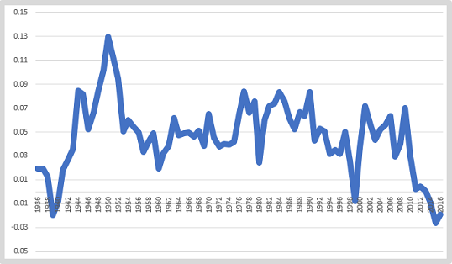
STOCKPICKING vs. INDEX FUND INVESTING IN 2021
STOCK EXAMPLES
2021 INVESTING SITUATION
INDEX FUNDS RETURNS
STOCK PICKING POSSIBILITIES
INDEX FUNDS RISKS
STOCK PICKING RISKS
CONCLUSION (Investing must always be about what is best for you!
Source: Sven Carlin – Modern Value Investing, Kenneth French Data!

Slide 32
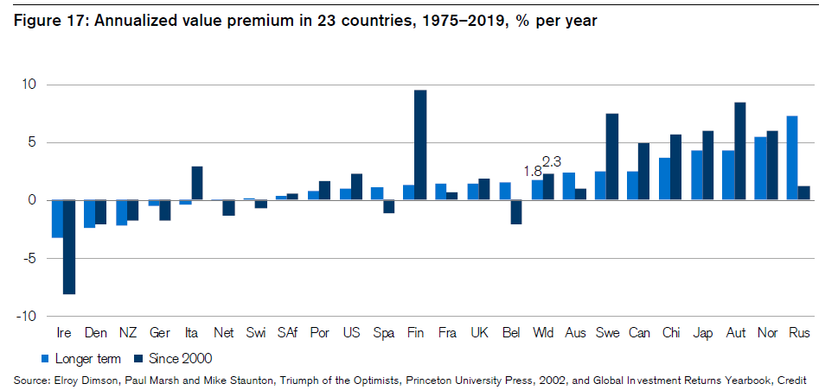
STOCKPICKING vs. INDEX FUND INVESTING IN 2021
RISKS
No bust, low cost, tax advantages!
RISKS=
- SHOW LONG TERM
2021 INVESTING SITUATION
INDEX FUNDS RETURNS
STOCK PICKING POSSIBILITIES
INDEX FUNDS RISKS
STOCK PICKING RISKS
CONCLUSION (Investing must always be about what is best for you!

Slide 33
STOCKPICKING vs. INDEX FUND INVESTING IN 2021
BIGGEST RISK FOR BOTH STRATEGIES:
YOU
2021 INVESTING SITUATION
INDEX FUNDS RETURNS
STOCK PICKING POSSIBILITIES
INDEX FUNDS RISKS
STOCK PICKING RISKS
CONCLUSION (Investing must always be about what is best for you!

Slide 34
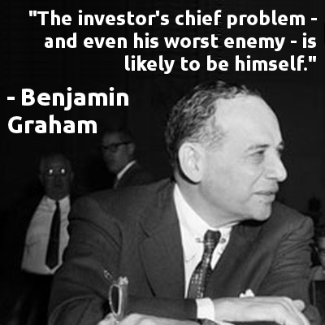
STOCKPICKING vs. INDEX FUND INVESTING IN 2021
BIGGEST RISK FOR BOTH STRATEGIES:
YOU
2021 INVESTING SITUATION
INDEX FUNDS RETURNS
STOCK PICKING POSSIBILITIES
INDEX FUNDS RISKS
STOCK PICKING RISKS
CONCLUSION (Investing must always be about what is best for you!

Slide 35
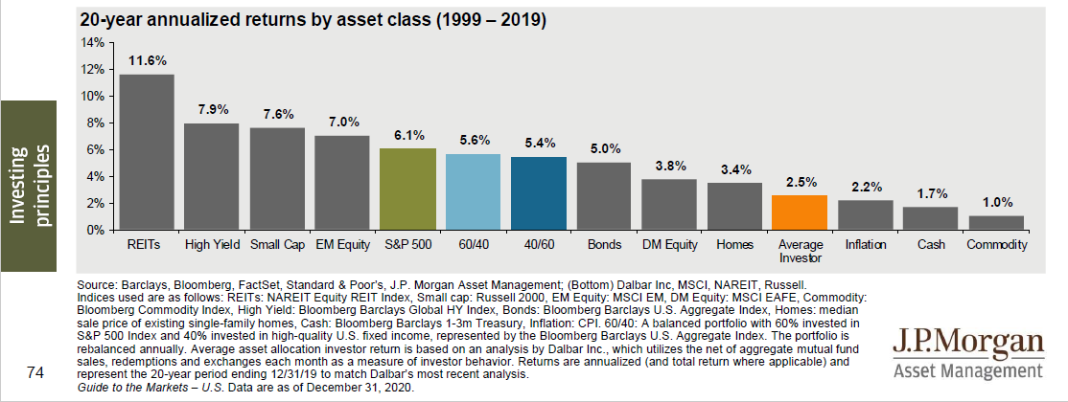
STOCKPICKING vs. INDEX FUND INVESTING IN 2021
2021 INVESTING SITUATION
INDEX FUNDS RETURNS
STOCK PICKING POSSIBILITIES
INDEX FUNDS RISKS
STOCK PICKING RISKS
CONCLUSION (Investing must always be about what is best for you!

Slide 36
STOCKPICKING vs. INDEX FUND INVESTING IN 2021
2021 INVESTING SITUATION
INDEX FUNDS RETURNS
STOCK PICKING POSSIBILITIES
INDEX FUNDS RISKS
STOCK PICKING RISKS
CONCLUSION (Investing must always be about what is best for you!

Slide 37
STOCKPICKING vs. INDEX FUND INVESTING IN 2021
2021 INVESTING SITUATION
INDEX FUNDS RETURNS
STOCK PICKING POSSIBILITIES
INDEX FUNDS RISKS
STOCK PICKING RISKS
CONCLUSION (Investing must always be about what is best for you!
FEAR AND GREED!

Slide 38
STOCKPICKING vs. INDEX FUND INVESTING IN 2021
2021 INVESTING SITUATION
INDEX FUNDS RETURNS
STOCK PICKING POSSIBILITIES
INDEX FUNDS RISKS
STOCK PICKING RISKS
CONCLUSION (Investing must always be about what is best for you!
FEAR AND GREED!
Everybody is buying
Today!

Slide 39
STOCKPICKING vs. INDEX FUND INVESTING IN 2021
WHAT IS BEST FOR YOU!
2021 INVESTING SITUATION
INDEX FUNDS RETURNS
STOCK PICKING POSSIBILITIES
INDEX FUNDS RISKS
STOCK PICKING RISKS
CONCLUSION (Investing must always be about what is best for you!

Slide 40
STOCKPICKING vs. INDEX FUND INVESTING IN 2021
WHAT IS BEST FOR YOU!
INDEX FUNDS – 5% to 10% - and that is it!
2021 INVESTING SITUATION
INDEX FUNDS RETURNS
STOCK PICKING POSSIBILITIES
INDEX FUNDS RISKS
STOCK PICKING RISKS
CONCLUSION (Investing must always be about what is best for you!

Slide 41
STOCKPICKING vs. INDEX FUND INVESTING IN 2021
WHAT IS BEST FOR YOU!
INDEX FUNDS – 5% to 10% - and that is it!
KEY IS TO COMPARE TO OTHER IN YOUR LIFE (13% credit card, 8% student loan, 2.5% mortgage)
2021 INVESTING SITUATION
INDEX FUNDS RETURNS
STOCK PICKING POSSIBILITIES
INDEX FUNDS RISKS
STOCK PICKING RISKS
CONCLUSION (Investing must always be about what is best for you!

Slide 42
STOCKPICKING vs. INDEX FUND INVESTING IN 2021
WHAT IS BEST FOR YOU!
STOCKS – 10% WITH GOOD BUSINESSES – 20 of them for the same risk or even less risk! (but takes time and learning)
2021 INVESTING SITUATION
INDEX FUNDS RETURNS
STOCK PICKING POSSIBILITIES
INDEX FUNDS RISKS
STOCK PICKING RISKS
CONCLUSION (Investing must always be about what is best for you!

Slide 43
STOCKPICKING vs. INDEX FUND INVESTING IN 2021
WHAT IS BEST FOR YOU!
STOCKS – 10% WITH GOOD BUSINESSES – 20 of them for the same risk or even less risk! (but takes time and learning)
Personally I don’t like index funds because I always look for better long-term investments!
2021 INVESTING SITUATION
INDEX FUNDS RETURNS
STOCK PICKING POSSIBILITIES
INDEX FUNDS RISKS
STOCK PICKING RISKS
CONCLUSION (Investing must always be about what is best for you!

Slide 44
STOCKPICKING vs. INDEX FUND INVESTING IN 2021
WHAT IS BEST FOR YOU!
YOU HAVE A BUSINESS, NO TIME FOR THINKING – no FUN LEARNING – go for index funds!
YOU HAVE A PASSION FOR OWNING BUSINESSES! YOU DON’T WANT TO OWN CRAZY TESLA!
2021 INVESTING SITUATION
INDEX FUNDS RETURNS
STOCK PICKING POSSIBILITIES
INDEX FUNDS RISKS
STOCK PICKING RISKS
CONCLUSION (Investing must always be about what is best for you!

Slide 45
STOCKPICKING vs. INDEX FUND INVESTING IN 2021
WHAT IS BEST FOR YOU!
YOU HAVE A BUSINESS, NO TIME FOR THINKING – no FUN LEARNING – go for index funds! (possible down 50% - dividend 3%)
YOU HAVE A PASSION FOR OWNING BUSINESSES! YOU DON’T WANT TO OWN CRAZY TESLA! (down 50%, ok dividend to reinvest 6 to 12%)
2021 INVESTING SITUATION
INDEX FUNDS RETURNS
STOCK PICKING POSSIBILITIES
INDEX FUNDS RISKS
STOCK PICKING RISKS
CONCLUSION (Investing must always be about what is best for you!

Slide 46
STOCKPICKING vs. INDEX FUND INVESTING IN 2021
WHAT IS BEST FOR YOU!
PERSONALLY THINKING – search and compare, gives you the courage to do things when others are fearful.
BUY HOUSE, INVEST, BUILD A BUSINESS, PROJECT, STOCKS – whatever!
LEADS TO INCREDIBLE RESULTS!
2021 INVESTING SITUATION
INDEX FUNDS RETURNS
STOCK PICKING POSSIBILITIES
INDEX FUNDS RISKS
STOCK PICKING RISKS
CONCLUSION (Investing must always be about what is best for you!

