Slide 1
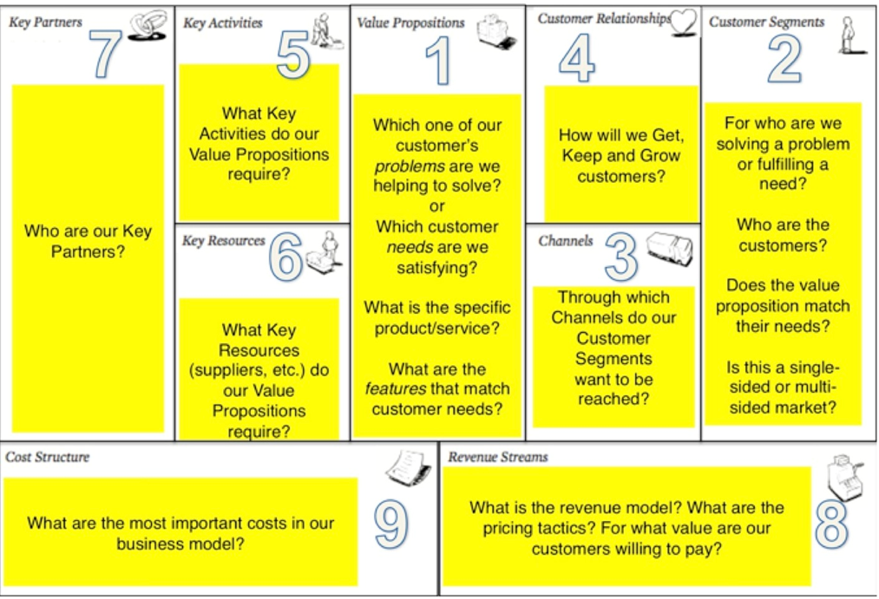

Slide 2
Business Model Canvas Template
CORE
CAPABILITIES
SUPPLIER
NETWORK
VALUE
PROPOSITION
CUSTOMER
RELATIONSHIP
TARGET
CUSTOMER
INFRASTRUCTURE
OFFER
CUSTOMER
DISTRIBUTION
CHANNEL
VALUE
CONFIGURATION
FINANCE
COST
STRUCTURE
REVENUE
STREAMS

