Slide 1

Memoir Writing
With Leslie A. Lawrence

Slide 2
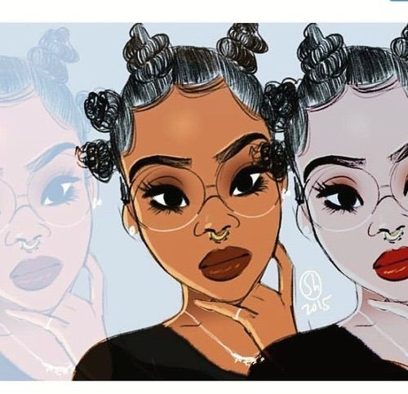
Your story, your experience

Slide 3

The Formula

Slide 4
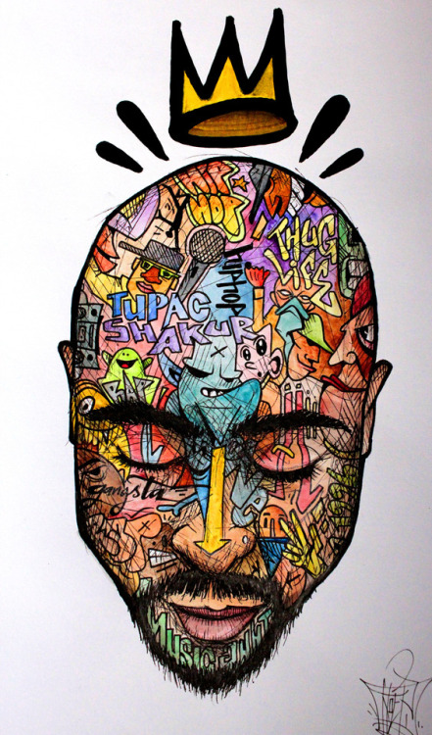
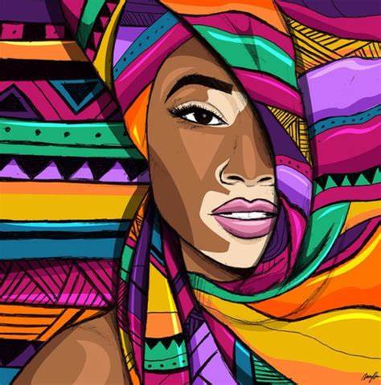
Who Was I at the time?
What happened?
What did I learn?
Who Am I now?

Slide 5
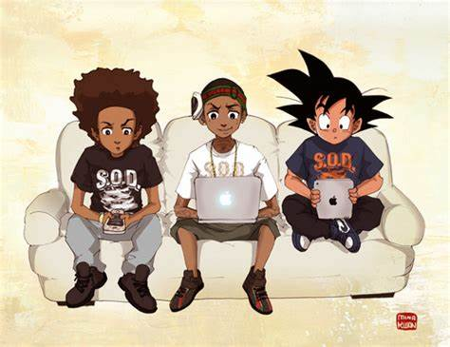
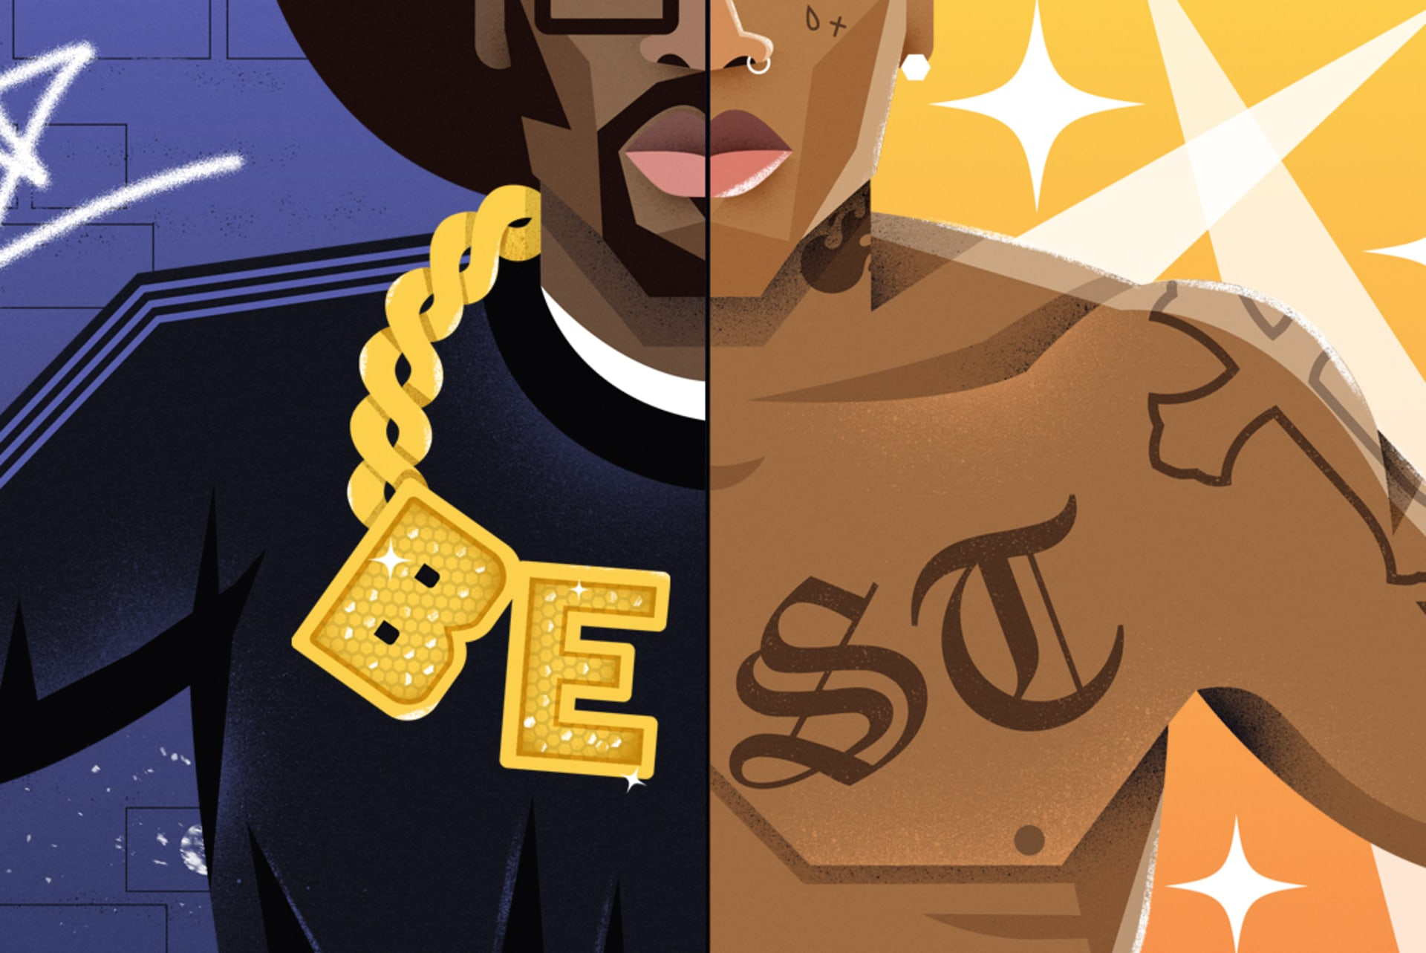
Remembering the past
The good, the bad, and the very ugly

Slide 6
Directions to memory lane
It’s okay to use pictures, articles, letters, etc.!
Talk to people who were close to you then, and close to you now. Are there any differences? Similarities? Anything that surprises you?
Don’t be afraid to RESEARCH! You’d be surprised at what’s on the internet.
If you do use letters or pictures from someone else, make sure you get their permission IN WRITING!
Listen for stories. In the midst of family events, talking with friends, looking at pictures

Slide 7

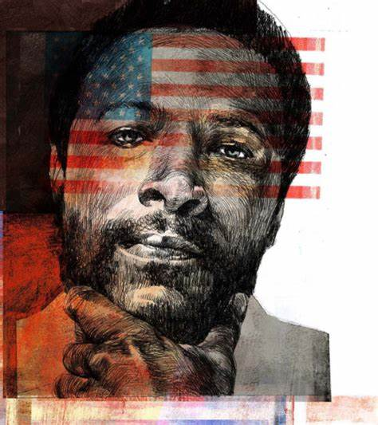
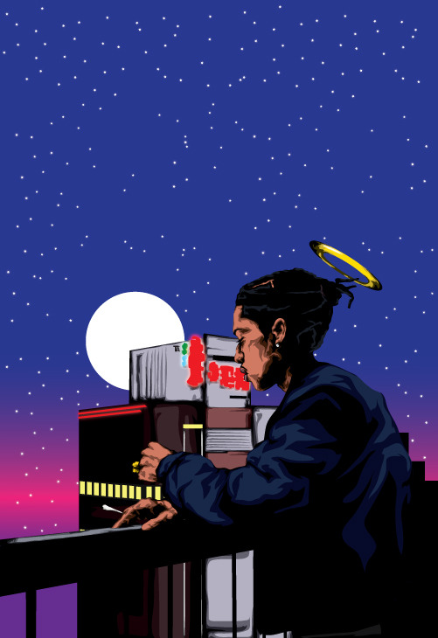
A reflection of yourself

Slide 8
On a piece of paper, reflect on these questions
Who did what about it?
What did that action cause?
What else happened?
What was the outcome?
- Who am I because of this?
Who was I at the time?
What did I want?
Who else was involved?
What did they want?
What obstacles were present?
How did it start?
When did it happen
What was the result?

Slide 9
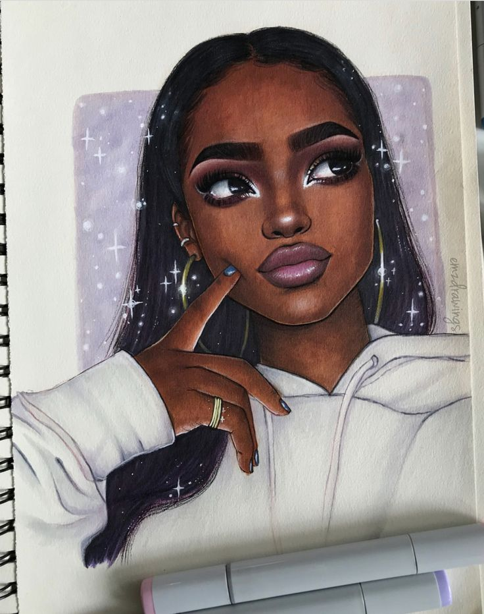
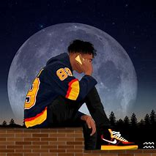
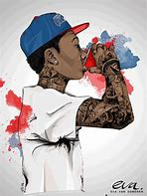
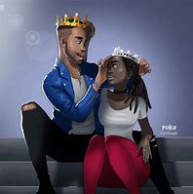
Every story needs
These Things…

Slide 10
All stories need a foundation
Character
Character’s goal
Character’s
motivation
Setting
- Use all five senses to describe what’s going on! The more details, the better! Readers want to feel like they are in the story with you!
Obstacles
Outcome
This is What every story breaks down in to

Slide 11
What do readers want?
Time Periods! What year was it? How old were you? What was going on in the news around that time?
Setting! Readers want to feel like they’re in the room with you.
Details! Details are reason people relate to the book.
Your unique voice! You were created unlike anyone else so let that reflect in your writing.
“Bad guys” People love drama, and somebody has to be the “bad guy”!
“Good guys” People also love triumph. You may be the “good guy” in the story who triumphs!
Creativity this memoir is yours. Make sure it shows!

Slide 12

As a writer you should…
- Get into the pattern of communicating with the readers both verbally and non verbally. Use words, gestures, eye contact, and quotations to talk to the reader.
- Get into the pattern of raising questions in the readers mind and then answering them.

Slide 13

Contact me to co-write your story and mentor you through the writing process!
Leslie A. Lawrence, Author
216-952-8133
UpNextLesThePoet@gmail.com
Instagram: @UpNextLes
Facebook: Leslie Lawrence

