Slide 1
GET STARTED WITH scheduling tools

Slide 2
Popular Social Media Scheduling Tools
Buffer
Hootsuite
Edgar
SmarterQueue
SocialOomph
Tailwind
BoardBooster
Planoly

Slide 3
Popular Social Media Scheduling Tools
Buffer
Hootsuite
Edgar
SmarterQueue
SocialOomph
Tailwind
BoardBooster
Planoly
Twitter
Facebook
LinkedIn

Slide 4
Popular Social Media Scheduling Tools
Buffer
Hootsuite
Edgar
SmarterQueue
SocialOomph
Tailwind
BoardBooster
Planoly
Twitter
Facebook
LinkedIn
Pinterest

Slide 5
Popular Social Media Scheduling Tools
Buffer
Hootsuite
Edgar
SmarterQueue
SocialOomph
Tailwind
BoardBooster
Planoly
Twitter
Facebook
LinkedIn
Pinterest
Instagram

Slide 6
It can be hard to choose the right scheduler because there’s a lot of overlap.
Buffer integrates with almost every site:
Facebook
Twitter
LinkedIn
Google+
Pinterest
Instagram
Hootsuite integrates with:
Facebook
LinkedIn
Google+
Twitter
YouTube

Slide 7
It can be hard to choose the right scheduler because there’s a lot of overlap.
Buffer integrates with almost every site:
Facebook
Twitter
LinkedIn
Google+
Pinterest
Instagram
Hootsuite integrates with:
Facebook
LinkedIn
Google+
Twitter
YouTube
So why not use these for every social channel?

Slide 8
It comes down to functionality and pricing
Straightforward scheduling
Integrates easily with RSS feeds and Feedly
$10
Social media management tool
Enterprise-level features
$20
Unlimited scheduling
Evergreen content
$50

Slide 9
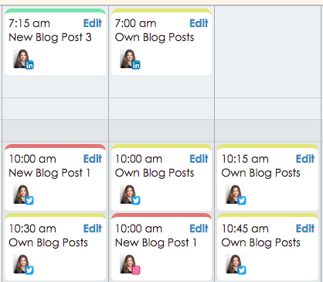
It comes down to functionality and pricing and your preference
SmarterQueue and Planoly can schedule to Instagram, but…
Displays posts as text only
Looks like your IG feed

Slide 10
When you look for scheduling tools, ask yourself these questions:
Can I get an initial boost in traffic for posts + promotions?

Slide 11
When you look for scheduling tools, ask yourself these questions:
Can I get an initial boost in traffic for posts + promotions?
Can I share content frequently enough for each platform?

Slide 12
When you look for scheduling tools, ask yourself these questions:
Can I get an initial boost in traffic for posts + promotions?
Can I share content frequently enough for each platform?
Is the tool designed to recycle and loop posts?

Slide 13
When you look for scheduling tools, ask yourself these questions:
Can I get an initial boost in traffic for posts + promotions?
Can I share content frequently enough for each platform?
Is the tool designed to recycle and loop posts?
How easy is it to share other people’s content?

Slide 14
When you look for scheduling tools, ask yourself these questions:
Can I get an initial boost in traffic for posts + promotions?
Can I share content frequently enough for each platform?
Is the tool designed to recycle and loop posts?
How easy is it to share other people’s content?
Does the price fit my overall social media budget?

Slide 15
When you look for scheduling tools, ask yourself these questions:
Can I get an initial boost in traffic for posts + promotions?
Can I share content frequently enough for each platform?
Is the tool designed to recycle and loop posts?
How easy is it to share other people’s content?
Does the price fit my overall social media budget?
How easy is it to use?

Slide 16
Scheduling Tool Features List
Get an initial boost in traffic
Schedule a lot of content
Recycle evergreen content
Share other people’s content
Navigate and use easily
Generate reports and analytics
Affordable

Slide 17
Scheduling Tool Features List
Get an initial boost in traffic
Schedule a lot of content
Recycle evergreen content
Share other people’s content
Navigate and use easily
Generate reports and analytics
Affordable
Buffer
Hootsuite
Edgar
SmarterQueue
SocialOomph
Tailwind
Boardbooster
Planoly

Slide 18
Most scheduling tools give you the ability to…
Boost traffic to new posts with more frequently scheduling and time slots

Slide 19
Most scheduling tools give you the ability to…
Boost traffic to new posts with more frequently scheduling and time slots
Share other people’s content and import RSS feeds

Slide 20
Most scheduling tools give you the ability to…
Boost traffic to new posts with more frequently scheduling and time slots
Share other people’s content and import RSS feeds
View analytics and engagement

Slide 21
Most scheduling tools give you the ability to…
Schedule new posts/promotions more frequently during the first week
Import RSS feeds and share other people’s content
View analytics and engagement
Not every scheduler offers unlimited scheduling and evergreen posting.

Slide 22
Feature comparison for Twitter, Facebook, LinkedIn
 | Buffer | Hootsuite | Edgar | SmarterQueue | SocialOomph
Initial boost in traffic | Easy | Fair | Easy | Easy | Easy
Share other people’s content | Easy | Fair | Fair | Easy | Hard
Analytics + reporting | 30 Days | Basic | Yes | Yes | No
Unlimited # of posts | No | No | Yes | Yes | Yes
Share evergreen content | No | No | Yes | Yes | Yes
Ease of use | Easy | Hard | Easy | Easy | Hard
Monthly fee | $10 | $19 | $49 | $20 | $14
1
2
3
4
5
6
7

Slide 23
Feature comparison for Twitter, Facebook, LinkedIn
 | Buffer | Hootsuite | Edgar | SmarterQueue | SocialOomph
Initial boost in traffic | Easy | Fair | Easy | Easy | Easy
Share other people’s content | Easy | Fair | Fair | Easy | Hard
Analytics + reporting | 30 Days | Basic | Yes | Yes | No
Unlimited # of posts | No | No | Yes | Yes | Yes
Share evergreen content | No | No | Yes | Yes | Yes
Ease of use | Easy | Hard | Easy | Easy | Hard
Monthly fee | $10 | $19 | $49 | $20 | $14
1
2
3
4
5
6
7

Slide 24
Feature comparison for Twitter, Facebook, LinkedIn
 | Buffer | Hootsuite | Edgar | SmarterQueue | SocialOomph
Initial boost in traffic | Easy | Fair | Easy | Easy | Easy
Share other people’s content | Easy | Fair | Fair | Easy | Hard
Analytics + reporting | 30 Days | Basic | Yes | Yes | No
Unlimited # of posts | No | No | Yes | Yes | Yes
Share evergreen content | No | No | Yes | Yes | Yes
Ease of use | Easy | Hard | Easy | Easy | Hard
Monthly fee | $10 | $19 | $49 | $20 | $14
1
2
3
4
5
6
7

Slide 25
My recommendations: Twitter, Facebook, LinkedIn

Slide 26
Schedulers for Twitter, Facebook, LinkedIn
 | Buffer | Hootsuite | Edgar | SmarterQueue | SocialOomph
Initial boost in traffic | Easy | Fair | Easy | Easy | Easy
Share other people’s content | Easy | Fair | Fair | Easy | Hard
Analytics + reporting | 30 Days | Basic | Yes | Yes | No
Unlimited # of posts | No | No | Yes | Yes | Yes
Share evergreen content | No | No | Yes | Yes | Yes
Ease of use | Easy | Hard | Easy | Easy | Hard
Monthly fee | $10 | $19 | $49 | $20 | $14
1
2
3
4
5
6
7

Slide 27
Schedulers for Twitter, Facebook, LinkedIn
 | Buffer | Hootsuite | Edgar | SmarterQueue | SocialOomph
Initial boost in traffic | Easy | Fair | Easy | Easy | Easy
Share other people’s content | Easy | Fair | Fair | Easy | Hard
Analytics + reporting | 30 Days | Basic | Yes | Yes | No
Ease of use | Easy | Hard | Easy | Easy | Hard
Monthly fee | $10 | $19 | $49 | $20 | $14
1
2
3
4
5

Slide 28
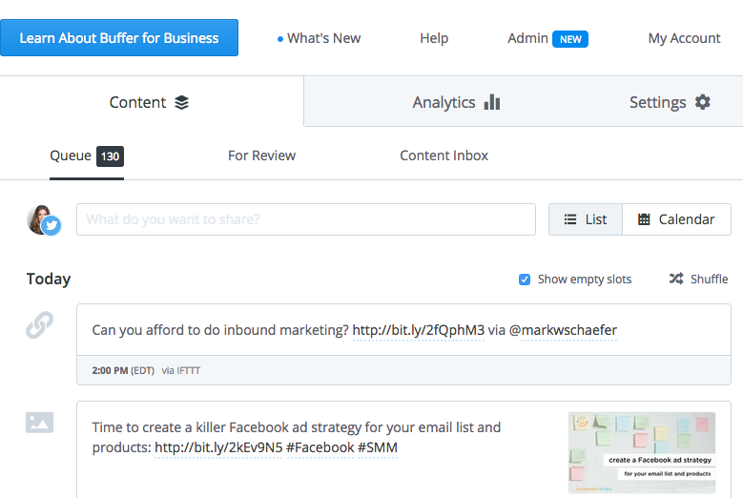
Use Buffer to schedule other people’s content to Twitter.
Integrates with Feedly and IFTTT so you can auto-populate your queue (up to 200 posts can be in the queue).
 | Buffer
Initial boost in traffic | Easy
Share other people’s content | Easy
Analytics | 30 Days
Ease of use | Easy
Monthly fee | $10
1
2
3
4
5

Slide 29
Feature Comparison: Evergreen Tools
 | Edgar | SmarterQueue | SocialOomph
Initial boost in traffic | Easy | Easy | Easy
Share other people’s content | Fair | Easy | Hard
Analytics + reporting | Yes | Yes | No
Unlimited # of posts | Yes | Yes | Yes
Share evergreen content | Yes | Yes | Yes
Ease of use | Easy | Easy | Hard
Monthly fee | $49 | $20 | $14
1
2
3
4
5
6
7
Twitter only

Slide 30
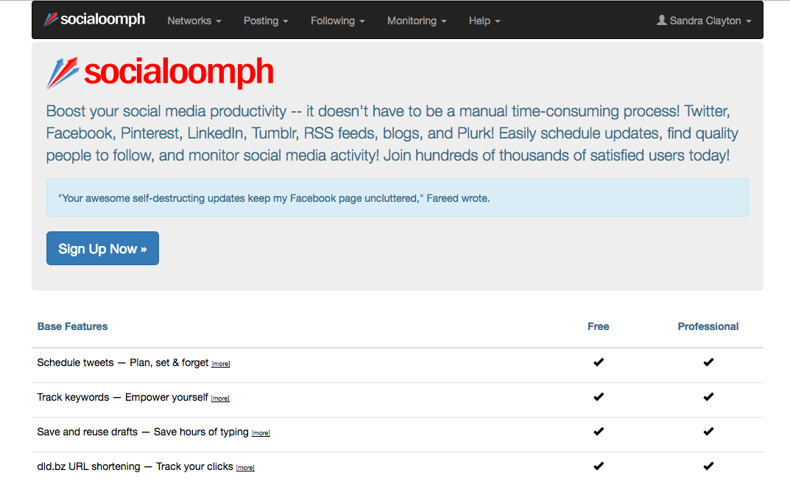
SocialOomph is a Twitter power tool
Why use it:
Randomize your queues
“Spin” your tweets
Schedule specific time intervals for recurring posts
Why it’s not a core scheduler in your toolbox:
Interface is outdated, clunky
No analytics
Not an all-in-one solution
More like an add-on to give you an extra boost on Twitter

Slide 31
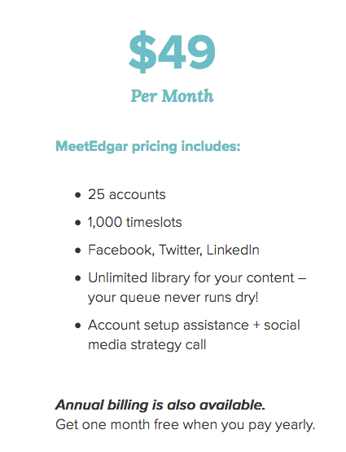
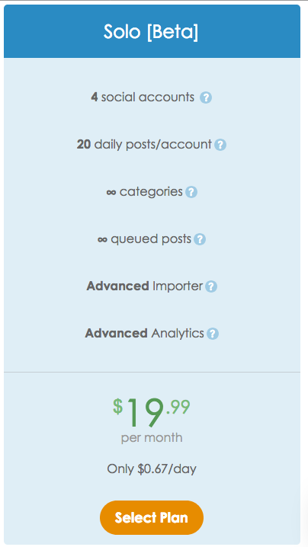
The biggest difference between Edgar and SmarterQueue is the price structure.
Unlimited # of posts in your queue
Recycle evergreen content
Share other people’s content
Easy to use
Analytics + reporting
Edgar – one package at $49 (includes 25 SM accounts + 1,000 timeslots)
SmarterQueue – Solo package is $20 (includes 4 accounts + 20 posts daily per account)

Slide 32
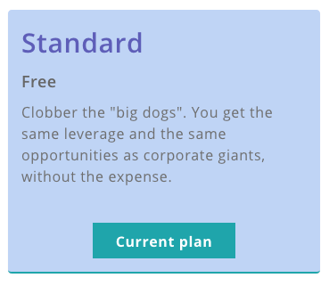
Recurpost is free for up to 3 accounts.
Good starter evergreen scheduler
Up to 100 recurring posts
10 daily posts per SM account
No RSS feeds (can’t schedule other people’s content)
Weak analytics

Slide 33
My recommendations: Pinterest + Instagram

Slide 34
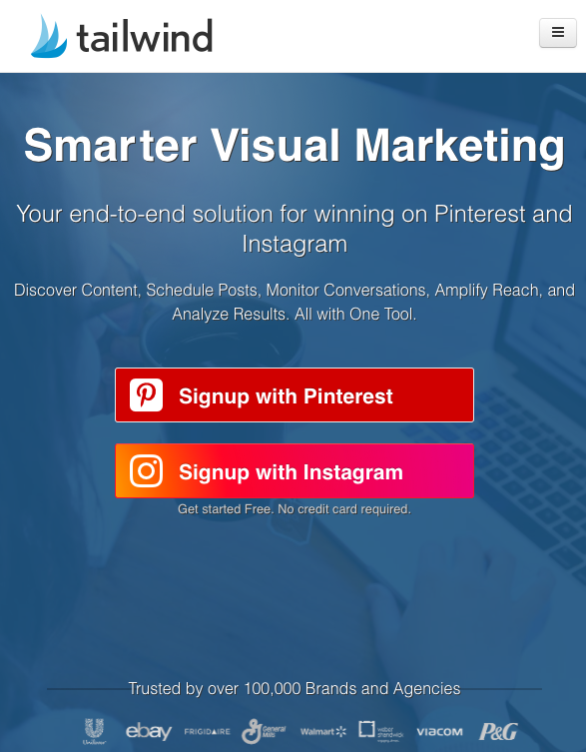
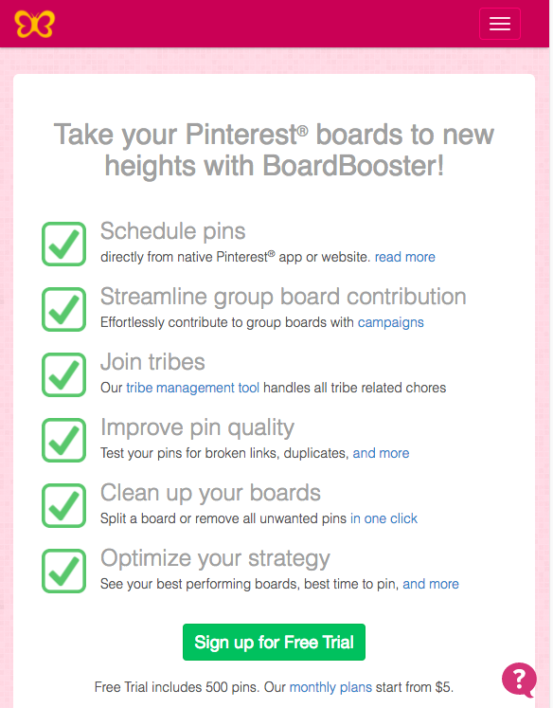
Tailwind and BoardBooster are both powerful schedulers for Pinterest.
It’s really a matter of preference.
Tailwind is easier to use and more visual.
BoardBooster has a steep learning curve, but the recycling features are very powerful.
Some people use Tailwind, others use BoardBooster, others use both.
$9.99/mo
$9.99/mo/1000 pins

Slide 35
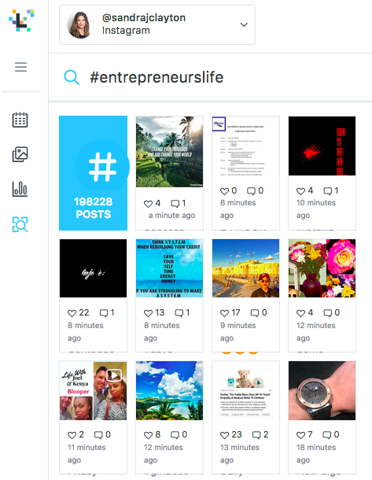
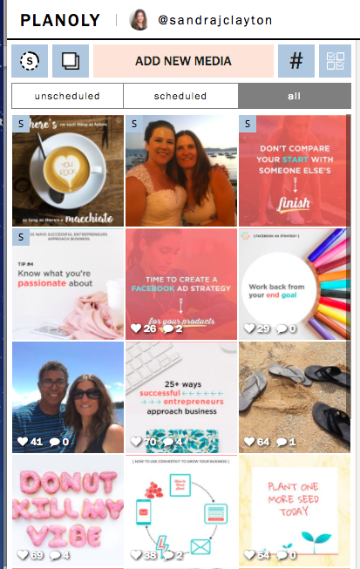
Planoly and Later for Instagram…
Both are visual platforms
Can schedule from desktop or the app
Can search for other people’s content to regram
Basic analytics
A matter of preference
Free (30 posts a month)
$7 a month

Slide 36
START HERE: Recurpost (LinkedIn, Twitter, Facebook) Buffer (Twitter) Tailwind (Pinterest) Later (Instagram)
ULTIMATE TOOLBOX:
SmarterQueue Best all-in-one scheduling tool Buffer (Twitter)
Tailwind + BoardBooster (Pinterest) Powerful automation
Planoly (Instagram)
SocialOomph (Twitter) Advanced tool

