Slide 1
DBH VIRTUAL PROVIDER TRAINING​
Best Practice and Clinical Application
Presenter: Andrea Piazza, Director of Virtual Programming​

Slide 2
Content Synopsis
OVERVIEW OF KEY IDEAS
DBH Clinician's Desk Reference
Best Practices and Guideline by Profession
Indications and Contraindications for Treatment
Clinical Preparation
Cultural Competency
Telepresence Review
Examination and Assessment
Care Models, Peripheral Devices, Substitutions
Use Cases
Follow up and Collaboration

Slide 3
Overview
OVERVIEW OF KEY IDEAS
Welcome to Discovery Behavioral Health’s training on Best Practices and Clinical Application for virtual program. This will be a comprehensive overview of the various telehealth best practice guidelines for each profession, clinical applications and considerations. We have talked about what telehealth is, how demonstrate telepresence and how to maintain security while doing so. In this training we will focus on the particular clinical applications for telemental health according to the most up to date guidelines available.

Slide 4
Learning Objectives
THE BEST PRACTICE GUIDELINES BY FIELD
THE TIMES THAT TELEHEALTH IS THE MOST APPROPRIATE OR INAPPROPRIATE
CULTURAL COMPETENCY IN TELEHEALTH
EXAMINATION AND ASSESSMENT IN TELEHEALTH
CURRENT TELEHEALTH CARE MODELS

Slide 5
What are the best practice guidelines for my field?
Who is telehealth appropriate for?
5 Questions You Will be Able to Answer
How do I conduct examinations and assessments using telehealth?
What are the current telehealth care models pertinent to my field?
Where can I find more resource on telehealth clinical application skills?

Slide 6
DBH Best Pratice Guidelines
Clinical Supervision Model, Philosophy and Components DBH 2021
Located in Sharepoint or the Intranet
No specific telehealth guidelines but the entire document is very helpful
Let's take a look
Notes:
https://discoverybehavioralhealth.sharepoint.com/teams/CSQMTeam/Shared%20Documents/Forms/AllItems.aspx?id=%2Fteams%2FCSQMTeam%2FShared%20Documents%2F5%2E%20Clinical%20Quality%20%28%26%20Documentation%29%2F5%2E%20Clinical%20Supervision%2F1%2E%20Clinicians%20Desk%20Reference%202021%2Epdf&parent=%2Fteams%2FCSQMTeam%2FShared%20Documents%2F5%2E%20Clinical%20Quality%20%28%26%20Documentation%29%2F5%2E%20Clinical%20Supervision&p=trueps%3A%2F%2Fdiscoverybehavioralhealth.sharepoint.com%2Fteams%2FCSQMTeam%2FShared%2520Documents%2FForms%2FAllItems.aspx%3Fid%3D%252Fteams%252FCSQMTeam%252FShared%2520Documents%252F5%252E%2520Clinical%2520Quality%2520%2528%2526%2520Documentation%2529%252F5%252E%2520Clinical%2520Supervision%252F1%252E%2520Clinicians%2520Desk%2520Reference%25202021%252Epdf%26parent%3D%252Fteams%252FCSQMTeam%252FShared%2520Documents%252F5%252E%2520Clinical%2520Quality%2520%2528%2526%2520Documentation%2529%252F5%252E%2520Clinical%2520Supervision%26p%3Dtrue&client=safari&rls=en&sxsrf=APq-WBuEkL-BLoHkUa5kTubFt96LOluLDA%3A1645483081310&ei=SRQUYsDIEpPNkPIP__uL8AQ&ved=0ahUKEwiAka6U7pH2AhWTJkQIHf_9Ak4Q4dUDCA0&uact=5&oq=https%3A%2F%2Fdiscoverybehavioralhealth.sharepoint.com%2Fteams%2FCSQMTeam%2FShared%2520Documents%2FForms%2FAllItems.aspx%3Fid%3D%252Fteams%252FCSQMTeam%252FShared%2520Documents%252F5%252E%2520Clinical%2520Quality%2520%2528%2526%2520Documentation%2529%252F5%252E%2520Clinical%2520Supervision%252F1%252E%2520Clinicians%2520Desk%2520Reference%25202021%252Epdf%26parent%3D%252Fteams%252FCSQMTeam%252FShared%2520Documents%252F5%252E%2520Clinical%2520Quality%2520%2528%2526%2520Documentation%2529%252F5%252E%2520Clinical%2520Supervision%26p%3Dtrue&gs_lcp=Cgdnd3Mtd2l6EAMyBwgAEEcQsAMyBwgAEEcQsAMyBwgAEEcQsAMyBwgAEEcQsAMyBwgAEEcQsAMyBwgAEEcQsAMyBwgAEEcQsAMyBwgAEEcQsANKBAhBGABKBAhGGABQsgdY5gxghBFoAXABeACAAQCIAQCSAQCYAQCgAQHIAQjAAQE&sclient=gws-wiz

Slide 7
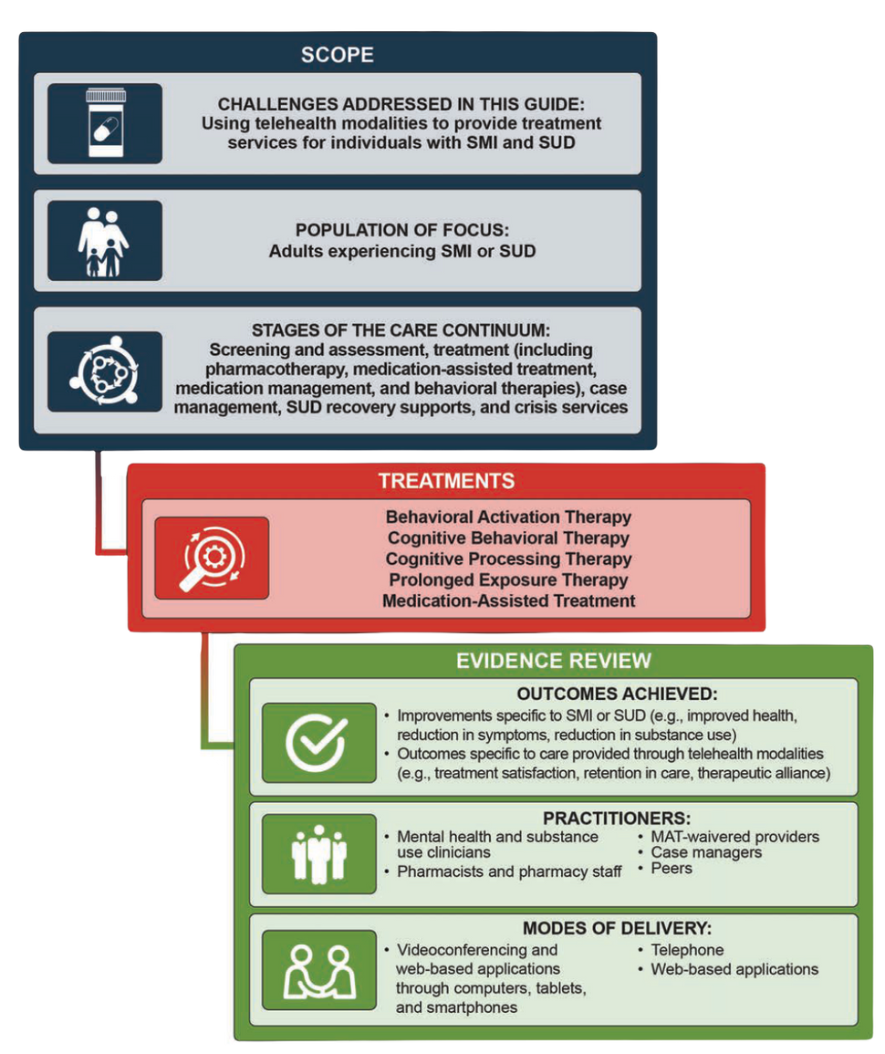
SAMHSA Telehealth Highlights
Evidence-Based Resource Guide Series Overview
Issue Brief
What Research Tells Us
Guidance for Implementing Evidence-Based Practices
Examples of Telehealth Implementation in Treatment Programs
Resources for Evaluation and Quuality Improvement

Slide 8
BEST PRACTICES FOR THE ONLINE PRACTICE OF COUPLE AND FAMILY THERAPY
1. Compliance
2. Infrastructure
3. Advertising and marketing
4. Informed consent
5. Initial assessment
6. Ongoing services
7. Crisis management
8. Failures and breaches
9. Accountability and review
Of course, technologies change quickly. So too can the regulatory environment surround the use of technology in online service delivery. MFTs are fundamentally obligated to remain abreast of changes in both law and technology that may impact their ability to effectively practice online.

Slide 9
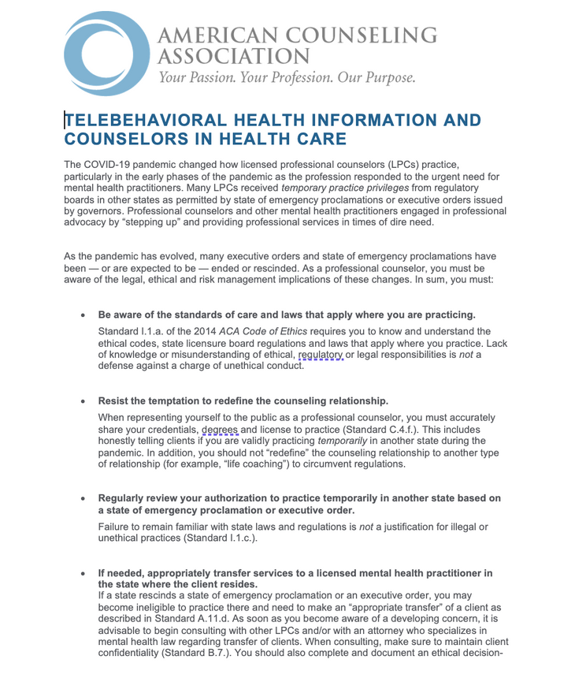
American Counseling Association Guidelines
Be aware of the standards of care and laws that apply where you are practicing
Resist the temptation to redefine the counseling relationship
Regularly review you authorization to practice temporarily in another state based on a state of emergency proclamation or executive order
If needed, appropriately transfer services to a licensed mental practitioner in the state where the client resides

Slide 10
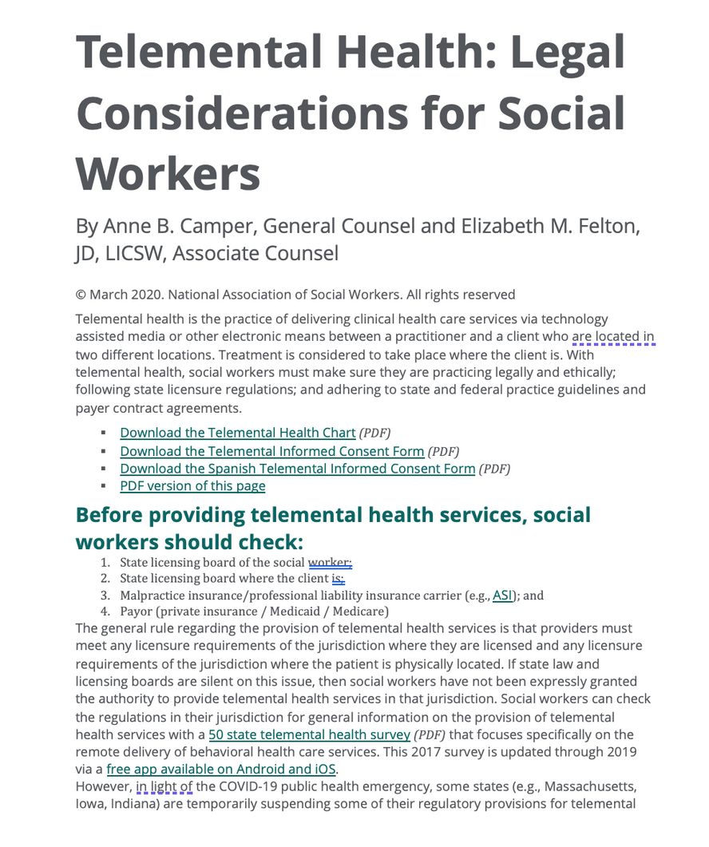
Social Work Best Practices
Before Providing Telemental Health
Telemental Health Informed Consent
Video Conferencing Platform
Professional Liability Coverage
Privacy/Confidentiality
Telemental Health Chart with HIPAA, CMS, and Licensure pre and post covid

Slide 11
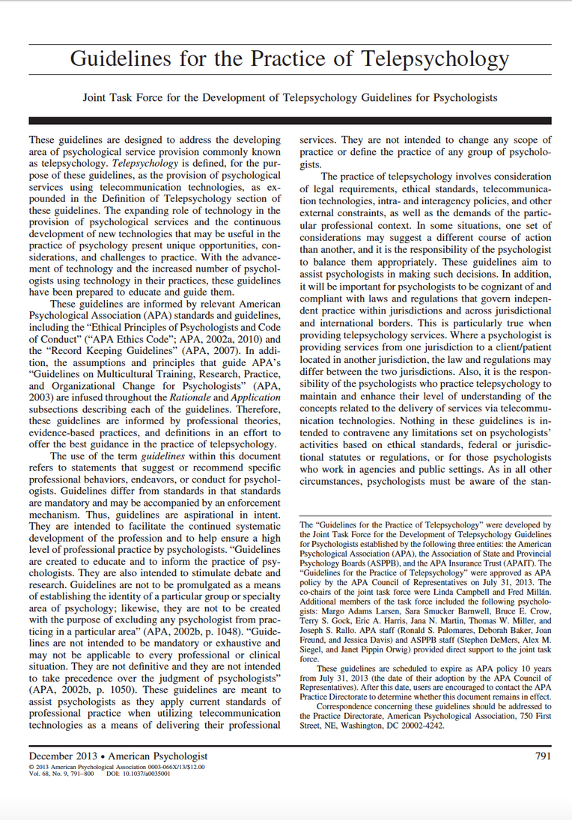
APA Resources
Guidelines for the Practice of Telepsychology Article
Competence of the psychologist
Standards of care delivery of telepsychology services
informed consent
Confidentiality of data and information
Security and transmission of data and information
Disposal of data and information and technologies
Testing and assessment
Inter-jurisdictional Practice

Slide 12
Dietary Best Practices
First Steps
Telehealth Platform/Vendor Selection
Workflow and Patient Care
Medicare Rules Around Telehealth Delivery During COVID-19
Coding, Billing, and Payment for MNT & DSMT When Delivered via Telehealth During COVID-19
Additional Telehealth Resources
More Telehealth Articles from the Academy

Slide 13
Nursing Connected Health Principles
Technologies does not alter the standards of professional practice
Subject to the same healthcare laws and board oversight as the healthcare provided in-person
Prioritize improving access to quality healthcare that is guided by best available evidence, accepted clinical standards, and best practices.
Mandates that healthcare professionals meet state specific regulatory and institutional requirements
Responsible for developing their own competencies
Should be congruent with in-person care and must adhere to the best available evidence
Continued...

Slide 14
AMA Playbook Highlights
130 Pages of incredibly helpful information
Telehealth basics and pathways to implementation
Identifying need
Forming a team
Defining success
Designing th workflow
Preparing the team
Partnering with the patient
Implementation
Evaluating success
Scaling

Slide 15
BEST PRACTICES FROM THE AMERICAN PSYCHIATRIC ASSOCIATION
Patient and Setting Selection
Management of Hybrid Patient-Provider Relationships
Ethical Considerations
Cultural Issues
Specific Populations and Settings

Slide 16
Addiction Medicine Recommendations
Benefits of Using Telehealth
Federal Policy Changes
State Policy Changes
Private Payers
General Considerations for Implementing Telehealth
DEA Policy: Exception to Separate Registration Requirements Across State Lines
Opioid Treatment Program (OTP) Guidance:
FAQs: Provision of Methadone and Buprenorphine for the Treatment of OUD in the COVID-19 Emergency:
DEA Guidance: Exemption Allowing Alternate Delivery Methods for OTPs:

Slide 17
Nursing Connected Health Principles
Technologies does not alter the standards of professional practice
Subject to the same healthcare laws and board oversight as the healthcare provided in-person
Prioritize improving access to quality healthcare that is guided by best available evidence, accepted clinical standards, and best practices.
Mandates that healthcare professionals meet state specific regulatory and institutional requirements
Responsible for developing their own competencies
Should be congruent with in-person care and must adhere to the best available evidence
Continued...

Slide 18
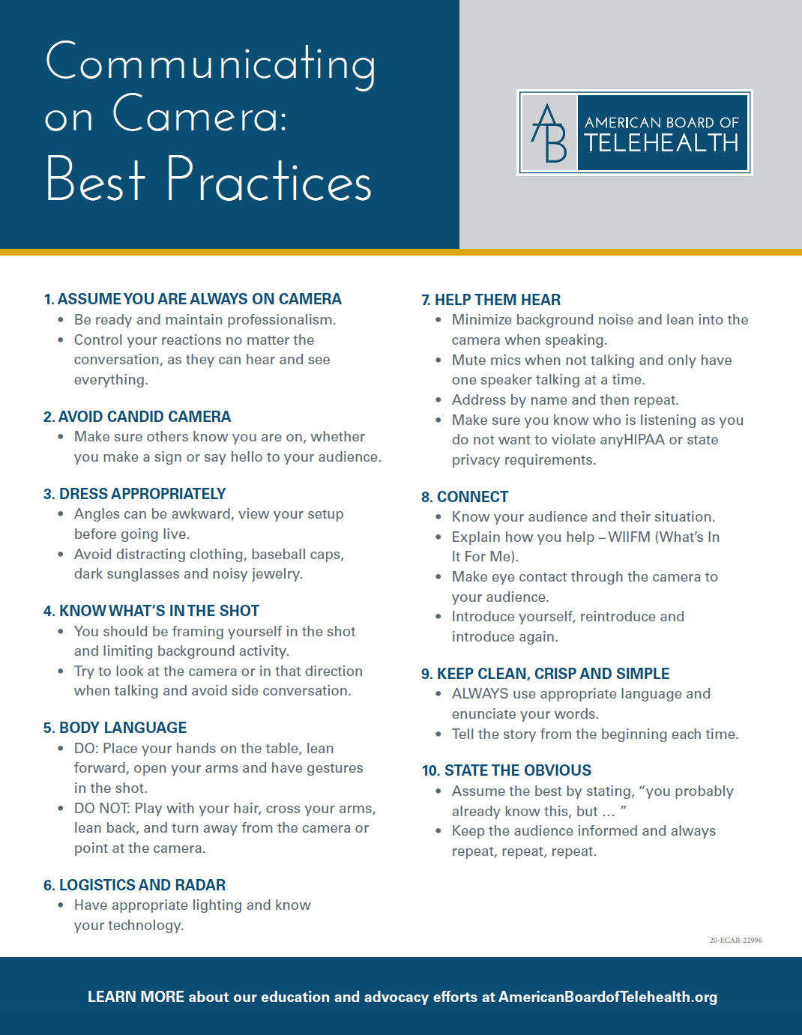
AMERICAN BOARD OF TELEHEALTH BEST PRACTICES

Slide 19
One Last Resource from IAEDP

Slide 20
Additional Considerations
Consent
Technology access & availability
Environmental appropriateness
Ability to gain accurate information from the patient

Slide 21
Clinical Preparation
Plan sessions and identify the main goal
Care model and scope of practice
Pre-read chart
Summarize knowledge of case and previous sessions
Functionality test technology
Consider scripting

Slide 22
Cultural and Social Determinants

Slide 23
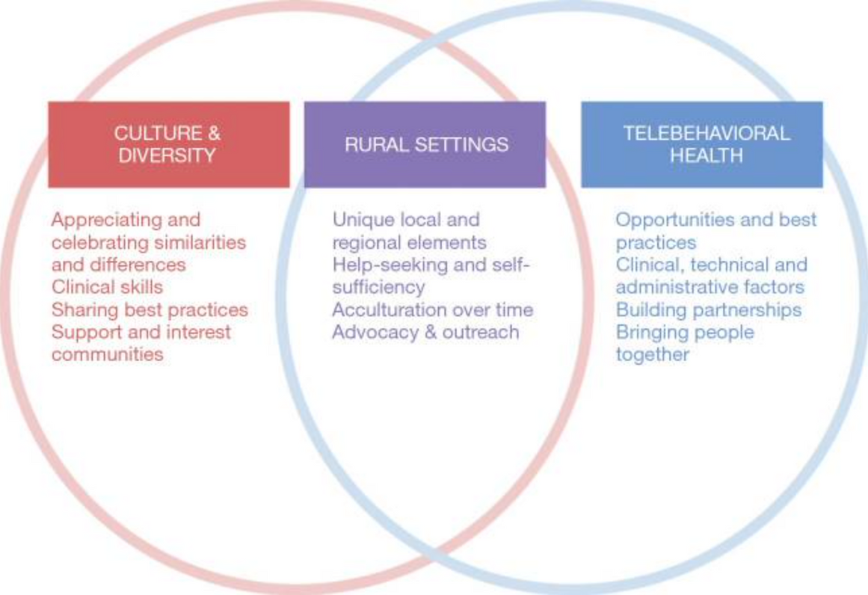
Cultural and Social Determinants
Integrating rural, cultural and telebehavioral health missions.
https://www.ncbi.nlm.nih.gov/pmc/articles/PMC7136658/

Slide 24
Telepresence Reminder
Keep language simple and clean
Body language awareness
Logistics and radar
Know who is listening
Be aware of what is in view
Dress appropriately

Slide 25
Consent Reminder
explain what telehealth is and how it could be helpful
benefits and cons
explain security risks and measures in place to protect security

Slide 26
Examination and Asessment
There is an art to examination and assessment in virtual
We cannot covertly assess things but watching for gait or hygiene
We need to be intentional about using questions and directions
Do you have peripheral devices you can use to support the visit?

Slide 27
Some options for improving the examination, assessment and observation experience via Telehealth -
Telemedicine grade video conferencing camera with end-use control
Camera Control
External web cams with pan and zoom features

Slide 28
Care Models
use validated screening scales and screeners
review and implement the scheduling process
review the emergency plan
review any needs or plans for lab work and prescriptions

Slide 29
Special Considerations
Telehealth scale
Telehealth blood pressure cuff
Digital stethoscope
Tele-EKG
Tele-glucose meter
Blood panel for lithium

Slide 30
Use Cases
Children & adolescents
Elderly
Group
Elderly
Medical inpatient
Rural

Slide 31
Key Considerations

Slide 32
SUMMARY
Telehealth for many providers is a new frontier. It is often daunting as we figure out how to transform our skillset to be effective online. Its important we are aware of the best practice guidelines and recommendations for our professional discipline. Having awareness of the resources and equipment available can enable providers to expand their digital capabilities. Effective clinical application of telehea;lth skills improve that patient and provider experience .

Slide 33
Thank You!
For Questions:
Apiazza@discoverybh.com

Slide 34
Resources
“Key Substance Use and Mental Health Indicators in the ...” The National Survey on Drug Use and Health, Substance Abuse and Mental Health Services Administration, Oct. 2021, https://www.samhsa.gov/data/sites/default/files/reports/rpt35319/2020NSDUHFFR1PDFW102121.pdf.
HPSA and MUA/P: HPSA scoring criteria: Guidance portal. HPSA and MUA/P: HPSA Scoring Criteria | Guidance Portal. (n.d.). Retrieved January 28, 2022, from https://www.hhs.gov/guidance/document/hpsa-and-muap-hpsa-scoring-criteria
Two-thirds of primary care physicians can't get mental health services for patients. Commonwealth Fund. (2009, April 14). Retrieved January 28, 2022, from https://www.commonwealthfund.org/press-release/2009/two-thirds-primary-care-physicians-cant-get-mental-health-services-patients?redirect_source=%2Fpublications%2Fpress-releases%2F2009%2Fapr%2Ftwo-thirds-of-primary-care-physicians-cant-get-mental-health-services-for-patients
Behavioral Health Workforce Projections. (2020, December). Retrieved from Health Resources & Services Administration (HRSA).
Hilty DM, Yellowlees PM, Parish MB, et al. Telepsychiatry: Effective, evidence-based and at a tipping point in healthcare delivery. Psych Clin N Amer 2015;38(3):559-592.
Shore, J. H., & Yellowlees, P. (2018). Telepsychiatry and Health Technologies: A Guide for Mental Health Professionals. Arlington, VA: American Psychiatric Association Publishing.
https://www.healthdata.org/infographic/covid-19-pandemic-has-had-large-and-uneven-impact-global-mental-health
Ostrowski, J., & Collins, T.P. (2016). A Comparison of Telemental Health Terminology Used across Mental Health State Licensure Boards).
National Consortium of Telehealth Resource Centers. How patients can engage in telehealth. https://www.telehealthresourcecenter.org/wp-content/uploads/2020/03/How-Patients-Can-EngageTelehealth-FINAL.pdf

