Slide 1
What is a Librarian?

Slide 2
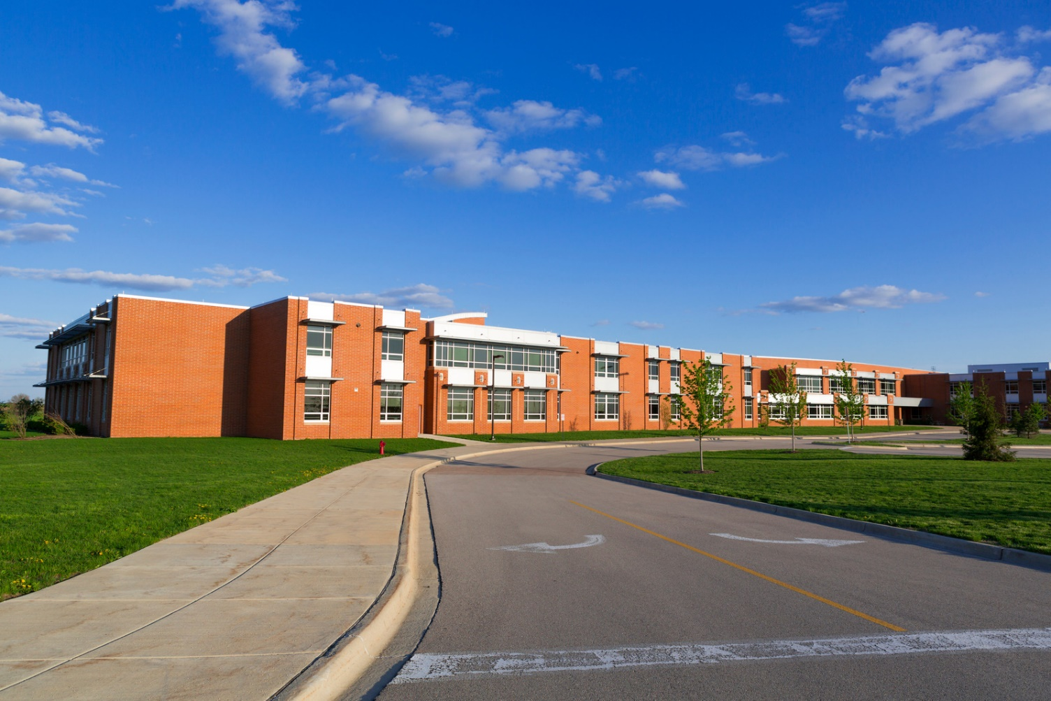
A librarian is a job at a school.

Slide 3
Where does a librarian work?

Slide 4
A librarian works in the library.

Slide 5
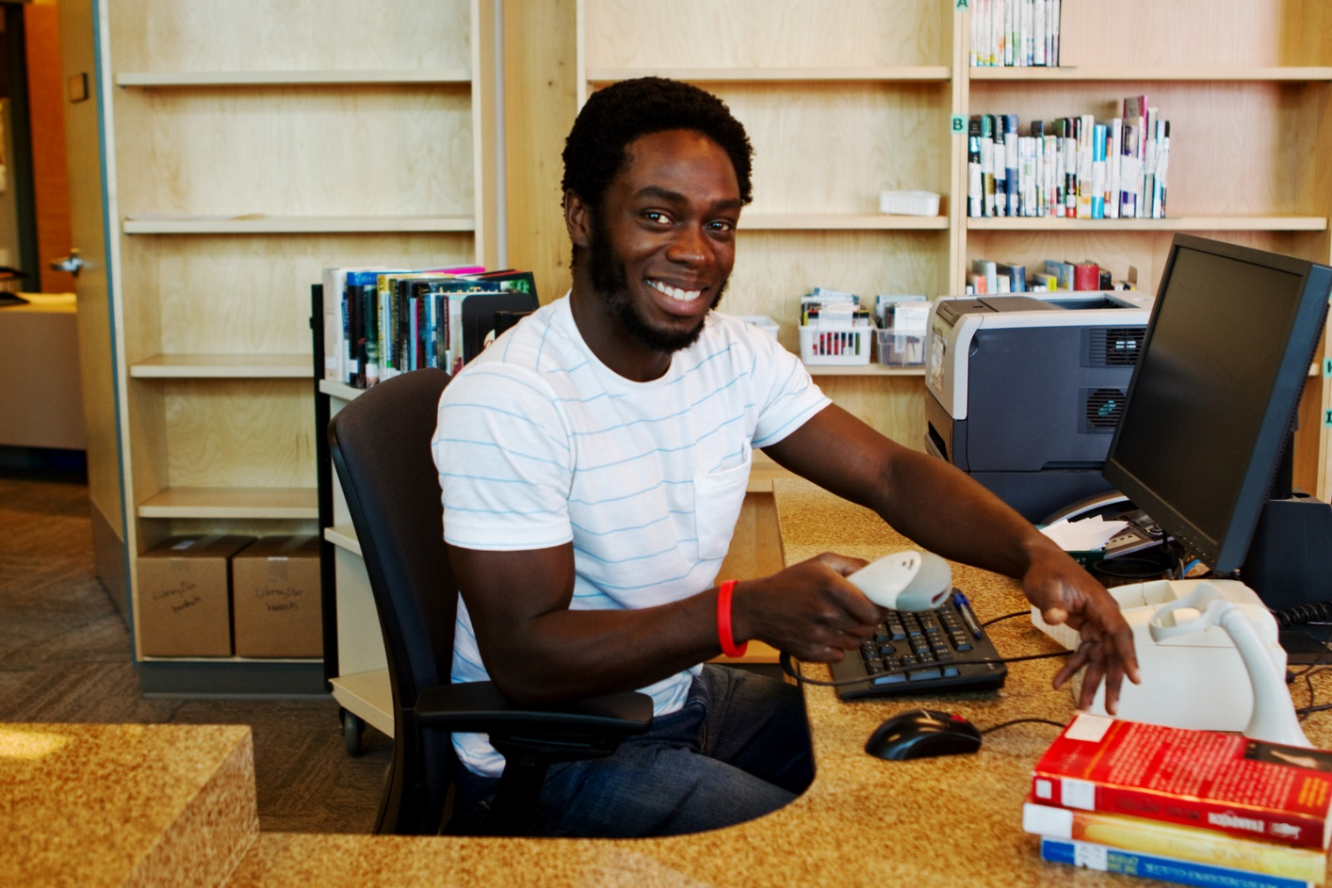
What does a librarian do?

Slide 6
A librarian helps teachers find books and materials.

Slide 7
A librarian helps students too.

Slide 8
A librarian helps you find books.

Slide 9
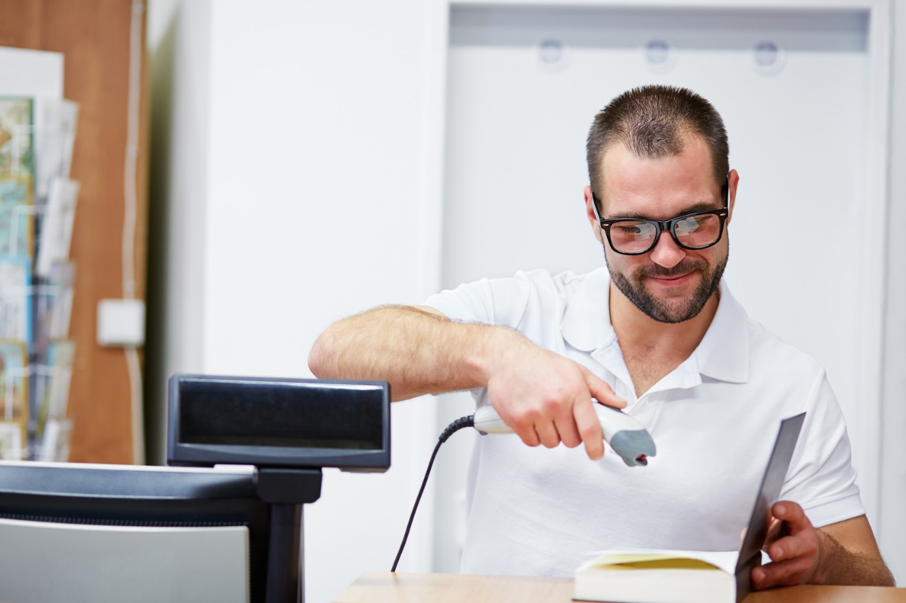
A librarian helps you check out books.

Slide 10
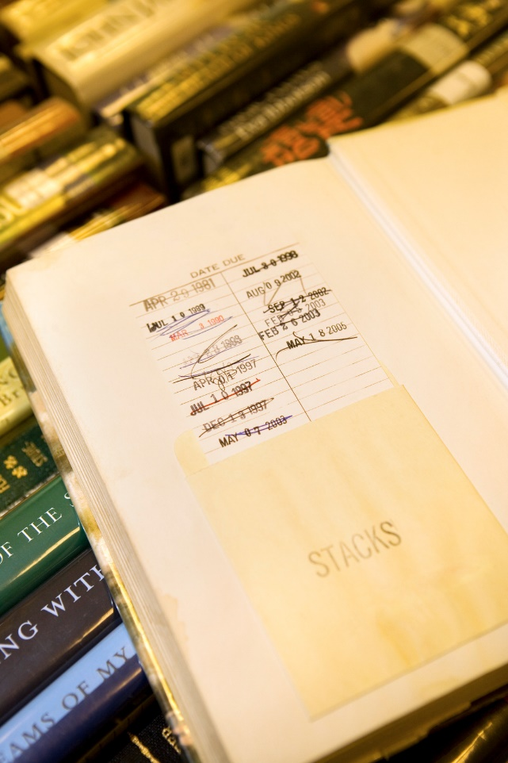
A librarian puts an overdue slip in your book.

Slide 11
A librarian puts books away.

Slide 12
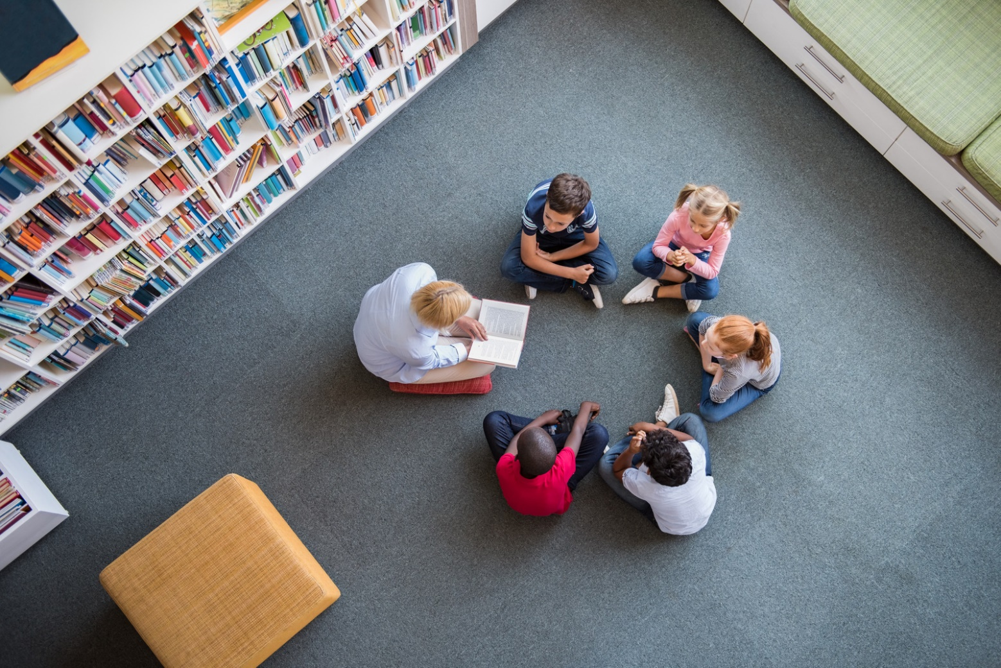
A librarian reads books to students.

Slide 13
A librarian looks for information on the computer.

Slide 14
A librarian works very hard.

Slide 15
Do you know who works in your library?

Slide 16
Review: What does a librarian do?

