Slide 1
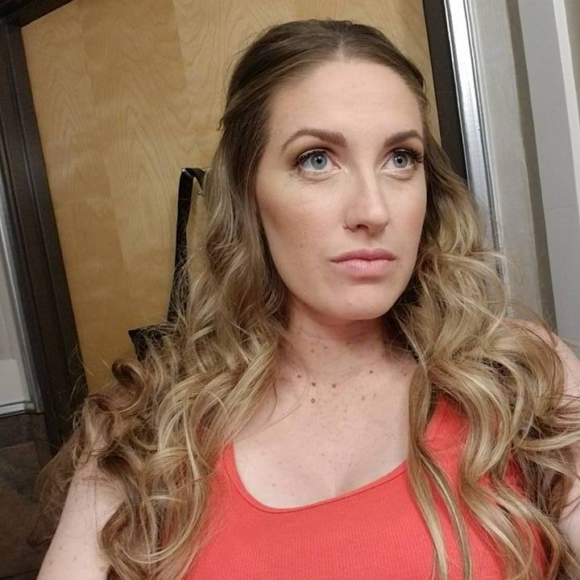
Who is K14?
Money coach- 1 on 1
Married, mom of 3 daughters
Course creator
Budgeting
Debt payoff
Credit building
Live trainings on FB
Blogger
Influencer
YouTuber
Instagram/Pinterest
Facebook group “K14’s Cash and Credit Community”
Soon to be podcaster
Weekly tips in email

