Slide 1
Conditionally Matching BGP Communities

Slide 2
BGP Communities
BGP communities provide capability for tagging routers and for modifying BGP routing policy.
BGP communities are an optional transitive attribute that can route from AS to AS
Communities are a 32-bit number included in the route
Range 0-4.2 billion
Full 16-bit number (6553700)
Two 16-bit number (100:100)
In order to use the newer format, you must type the following:
R2(config}#IP BGP-Community NEW-format

Slide 3
BGP Communities
Well-Known Communities
RFC1997: defines a set of global communities
Range: 4,294,901760 to 4,294,967,195
Three common well-know communities
Internet: advertised on the internet
No_Advertise: Not advertises to any BGP peer (iBGP/eBGP)
No_Export: Will not advertise communities for eBGP. Will advertise for iBGP
How to enable BGP community support
neighbor 10.1.1.9 send-community both

Slide 4
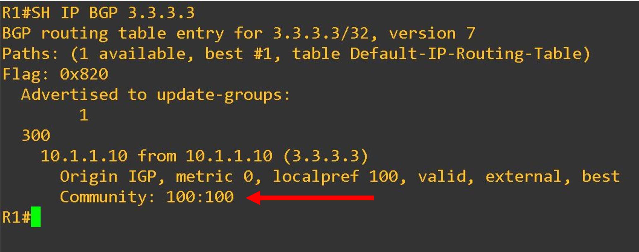
BGP Communities

