Slide 1
Week 4: Pro Forma Financials

Slide 2
Here’s what we’re going to cover
Infrastructure to have in place before you launch
How to create an ongoing budget to actual projection model
How to populate your pro forma financial model
How to manage and present your cap table

Slide 3
Pre-launch Infrastructure

Slide 4
Pre-launch Infrastructure
Monthly reconciliations
Generate statements at the touch of a button

Slide 5
Pre-launch Infrastructure
Capital Strategy
Rolling Budget
Make a budget with the finish line in mind.
Allocate you budget across your income and expenses.
Close out your books on a monthly basis and compare it to your actuals from QuickBooks.
Gain better control over your budget by pushing accountability for line items out to other individuals.
The ‘finish line’
Once you get your raise, back figure where you need to be.

Slide 6
Pre-launch Infrastructure
Financial Model Template
A guide to pulling your actuals into QuickBooks to then compare to you budget
Important to consider when setting up your chart of accounts:
Properly categorizing your fees based on how your accountant will accept invoices into QuickBooks
Example: Professional fees = legal fees + accounting fees + broker fees (does not include engineering fees for a software build)
There may be changes to the budget over the course of 60-90 days while the necessary changes are being made within your chart of accounts – start now and get clarity.

Slide 7
Pro Forma Financial Statements

Slide 8
Pro Forma Financial Statements
Projected or “future” financial statements
— Write down a sequence of financial statements that represent expectations of what the results of actions and policies will be on the future financial status of the firm.
Pro forma income statements, balance sheets, and the resulting statements of cash flow are the building blocks of financial planning.
Vital for any valuation exercises one might do in investment analysis or M&A planning.
Remember, it is future cash flow that determines value.
Financial modeling skills such as these are also important skills for those interested in finance or marketing to develop.

Slide 9
Generic Forms

Slide 10
Generic Forms: Income Statement
Sales (or Revenue)
Less Cost of Goods Sold
Equals Gross Income (or Gross Earnings)
Less Operating Expenses
Equals Operating Income
Less Depreciation
Equals EBIT
Less Interest Expense
Equals EBT
Less Taxes
Equals Net Income (Net Earnings, EAT, Profits)

Slide 11
Generic Forms: Balance Sheet
Generated automatically from QuickBooks
Assets
Cash
Accounts Receivable
Inventory
Prepaid Taxes
Marketable Securities
Total Current Assets
Gross PP&E
Accumulated Depreciation
Net PP&E
Land
Total Assets
Liabilities + O’s Equity
Bank Loan
Accounts Payable
Wages Payable
Taxes Payable
Current Portion – L-T Debt
Total Current Liabilities
Long-Term Debt
Preferred Stock
Common Stock
Retained Earnings
Total Liabilities + Equity

Slide 12
Generic Forms: Bridge
Clearly we cannot hope to get anywhere if we develop separate forecasts of the different statements.
The income statement records the effect of a given year while the balance sheets show the situation at the beginning of and after that year.
Furthermore, the balance sheet must balance.
The two statements must therefore be intimately linked. There must be a “bridge” between them.

Slide 13
Generic Forms: Bridge
Important bridges:
1. Net Income – Dividends = Change in retained earnings
An income statement amount less dividends equals a balance sheet amount.
2. Interest Expense = Interest Rate × Interest Bearing Debt
An income statement amount equals a balance sheet amount times a cost figure.
These simple relations, plus requiring the balance sheet to balance, tie the income statement directly to the balance sheet and vice versa.

Slide 14
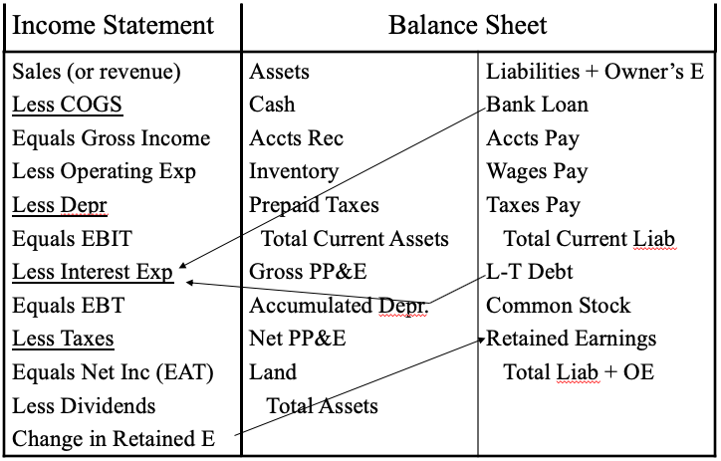
Bridge

Slide 15
The Forecasting Process
The most common way to proceed is to fill in the income statement first.
The standard approach is called “percent of sales forecasting.”
Why?: You first get the sales (or sales growth) forecast.
Then, you project variables having a stable relation to sales using forecasted sales and the estimated relations.
Then there is the rest.

Slide 16
Revenue Model
Don'ts:
Doing a percent of sales forecasting where you take your sales and grow them by a certain percentage every month.
Taking a percentage of each of the expenses based on a percent of sales.
Refer back to your one and three year plan and on how many employees your project will have and what seats you are going to have and pull those into your pro forma.
As a manager, it is an important and useful exercise to understanding the how and why by making these entries into the financial statements

Slide 17
The Process
How would we describe and estimate the following:
COGS
Operating expenses
Depreciation & Amortization
Interest expense
Taxes

Slide 18
The Process - COGS
COGS will generally vary directly with sales. If not, it is likely that something has gone (or is going) very wrong.
Calculate the COGS/Sales ratio for the last few years. Multiply a forecast for this ratio times the forecast for sales to find a forecast for COGS.
How do we forecast the COGS/Sales ratio?
Note that there may also be a fixed component for some of these relations. How do you adjust?
Operating expenses is a good example.
Important to understand and ask yourself…
What do you think your cogs are at the projected sales in the future?
Can you defend that number with investors after benchmark analysis?

Slide 19
The Process – Operating Expenses
We then require estimates of the components of expenses that don’t vary directly (and in a stable way) with sales to complete the income statement.
Other Expenses
Other Income
Depreciation
Taxes
Net Income
Dividends
Critical elements to highlight the use of every dollar:
Understanding and benchmarking your cost of goods sold number
Understanding your sales and marketing costs and benchmarking those to the types of revenues that you are projecting
Looking at your other expenses to make sure they are in line with the payroll you should have

Slide 20
Financial Model

Slide 21
Financial Model
Cap table management tools
Free (i.e. QuickBooks)
Canva - If it fits within your budget, you will be doing 10+ transactions, have 10+ employees, or you have completed a couple of investment rounds.
Use the software to punch out the existing cap table, then to punch out a pro forma capitalization table (what happens to the cap table, assuming you get the round of financing that you are describing).
This will then be pulled into the investment overview offerings slides.
Without this, it will be impossible to close capital.
You must have a cap table that is tight, that you can manipulate, that you understand on the fly when investors ask you about the money, and that looks like everybody else’s that is raising capital.

Slide 22
“Success usually comes to those who are too busy to be looking for it.”
—Henry David Thoreau

