Slide 1
Taking Charge of Your Finances 100%,
MODULE ONE
Nurturing the Abundance Mindset

Slide 2
Your Money GoalPost
Fantasy Island – Everything is possible
What do you want?
Notes:
Hadith Qudsi- If Allah were to ask of every man & Jinn….
May be difficult – pretend to be a kid again and dream

Slide 3
Why bother?
Allah Permits it - why not?
He instructs us to ask for it.

Slide 4
Evidence from Sahabiyyat
They went to Jannah – Same goal of Ultimate Success
Khadijah bint Khuwaylid (Legacy of Islam)
Zainab bint Jahsh Al –Asadiyyah (The one with the longest hand)
Maymunah bint Al Harith (Freed Slaves)

Slide 5
Core act of worship
“Alif, Lam, Meem.
This is the Book about which there is no doubt, a guidance for those conscious of Allah.
Who Believe in the unseen,
Establish prayer, and
Spend out of what We have provided for them”
Surah Baqarah Verses 1 -3

Slide 6

MINDSET
Modelling (from Parents & Caregivers, Circles)
Environment (Social, Cultural)
Significant Emotional Experiences (Negative Interpretations, Trauma, Abuse)

Slide 7
MINDSET
SCARCITY
ABUNDANCE
Fear Based
Rigid
Limited Resources
Problem Focused
Lack
Holds you back in Life
Negative Energy
Kills abundance
Trusts in Allah
Open Minded
Abundant Resources
Possibility Focused
Plenty
Helps you move forward with ease in Life
Positive Energy
Attracts more Abundance

Slide 8
Mindset - 95% Subconscious
Unconscious Mind Sabotages

Slide 9
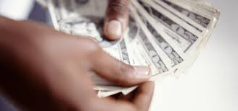
Beliefs about Money
It’s hard to earn money
Money leads to arrogance
You can’t be rich and happy/a good muslim

Slide 10

Beliefs about Self
Not being _______ enough
Not worthy of ________
Who am I to ____________
I have always being _________ so I can’t …
Women can’t/shouldn’t ___________

Slide 11
Beliefs about Others
So and so struggles so I will too
My Family was not wealthy so I can’t be
So and so has always been smarter than I

Slide 12
Jumping the hurdle…
Decide to make a change
Tawwakul Trust in Allah
Tie Your Camel Make right effort

Slide 13
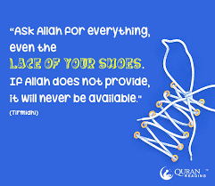
Tawwakul
Have Tawwakul – Trust in Allah
Seek refuge from Poverty
Invoke Allah – Your effort is not alone
Ref. (Maryam mother of Esa As)

Slide 14
Tie Your Camel
Reprogram Beliefs holding you back
  Is it true?
  What’s the evidence?
    From yourself or others
  Flip belief – What would serve you
New Beliefs
Affirmations

Slide 15
The PriceTag of Your Dreams
Dream Vacation
Dream House
Dream Education
Dream Car
Dream Project
Go ahead and make the enquiries, what will that dream cost?
With Allah you can get EVERYTHING you want

Slide 16
END OF
MODULE ONE
Nurturing the Abundance Mindset
QUESTIONS?
TAKEAWAYS?
PLEASE POST BELOW

