Slide 1


Wheel of Life
Setting Client Goals

Slide 2
What is the wheel of life?
Demonstrates balance & imbalance in client’s life
Demonstrably shows improvement
Encourages overall improvement

Slide 4
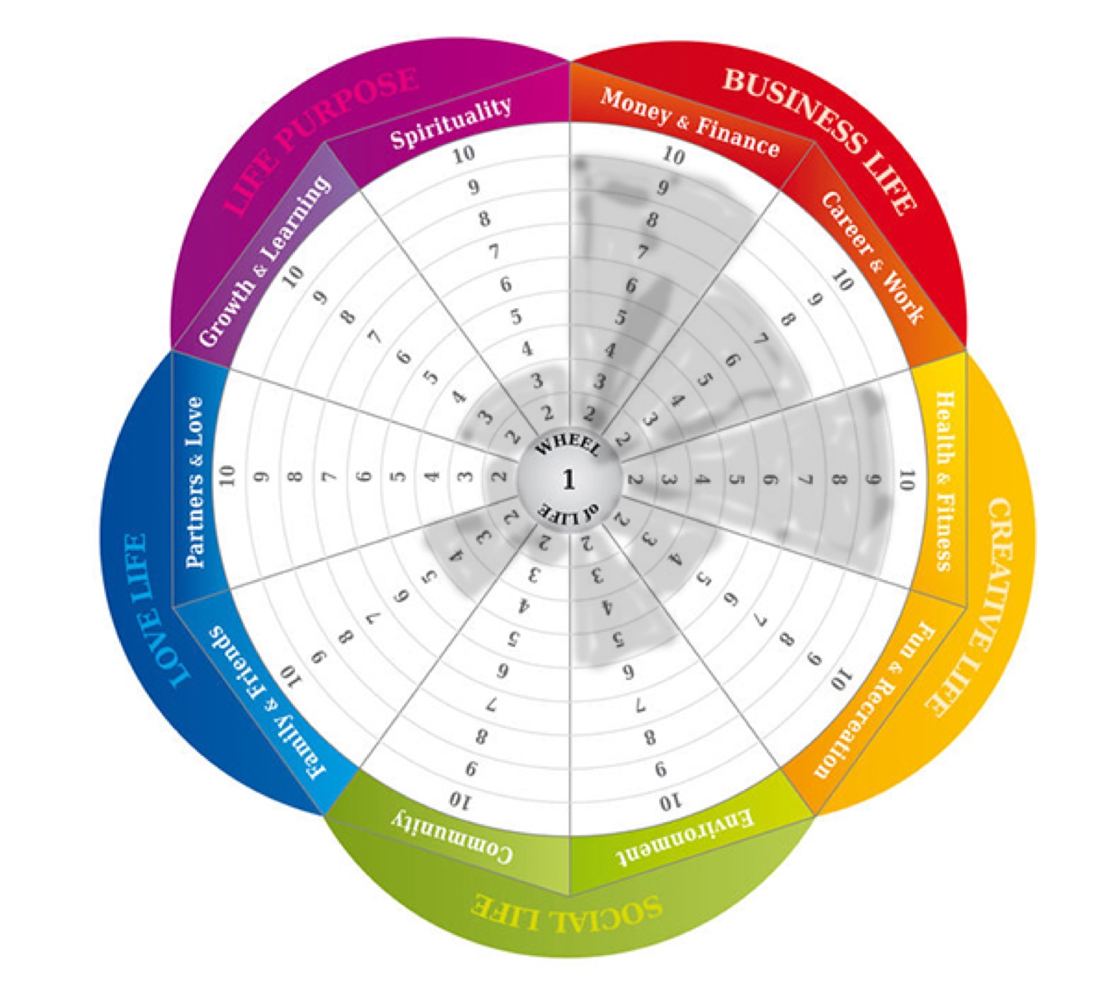
Original wheel of life score
Client scores their own experience based on 1 (with 1 being not great to 10, with 10 being amazing).
They then shade the areas as shown in this wheel of life

Slide 5
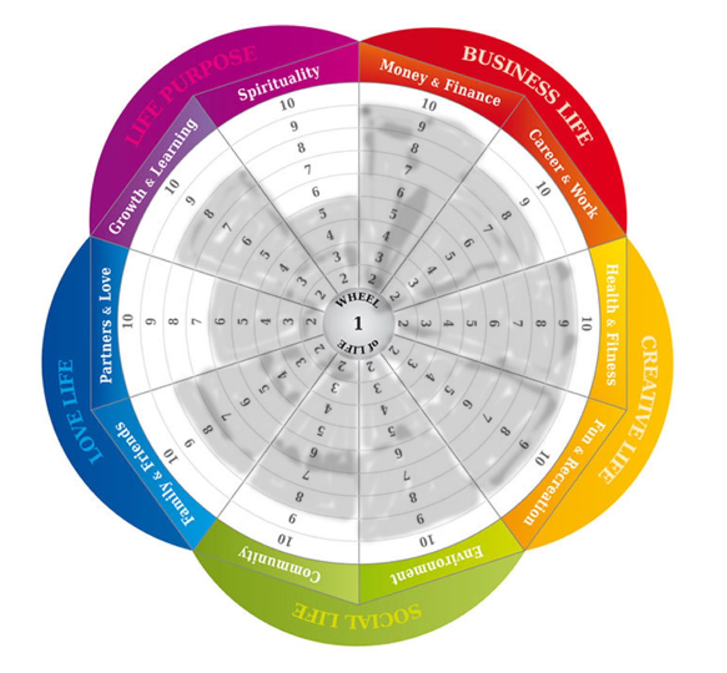
Progress Wheel of Life
More balanced wheel
Improvement in particular areas
Still a work in progress

