Slide 1
Soft Skills Training

Slide 2
Module Two Communication
In this course, we will;
Explore the concept of communication, the models of communication and how to effectively communicate.
Identify key elements and principles of communication.
Explore the importance of active listening and empathy skills towards others.
Learn the effects of non-verbal messages and what it is telling others

Slide 3
course outline
01
02
03
04
05
Lesson
Lesson
Lesson
Lesson
Lesson
Understanding Communication
Forms of Communication
Verbal & Non-Verbal Communication
Email & Written Communication
Giving and Receiving Feedback

Slide 4
“
"The single biggest problem in communication is the illusion that it has taken place." - George Bernard Shaw
“The biggest communication problem is that we do not listen to understand. We listen to reply” – Steven Covey
“Excellent communication doesn’t just happen naturally. It is a product of process, skill, climate, relationship and hard work.” – Pat McMillan, author, CEO

Slide 5
What is Effective Communication
Effective Communication is a communication between two or more persons wherein the intended message is successfully delivered, received and understood.
Effective communication is a process of exchanging ideas, thoughts, knowledge and information such that the purpose or intention is fulfilled in the best possible manner. In simple words, it is nothing but the presentation of views by the sender in a way best understood by the receiver.

Slide 6
Why is communication important in the workplace
Collaboration and Teamwork
It enhance productivity
Conflict resolution
It facilitates creativity and innovation
It facilitates growth, creativity and innovation
It enhance team building and trust
Notes:
Collaboration and Teamwork: Effective communication fosters collaboration and teamwork. It allows team members to share ideas, exchange information, and work together towards common goals. Clear communication ensures that everyone is on the same page, minimizes misunderstandings, and promotes a harmonious work environment.
Efficient Workflow: Good communication streamlines workflow and enhances productivity. When information is communicated clearly and timely, tasks are completed more efficiently, deadlines are met, and work progresses smoothly. It helps in coordinating efforts, delegating responsibilities, and avoiding unnecessary delays or errors.
Conflict Resolution: Miscommunication often leads to conflicts in the workplace. Effective communication skills enable individuals to express their concerns, listen to others, and find mutually acceptable resolutions. It helps in reducing misunderstandings, addressing differences of opinion, and maintaining positive working relationships.

Slide 7
Typical Communication Process
1. Speaker encodes
2. Message goes to the listener
3. Listener decodes
Noise
4. Listener encodes
Noise
6. Speaker decodes
5. Feedback goes to the speaker
Frame of Reference
Frame of Reference
SPEAKER’S WORLD
LISTENER’S WORLD

Slide 8
It’s not really WHAT you say that counts, it is HOW you say what you say

Slide 9
02
lesson
Forms of Communication

Slide 10
Forms of Communication
Types of Communication
Based on Channel
Based on Style and Purpose
Verbal
Non-verbal
Formal
Informal
Oral
Written
Notes:
There are various forms of communication, including:
Verbal Communication: This is the most common form of communication, involving spoken or written words. It includes face-to-face conversations, meetings, phone calls, presentations, memos, emails, and other written correspondence.
Nonverbal Communication: Nonverbal communication refers to the transmission of messages without the use of words. It includes body language, facial expressions, gestures, eye contact, posture, tone of voice, and even silence. Nonverbal cues can convey emotions, attitudes, and intentions.
Written Communication: This form of communication involves the use of written words to convey messages. It includes emails, reports, letters, memos, manuals, presentations, and any other form of written documentation. Written communication provides a permanent record and allows for careful crafting and editing of messages.
Visual Communication: Visual communication involves the use of visuals, such as charts, graphs, diagrams, photographs, videos, and infographics, to convey information. Visuals can enhance understanding, simplify complex concepts, and engage the audience.
Electronic Communication: Electronic communication refers to the use of technology to transmit messages. It includes emails, instant messaging, video conferences, social media platforms, and other digital tools. Electronic communication enables quick and efficient information exchange across different locations and time zones.
Interpersonal Communication: Interpersonal communication occurs between individuals or small groups, typically in face-to-face or direct interactions. It involves active listening, speaking, and engaging in conversations to exchange ideas, thoughts, and information.
Group Communication: Group communication takes place within a team or a larger group of people. It involves discussions, meetings, brainstorming sessions, and collaborative decision-making. Group communication focuses on exchanging information, generating ideas, and reaching consensus.
Formal Communication: Formal communication follows established rules, protocols, and hierarchies within an organization. It includes official announcements, policies, procedures, and reports. Formal communication ensures consistency, clarity, and adherence to organizational standards.
Informal Communication: Informal communication occurs spontaneously and outside formal channels. It includes casual conversations, water cooler chats, informal emails, and social interactions. Informal communication helps build relationships, foster camaraderie, and share information in a more relaxed manner.
It's important to note that these forms of communication are often interrelated and can overlap. Effective communication often involves a combination of verbal, nonverbal, written, and visual elements, depending on the context and purpose of the communication.

Slide 11
7 C’s of Communication
Clear
Make your objective and purpose of your message clear.
Avoid complex words and phrases
Concise
Keep it clear and to the point.
Avoid filler words and unnecessary jargons.
Concrete
Be specific not vague.
Use facts and figures your support your message
Correct
Try to avoid typos. Use correct facts and figures.
Use the right level of language
Coherent
Does your message make sense? Ensure it flows logically.
Avoid covering too much
Complete
Each message must have a clear conclusion in
order to make proper decisions and make action plans.
Courteous
Being polite builds goodwill. Ensure your message is
respectful, sincere and enthusiastic

Slide 12
03
lesson
Verbal and Non-Verbal Communication

Slide 13
Verbal Communication
Verbal communication is the exchange of information, ideas, and messages through spoken words.
It involves both speaking and listening skills and is a fundamental form of human interaction
The two major forms of verbal communication include written and oral communication.
Some of the key components of verbal communication are sound, words, speaking, and language
Notes:
In life, we spend so much time focusing on our outer selves - the person we present to others.
The outer self is concerned with what others think about us - looking over our shoulders, at what others are doing and comparing ourselves to others.
The outer self is the mask we wear to cover up the fact that we have lost connection with our true self.
The inner self is the person that no one ever sees – your true self. This represents the aspects of yourself that are known only to you, including your thoughts, feelings, desires, and personal values.

Slide 14
Forms of Verbal Communication
Face to Face conversation
Meetings
Presentations
Public Speaking
Written – Emails, letters
Interviews
Negotiations

Slide 15
Non-Verbal Communication
Non-verbal communication is communications without words. It refers to all aspects of a message, which are not conveyed by the exact meaning of words.
People are more likely to believe your non-verbal communication than your verbal communication if the two are contradictory
It includes body language, facial expressions, gestures, posture, tone of voice, and other non-verbal cues
Notes:
In life, we spend so much time focusing on our outer selves - the person we present to others.
The outer self is concerned with what others think about us - looking over our shoulders, at what others are doing and comparing ourselves to others.
The outer self is the mask we wear to cover up the fact that we have lost connection with our true self.
The inner self is the person that no one ever sees – your true self. This represents the aspects of yourself that are known only to you, including your thoughts, feelings, desires, and personal values.

Slide 16
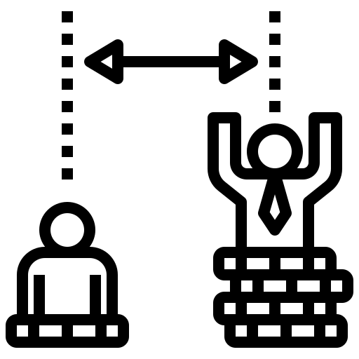
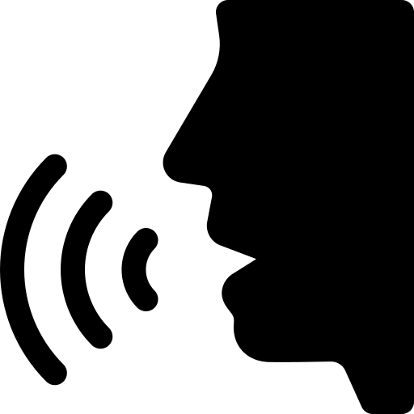
Types of Non-Verbal Communication
Body Language
Facial Expressions
Proxemics
Paralinguistics
Posture: Slouching versus standing tall can convey confidence or lack thereof.
Gestures: Hand movements, such as pointing, waving, or thumbs up, can add emphasis or clarify meaning.
Eye Contact: Maintaining eye contact shows engagement and interest in the conversation.
Smiling: Expresses warmth, friendliness, and approachability.
Frowning: Indicates displeasure, disagreement, or concern.
Raised Eyebrows: Can indicate surprise, curiosity, or skepticism.
Personal Space: The distance maintained between individuals can signal comfort or establish boundaries.
Physical Contact: Hugs, handshakes, or pats on the back convey greetings, support, or affection.
Tone of Voice: The way words are spoken can convey emotions, confidence, or sarcasm.
Pitch: High or low pitch can indicate excitement, seriousness, or surprise.
Volume: Loud or soft speaking can express assertiveness or passivity.

Slide 17
The Albert Mehrabian Communication Model
Spoken Words
7%
55%
38%
Developed by psychologist Albert Mehrabian in the 1960s, the model suggests that communication is composed of three elements: words, tone of voice, and non-verbal cues.
Which of these, do you think matters the most in communication; your words, tone of voice or body language?
Tone of Voice.
(Tone, modulation and pauses)
Body Language.
(Use of arms, body and facial expressions)
Notes:
often referred to as the "7-38-55 Rule," is a widely cited communication model that focuses on the importance of non-verbal communication cues in conveying emotions and attitudes.

Slide 18
04
lesson
Email & Written Communication

Slide 19
Effective Written Communication
Clear and precise written communication ensures accurate message conveyance.
Reflects competence and professionalism in various digital interactions.
Written communication bridges language and cultural barriers.
Effective written communication supports the ability to persuade and influence.
Strong written communication skills are highly valued in the workplace.

Slide 20
Tips for Email Communication
Subject Line
Use a specific and concise subject line, such as "Meeting Request: [Date/Time/Topic].“
Salutation and Greeting
Start with a formal salutation (e.g., "Dear Mr./Ms./Dr."), followed by a polite greeting (e.g., "I hope this email finds you well").
Structure and Organization
Divide the email into paragraphs with clear headings or bullet points to enhance readability.
Tone and Language
Maintain a professional and courteous tone throughout the email, avoiding slang or inappropriate language.
Conciseness and Clarity
Keep the email concise and to the point
Clearly articulate your key information
Proper Sign-Off
End the email with an appropriate closing and your name. Example: "Sincerely," "Best regards," followed by your full name.
Proofreading and Editing
Review the email for spelling, grammar, and punctuation errors before sending
Professional Email Signature
Include a professional email signature with your contact information.
Attachments and Formatting
Use proper formatting, such as font styles and sizes, for clarity. Be cautious with attachments; ensure they are relevant and necessary.

Slide 21
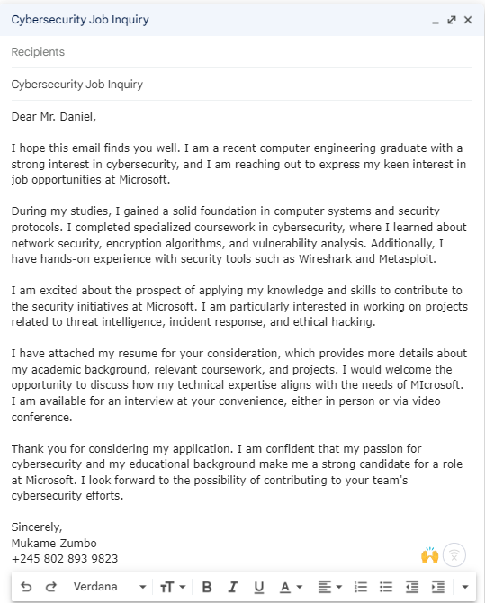
Sample Email
Subject Line
Subject
Salutation
Paragraph spacing
Fonts
Closing
Signature

Slide 22
Email Etiquettes
Use standard formatting
Include a clear subject line
Email from a professional email address
Use the correct email format
Use professional greetings
Choose your salutation and sign-off carefully
Avoid using all caps
Double-check attachments
Shorten links
Proofread
Use Bcc appropriately
Set informative out-of-office replies
Be aware of cultural differences
Include a call to action
Write the email address last
Keep your tone professional
Reply within 24 hours
Don't use emojis

Slide 23
Developing your writing skills
Read widely
Practice Regularly
Share your writing
Do your Research
Use outlines
Celebrate progress
Pay Attention to Grammar and Punctuation
Don’t delay, just write!
Notes:
Importance
It contributes to effective decision-making by providing clarity on values, priorities, and long-term goals.
It fosters empathy, understanding, and appreciation for others, promoting positive and meaningful connections.

Slide 24
05
lesson
Giving & Receiving Feedback

Slide 25
Listening… the other side of communication
Too many people see communication as merely speaking
A good question to ask yourself is, are you really listening or simply waiting for your turn to talk?
If you are thinking about your reply before the other person has finished, then you are not listening!
“Nature gave us one tongue and two ears so we could hear twice as much as we speak.” - Epictetus

Slide 26
Active Listening
One of the most important rule of communication is to “Seek more to understand than to be understood”
Communication is not just about talking but listening to understand the message so you can give appropriate feedback or response
Level 1: Hearing
Level 2: Listening
Level 3: Active Listening
Level 4: Interactive Listening

Slide 27
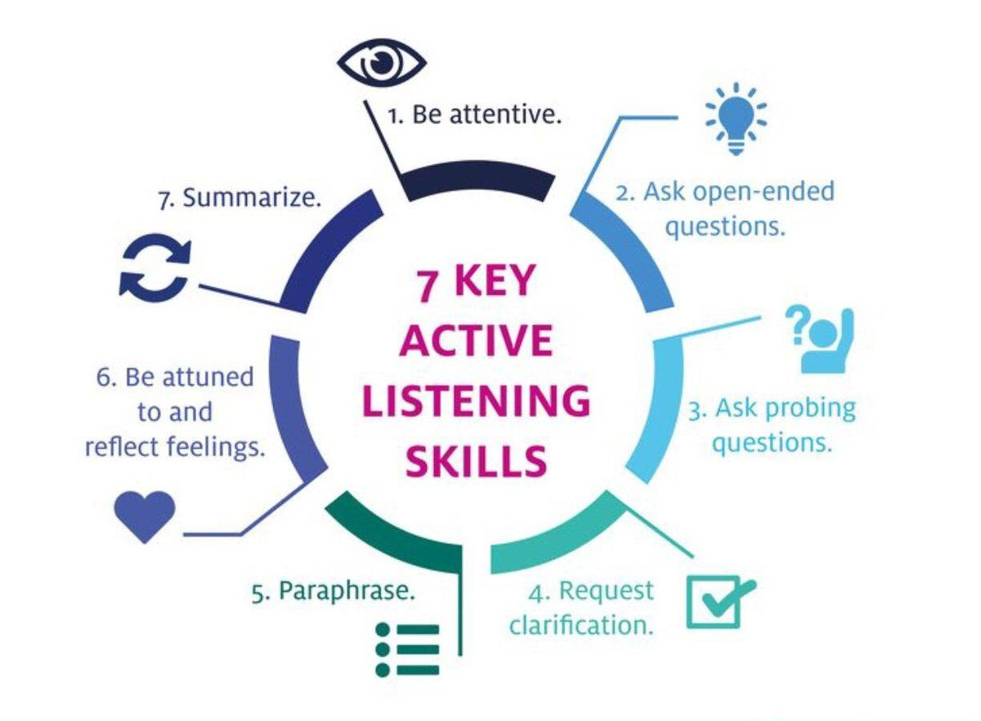
Active Listening
Ask questions to clarify the message from the sender
Reflect your feelings and use non-verbal cues when listening
Pay attention to the speaker, put away your phone and any other distraction.
Establish appropriate eye contact to show interest.
Create a need to listen by thinking about what you can learn from the speaker
Being Open Minded & Non-Defensive

Slide 28
Giving Feedback
Notes:
Feedback is Information about performance or behaviour that leads to action to affirm or develop that performance or behaviour.
The purpose of Feedback:
How can we expect people to change and develop if they don’t know what they need to change?
Unless they get feedback, how do they know what they do well so they can continue doing it?

Slide 29
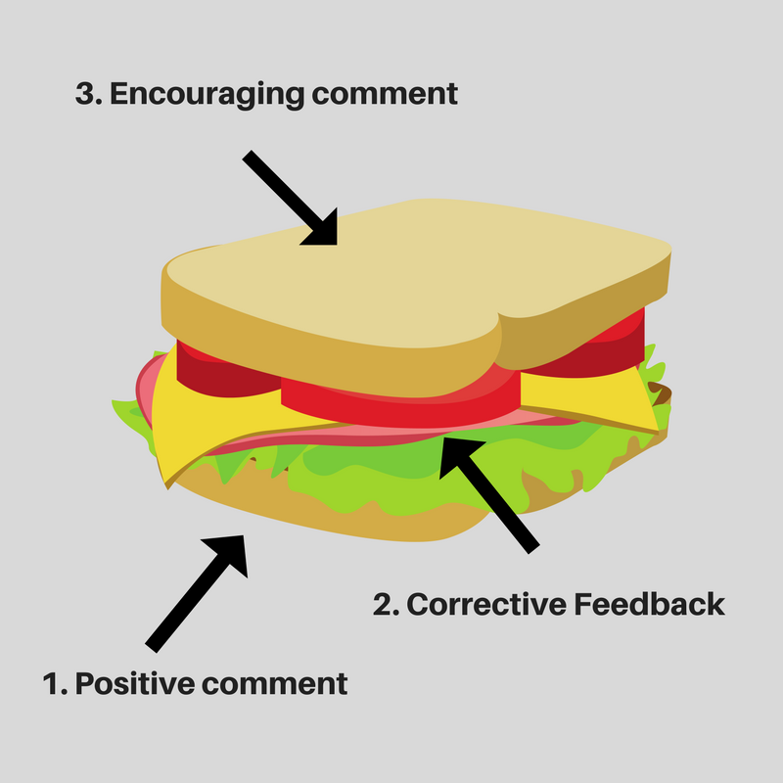
The Feedback Sandwich Method
How can we expect people to change and develop if they don’t know what they need to change? Unless they get feedback, how do they know what they do well so they can continue doing it?
Giving Feedback: to be effective in giving feedback, the feedback sandwich method is highly recommended. The feedback sandwich consists of starting your feedback with PRAISE followed by a corrective feedback or criticism and closed by PRAISE.
Notes:
The sandwich feedback method consists of praise followed by corrective feedback followed by more praise.

Slide 30
Example
Positive Feedback: I want to acknowledge your dedication and commitment to meeting project deadlines. Your ability to manage multiple tasks simultaneously has been impressive.
Constructive Feedback: I noticed that in the last team meeting, you didn't actively participate in the group discussion. It would be beneficial for you to share your insights and ideas more actively, as it contributes to the overall team collaboration and problem-solving process.
Encouraging Comment: I have confidence in your abilities, and I believe that by sharing your valuable perspectives, you can make an even greater impact on our team's success.
Notes:
The sandwich feedback method consists of praise followed by corrective feedback followed by more praise.

Slide 31
Situation-Behaviour-Impact
Situation
Behaviour
Impact
Describe the situation with specifics.
Describe the behavior observed; do not try to guess at motives or causes of the behavior.
Describe the impact the observed behavior had
Situation: “This morning at the 11 a.m. team meeting…”
Behaviour: You interrupted me while I was telling the team about the monthly budget,” instead of “You were rude.”
Impact: “I felt frustrated when you interrupted me because it broke my train of thought.”
Intent: “What were you hoping to accomplish with that?
Notes:
The SBI method is simple and direct. We can capture and clarify the Situation, describe the specific Behaviors observed, and explain the impact that the person's behavior had on you. By using the SBI tool as your framework for giving feedback, you are able to curate a perfect picture for yourself before communicating with the other party
Inquiring about intent prevents us from veering off in the wrong direction based on faulty assumptions. Extending the Situation-Behavior-Impact (SBI) tool for delivering feedback to be Situation-Behavior-Impact-Intent (SBII) allows you to have a conversation to address what was behind a person’s actions. What were their original intentions?
Using the SBI model allows you to give feedback in a constructive and non-confrontational manner. It provides a clear framework for addressing behaviors and their impact, promoting growth and improvement in individuals and teams.

Slide 32
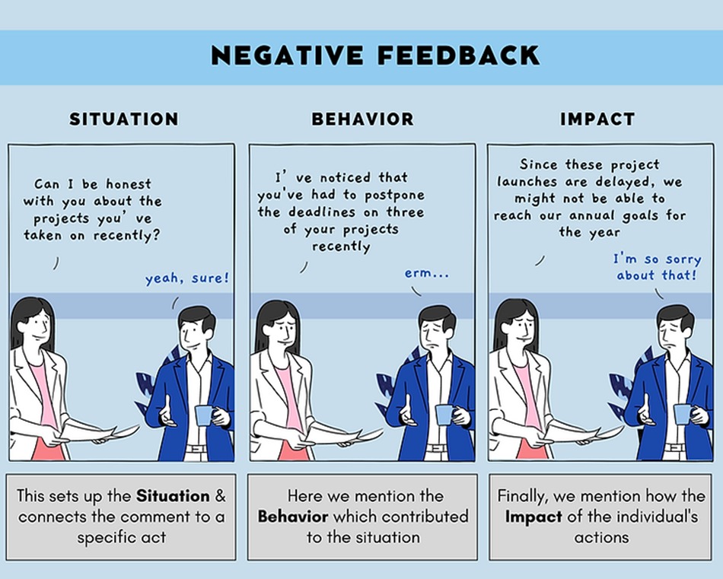
Example of the SBI Model

Slide 33
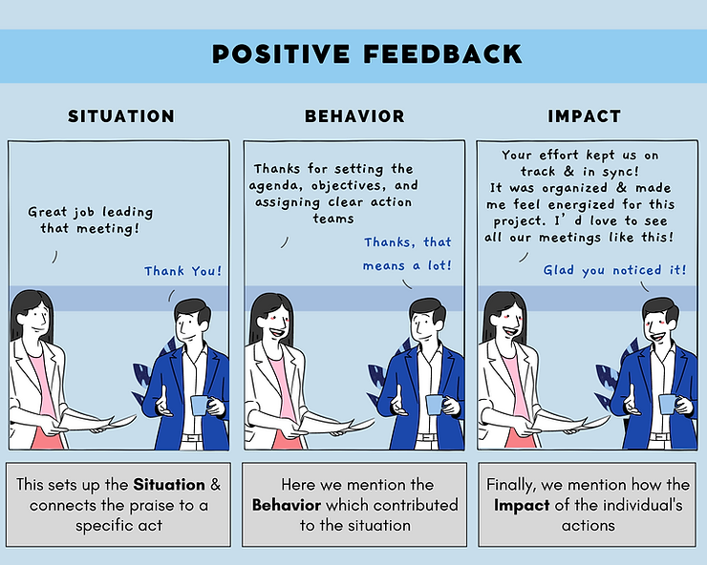
Example of the SBI Model

Slide 34
Giving Feedback
1
Check your motives
Focus on the issue/performance and not the person
2
3
Celebrate in public, Criticize in private
Do it regularly and be specific
4
5
Come with a deep level of empathy
Make the conversation a two-way street
6

Slide 35
Receiving Feedback

Slide 36
Receiving Feedback
Feedback can be uncomfortable at the best of times. When we receive feedback, particularly constructive feedback, often we take it personally — feel the need to defend ourselves or justify our actions. All these reactions are completely normal and simply part of the feedback process.
One framework that is helpful in explaining this is the Feedback Staircase. The staircase explains five ‘steps’ or emotions that we all naturally feel when receiving feedback.
Deny, Defend, Explain, Understand and Change.

Slide 37
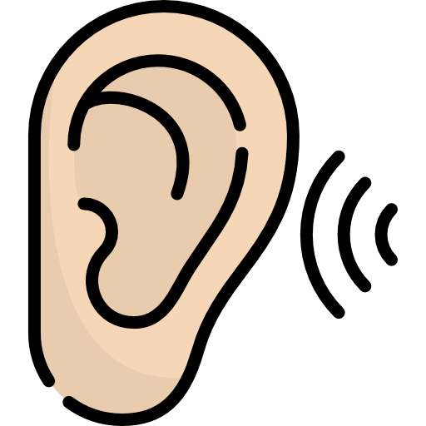
RECEIVE Model
Relax
Engage
Clarify
Express Appreciation
Internalize
Value Perspectives
Remain calm and open-minded when receiving feedback.
Listen attentively. Maintain eye contact and show genuine interest.
Ask questions for further explanation or examples to enhance your comprehension.
Express gratitude and appreciation for the feedback received.
Take time to process the information & consider how it aligns with your goals and areas for improvement.
Identify specific actions you can implement to make improvements based on the feedback received.
Explore Action Steps
Recognize that others' viewpoints can contribute to your professional growth.
Notes:
Feedback plays an essential role in leading ourselves to grow and make changes in our behavior
Attitude Matters
Feedback can be a gift, regardless of the source
We are not our behavior. Be kind to yourself!
Guard against two natural tendencies: to rate our performance more highly than others do or blame others or circumstances when we fail

Slide 38
Assertive communication is a communication style that involves expressing your thoughts, opinions, and needs in a clear, confident, and respectful manner while considering the rights and feelings of others. It involves standing up for yourself, setting boundaries, and advocating for your own interests without disregarding or disrespecting others.
Assertive communicators aim for both sides to win in a situation, balancing one’s rights with the rights of others.
Clear & Assertive Communication

Slide 39
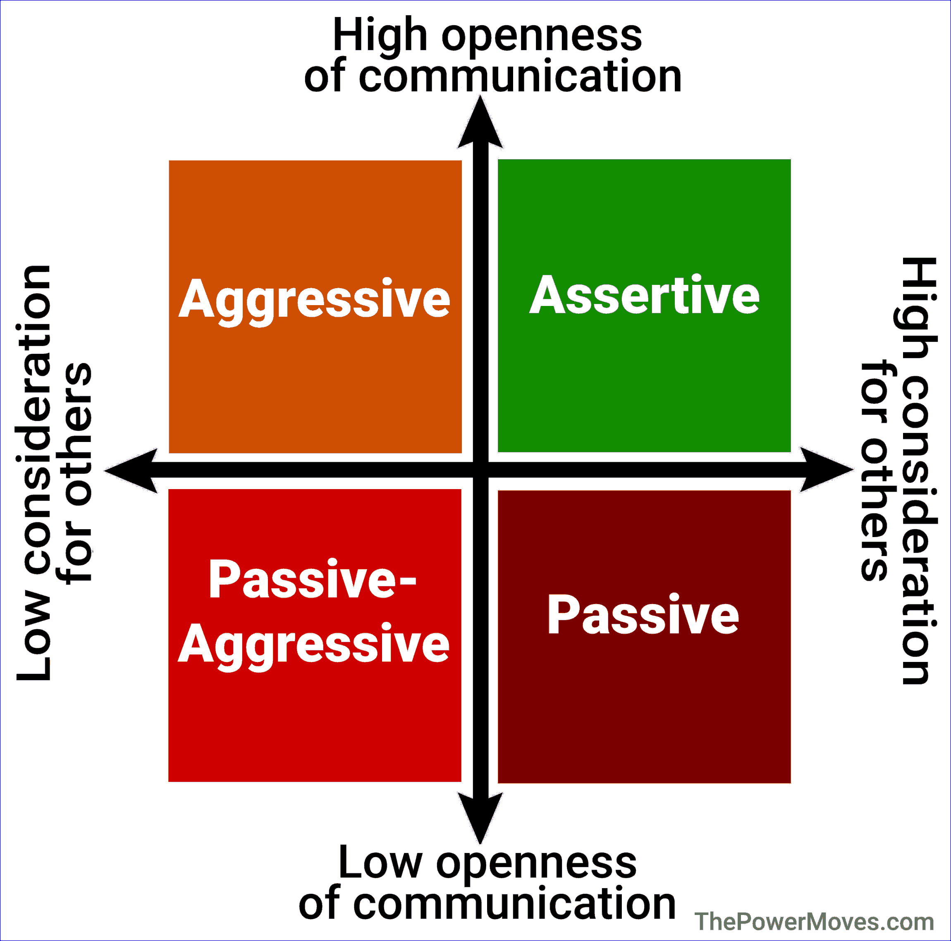
Communication Styles
Passive communication is a communication style characterized by a reluctance to express one's thoughts, opinions, or needs. They often prioritize others' needs over their own and may struggle with setting boundaries or standing up for themselves. Passive communication often leads to misunderstanding, built-up anger, or resentment.
Examples include statements like “I’m okay with whatever you want to do”; body language includes failing to make eye contact or looking down.
Aggressive communication is a communication style characterized by forceful and dominating behavior. They tend to express their thoughts, opinions, and needs in a manner that disregards the rights and feelings of others. They may use intimidation, criticism, or insults to assert their dominance or get their way. Aggressive communication often leads to conflict, and hostility.
Examples include statements like “this is what we’re doing,” or “get over it”; body language includes crossing arms, eye rolling, or finger pointing.
Notes:
Passive communication is a communication style characterized by a reluctance to express one's thoughts, opinions, or needs. They often prioritize others' needs over their own and may struggle with setting boundaries or standing up for themselves. Passive communication often leads to misunderstanding, built-up anger, or resentment. Can be a safer communication option when a conflict may escalate to violenc
Aggressive communication is a communication style characterized by forceful and dominating behavior. They tend to express their thoughts, opinions, and needs in a manner that disregards the rights and feelings of others. They may use intimidation, criticism, or insults to assert their dominance or get their way. Aggressive communication often leads to conflict, hostility, and strained relationships.

Slide 40
Communication Styles
Passive-Aggressive Communication: Appearing passive on the surface, but subtly acting out anger. Exerting control over others by using sarcasm and indirect communication or avoiding the conversation. Limited consideration for the rights, needs, or feelings of others
Examples include statements and body language followed by giving the "silent treatment", spreading rumors, and sabotaging another person’s efforts.
Assertive communication is a communication style that involves expressing one's thoughts, opinions, and needs in a clear, direct, and respectful manner. It is an open and honest approach that values both self-expression and consideration for others.
Examples include statements like “I feel...when you…and I need for you to do…”; body language includes eye contact, straight posture, and relaxed gestures.
Notes:
Passive communication is a communication style characterized by a reluctance to express one's thoughts, opinions, or needs. They often prioritize others' needs over their own and may struggle with setting boundaries or standing up for themselves. Passive communication often leads to misunderstanding, built-up anger, or resentment. Can be a safer communication option when a conflict may escalate to violenc
Aggressive communication is a communication style characterized by forceful and dominating behavior. They tend to express their thoughts, opinions, and needs in a manner that disregards the rights and feelings of others. They may use intimidation, criticism, or insults to assert their dominance or get their way. Aggressive communication often leads to conflict, hostility, and strained relationships.
Passive-Aggressive Communication: Passive-aggressive communication is a communication style that combines elements of both passive and aggressive behaviors. It involves indirectly expressing negative feelings, resentment, or anger through subtle or disguised actions or remarks. Passive-aggressive communicators may use sarcasm, backhanded compliments, or sabotage to express their dissatisfaction. This style can create tension and confusion in relationships as the true feelings and intentions are often masked.
Assertive Communication
Direct, honest communication of thoughts and feelings
Respecting the feelings, ideas, and needs of others while also asserting your own
May not be effective when interacting with individuals that threaten your personal safety
People often misinterpret assertive behavior as aggressive – Americans and women are often mislabeled as a result

Slide 41
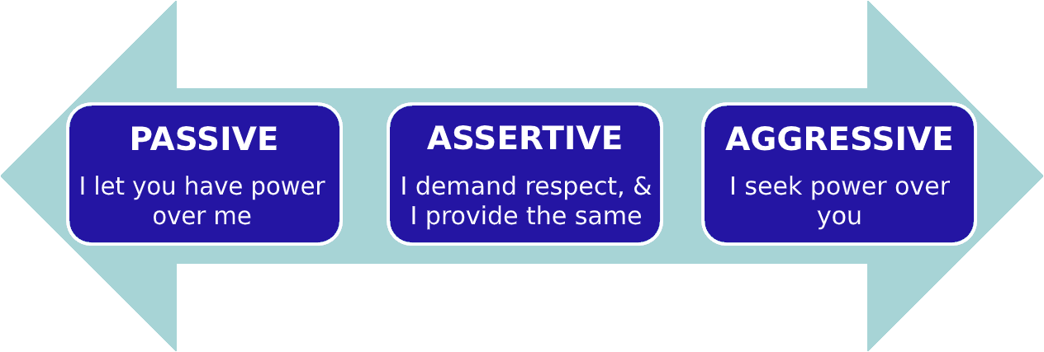
Tips for Practicing Assertive Communication
Take ownership (use “I” statements)
Use Clear and Concise Language
Be Mindful of Timing:
Voice your needs and desires confidently
Use body language
Keep emotions in check
Use simple and direct language.
Seek clarification when needed.
Manage emotions and stay calm.
Practice empathy and consider others' perspectives.
What other want
What you
want
Assertive
Notes:
Use "I" statements to express your thoughts and feelings without blaming others. - Express your opinions or concerns using "I" language instead of "you" language. This approach takes ownership of your perspective and promotes open dialogue.
Use simple and direct language to convey your message. Avoid jargon or technical terms that may confuse others.
Choose appropriate timing for important conversations.. Avoid addressing sensitive topics when emotions are high or in public settings.
Maintain eye contact and use confident body language, such as standing tall and maintaining an open posture.
Practice active listening, showing respect and empathy towards others' perspectives.
Be mindful of your tone of voice, keeping it calm and composed.
Practice self-assertion by setting and maintaining healthy boundaries.
Practice assertiveness in various situations to build confidence gradually.

Slide 42
Summary & Reflections
It is not what you say that only matters, how you say it is of more importance
Communication in the workplace is very important and takes different forms including verbal and non-verbal
Giving and receiving feedback is essential for personal and professional development
What are you going to START doing, STOP doing or CONTINUE doing?

Slide 43
Thank You!

