Slide 1
ABOUT THE PENDULUM

Slide 2
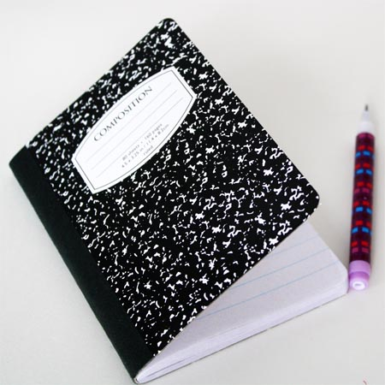
Getting Started - What You’ll Need
A pendulum like the one to the left
Alternatively, you can use a regular key (house key) on a string or chain or other weighted object – ideally either narrower at bottom or a ball shaped that is attached to a string or chain
Notebook and writing instrument
Printed pendulum chart you received when you registered
Printed book: Pendulums and Protection: An Introduction

Slide 3
About the Pendulum
The pendulum has been around for at least 10,000 years.
It has been used across the world from China to India and in Rome and Greece.

Slide 4
Why Use the Pendulum
The pendulum is small enough to be carried in your pocket.
It is powerful enough to provide guidance on a broad range of questions beyond those with a simple yes or no answer.

Slide 5
Why Use the Pendulum
People use the pendulum to receive guidance on all areas of their lives including:
Family
Career
Health
Relationships

