Slide 1
Mandatory or voluntary DPO
Article 37

Slide 2

A DPO is required
Article 37
Public authority or body except for courts
Core activities require monitoring of data subjects on a large scale
Core activities – process large scale special categories

Slide 3
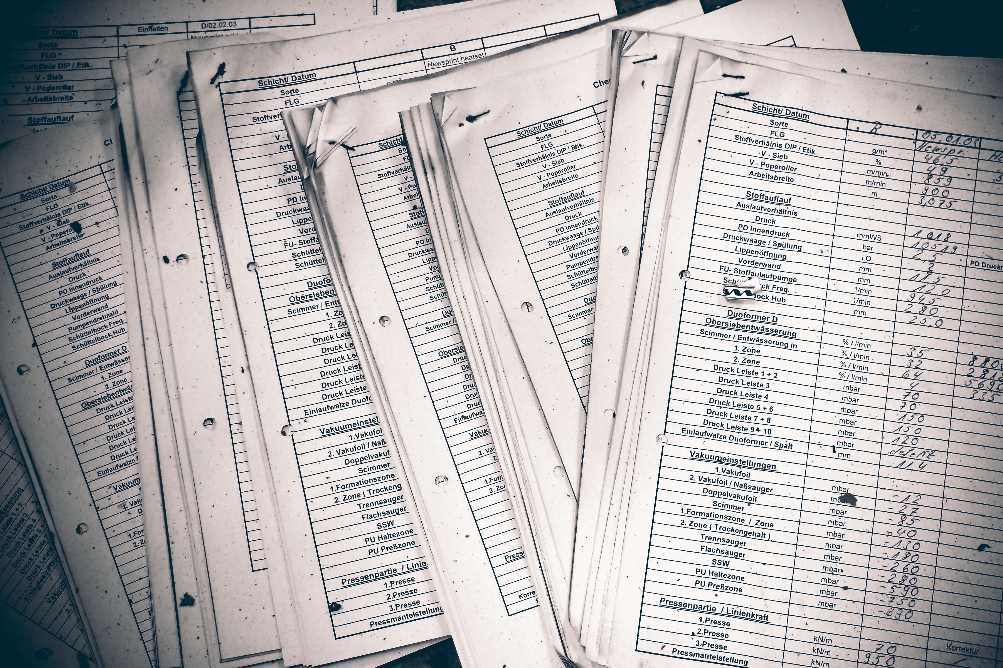
Working Party 29
Core Activities (WP29) = how
an organization makes money
Regular & systematic monitoring
= include but not limited to
Online tracking & Profiling

