Slide 1
Juvenile Delinquency Advocacy
What’s the Deal? How Delinquency Differs from Adult Criminal Court

Slide 2
Legislative Mandate
It is the intent of the General Assembly to promote a juvenile justice system
that will protect the community, impose accountability for violations of law, provide treatment and rehabilitation, and equip juvenile offenders with the ability to live responsibly and productively.
O.C.G.A. 15-11-11

Slide 3
Legislative Mandate
Above all, this chapter shall be liberally construed to reflect that the paramount child welfare policy of this state is to determine and ensure the best interests of its children.
O.C.G.A. 15-11-11

Slide 4
In 20 numbered paragraphs, the Georgia Legislature enumerates factors to be evaluated, concluding with “Any other factors considered by the court to be relevant and proper to its determination.”
OCGA 15-11-26: Best Interest of Child

Slide 5
The court will consider necessities, family bonds, peculiarities of a particular family, child’s attachment, parents, home environment, stability, the health of individuals, child’s request, bonds to school & community, safety risks, and other factors.
OCGA 15-11-26

Slide 6
Who’s on First?
-Abbott and Costello
Juvenile court often feels like a strange land with a foreign language.

Slide 7
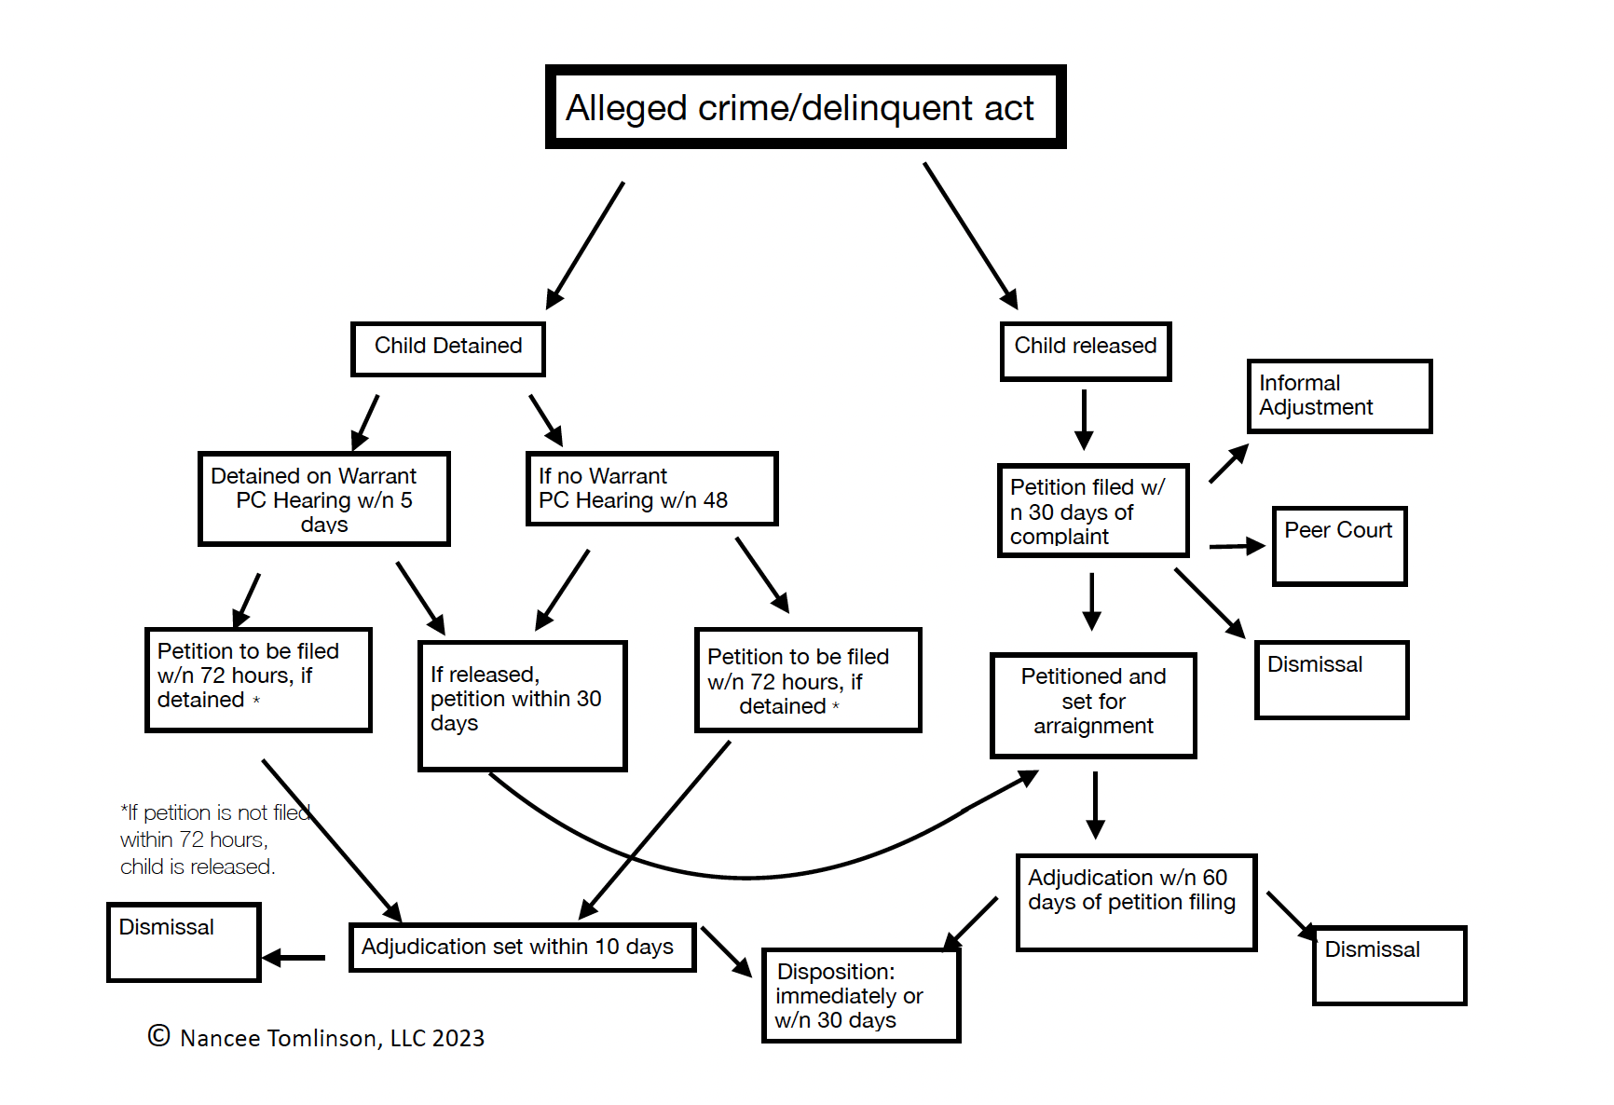

Slide 8
Always Asking About the Child
DJJ, PDRA, DAI, and who is a party

Slide 9
DJJ: Department of Juvenile Justice will check in with children and families during the pendency of a case. They are not just post-disposition services
Always Asking About the Child

Slide 10
DJJ will ask parents and children a series of questions before disposition to help with PDRA.
Always Asking About the Child

Slide 11
PDRA is a screening tool that evaluates the child, the child’s circumstances, & the alleged behaviors. PDRA levels the disposition (sentencing) playing field across the State.
Always Asking About the Child

Slide 12
At least, it’s supposed to.

Slide 13
PDRA evaluates 10 items: 1. Age at first adjudication
Always Asking About the Child

Slide 14
2. The number of adjudications (different dates) 3. Total Adjudication for violent/assaultive offenses
Always Asking About the Child

Slide 15
4. Is the most current offense property related? 5. The number of prior out-of-home placements (not predisposition, group home, of DFCS placements)
Always Asking About the Child

Slide 16
6. School discipline/ attendance last 12 months. Truancy is an indicator of many problems.
Always Asking About the Child

Slide 17
7. Substance use/abuse. Examining the degree to which substance use impairs behavior, impacts parent-child relationship/strain, school problems, and/or arrests.
Always Asking About the Child

Slide 18
8. Peer relationships. Positive or negative support relationships
Always Asking About the Child

Slide 19
9. Parental/Caregiver Supervision Have there been issues? Measured on a scale from none to some to major
Always Asking About the Child

Slide 20
10. Youth Participation in Pro-social activities Sports, church, afterschool, positive hobbies, anything that’s keeping the child occupied and out of trouble with the law
Always Asking About the Child

Slide 21
Computer program JTS calculates a score Low:-4 to 1 Medium:2 to 5 High:6 and above
Always Asking About the Child

Slide 22
The JTS score cannot be manipulated. HOWEVER if a resolution will involve lesser charges, make sure DJJ computes based on the lesser charge not the original.
Always Asking About the Child

Slide 23
DAI: Detention Assessment Instrument
Always Asking About the Child

Slide 24
DAI: The highest score is 26. Low is good; high means detention.
Always Asking About the Child

Slide 25
DAI: notes gender & race, while looking at and weighing placement at time of offense, most serious current offense, past history, prior escapes, prior adjudications, probation violations, administrative revocations,
Always Asking About the Child

Slide 26
& current status with DJJ. Each answer has a weight. A score of 12 or more detain.
Always Asking About the Child

Slide 27
For perspective, a new felony charge has a score of 12.
Always Asking About the Child

Slide 28
DJJ, parents, community, and alleged victims can weigh in on the disposition.
Always Asking About the Child

Slide 29
Parents are not parties, but are required to be present.
Always Asking About the Child

Slide 30
An absent parent can prompt the request for a Guardian ad litem, the request for a protective to make the parent a subject to the Court, and/or a show cause motion for contempt can be filed.
Always Asking About the Child

Slide 31
Yes, juvenile court is different.
Always Asking About the Child

Slide 32
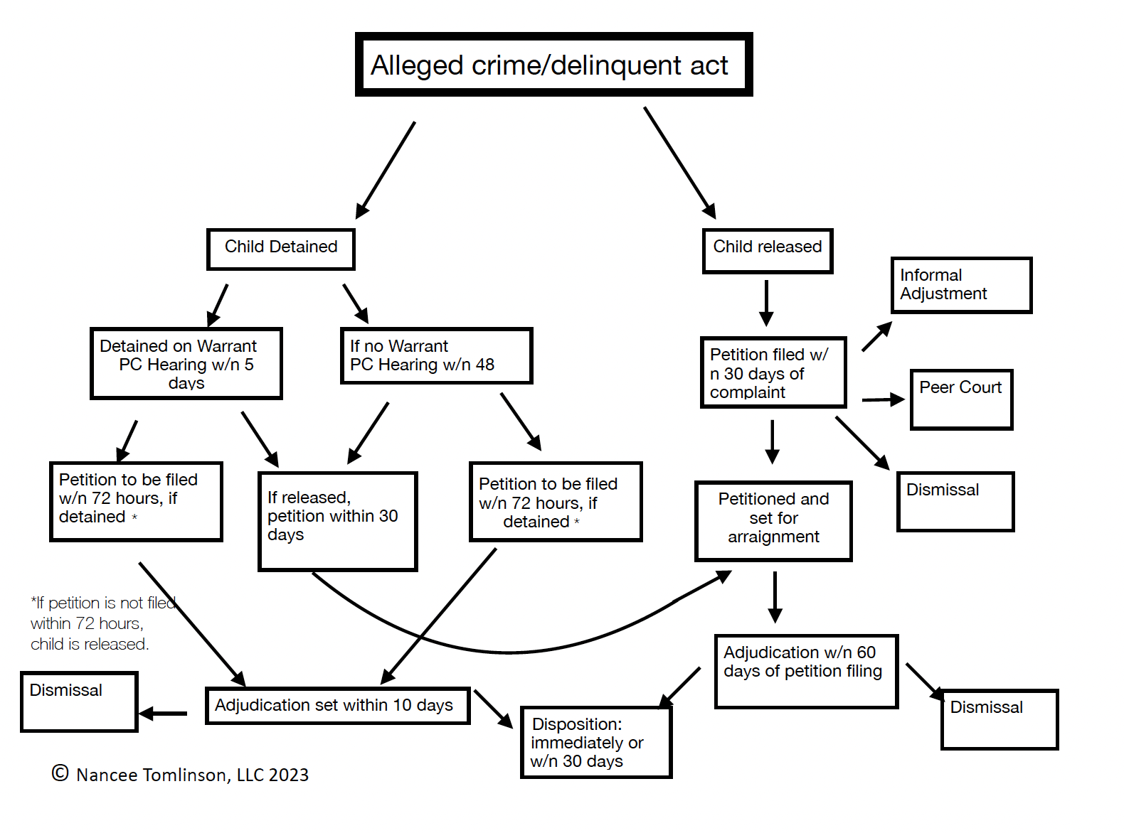

Slide 33
Refences
Davis, Cathy. Update PDRA & SDM, 2018 Department of Juvenile Justice. Online
NCCD @2015 DAI Screening Tool, Online
Official Code of Georgia

Slide 34
Nancee Tomlinson Nancee Tomlinson, LLC
tomlinson-lawfirm.com
706-200-177
nanceetomlinson@gmail.com

