Slide 1

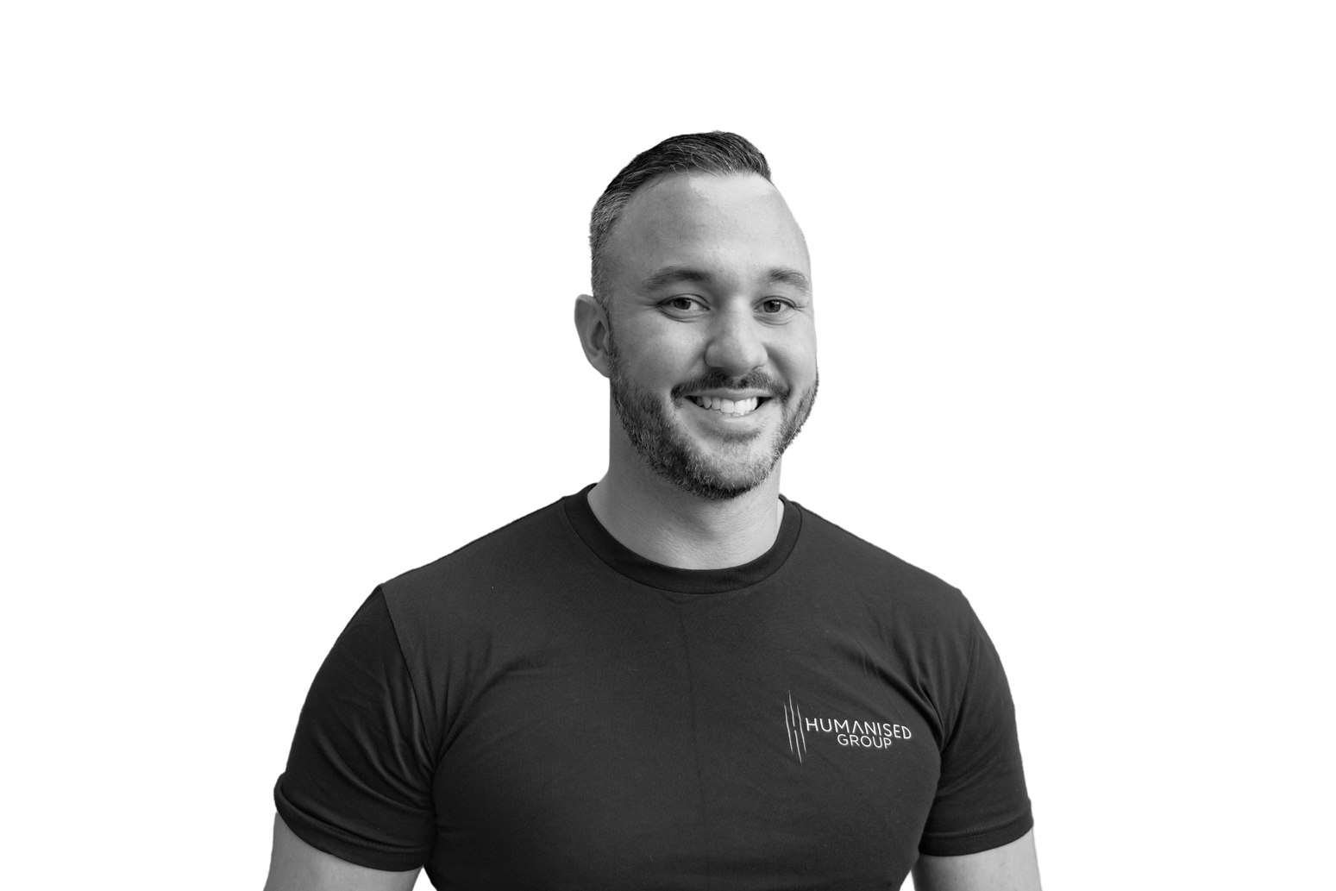
Getting Into IT - What Recruiters Look For.
Infrastructure & Cloud Division Lead
– Jareth Oades-Gularte

Slide 2
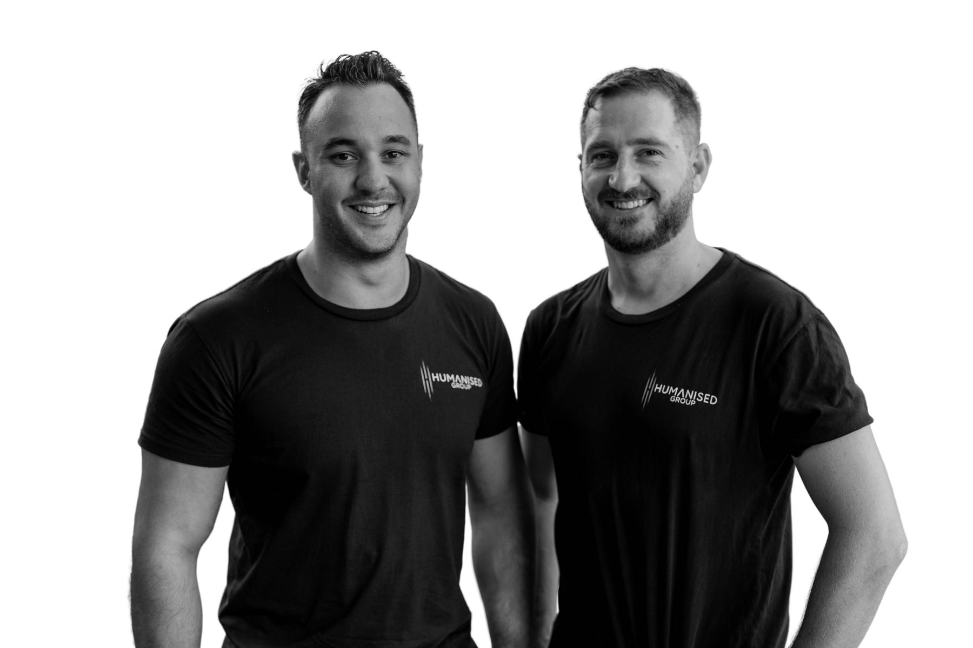
Jareth’s Recruitment Journey

Slide 3




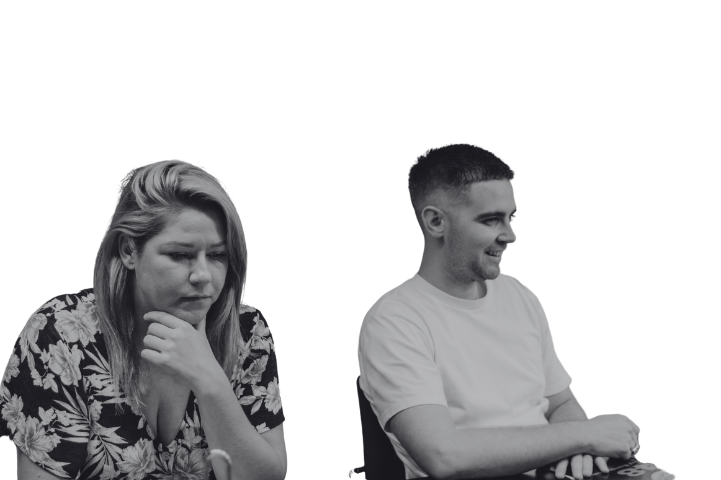


What recruiters look for
Soft skills
Emotional intelligence
Active listening
Realistic expectations of the role
Are you confident or cocky?
Straight talking!
A recruitment consultant
should always be considered
a partner in your career journey
Career Orientated
Has a passion for IT
Life Experience
Relatable Experiences

Slide 4
What recruiters look for
Certs VS Degrees
Up to date CV and LinkedIn
Ask for feedback & learn
Follow up, don’t just apply, call!

Slide 5
Trending Roles
  Working from home VS Office attendance
  Positions are evolving with the advancement in technology, cloud (Azure, AWS) is becoming more dominant but there is still requirements on server & on-prem
  Automation
  Power Apps
  0365
IT Support path into:
  Cyber
  PMO
  Data
  DevOps
  Dev
  Systems, Network or Cloud Engineering / Pre Sales / Solutions Architecture
  IT Sales

Slide 6
Experience & Qualifications
Experience & Skillset
Qualifications
  Customer service
  Have a problem? Come up with a solution
  Communication and Tone of voice
  It’s not always about cloud, How about networks?!
  Trouble shooting experience
  ITILv4
  COMPTIA A+
  Cert III, IV or Diploma Information Technology
  CCNA
  Microsoft Fundamentals
  AZ-040T00: Automating Administration with Powershell
  Cloud Practitioner AWS

Slide 7
How do I get the experience if nobody is willing to give me a go?
  Service Desk is a great starting point!
  Read only access
  Shadow more seasoned operators
  Men & Women VS Boys & Girls of IT
  Play with test environments at home
  Get a mentor
  Ask to moonlight in the area you’d like to move to
  Be patient! It can be a huge jump before you get the right job
  Attend networking & meet up events

Slide 8
Questions?
If you know someone who could be a perfect fit for a role then please email:
joades@humanisedgroup.com
0412 540 973

