Slide 1

What this class will cover

Slide 2
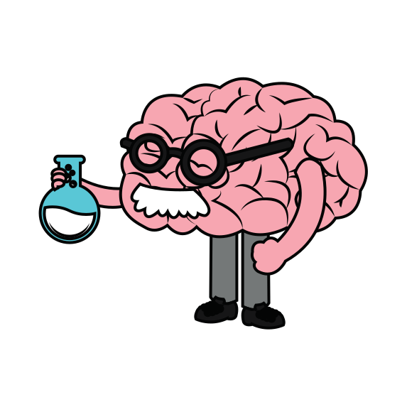
OVERARCHING CONCEPTS FOR YOUNG PEOPLE TO KNOW
www.whodowewant2be.com

Slide 3

Your brain grows throughout your whole life
www.whodowewant2be.com

Slide 4

You have more control over your brain than you think
www.whodowewant2be.com

Slide 5
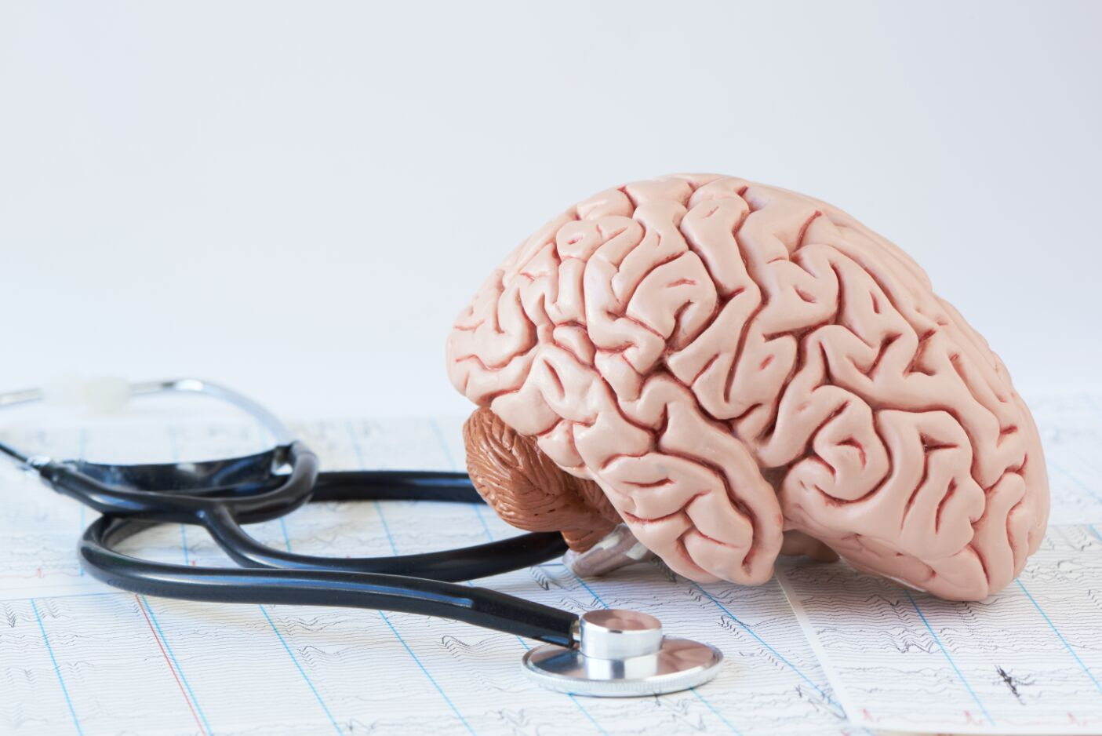
Human brains are wired to protect us
www.whodowewant2be.com

Slide 6

Sometimes that works against us
www.whodowewant2be.com

Slide 7

Surprise....there is good news though!
You have Jedi like powers
www.whodowewant2be.com

Slide 8




SCOPE AND SEQUENCE
MODULE 1: INTRODUCTION TO COURSE
MODULE 2: NEUROPLASTICITY - THE BRAIN IS PLASTIC
MODULE 3: THREE BASIC MECHANISMS FOR SURVIVAL
MODULE 4: EMOTIONS DRIVE LEARNING AND BEHAVIOR
MODULE 5: THE AUTONOMIC NERVOUS SYSTEM
MODULE 6: USING EMOTIONS AS YOUR GUIDE
MODULE 7: SELF-DIRECTED NEUROPLASTICITY
MODULE 8: MINDFUL CLASSROOMS
MODULE 9: RESOURCES
Notes:
These are the main concepts we will cover throughout this course!

Slide 9

LET'S DO THIS

