Slide 1
Let’s Review!
Can you name a Polygon?

Slide 2
a polygon with three sides
TRIANGLE

Slide 3
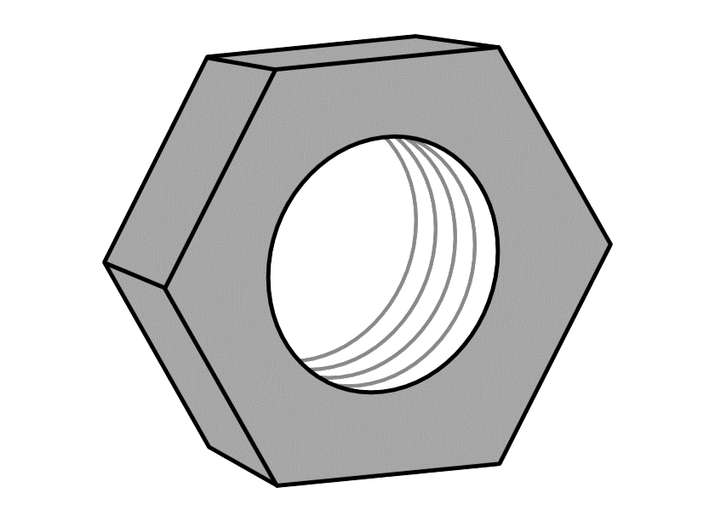
a polygon with six sides
HEXAGON

Slide 4
a polygon with eight sides
OCTAGON

Slide 5
a polygon with five sides
PENTAGON

Slide 6
a polygon with seven sides
HEPTAGON

Slide 8
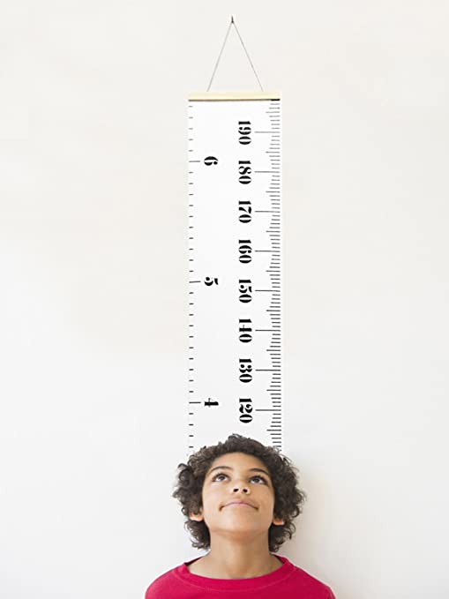
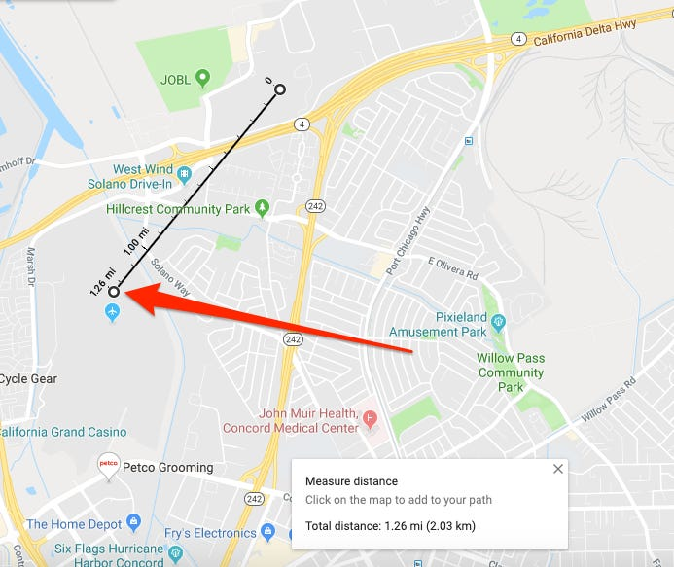
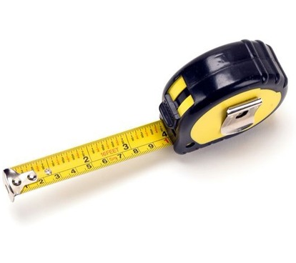
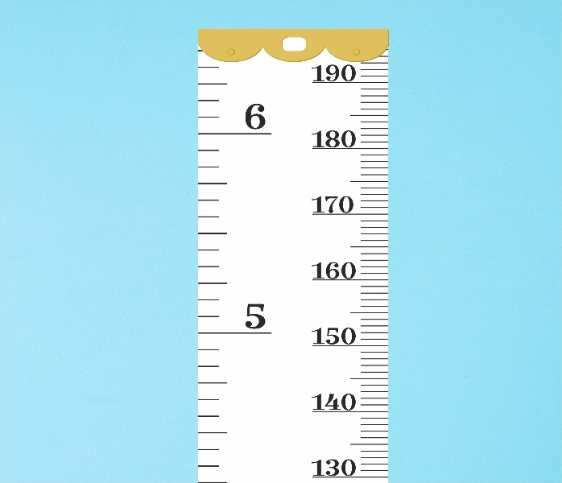
_ _ _ _ _ _ _
M E A S U R E

Slide 9
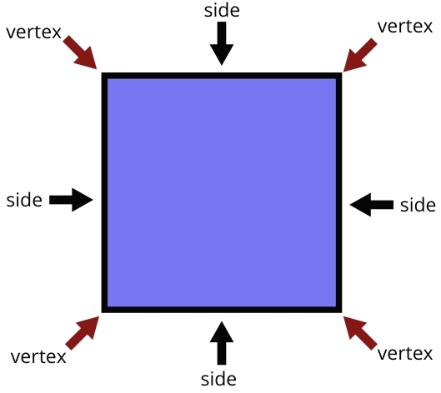
_ _ _ _ _
S I D E S

Slide 10
_ _ _ _ _ _
S H A P E S

Slide 11
OBJECTIVES
Solve the Perimeter of the geometric figures using the given formula.
Relate the concept of Perimeter in real life.

Slide 12
PERIMETER
is the length of the outline of a shape.
To find the perimeter, add the length of all the sides of the given shape.

Slide 13
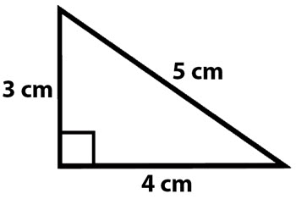
P= A + B + C
P= 3 + 5 + 4
P=12 cm

Slide 14
P= 8s
P=8(3)
P= 24 mm
s= 3 mm

Slide 15
P= 4s
P= 4(5)
P= 20 cm

Slide 16
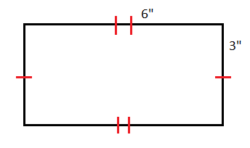
P= l+l+w+w
P= 2(l)+2(w)

Slide 17
P= 2(l)+2(w)
P= 2(6)+2(3)
P= 12+6
P= l+l+w+w
P= 18 in.
P= 6+6+3+3
P= 18 in.

Slide 18
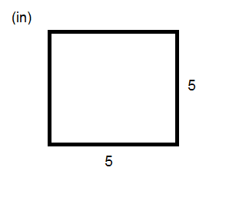
LET’S TRY!
s= 5in
P=?

Slide 19
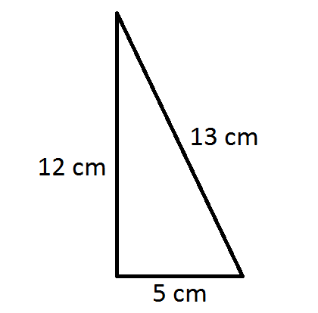
LET’S TRY!
P=?

Slide 20
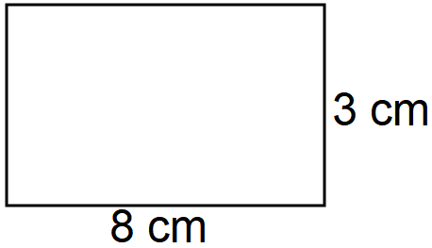
LET’S TRY!
P=l+l+w+w

Slide 21
LET’S TRY!
P=2(l)+2(w)

Slide 22
is the length of the outline of a shape.
To find the perimeter, add the length of all the side.

Slide 23
In real life, we often find the perimeter when we put fence around our house, measuring the length of table mat, or finding the total length of a soccer field.

Slide 24
God gave us the knowledge
to measure
Remember when God asked Noah to build an Ark?
God gave him the knowledge to measure the ark that will be loaded with animals and his family.
Because Noah trust God, the ark turned into an amazing masterpiece! And used for almost 40 days and Nights!
Can you imagine if we don't know how to measure? No way!

Slide 25
QUIZ TIME!
FIND THE PERIMETER OF THE FOLLOWING:
1. s= 6mm
2. s=9in.

Slide 26
QUIZ TIME!
FIND THE PERIMETER OF THE FOLLOWING:
4. l= 8cm
w= 4cm
3. s= 10m
3. s= 10m

Slide 27
HOMEWORK
Solve these story problems.
1. Joseph’s parents built a new swimming pool last August. The pool is 42 ft. long and 27 ft. wide. What is the perimeter of the pool?

Slide 28
HOMEWORK
2. Anne built a square doghouse for Oreo. Each side is 4ft. What is the perimeter of the dog house?

