Slide 1
Lecture 1 - Introduction
Be a better you
By instructor Emilie Schrevens

Slide 2
About the course
This course will be in English
Not about success
About turning you failures into something successful
You’re already on the way to succeed !

Slide 3
The first step
Realizing you failed before
Finding new ways to do things
You’re in the right set of mind
It’s not too early or too late !

Slide 4
The 5 sections
Finding out what’s stopping you
Acting the right way to get things done
Observing yourself to overcome your bad habits
Time and how to stop wasting it
Taking a break / Work-Reward pattern

Slide 5
Recommendations
Work on one concept a day
Don’t rush through
Be honest with yourself
Find new ways that suit you

Slide 6
Before you start
Not satisfied? Ask for a refund !
You can take notes using “b” and download resources when indicated
Check the next slide for instructions

Slide 7
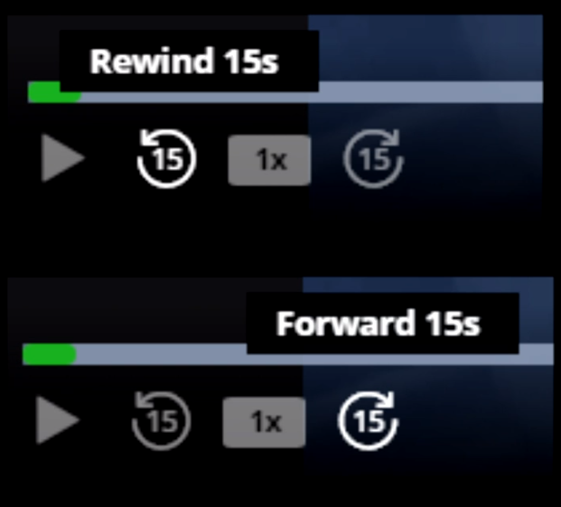
Instructions
Use “b” to take a personal note (not shared publicly)
You can go back 15 seconds

Slide 8
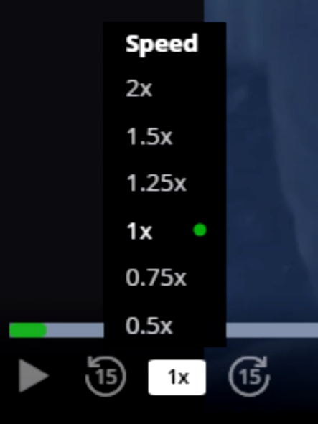
Instructions
You can change the speed
of the video
Pause using the left click,
Enter, or the space bar

Slide 9
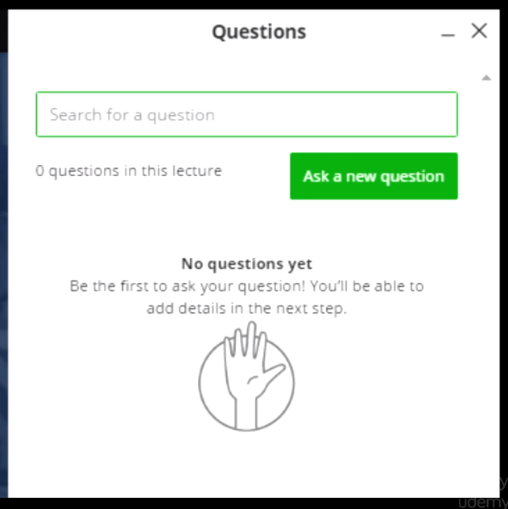
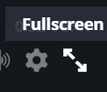
Instructions
Hit “Q” to see the questions
asked before
Hit “F” or click the icon to
go full screen

Slide 10
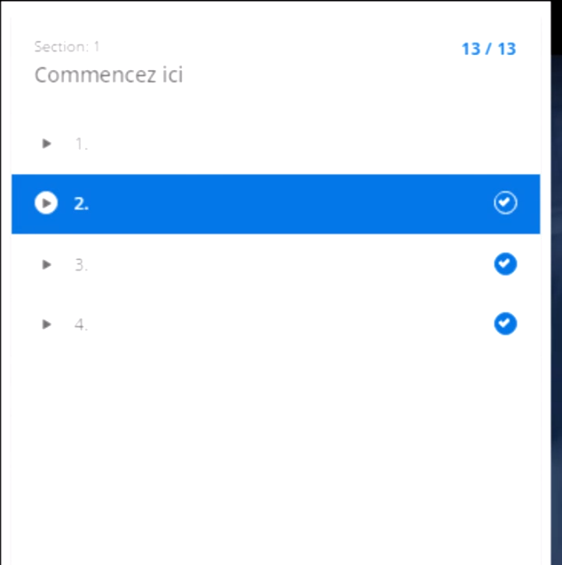
Instructions
Hit “C” to see
the curriculum

Slide 11
Key Findings / Results 1

Slide 12
Key Findings / Results 2

Slide 13
Key Findings / Results 3
Run number | Description | Result A | Result B
1 | Condition A | True | True
2 | Condition B | True | False
3 | Condition C | False | False

Slide 14
Conclusion
Add your conclusion here

Slide 15
Questions & Discussion

