Slide 1
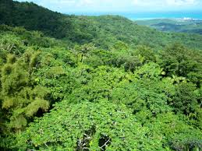
The Emergent Layer

Slide 2
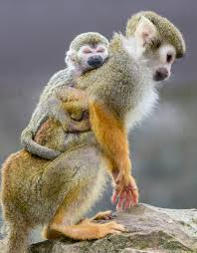
Squirrel Monkey

Slide 3
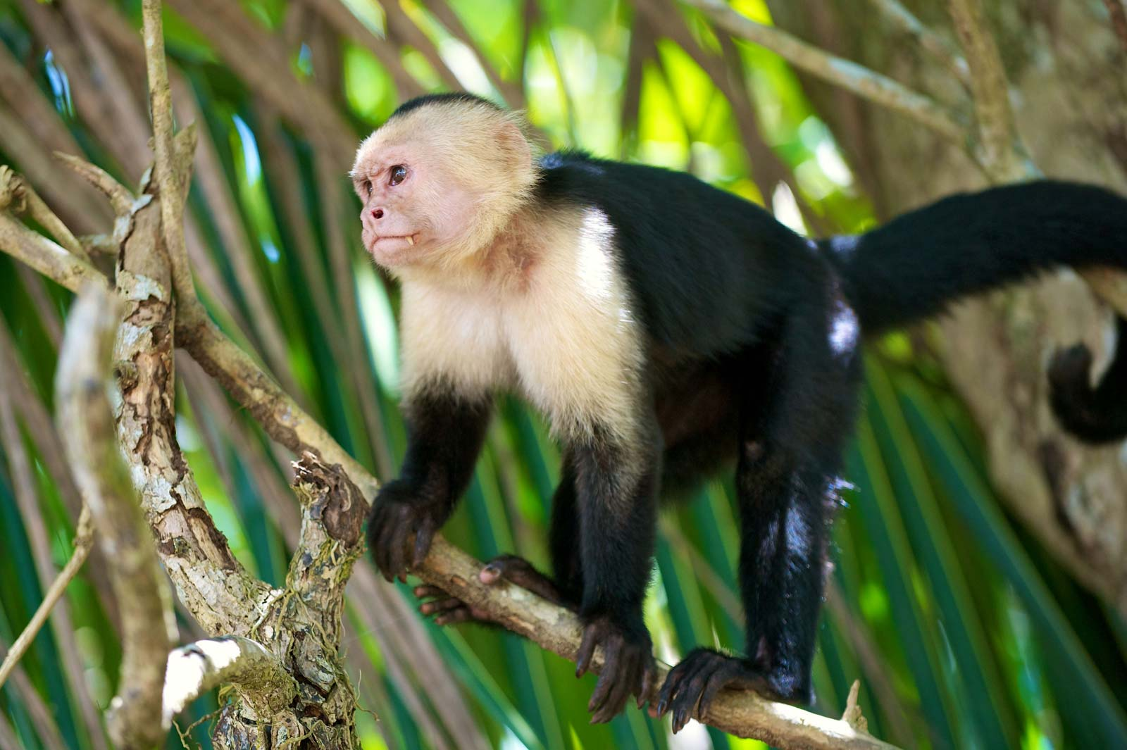
Capuchin Monkey

Slide 4
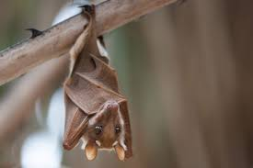
Bats

Slide 5
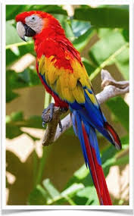
Scarlet Macaw Parrot

Slide 6
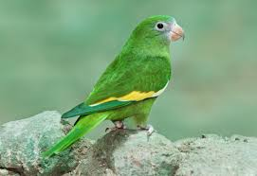
Canary Winged Parakeet

Slide 7
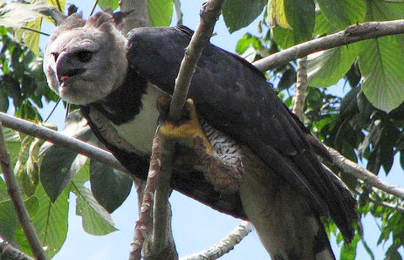
Harpy Eagle

Slide 8
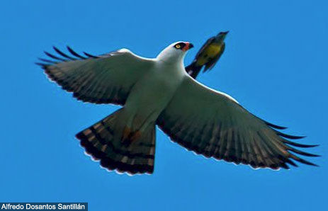
Hawk Eagle

Slide 9
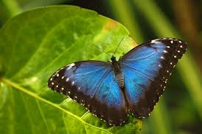
Morpho Butterfly

